Slide 1

INTELLERA: A Hardware Based Accelerated Matrix MAC Processor
Team Members:
2020414 Saad Khan
2020487 Syed Zaeem Shakir
2020217 Mahnoor Maleeka
Supervisor: Dr Fahad Bin Muslim
Co-supervisor: Dr Taj Muhammad
Faculty of Computer Sciences and Engineering Ghulam Ishaq Khan Institute of Engineering Sciences and Technology, Pakistan
Notes:
1

Slide 2
Evaluation Criteria
PLO 3 | Design/Development of Solutions
PLO 4 | Investigation
Rubrics | PLO3 | PLO4 | - | Marks
Requirements Gathering Methodology |  | ✓ |  | 5
Requirements Specifications |  | ✓ |  | 10
Proposed Design | ✓ |  |  | 10
Requirements were mapped to the design adequately | ✓ |  |  | 5
Division of Tasks / Use of Project Management Tools | - | - | ✓ | 10

Slide 3
Recap
Motivation:
Faster
Greener
Game-Changer
Benefits:
Speed
Efficiency
Breakthroughs
Significance:
Innovation
High-Performance Computing
Conclusion:
Matrix MAC FPGA Acceleration

Slide 4
Introduction / Problem Statement
Introduction: RISC-V FPGA Matrix MAC
Problem: Speeding Up Matrix Operations
Challenge: Efficiency & Performance
Objective: Innovative FPGA Solution

Slide 5

REQUIRMENTS GATHERING METHODOLOGY
RUBRIC # 1

Slide 6
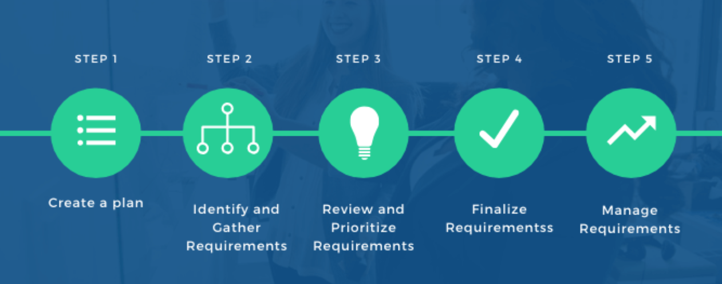
Requirements Gathering Methodology
RUBRIC 1 : Requirement Gathering Methodology

Slide 7
Requirements Elicitation Technique(s) Followed
RUBRIC 1 : Requirement Gathering Methodology
Literature Review: Studied past research papers.
Benchmarking Data: Studied past work.
Consultations: Consulted Different professors working in the same field
Brainstorming: Detailed discussions on our project.
Notes:
Elaborate with example(s) from your project

Slide 8
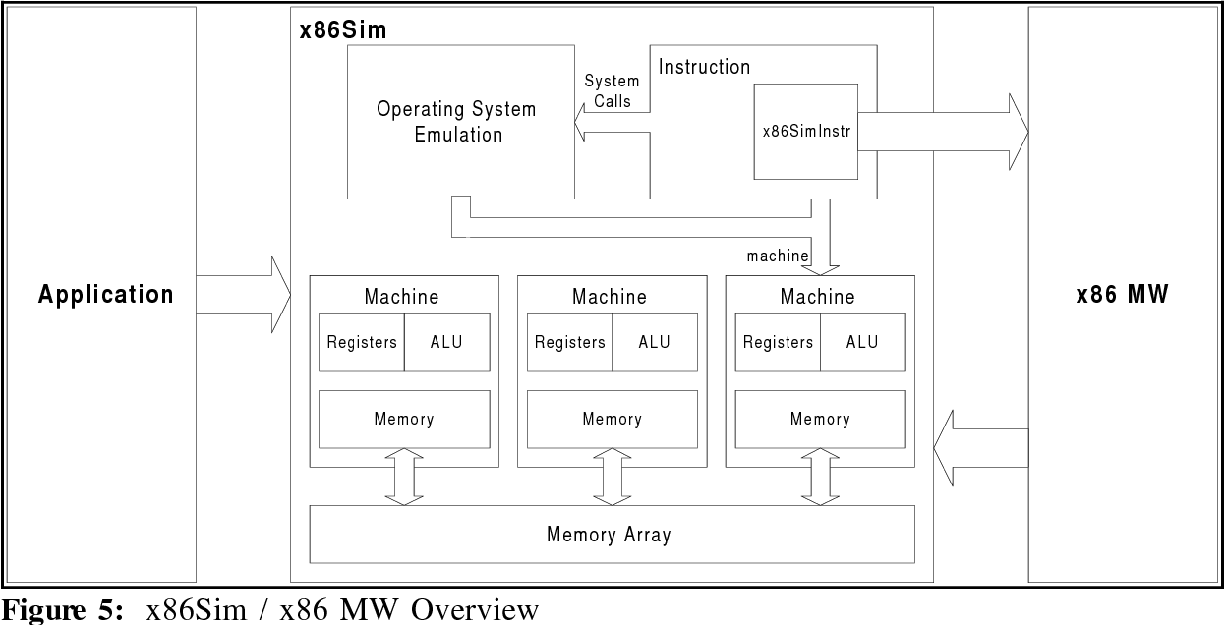
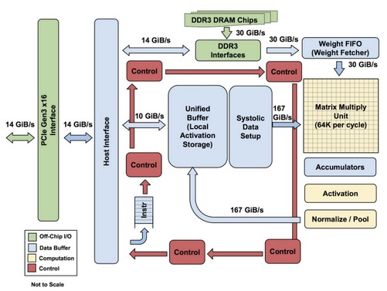
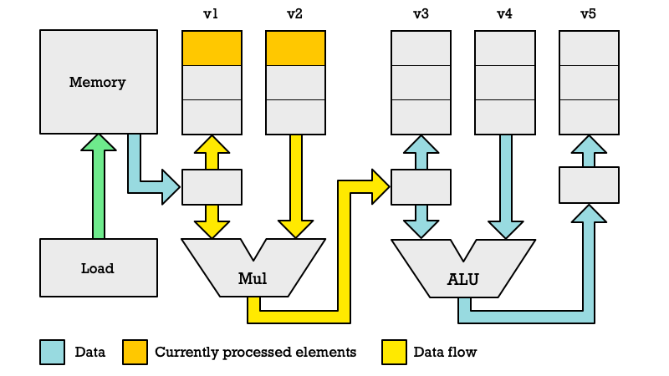
RUBRIC 1 : Requirement Gathering Methodology
ARM X86 Architecture
TPU Architecture
RISC-V Vector Extension Architecture
3
Previous
Designs
2
1
https://ieeexplore.ieee.org/document/9774501/
https://ieeexplore.ieee.org/document/8358031
https://ieeexplore.ieee.org/document/9988933/

Slide 9
RUBRIC 1 : Requirement Gathering Methodology
ARM X86 Architecture
TPU Architecture
RISC-V Vector Extension Architecture
3
Previous
Designs
2
1
https://ieeexplore.ieee.org/document/9774501/
https://ieeexplore.ieee.org/document/8358031
https://ieeexplore.ieee.org/document/9988933/

Slide 10
RUBRIC 1 : Requirement Gathering Methodology
ARM X86 Architecture
RISC-V Vector Extension Architecture
TPU Architecture
3
Previous
Designs
2
1
https://ieeexplore.ieee.org/document/9774501/
https://ieeexplore.ieee.org/document/8358031
https://ieeexplore.ieee.org/document/9988933/

Slide 11
RUBRIC 1 : Requirement Gathering Methodology
ARM X86 Architecture
TPU Architecture
RISC-V Vector Extension Architecture
3
Previous
Designs
2
1
https://ieeexplore.ieee.org/document/9774501/
https://ieeexplore.ieee.org/document/8358031
https://ieeexplore.ieee.org/document/9988933/

Slide 12
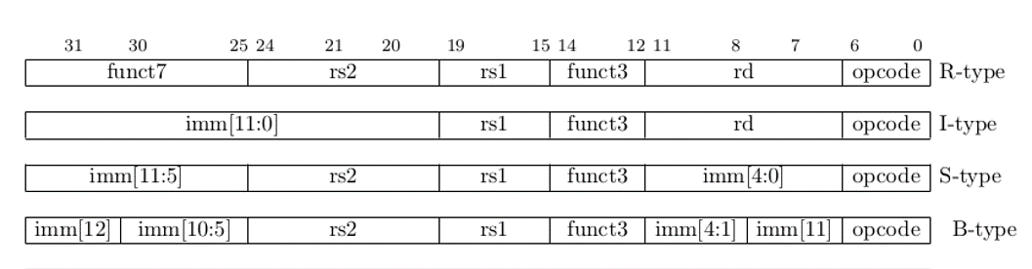
RUBRIC 1 : Requirement Gathering Methodology
Type of Instructions

Slide 13
R type instruction
Source Register 2
Source Register 1
Destination Register
Bits placement:
| 31 25 | 24 20 | 19 15 | 14 12 | 11 7 | 6 0 |
Bits Division:
funct7
rs2
rs1
funct3
rd
opcode
Bits Size:
7-bits
5-bits
5-bits
3-bits
5-bits
7-bits
Demo Instruction: add x1, x2, x3
Opcode: 0110011
F3 Value: 000
F7 Value: 0000000
X1 Address: 00001
X2 Address: 00010
X3 Address: 00011
funct7
rs2
rs1
funct3
rd
opcode
funct7
X3
X2
funct3
X1
opcode
0000000
X3
X2
000
X1
0110011
0000000
00011
00010
000
00001
0110011

Slide 14
Project - Assumptions & Constraints
RUBRIC 1 : Requirement Gathering Methodology
Assumptions: Clear ISA Understanding
Constraints: FPGA Resource Limitations
Guiding: Design and Implementation

Slide 15
Requirements Specifications
Rubric # 2

Slide 16
RUBRIC 2 : Requirement Specification
FUNCTIONAL REQUIREMENTS
Custom ISA
Matrix MAC Instructions
Pipelining
Compatibility
FPGA Implementations

Slide 17
RUBRIC 2 : Requirement Specification
NON-FUNCTIONAL REQUIREMENTS
Power Efficiency
Performance
Scalability
Testing & Verification

Slide 18
Feature Set Matrix
RUBRIC 2 : Requirement Specification
Feature / Use Case | Priority of Development | Dependencies
Load Data | High | None
Perform any Operation | High | Load Data
Store Result | High | Perform Matrix Operation
Implement FPGA | Medium | None
Optimize Matrix MAC Code | Medium | Perform Matrix Operation
Error Handling | Medium | All Features
Performance Optimization | Low | Optimize Matrix MAC Code

Slide 19

Any other external requirements
RUBRIC 2 : Requirement Specification
Regulatory Compliance
Customer/Stakeholder Expectations
Resource Constraints
Environmental Factors
Supplier Dependencies
Intellectual Property
Safety & Compliance
Ethical & Social Considerations
Documentation & Reporting

Slide 20
UML Diagram’s
Notes:
Only need to create a component diagram In this

Slide 21
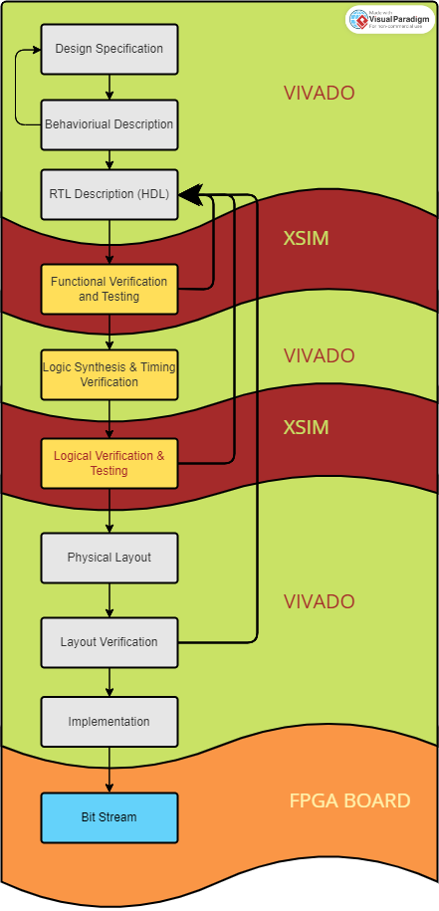
Context Diagram / High Level Block Diagram
RUBRIC 2 : Requirement Specification

Slide 22
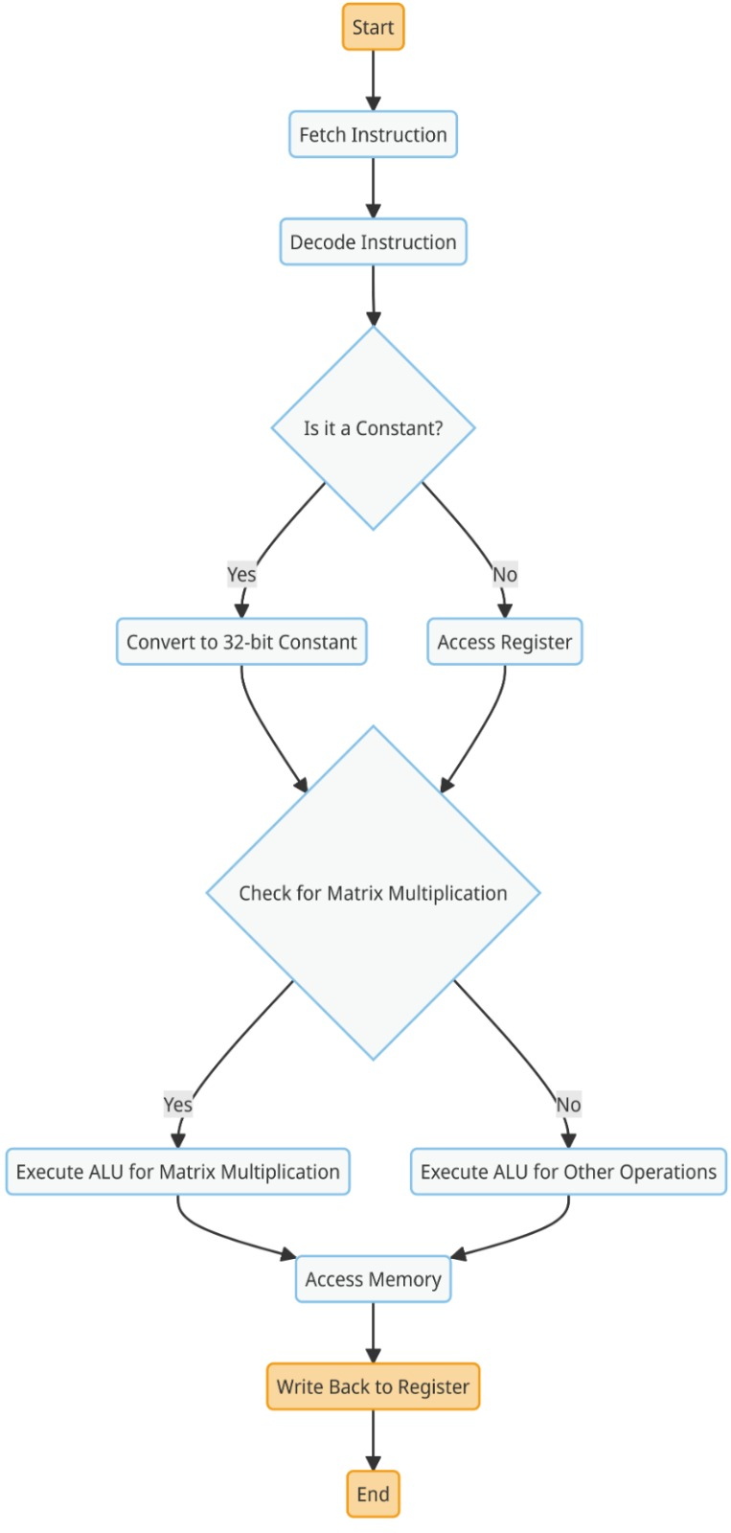
STATE/ACTIVITY DIAGRAM
RUBRIC 2 : Requirement Specification

Slide 23

Project Design
RUBRIC # 3

Slide 24



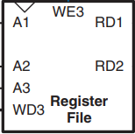
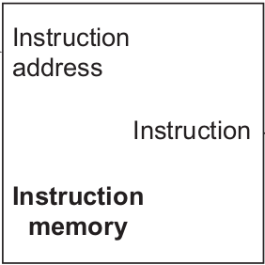

Animation of a Single Cycle Processor
RUBRIC 3: Proposed Design

Slide 25
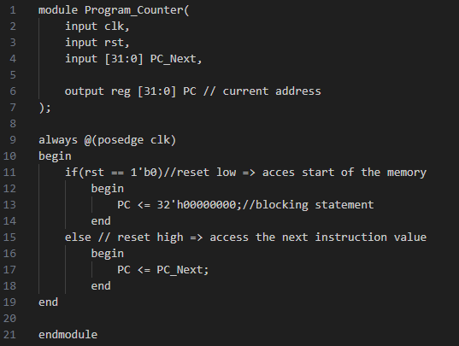
Program Counter
RUBRIC 3: Proposed Design

Slide 26
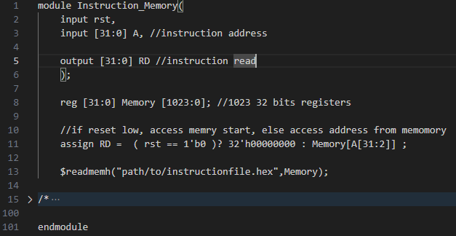
Instruction Memory
RUBRIC 3: Proposed Design

Slide 27
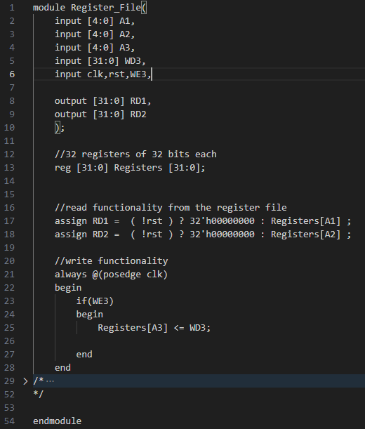
Register File
RUBRIC 3: Proposed Design
RUBRIC 3: Proposed Design

Slide 28
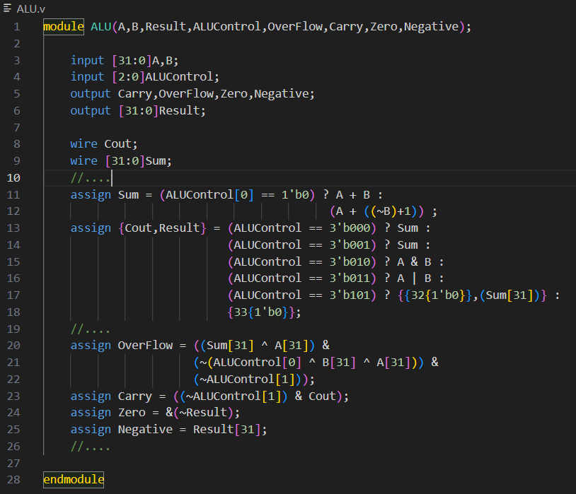
ALU
RUBRIC 3: Proposed Design

Slide 29
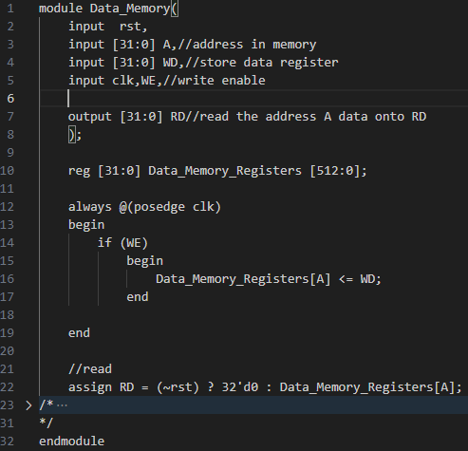
Data Memory
RUBRIC 3: Proposed Design

Slide 30
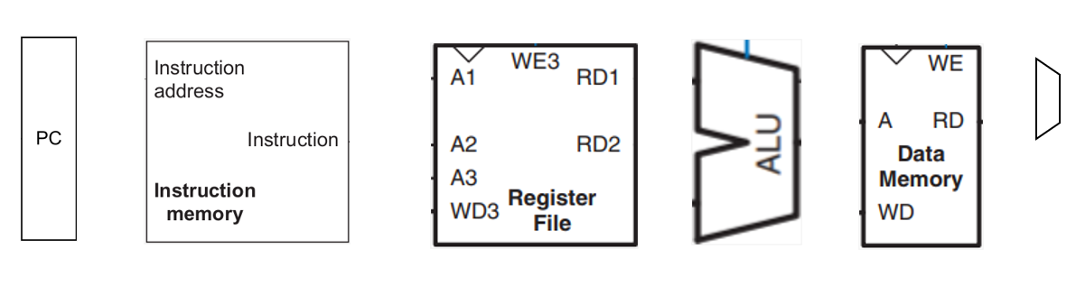

RUBRIC 3: Proposed Design
Animation of a Single Cycle Processor
5
0x4
X2
2
5
003100B3
X3
3
5
X1
5
Test Case:
PC Hex-Code Assembly
5 = 2 + 3

Slide 31
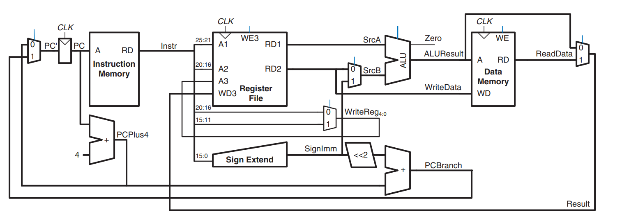
RUBRIC 3: Proposed Design
A Complete Single Cycle Processor
A Pipelined Processor
Fetch
Decode
Execute
Memory
Writeback
Hazard Unit
Proposed Design

Slide 32
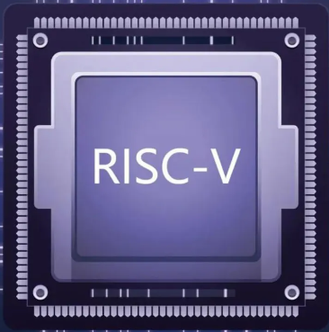
Proposed Design
RUBRIC 3: Proposed Design
A Complete Single Cycle Processor
A Complete Matrix MAC Processor
A Pipelined Processor
INPUT
OUTPUT
Fetch
Decode
Execute
Memory
Writeback
Matrix
MAC
Hazard Unit

Slide 33
Requirements mapped Adequately to the Design
RUBRIC # 4

Slide 34
Division of Tasks & Project Management
RUBRIC # 5

Slide 35
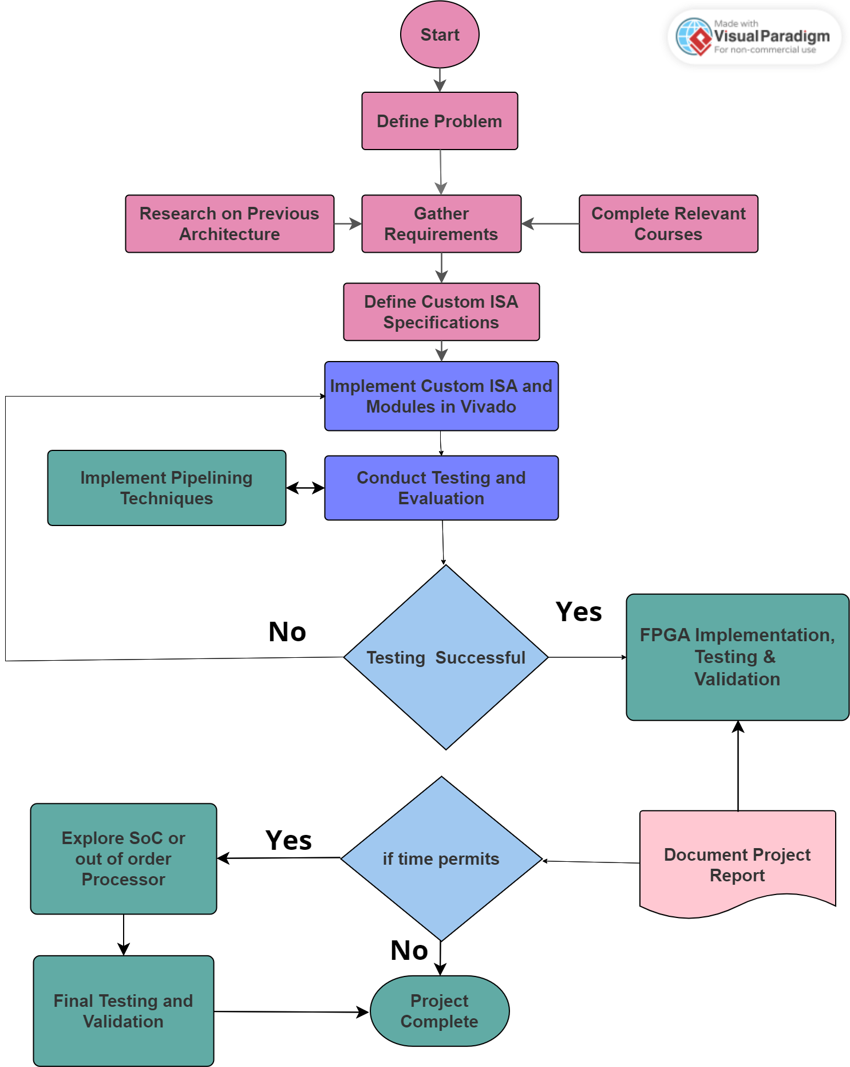
Workflow Chart
RUBRIC 5: Tasks Division & Project Management

Slide 36
Division of Tasks
RUBRIC 5: Tasks Division & Project Management
Assigned Responsibilities
Team Members:
Saad Khan – Team Lead
Mahnoor Maleeka
Zaeem Shakir
Saad Khan:
RISC-V Processor Architecture
Pipeline Implementation
Matrix MAC Instruction Module
Hazard’s Solution
Project Management (Jira and GitHub)
Mahnoor Maleeka:
RISC-V Processor Architecture
Pipeline Design
FPGA Implementation
Testing and Verification
Documentation
Zaeem Shakir:
RISC-V Processor Architecture
Matrix MAC Instruction Module
FPGA Implementation
Performance Optimization
GitHub Management

Slide 37
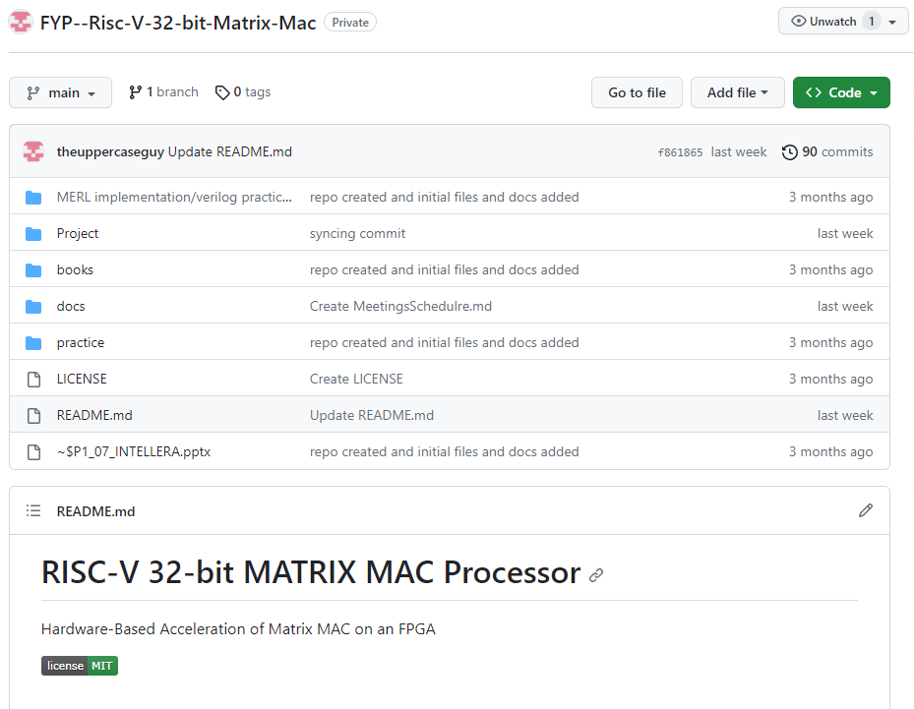
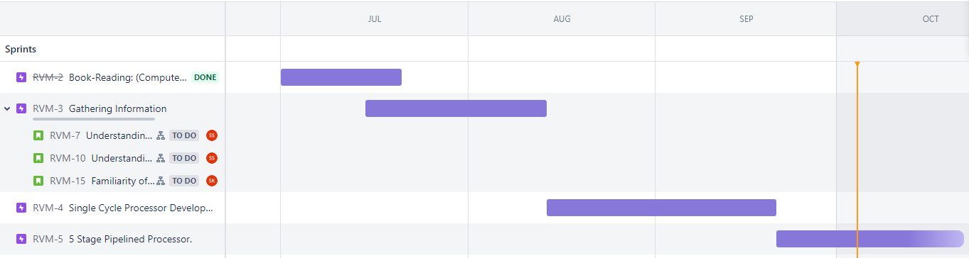
Project Repository Tool: GITHUB
RUBRIC 5: Tasks Division & Project Management
Project Management Tool: JIRA

Slide 38

Thank You

