Slide 1


INTELLERA:
A HARDWARE BASED ACCELERATED RISC V MATRIX MAC PROCESSOR ON FPGA
TEAM MEMBERS:
SAAD KHAN (Team Lead)
MAHNOOR MALEEKA SYED ZAEEM SHAKIR
ADVISOR’S:
Dr. FAHAD BIN MUSLIM
Dr. WAQAR AHMAD (CO) Dr. MUHAMMDA TAJ (CO)
Faculty of Computer Sciences and Engineering Ghulam Ishaq Khan Institute of Engineering Sciences and Technology, Pakistan
REQUIREMENTS & PROPOSED DESIGN:
FPGA Implementation
Testing
BASIC RISC ISA
Matrix MAC ISA
5 Stage Pipelining
MAC Decoder
Hazard Unit
Matrix MAC

Slide 2








REQUIREMENTS & PROPOSED DESIGN:

Slide 3
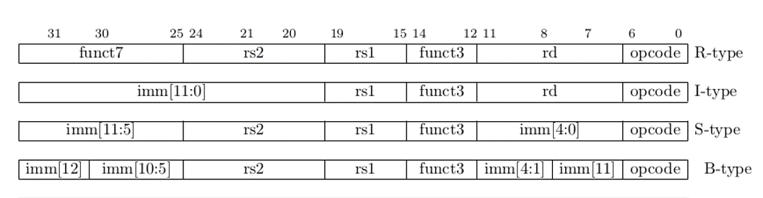
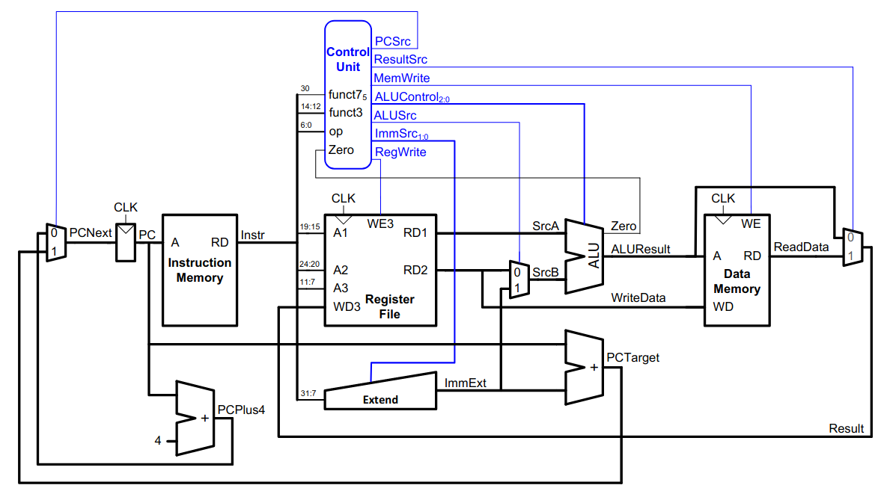
BASIC RISC-V ISA IMPLEMENTATION
SINGLE CYCLE PROCESSOR

Slide 4
5 STAGE PIPLINING
Fetch
Decode
Execute
Memory
Writeback

Slide 5
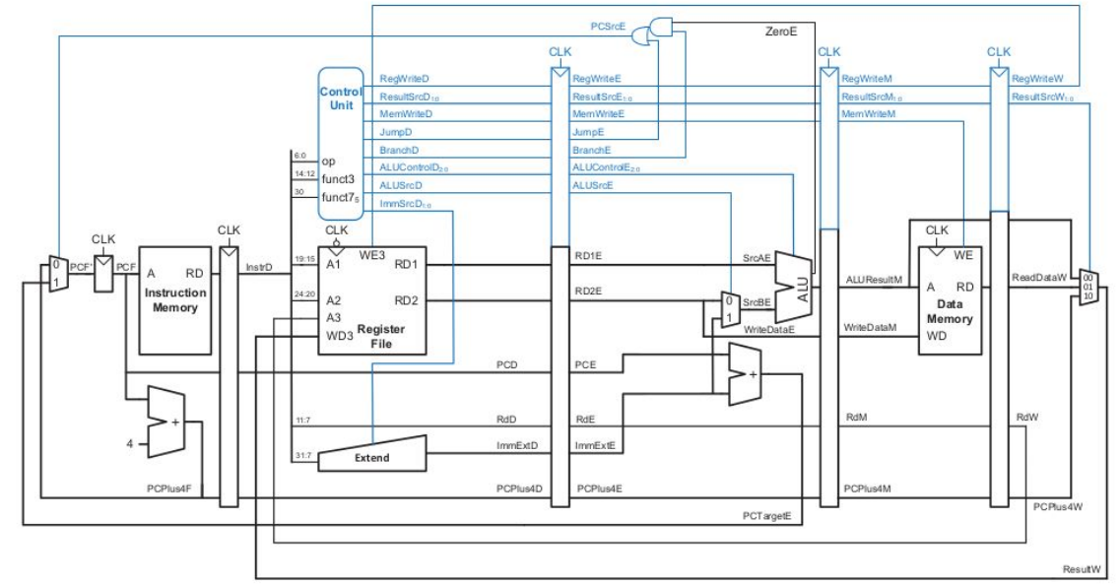
HAZARD UNIT
Fetch
Decode
Execute
Memory
Writeback
Hazard Unit

Slide 6
MATRIX MAC MODULE
26
31
36
41
46
26
31
36
41
46
26
31
36
41
46
26
31
36
41
46
26
31
36
41
46
1
2
3
4
5
6
7
8
9
10
11
12
13
14
15
16
17
18
19
20
21
22
23
24
25
Instr. Type
MATRIX A
I
N
P
U
T
1 | 2 | 3 | 4 | 5
6 | 7 | 8 | 9 | 10
11 | 12 | 13 | 14 | 15
16 | 17 | 18 | 19 | 20
21 | 22 | 23 | 24 | 25
RESULTANT
590 | 605 | 620 | 632 | 650
1490 | 1530 | 1570 | 1602 | 1650
2390 | 2455 | 2520 | 2572 | 2650
3290 | 3380 | 3470 | 3542 | 3650
4190 | 4305 | 4420 | 4512 | 4650
OPERATION
MUX
25 x 32 bits
26 | 27 | 28 | 29 | 30
31 | 32 | 33 | 34 | 35
36 | 37 | 38 | 39 | 40
41 | 42 | 43 | 44 | 45
46 | 47 | 48 | 49 | 50
MATRIX B

Slide 7
MAC DECODER
CONTROL UNIT
CONTROL
UNIT
MAIN DECODER
RegWrite
RegWrite
OP[6:0]
ResultSrc
ResultSrc
MemWrite
MemWrite
Branch
ALUSrc
MAC DECODER
Branch
ImmSrc [1:0]
MACControl [3:0]
ALUControl [5:0]
MACDM [1:0]
ALUSrc
FUNCT3 [2:0]
ImmSrc [1:0]
OP[6:0]
ALU DECODER
ALUControl [5:0]
FUNCT7 [31:30]
FUNCT3[14:12]
MAC_OP
MACControl [3:0]
FUNCT7[31:27]
OP[6:0]
MACDM [1:0]
FUNCT3[14:12]
FUNCT7[31:27]

Slide 8
MAC ISA
Instruction | Funct 3 | Funct 7 | Instruction Number
LMACA Start_adr, Offset | 00 | 000 | 0000 = 0
LMACB Start_adr, Offset | 00 | 001 | 0001 = 1
CLR A | 01 | 000 | 0010 = 2
CLR B | 01 | 001 | 0011 = 3
CLR R | 01 | 010 | 0100 = 4
CLR ALL | 01 | 011 | 0101 = 5
MAC M | 10 | 000 | 0110 = 6
MAC ADD | 10 | 001 | 0111 = 7
MAC SUB | 10 | 010 | 1000 = 8
SUB MAC | 10 | 011 | 1001 = 9
STR R | 11 | 000 | 1010 = 10
BITS:
31-30
29------20
19------10
9--7
6-------0
LOAD’s:
F7
Offset
Start_adr
F3
opcode
CLR’s:
F7
Reserved
Reserved
F3
opcode
Operation’s:
F7
Reserved
Reserved
F3
opcode
STR:
F7
Reserved
Reserved
F3
opcode

Slide 9
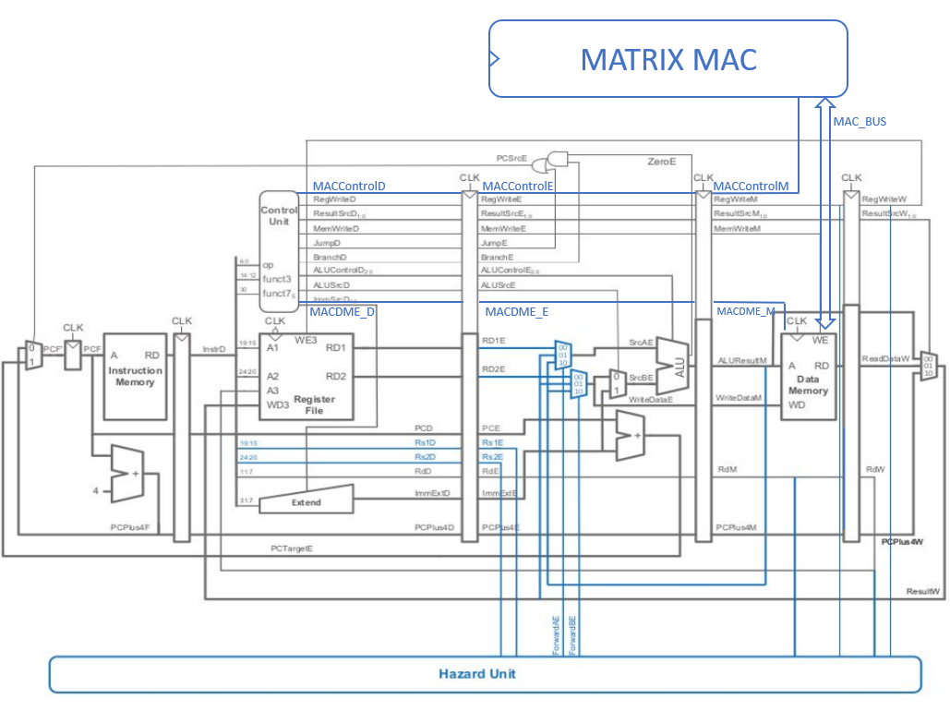
TESTING
TEST INSTRUCTIONS
Loaded values 1 to 50 in Data Memory.
Executed MAC Instructions.
CLR ALL
LMAC A 400, 5
LMAC B 425, 5
MAC M
STR R

Slide 10
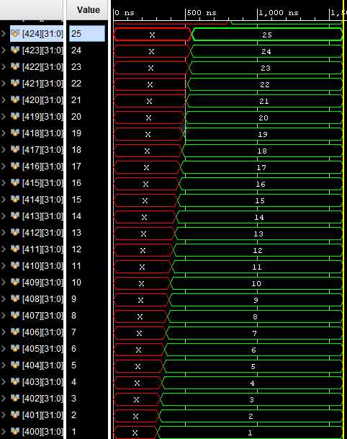
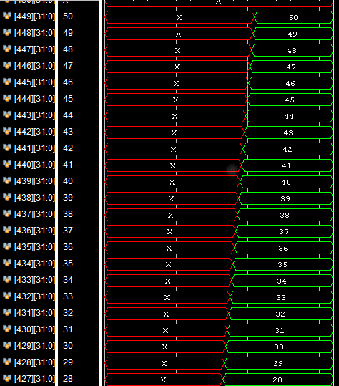
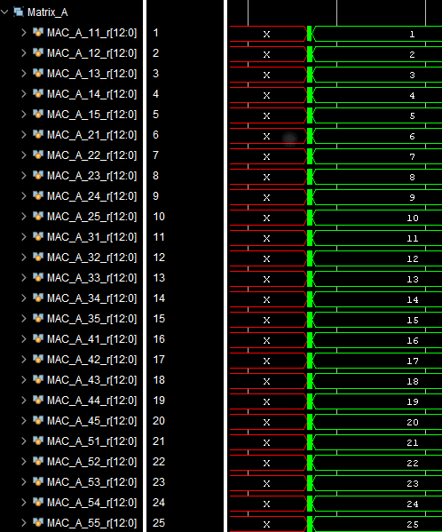
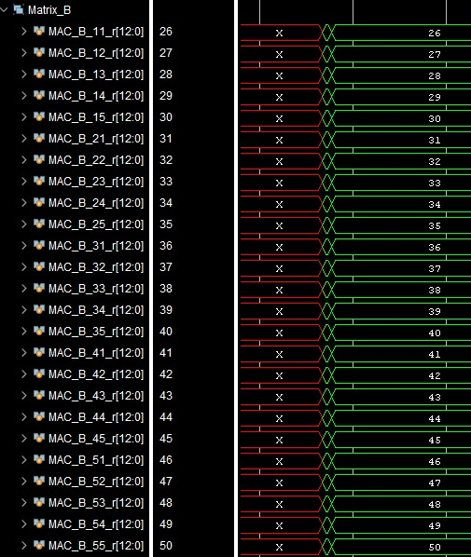
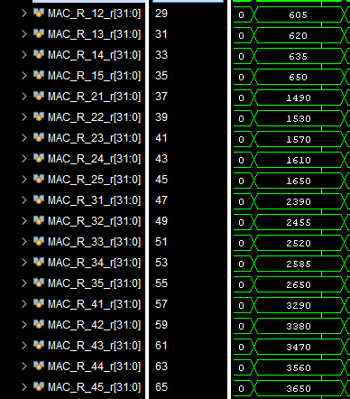
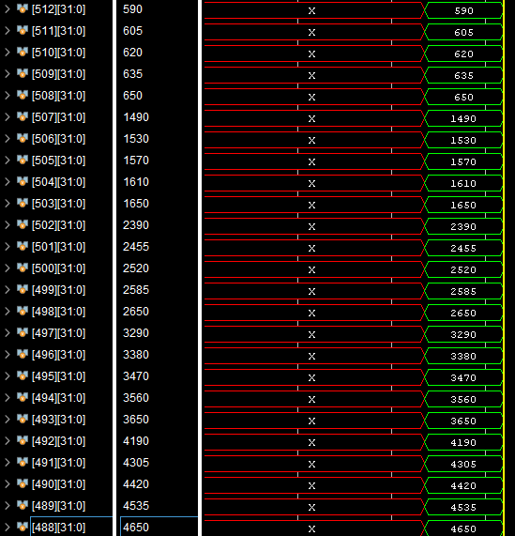
FPGA IMPLEMENTATION
BEHAVORIAL SIMULATION

Slide 11
FPGA ANALYSIS
Parameters | Single Cycle Processor | 5 stage Pipelining with Control Unit | Processor with Matric MAC
Lookup Tables | 89 | 283 | 6,340
Flip Flops | 8 | 223 | 688
LUTRAM | 48 | 48 | N/A
DSP | 0 | 3 | 3
Frequency | 322 MHz | 322 MHz | 322 MHz
Power | 0.165 W | 0.132 W | N/A

Slide 12
REQUIREMENTS & PROPOSED DESIGN:
RISC ISA
PIEPLINING
HAZARD UNIT
MATRIX MAC
MAC DECODER
MAC ISA
TESTING
FPGA IMPLEMNTAION

Slide 13
REQUIREMENTS & PROPOSED DESIGN:
INTELLERA:
FPGA Implementation
Testing
A HARDWARE BASED ACCELERATED RISC V MATRIX MAC PROCESSOR ON FPGA
BASIC RISC ISA
Matrix MAC ISA
TEAM MEMBERS:
SAAD KHAN (Team Lead)
MAHNOOR MALEEKA SYED ZAEEM SHAKIR
ADVISOR’S:
Dr. FAHAD BIN MUSLIM
Dr. WAQAR AHMAD (CO) Dr. MUHAMMDA TAJ (CO)
5 Stage Pipelining
MAC Decoder
Hazard Unit
Matrix MAC
Faculty of Computer Sciences and Engineering Ghulam Ishaq Khan Institute of Engineering Sciences and Technology, Pakistan

Slide 14
INTELLERA: A Hardware Based Accelerated Matrix MAC Processor
Team Members:
2020414 Saad Khan
2020487 Syed Zaeem Shakir
2020217 Mahnoor Maleeka
Supervisor: Dr Fahad Bin Muslim
Co-supervisor: Dr Taj Muhammad
Faculty of Computer Sciences and Engineering Ghulam Ishaq Khan Institute of Engineering Sciences and Technology, Pakistan
Notes:
14

Slide 15
INTELLERA:
A HARDWARE BASED ACCELERATED RISC V MATRIX MAC PROCESSOR ON FPGA
TEAM MEMBERS:
SAAD KHAN (Team Lead)
MAHNOOR MALEEKA SYED ZAEEM SHAKIR
ADVISOR’S:
Dr. FAHAD BIN MUSLIM
Dr. WAQAR AHMAD (CO) Dr. MUHAMMDA TAJ (CO)
Faculty of Computer Sciences and Engineering Ghulam Ishaq Khan Institute of Engineering Sciences and Technology, Pakistan

Slide 16
INTELLERA:
A HARDWARE BASED ACCELERATED RISC V MATRIX MAC PROCESSOR ON FPGA
TEAM MEMBERS:
SAAD KHAN (Team Lead)
MAHNOOR MALEEKA SYED ZAEEM SHAKIR
ADVISOR’S:
Dr. FAHAD BIN MUSLIM
Dr. WAQAR AHMAD (CO) Dr. MUHAMMDA TAJ (CO)
Faculty of Computer Sciences and Engineering Ghulam Ishaq Khan Institute of Engineering Sciences and Technology, Pakistan

Slide 17
REQUIREMENTS & PROPOSED DESIGN:
RISC ISA
PIEPLINING
HAZARD UNIT
MATRIX MAC
MAC DECODER
MAC ISA
TESTING
FPGA IMPLEMNTAION

