Slide 1
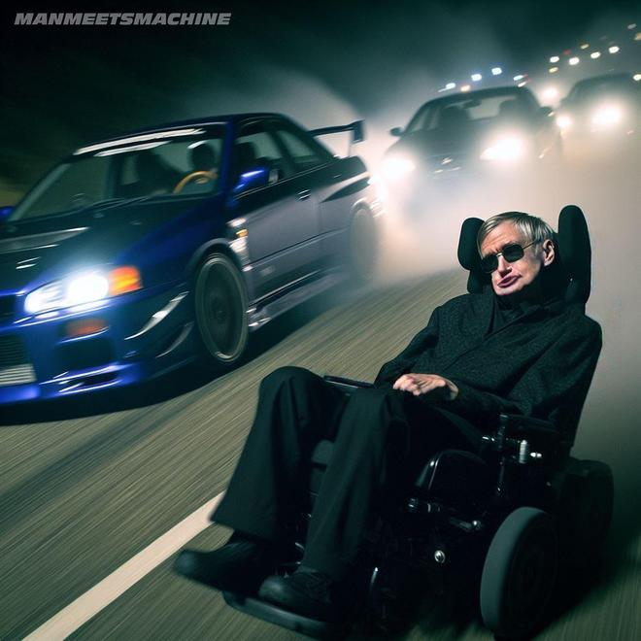
Are AI-generated videos creating new ethical
and regulatory challenges for the media industry?
Background
In next few years, text-to-video models will become mature that can generate hyper-realistic videos from written prompts. We can often see the photos and videos generated on Tiktok. Although the generated videos are very realistic, what worries us is whether we can really handle this unrestricted AI creation tool well. Is there a copyright issue or ethical problem involved in?
Why this topic matters?
Raises concerns about misinformation, copyright….
Challenges the boundaries between truth and fiction in online media.
Understanding these issues helps society develop responsible AI practices.

Slide 2

Ethical implications of AI-generated video content — especially deepfakes, privacy, and trust in digital media.
Ultimate goal
Combine AI-assisted literature searching with human ethical reasoning to review how society should regulate tools like Sora.
Methodology
Databases: Google Scholar, ACM digital library
Keywords: “AI video ethics”, “synthetic media regulation”, “deepfake misinformation”, “OpenAI”.
AI Tools Used: Used ChatGPT to summarize and compare literature. Used Semantic Scholar to locate related articles.
Human Judgment: Interpretation and ethical evaluation are done manually to ensure critical analysis beyond AI-generated summaries.

Slide 3
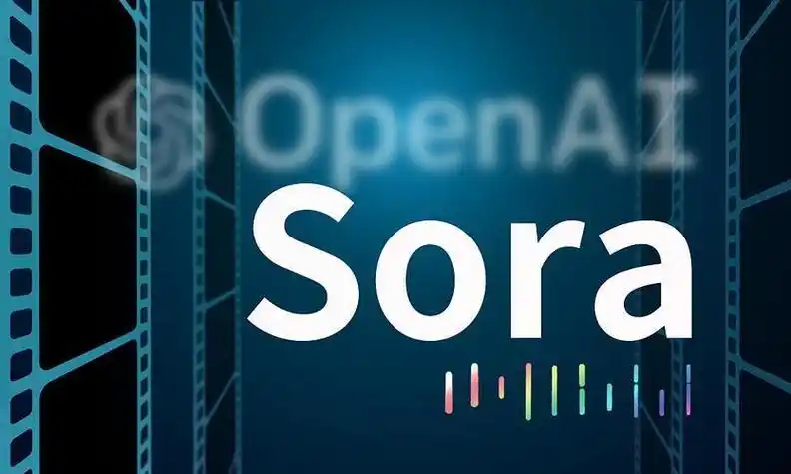
AI tool example
Sora (OpenAI, 2025) – A cutting-edge text-to-video model producing realistic moving scenes.
→ Demonstrates both creative opportunities and serious ethical risks, including misinformation and consent violations.
Example literature
Emerald Publishing, (2025). Deepfakes and the crisis of digital authenticity: ethical challenges in the age of synthetic media
→ Examines perceptions among social media users in India – a context marked by high internet penetration but uneven digital literacy – while investigating the ethical implications of deepfake technologies and their influence on public trust in digital content.
These sources help frame the debate on how generative AI like Sora can be used responsibly in society.

