Slide 2
GIT Repo
https://github.com/gdzierzon/Angular-Observables-Demo.git

Slide 3
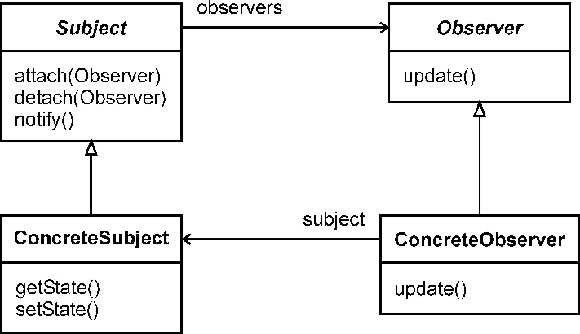
GoF Observer Pattern

Slide 4
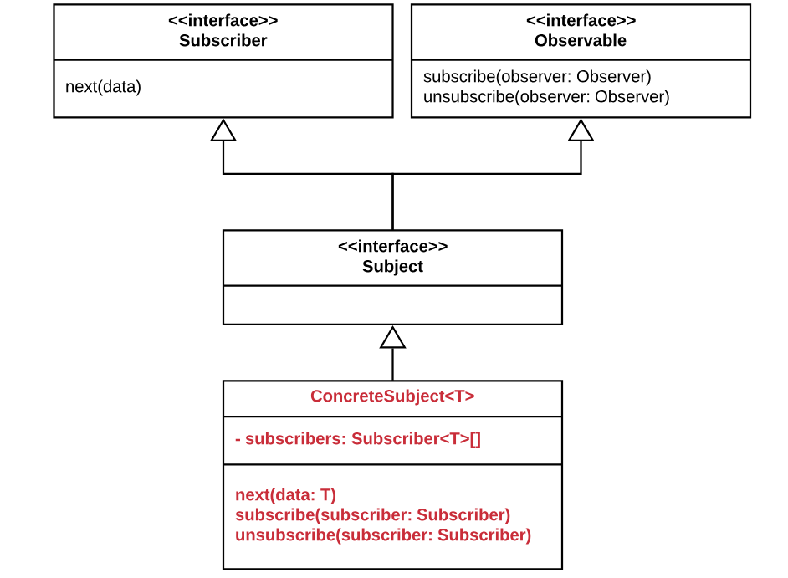
Reactive.io (RxJS) Observer Pattern

