Slide 2
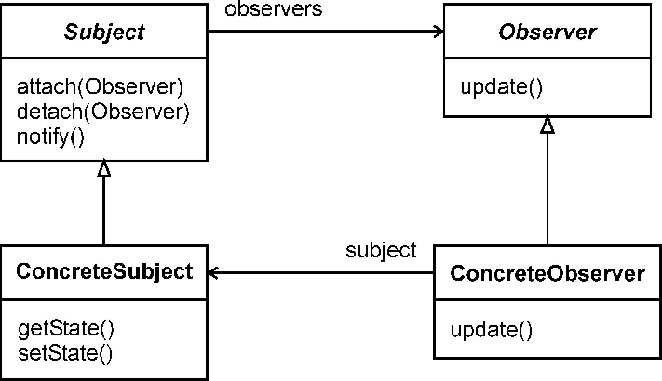
GoF Observer Pattern

Slide 3
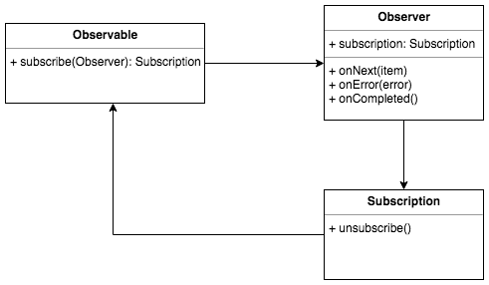
Reactive.io (RxJS) Observer Pattern

