Slide 1
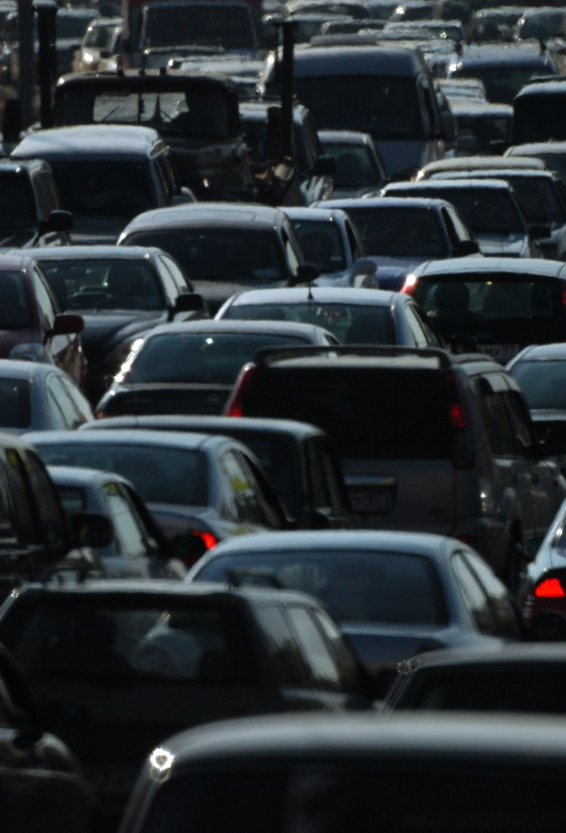
Classifier to Predict Primary Contributory Causes of Car Crashes in Chicago.
By Nyairo Caroline Gesaka
Notes:
Classifier to predict Primary Contributory Causes of Car Crashes in Chicago

Slide 2

Business Problem
The primary business problem to be addressed is the high rate of car accidents in Chicago. By identifying and understanding the leading causes of these accidents, the city can implement specific interventions.

Slide 3

Objective.
The goal is to develop a machine learning classifier capable of predicting the primary contributory cause of car accidents in Chicago.

Slide 4
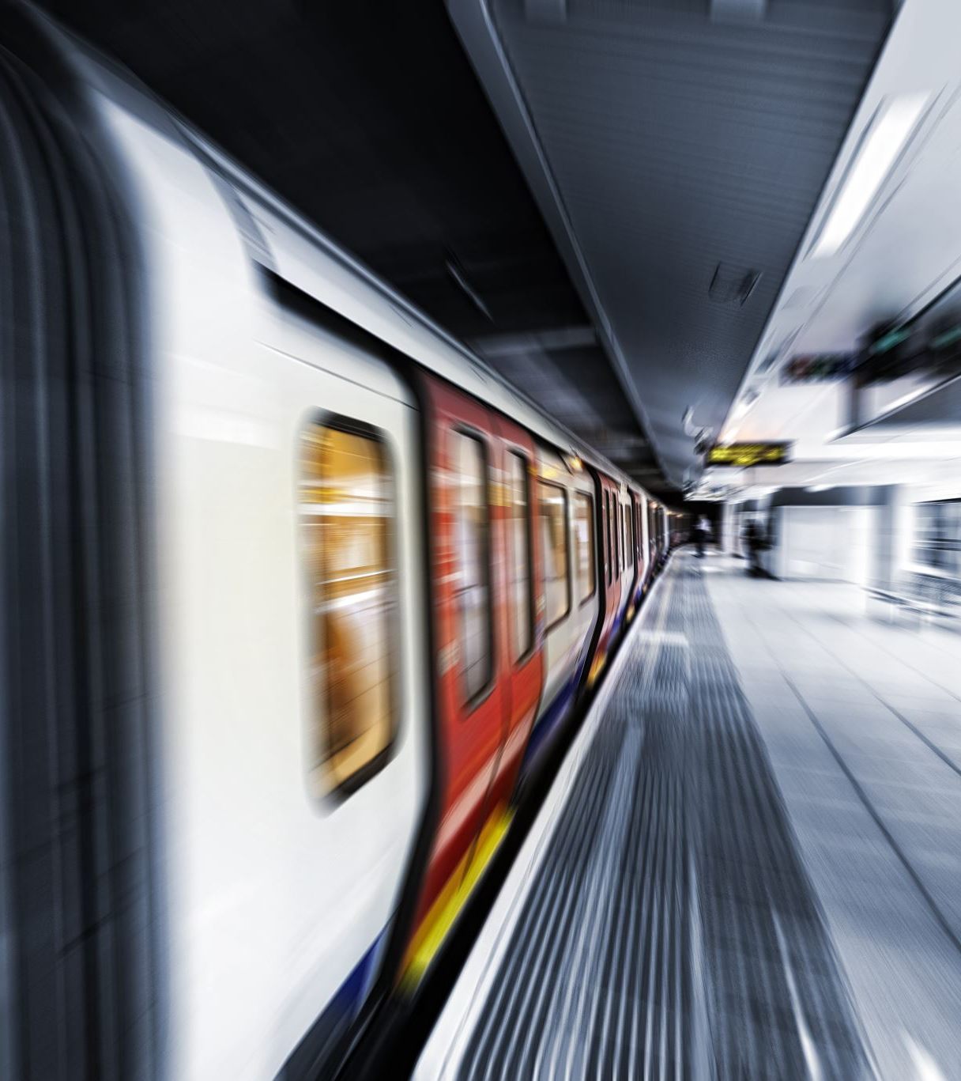
Stakeholders
City of Chicago. Vehicle Safety Board.

Slide 5
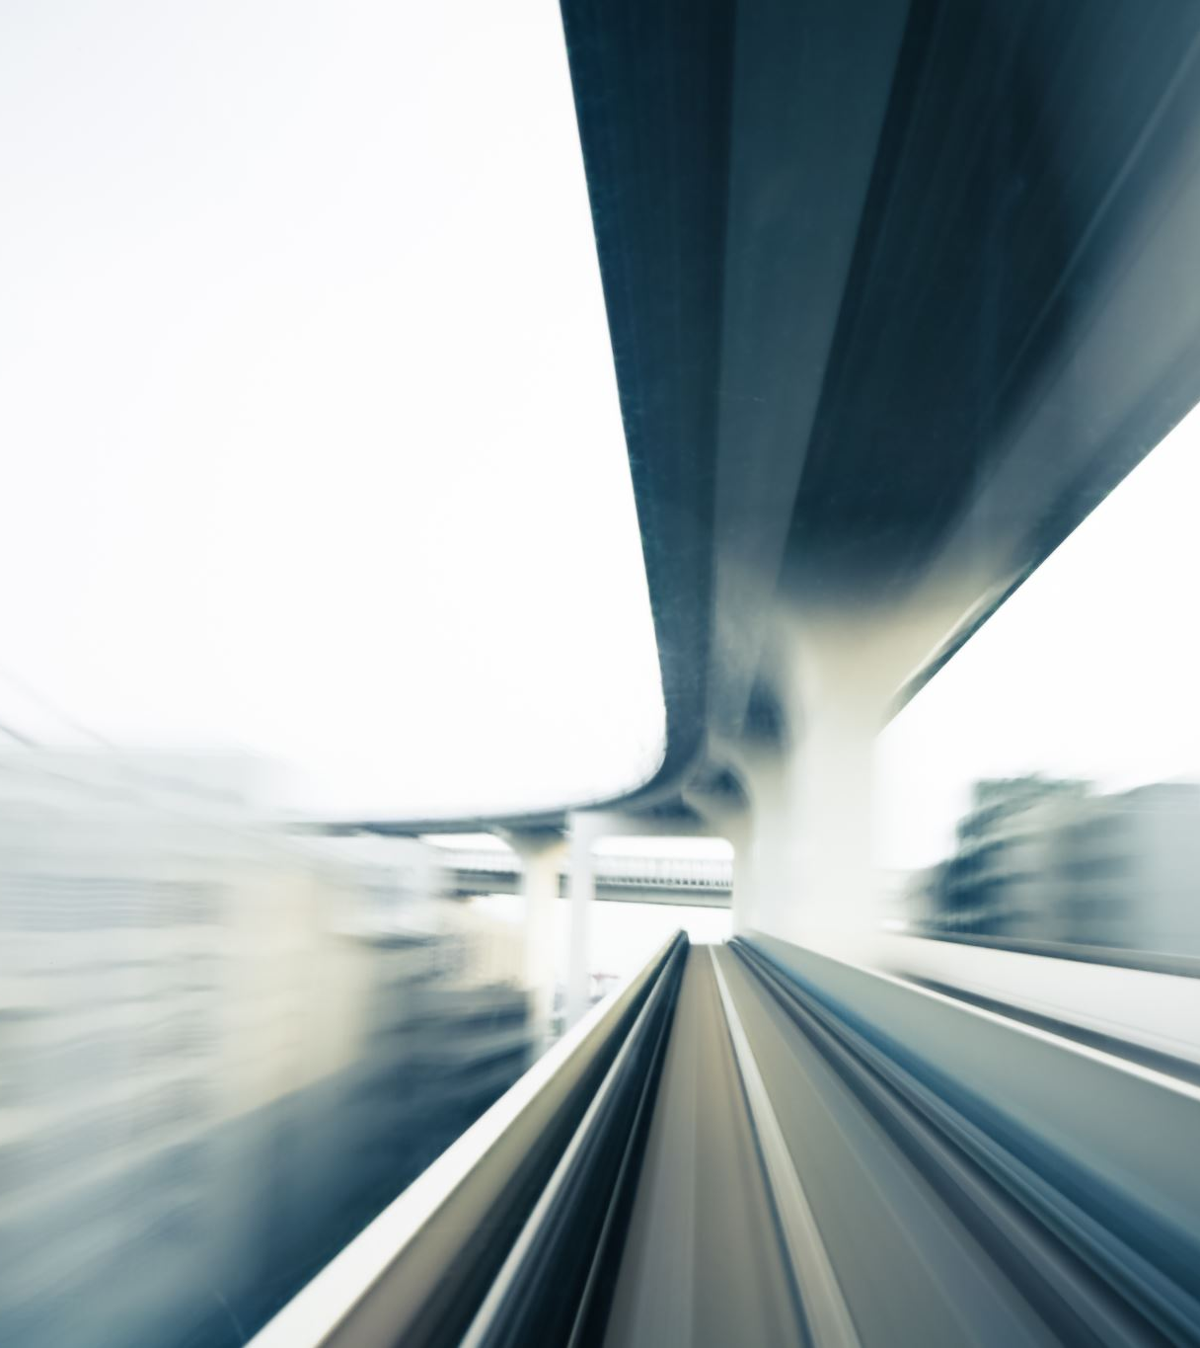
Data-Set
Chicago Car Crashes dataset(Traffic_Crashes_Crashes_20240516.csv).

Slide 6
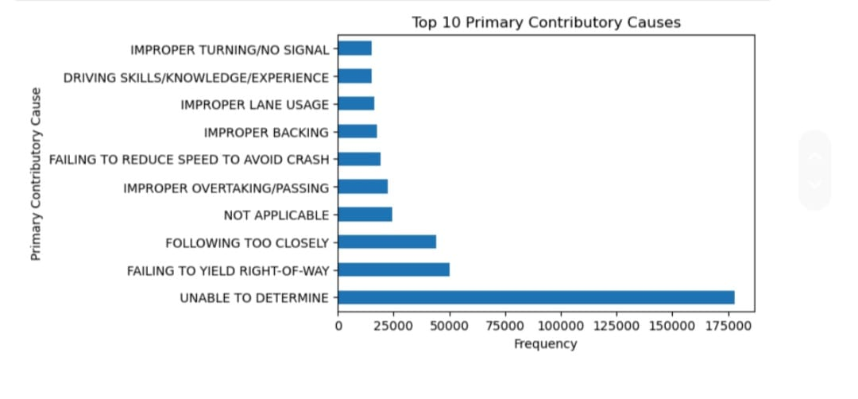
Top 10 Primary Contributory Cause

Slide 7
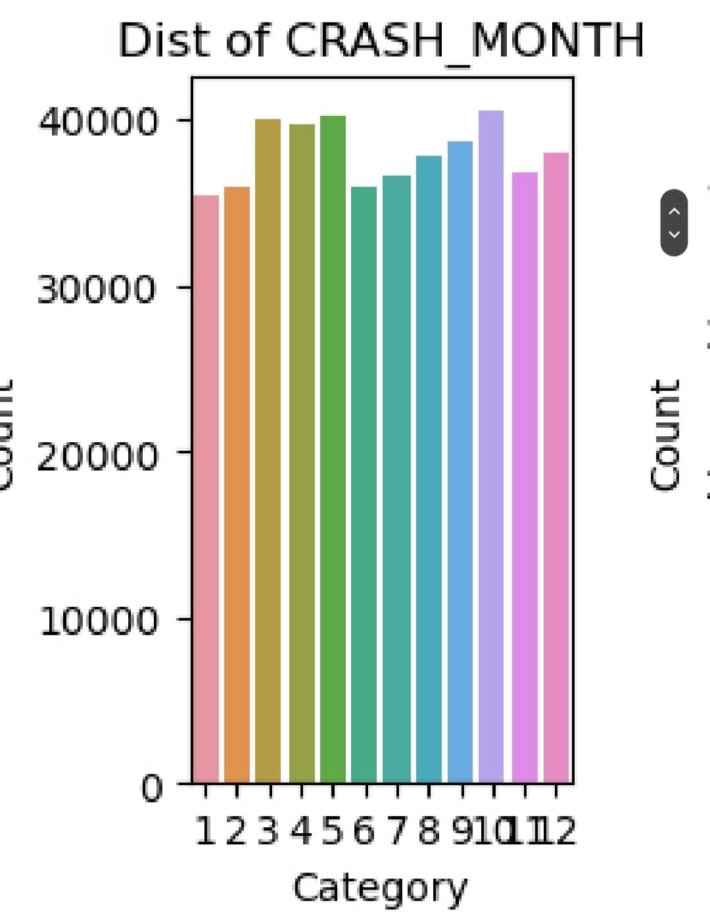
Hourly Accidents are high

Slide 8
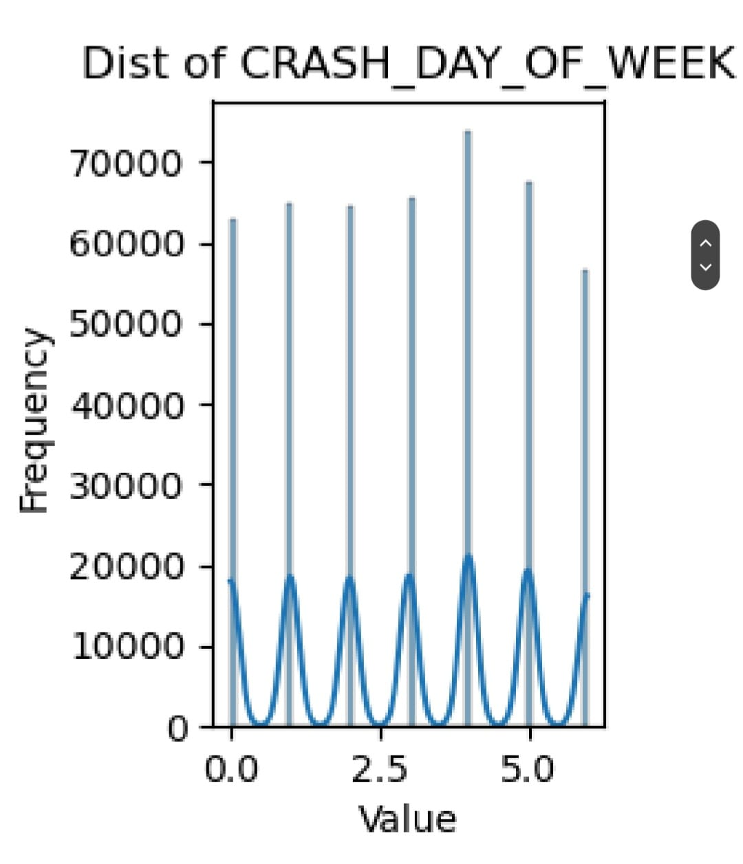

Slide 9

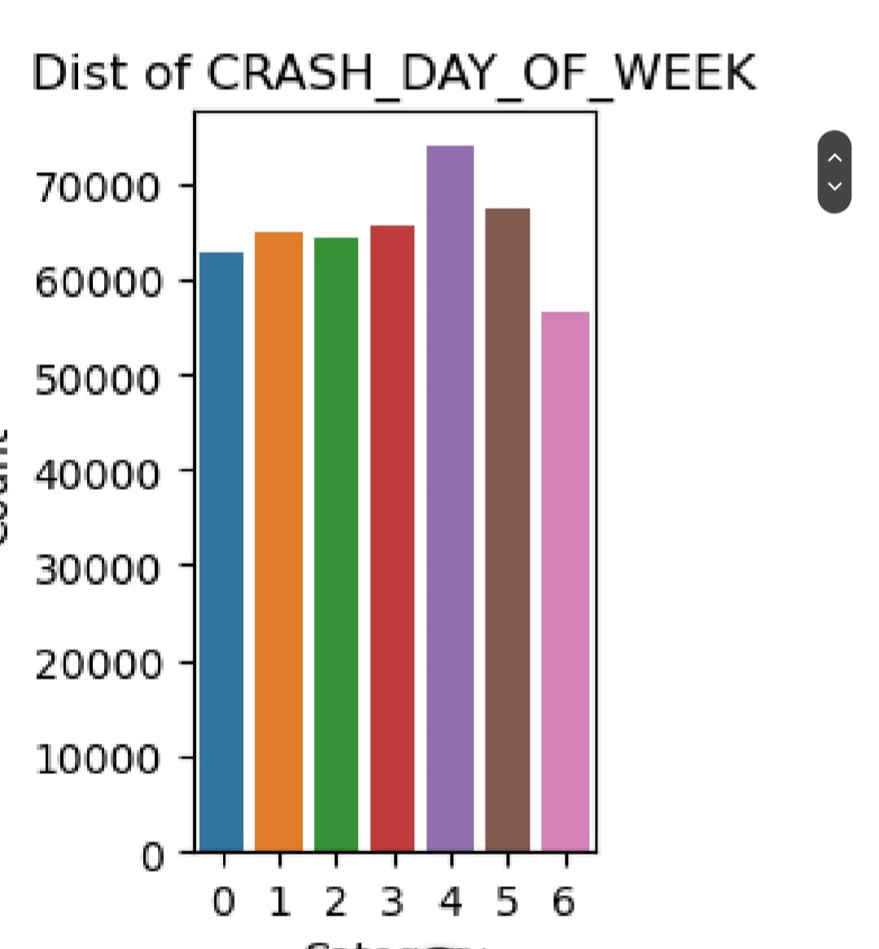
Crashes occur mostly on the 5th Day of the Week.

Slide 10
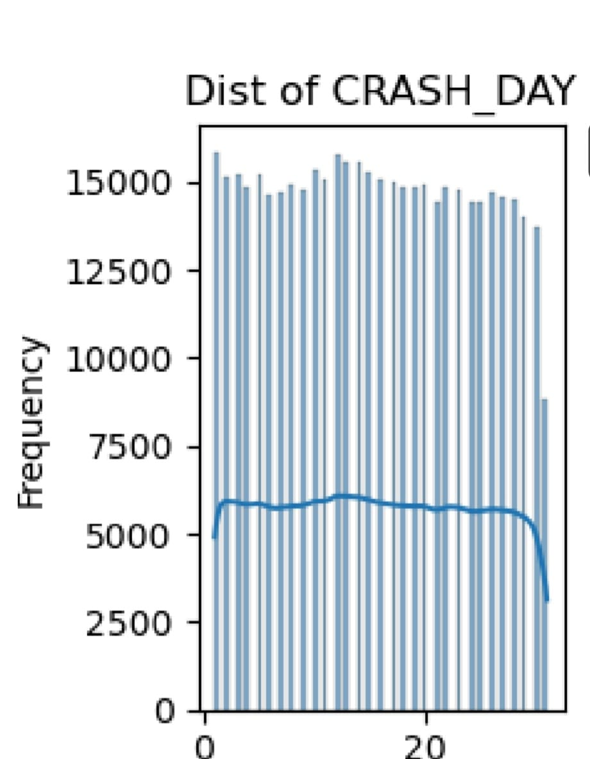

Slide 11
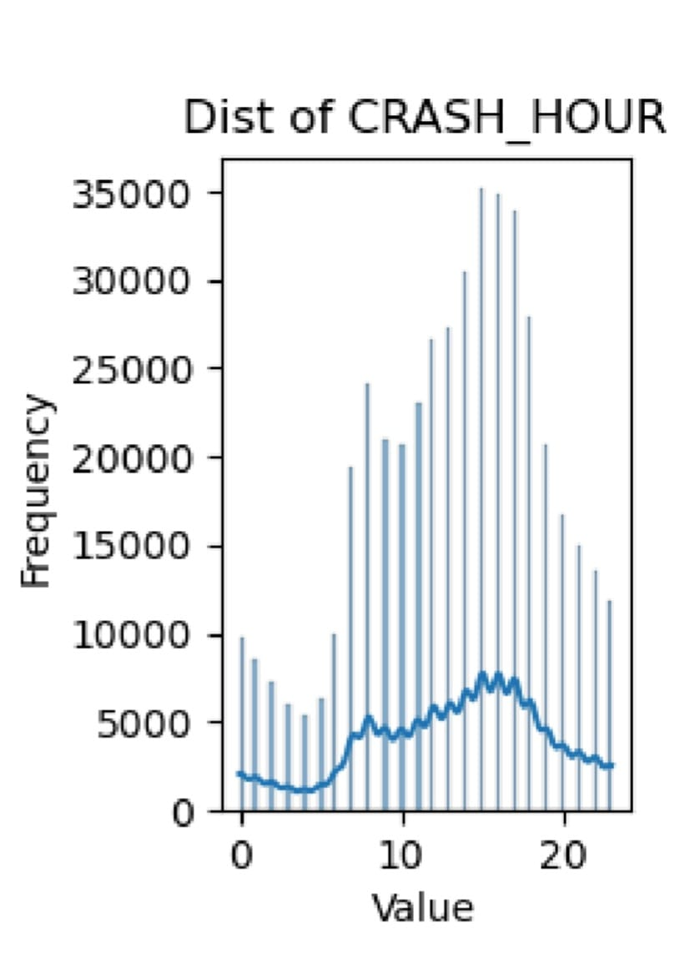
Hourly Distribution

Slide 12
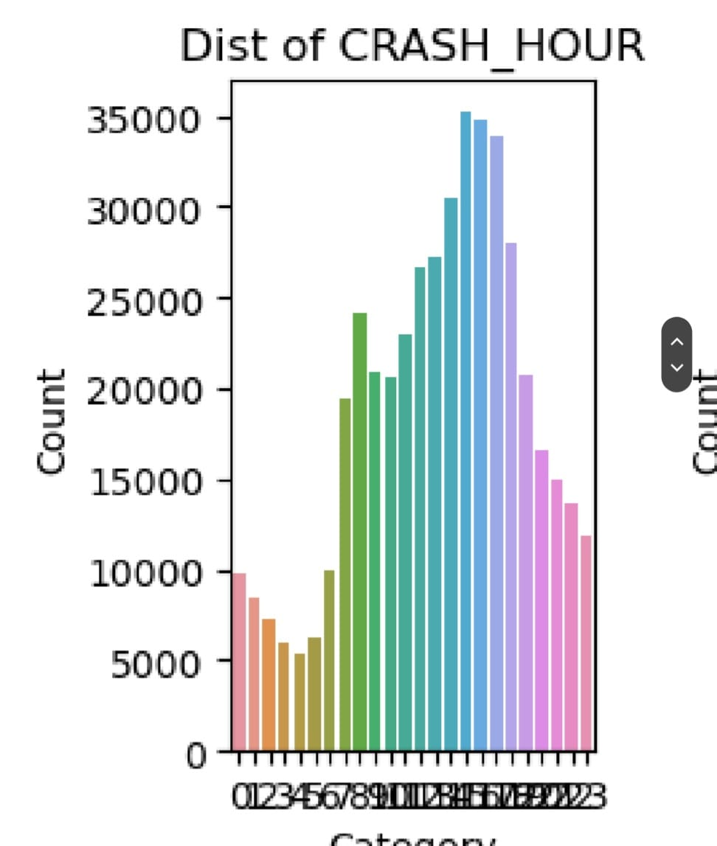

Slide 13
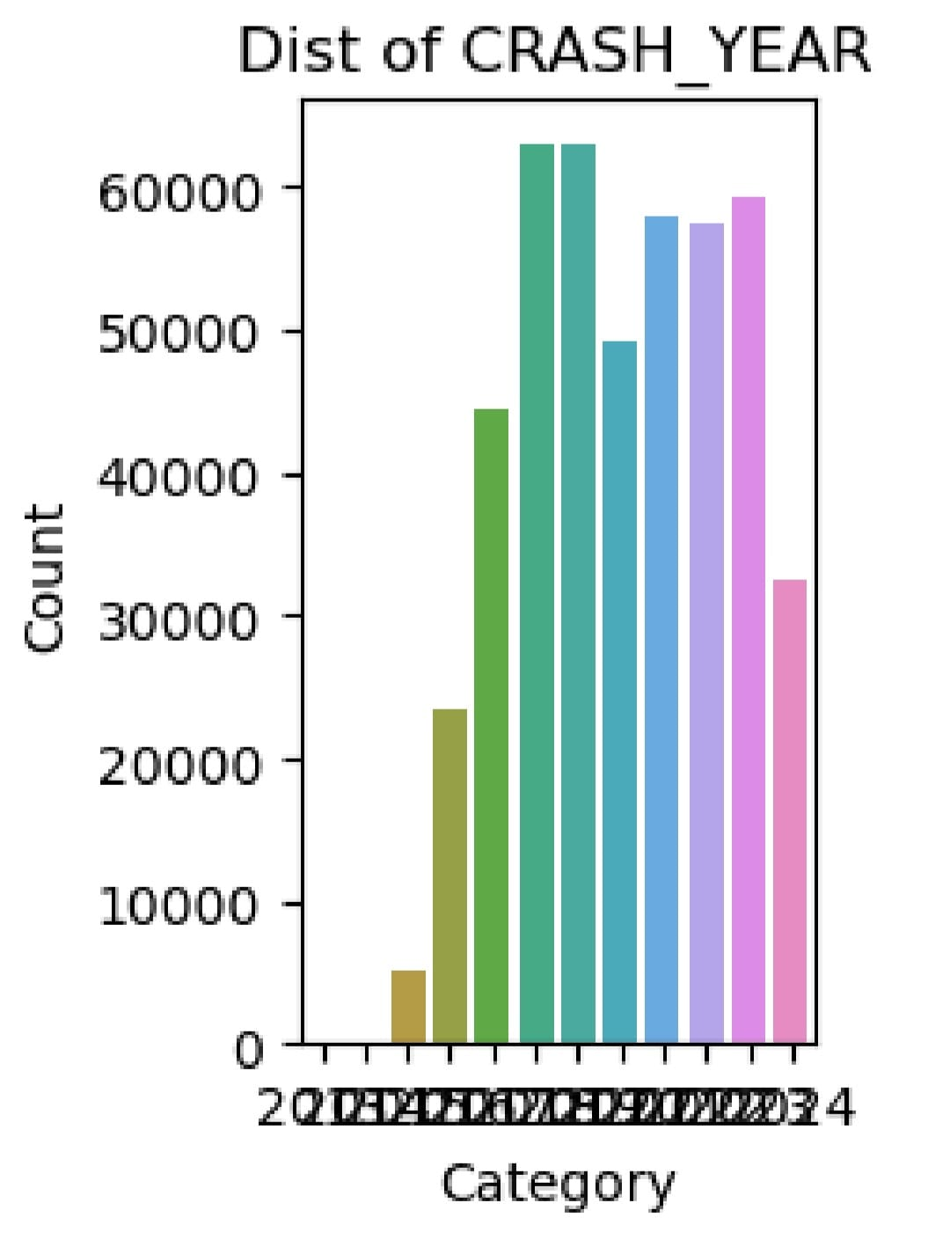

Slide 14
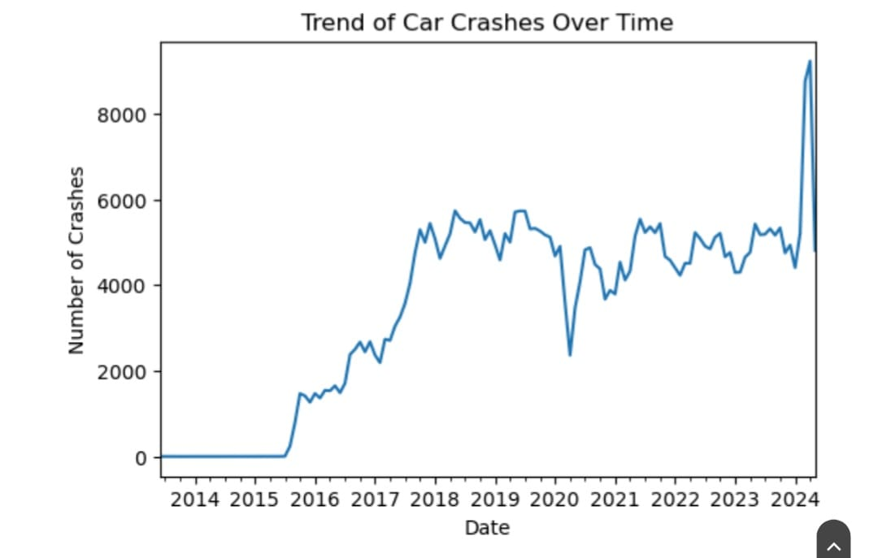
Crashes increasing yearly.

Slide 15
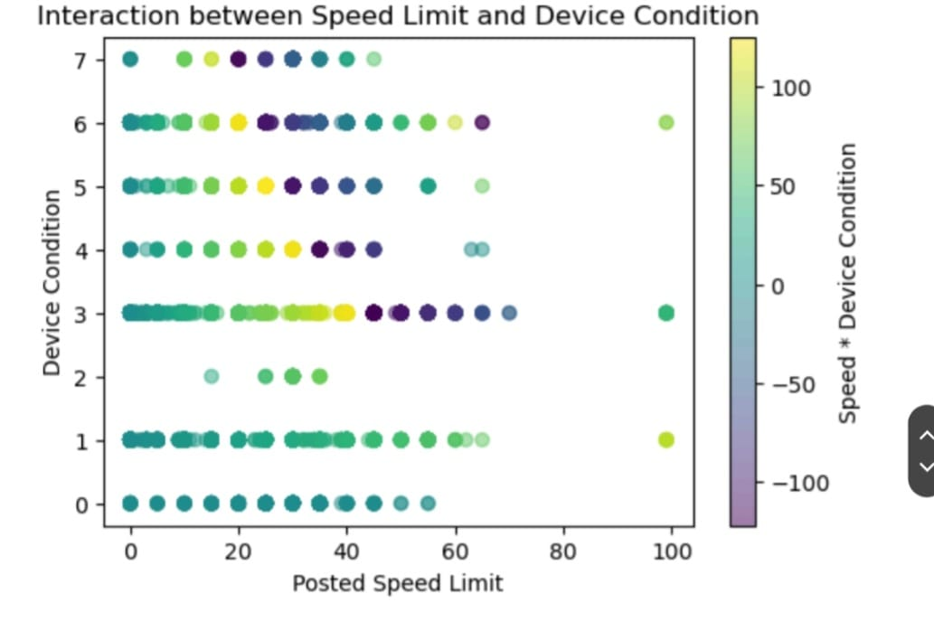
Speed Limit vs Device Condition

Slide 16
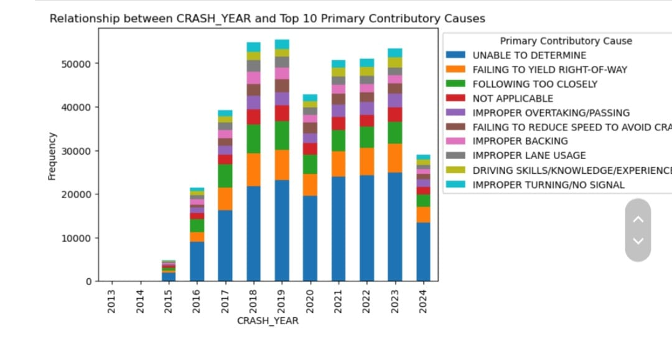
Causes of crashes are repeatedly

Slide 17
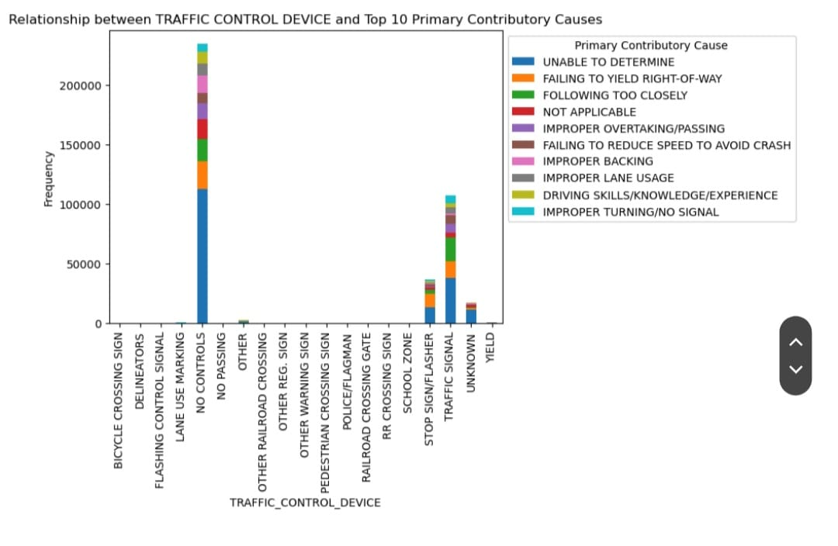
Traffic Control Device vs Primary Contributory cause

Slide 18
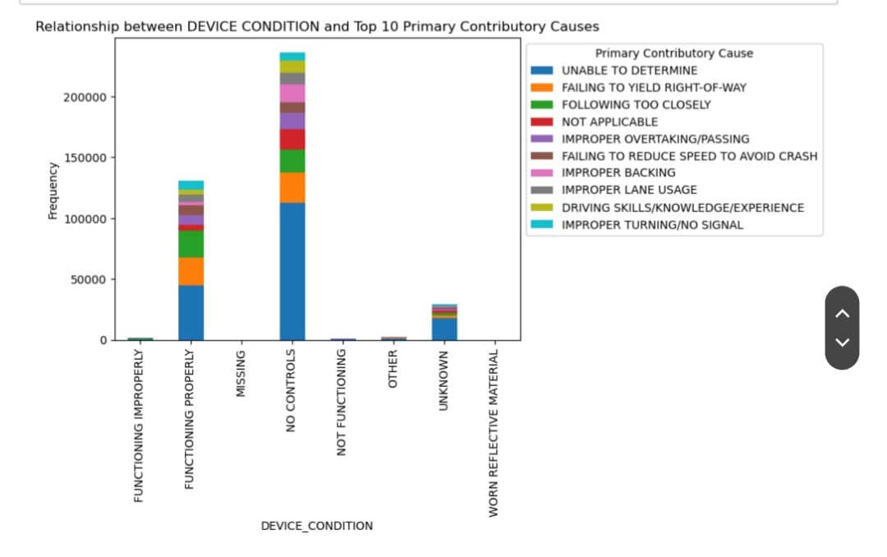
Device Control vs Primary Contributory cause

Slide 19
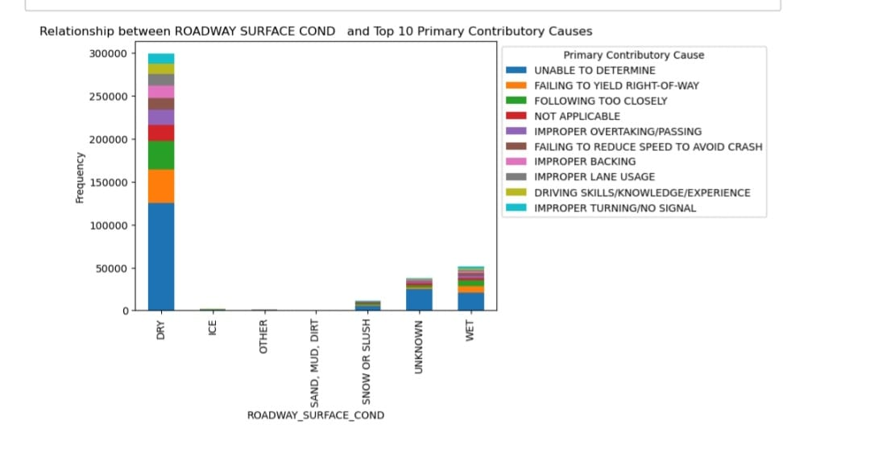
Road Surface vs Primary Contributory Cause

Slide 20
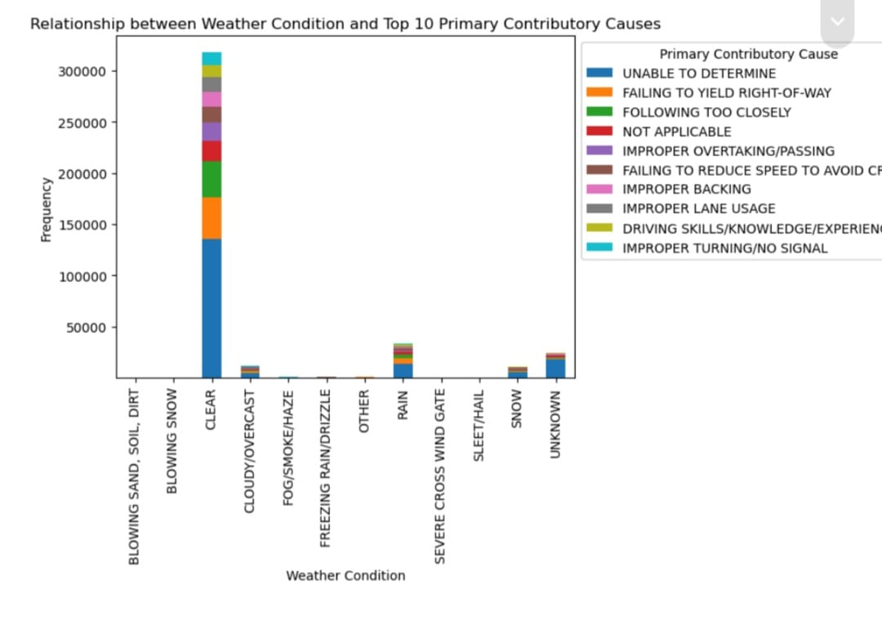
Weather vs Primary Contributory Cause

Slide 21
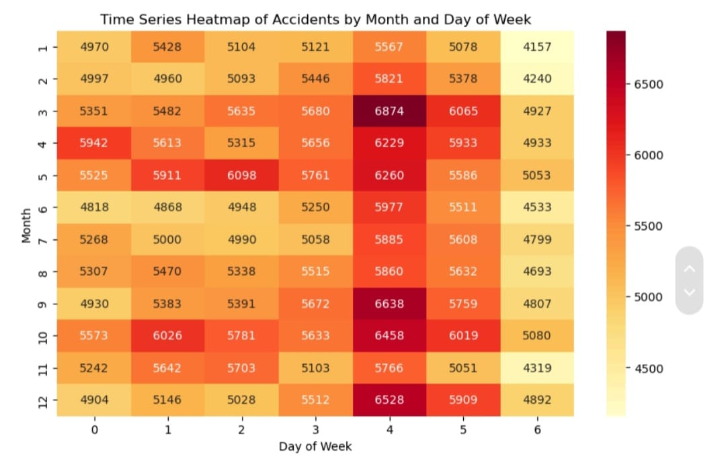
Accidents by month and week

Slide 22
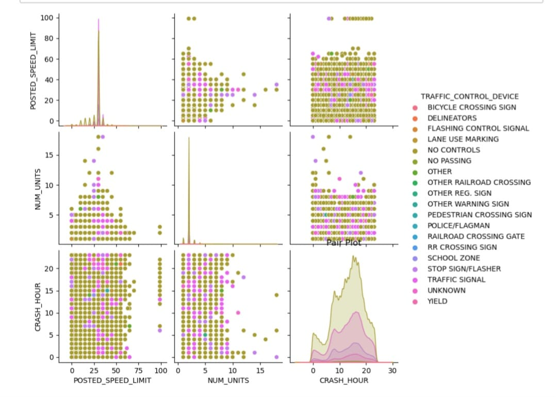

Slide 23

Conclusion
LogisticRegressoris the base model.
RandomClassifier is the Suitable model for Accuracy.

Slide 24

Recommendation
Feauture engineer advance features.
Model optimization to improve model performance.
Community Engagement to create Awareness
Policy implementation.
Explore Advanced Future Engineering

