Slide 1

Computational Haptics Laboratory Project Presentation
Hao Dong, Han Liang, Yanran Zhang
Technical University of Munich
TUM Department of Electrical and Computer Engineering
Chair of Media Technology
Munich, 26 September 2022
Chai3D meets Unity3D
Notes:
Chai3d is a power simaliatiopon framework for haptic app. But is not used as a game engine, unity3d is a popular choose for game development. We would like to intergrastion chai3d with unity3d to simplifier a haptic development. Focus We provide our haptic force rendering model to Han, She integrated the CHAI3D ……………..

Slide 2
Contents
Introduction
Haptic Force Rendering
Stick-Slip Friction
Stone track
Magnet Bar
Conveyor Belt
Deformable Object
Integration between Unity3D and CHAI3D
Framework
Concept
Game design
Summary
Future Work
Haptics Game
Notes:
The detail & relationshaip

Slide 3
Introduction
Haptic Force Rendering
Unity3D Game Engine
C# Wrapper
Prepare Haptics
Game Manager
Modules
updateHaptics
GEL
ODE
Touchable Object
Objects
Audio Manager
Stop Haptics

Slide 4
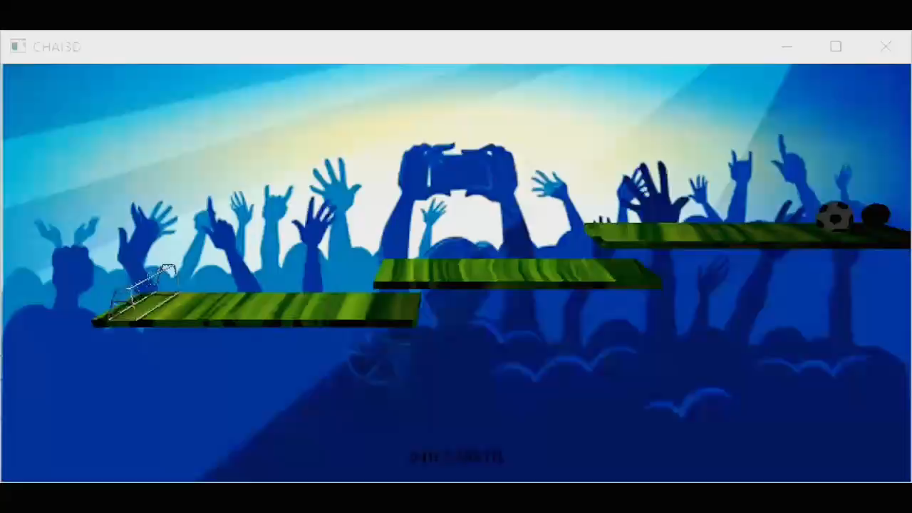

Haptic Force Rendering
Stick-Slip friction
Surfaces alternating between sticking to each other and sliding over each other, with a corresponding change in the force of friction.
Implement: $fr_{static}>{fr}_{kinetic}$

Slide 5
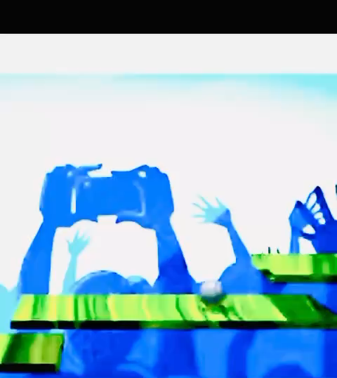
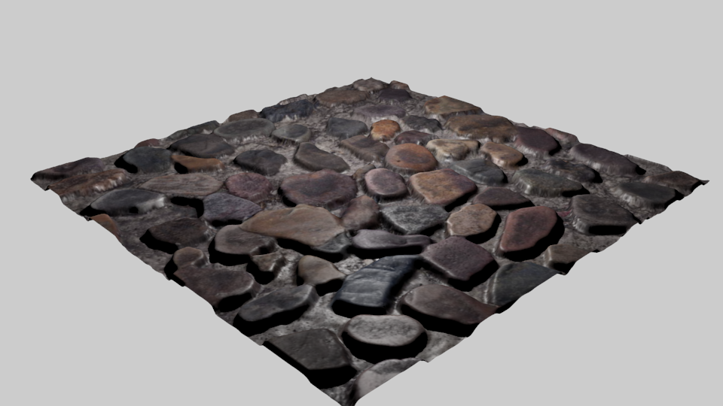
Haptic Force Rendering
Stone track
Simulate a stone track with rough surface
Implement: set a big stiffness on the object / add vibration effect on the object
Plan to do: try to use a rough surface model and set stiffness to the dynamic mesh of object

