Slide 1

Normative Modelling for Brain Development Trajectory
Carlotta Sophia Hölzle
Technische Universität München
TUM School of TUM School of Medicine and Health
Lehrstuhl für Artificial Intelligence in Medical Imaging
München, 15 Juli 2024

Slide 2
Overview
Normative Models
Literature Review
Comparison of 3 Approaches
1.
2.
3.

Slide 3

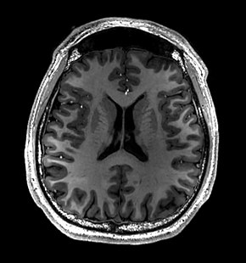
Motivation
Cases
Reality
Predictor 2
Predictor 2
Controls
Predictor 1
Predictor 1
https://www.google.com/url?sa=i&url=https%3A%2F%2Fen.wikipedia.org%2Fwiki%2FMagnetic_resonance_imaging_of_the_brain&psig=AOvVaw1_yxq-dsWazDFtlLnqMWBS&ust=1720942879358000&source=images&cd=vfe&opi=89978449&ved=0CBEQjRxqFwoTCIi6h_vBo4cDFQAAAAAdAAAAABAJ
Notes:
Neurological disorders often stem from atypical brain developmental trajectories.
By monitoring and predicting these changes, we can gain a deeper understanding of these conditions, improve diagnostic accuracy, and develop targeted interventions. How to best do this? Try to early determine case vs. control
Looking at the lower left figure we can see that traditional group-level statistics, which tries to distinctly categorize cases vs. controls. However, in reality, the boundaries between cases and controls are often blurred due to overlapping distributions.
This overlap leads to a mixed and often unclear picture, making it difficult to accurately diagnose and understand individual cases.
Pure MRI data can help diagnose and analyze neurological diseases, by comparing them with reference markers from healthy populations.
Challenges
Evaluator Variability
Demographic Factors
Imaging Variations
This is where the use of normative models becomes crucial. Normative models are used to establishing a reference range for typical brain development.
Personalized Baselines: Each individual’s data can be compared against these references to detect deviations that might indicate neurological disorders.
Comparison: Instead of broad group comparisons, normative models allow us to pinpoint where an individual falls within the healthy range for each predictor.

Slide 4
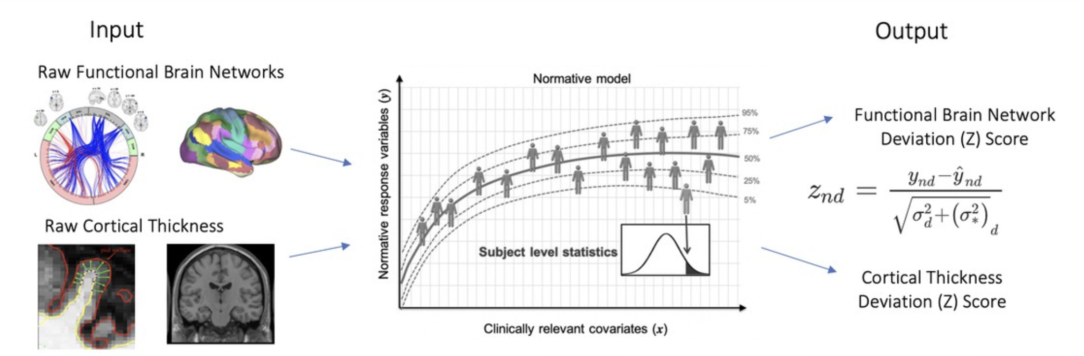
Normative Models
Covariates
Age, Sex, Scanner Site
Z-Scores
Rutherford, S., Barkema, P., Tso, I. F., Sripada, C., Beck- mann, C. F., Ruhe, H. G., and Marquand, A. F. Evidence for embracing normative modeling. Elife, 12:e85082, 2023.
Notes:
Normative models represent a personalized approach that identifies individual patterns rather than relying on group averages or clinical divisions, which typically depend on static, single-point comparisons using basic statistics.
These models use statistical techniques to generate healthy growth curves or reference growth curves. This baseline "norm" for various biological measures provides a dynamic framework to compare individual data against a healthy standard
For example, normative models can predict cortical thickness or brain volume by incorporating demographic factors such as age, sex, and even the scanner site.
These models are sophisticated as they can incorporate both model and data variance or percentile ranks, offering a more detailed and accurate understanding of individual development. This personalized approach allows for better identification of deviations from typical growth patterns, facilitating early detection and diagnosis of potential health issues.

Slide 5
Literature Review – Estimation of Normative Models
Bayesian & Hierachical Models
Non-Linear Models
Linear Models
Quadratic Fit Lines
Partial Least Squares Regression
Generalized Regression Models
Support Vector Regression
Bayesian Linear Regression
Gaussian Process Regression
Hierachical Linear Modelling
Local Polynomial Regression Fitting
Generalized Additive Models LSS
Notes:
Bayesian Linear Regression: For example, a posterior distribution might show the probable range of brain volumes for a specific age group, updated with new MRI data, reflecting both prior knowledge and new observations.

Slide 6
Literature Review – Estimation of Normative Models
Bayesian & Hierachical Models
Non-Linear Models
Linear Models
Quadratic Fit Lines
Partial Least Squares Regression
Generalized Regression Models
Support Vector Regression
Bayesian Linear Regression
Gaussian Process Regression
Hierachical Linear Modelling
Local Polynomial Regression Fitting
Generalized Additive Models LSS
Notes:
Generalized regression models are an extensions of linear regression models. They allow for different types of response variables by using a link function, which linearly connects the expected value of the response to the predictors.
GAM: General Adaptive Model: non-linearities through smooth functions of preditors (linear, squared, or more complex non linear terms; extend traditional linear regression to more complex relationships. the predictor is still linear in terms of the coefficients

Slide 7
Literature Review – Estimation of Normative Models
Bayesian & Hierachical Models
Non-Linear Models
Linear Models
Quadratic Fit Lines
Partial Least Squares Regression
Generalized Regression Models
Support Vector Regression
Bayesian Linear Regression
Gaussian Process Regression
Hierachical Linear Modelling
Local Polynomial Regression Fitting
Generalized Additive Models LSS
Notes:
Generalized Additive Models for Location, Scale, and Shape (GAMLSS): can model complex non linear relationship
fractional polynomials and random effects to account for individual variability.

Slide 8
Literature Review – Estimation of Normative Models
Bayesian & Hierachical Models
Non-Linear Models
Linear Models
Quadratic Fit Lines
Partial Least Squares Regression
Generalized Regression Models
Support Vector Regression
Bayesian Linear Regression
Gaussian Process Regression
Hierachical Linear Modelling
Local Polynomial Regression Fitting
Generalized Additive Models LSS
Notes:
Bayesian Linear Regression: For example, a posterior distribution might show the probable range of brain volumes for a specific age group, updated with new MRI data, reflecting both prior knowledge and new observations.

Slide 9
Using the Output of Normative Models

Slide 10
Evaluating Output from Normative Models
Simple Regression Methods
$$z= y−\hat{y}$$
𝑧= 𝑦−𝑦 ̂
Group-level correlations

Slide 11
Evaluating Output from Normative Models
Statistical Methods
$$z= \frac{y − \hat{y}}{σ}$$
𝑧= (𝑦 − 𝑦 ̂)/𝜎
Std. Dev.
Simple Regression Methods
$$z= y−\hat{y}$$
𝑧= 𝑦−𝑦 ̂
Group-level correlations
Bayesian Methods
$$z= \frac{y − \hat{y}}{\sqrt{σ_{a}− σ_{e}}}$$
𝑧= (𝑦 − 𝑦 ̂)/√(𝜎_𝑎− 𝜎_𝑒 )
Aleatoric & epistemic uncertainty

Slide 12
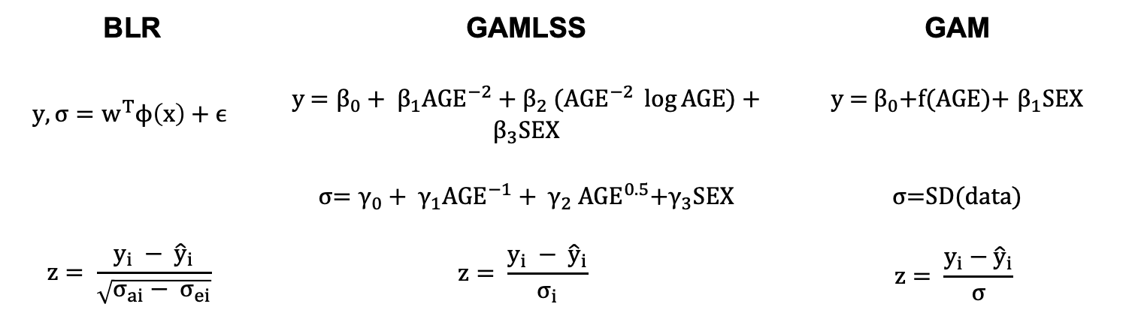
Comparing Bayesian Linear Regression (BLR) with GAMLSS and GAM Normative Models
BLR | GAMLSS | GAM
$$y,\text{σ}=w^{T}ϕ\left(x\right)+ϵ$$ | y = ${\text{β}}_{0}+ {\text{β}}_{1}{AGE}^{−2}+{\text{β}}_{2}$​(${AGE}^{−2} \log{AGE}$) + ${\text{β}}_{3}SEX$ | y = ${\text{β}}_{0}$+f(AGE)+ ${\text{β}}_{1}$SEX
 | σ= ${\text{γ}}_{0}+ {\text{γ}}_{1}{AGE}^{−1}+ {\text{γ}}_{2} {AGE}^{0.5}$+${\text{γ}}_{3}SEX$ | σ=SD(data)
$$z= \frac{y_{i} − {\hat{y}}_{i}}{\sqrt{σ_{ai}− σ_{ei}}}$$ | $$z= \frac{y_{i} − {\hat{y}}_{i}}{σ_{i}}$$ | $$z= \frac{y_{i}−{\hat{y}}_{i}}{σ}$$

Slide 13
Methods
Qualitative
Bayesian Linear Regression
Prepare data
PCNToolkit reproducibility
Modelling
Performance Analysis
GAM & GAMLSS
Quantitative

Slide 14
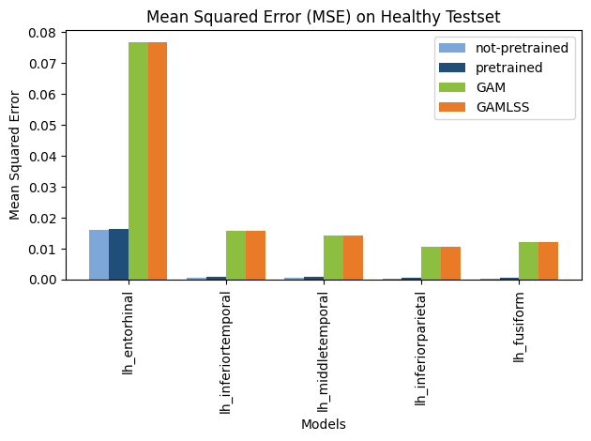
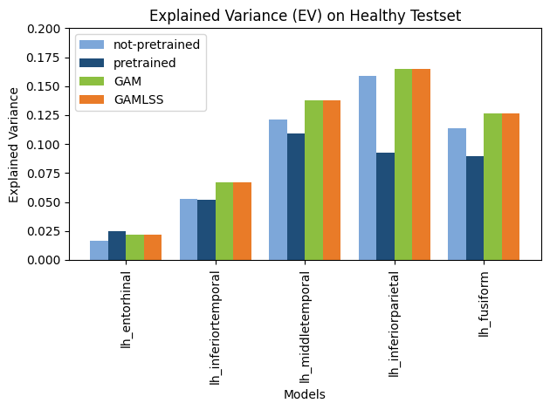
Quantitative
Notes:
EV: how well a model's predictions account for the variability in the observed data
explained variance is relatively low, this implies that the model is not effectively capturing the underlying patterns in the data.

Slide 15
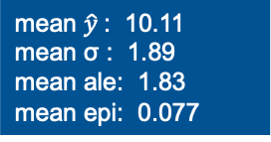
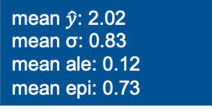
Variance
AD_ROI | not-pretrained (epi. + ale.) | pretrained (epi. + ale.) | GAMLSS (sigma) | GAM (std.dev)
L Entorhinal | 0.8303277 | 1.8930933 | 0.92816 | 0.350095
L Inferiortemporal | 0.4597567 | 2.6385804 | 1.015558 | 0.1585483
L Middletemporal | 0.4619569 | 2.5924265 | 0.9731803 | 0.1507982
L Inferiorparietal | 0.3237705 | 2.7239925 | 0.9051525 | 0.1287471
L Fusiform | 0.4257601 | 2.71668121 | 1.073093 | 0.1371672
mean $\hat{y}$: 2.02
mean σ: 0.83
mean ale: 0.12
mean epi: 0.73
mean $\hat{y}$: 10.11
mean σ : 1.89
mean ale: 1.83
mean epi: 0.077
Notes:
wT is the estimated weight vector, ϕ(x) is a B-spline basis expansion: model non-linear effects of age,
$ε$ (epsilon) Gaussian noise distribution with mean zero and noise precision term β (the inverse variance)

Slide 16
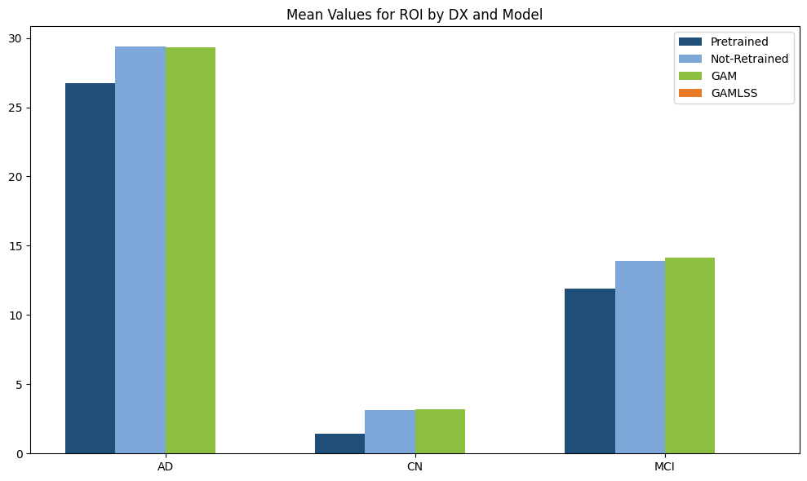
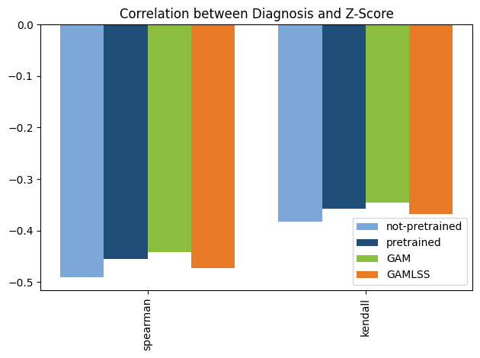
Quantitative

Slide 17
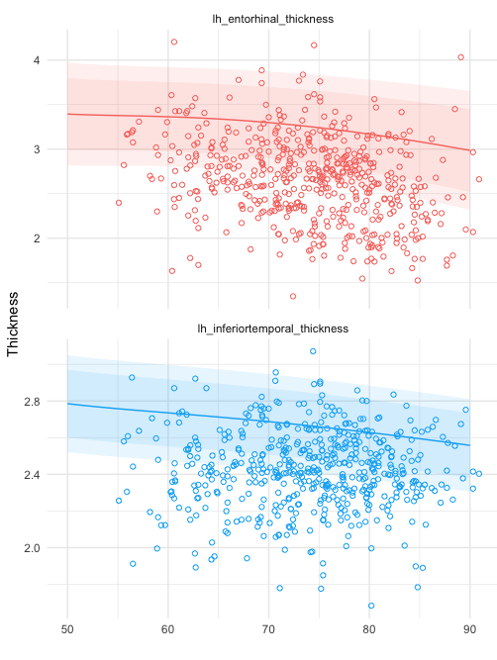
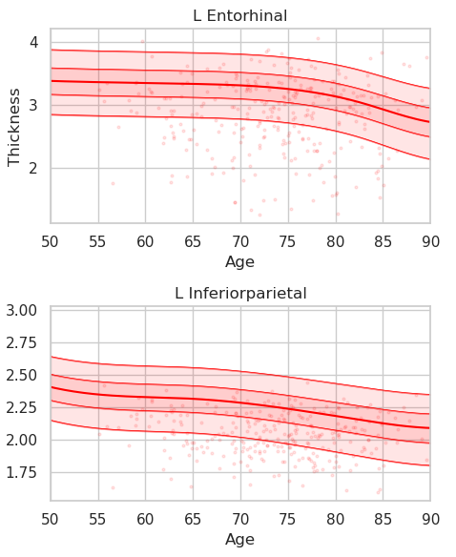
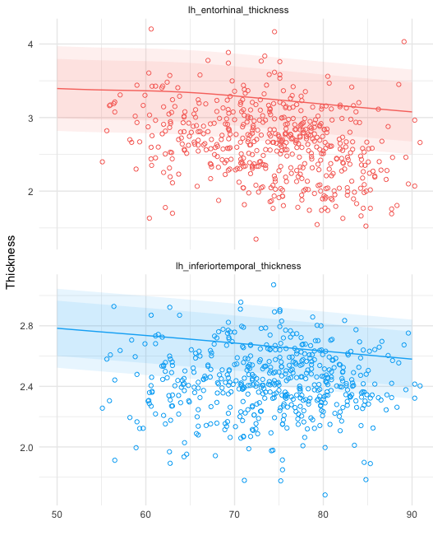
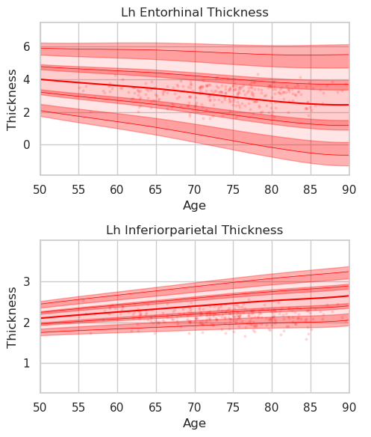
Quantitative
Not-Pretrained
Pretrained
GAM
GAMLSS

Slide 18
Main Take-Aways
Diverse Approaches:
Various methods exist for modelling the Normative Growth Curve.
Statistical/Bayesian Methods:
Essential for individual analysis of predicted norm values.
Purpose-Driven Approach:
Optimal method depends on specific goals.
Performance Disparity:
Significant gap between quantitative and qualitative performance.

Slide 19
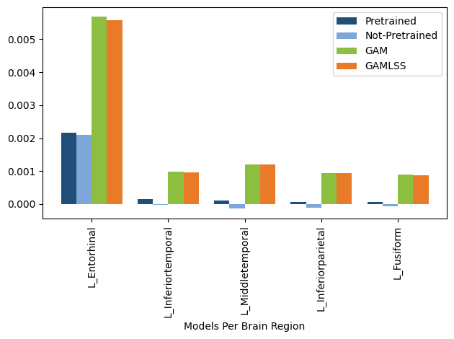
MSE Differences Healthy – All Data

Slide 20
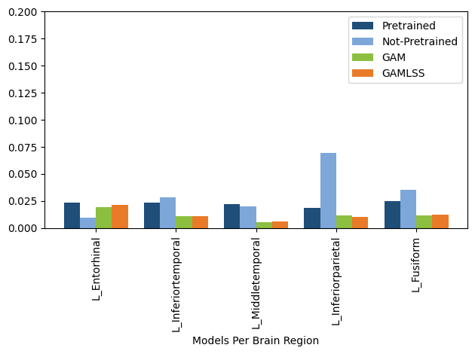
EV Differences Healthy – All Data

