Slide 1

Test Task
Beer Style Classification
Preprocessing
Searching for relations
Building models

Slide 2

Preprocessing
Read data with
pandas
01
Delete insignificant columns
03
Modify type of columns
04
Remove specific chars from column name
05
Fill empty cells with the median of its style type
06
Normalize data
07
Shuffle data
08
Replace Name with the most frequent word
02

Slide 3

Preprocess Name column
Lowercase the words to reduce different types
Make a frequency dictionary
Remove words that are frequent, but doesn’t correlate with Style
Make an unknown category for words that aren’t frequent
Replace names with the most frequent word in it, if there aren’t any, then replace with unknown

Slide 4
Searching for relations
Correlation matrix was checked
Data was grouped by SugarScale to check means
Data was grouped by BrewMethod to check means
Data was grouped by SugarScale and BrewMethod to check the quantity and mean of categories
The distribution of StyleID was checked

Slide 5

Significant correlations
The bigger the correlation absolute value the stronger the relation is
BoilGravity – FG : 0.879
OG – FG : 0.905
BoilGravity – OG : 0.969
Size – BoilSize : 0.994

Slide 6
Understand correlations
BoilGravity – FG : The more amount we have before the process the more we have at the end
OG-FG : The more amount we have before the process the more we have at the end
BoilGravity – OG : describes the same thing before different processes
Size-BoilSize: Bigger amount of brew means bigger amount of fluid

Slide 7
Results
Where the Sugarscale’s type is Plato the size is 6x, the OG 14x, the FG 3.5x, the BoilSize 6x, the BoilGravity 12x bigger than where the type is Specific Gravity
Where the BrewMethod’s type is extract, the efficiency is low
Where the BrewMethod’s type is All Grain, the size and boilSize is 3x bigger than other types
We have data mostly from Specific Gravity SugarScale type and All Grain BrewMethod
The types of Style is not equally distributed which might cause problem when training models

Slide 8

Building Models
Multiple algorithms was used to find the optimal one
  Support Vector Machine
  Decision Tree
  K Nearest Neighbors
  Deep Neural Network

Slide 9
SVM
Training takes a lot of time
Doesn’t scale well with large datasets
Accuracy was about 25%

Slide 10
Decision Tree
Training is fast
Sensitive to noisy data
Accuracy was about 41%

Slide 11
KNN
Training takes the least time
Doesn’t scale well with large dimensional datasets
Accuracy reached 41% with Name column

Slide 12
Neural Network
Split the data into test and train
Create feature columns
Separate the target column
Make it categorical

Slide 13
Building a Model
Small network was used, 3 dense layers, the last layer used softmax activation
Create feature columns
Separate the target column
Make it categorical

Slide 14
Compile & Fit model
CategoricalCrossentropy was used as lost function
Adam was used as optimizer
The training lasted for 50 epochs and tested at the end of each epoch
Callback was used to stop training after accuracy stopped improving

Slide 15
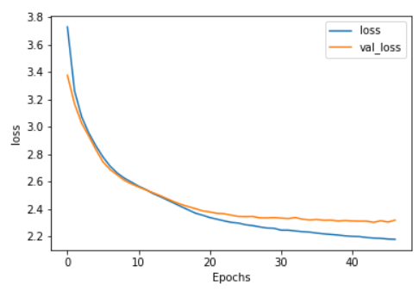
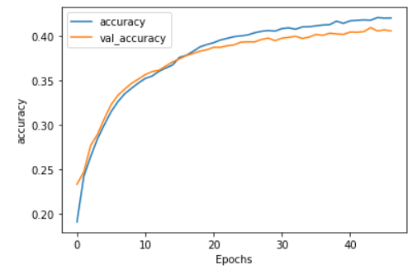
Results without Name column

Slide 16
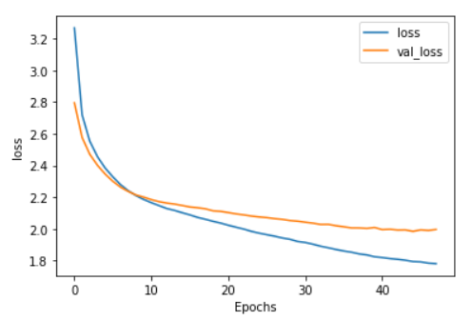
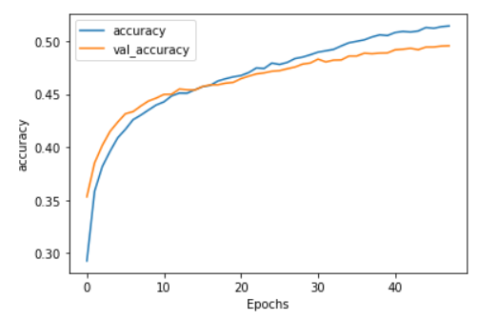
Results with Name column

Slide 17
Comparison
Algorithm | Without Name Column | With Name Column
SVM | 25% | N/A
DT | 33% | 41%
KNN | 33% | 41%
DNN | 42% | 50%
SVM performed the worst with the slowest training, accuracy was 25% and couldn’t work with Name column
DT and KNN performed better, accuracy was 41%
Neural network scales well with large datasets, accuracy reached 50%

Slide 18

How to make it even better
Gather more data
Balance the quantity of style categories

Slide 19


Thanks for your attention!
Gergely Ákos
+36304114256
geakos01@hotmail.hu

