Slide 1


Test Task
Text Classification
Neural network
Webscraping
Neural network with webscraping
SVC

Slide 2



Neural network

Slide 3

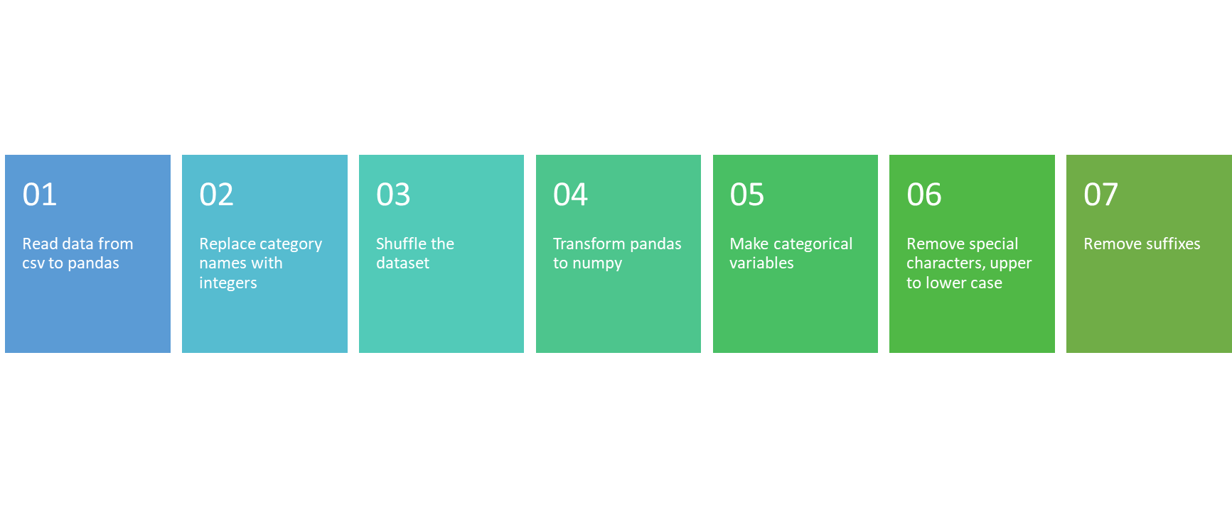
Preprocessing

Slide 4

Statistics

Slide 5
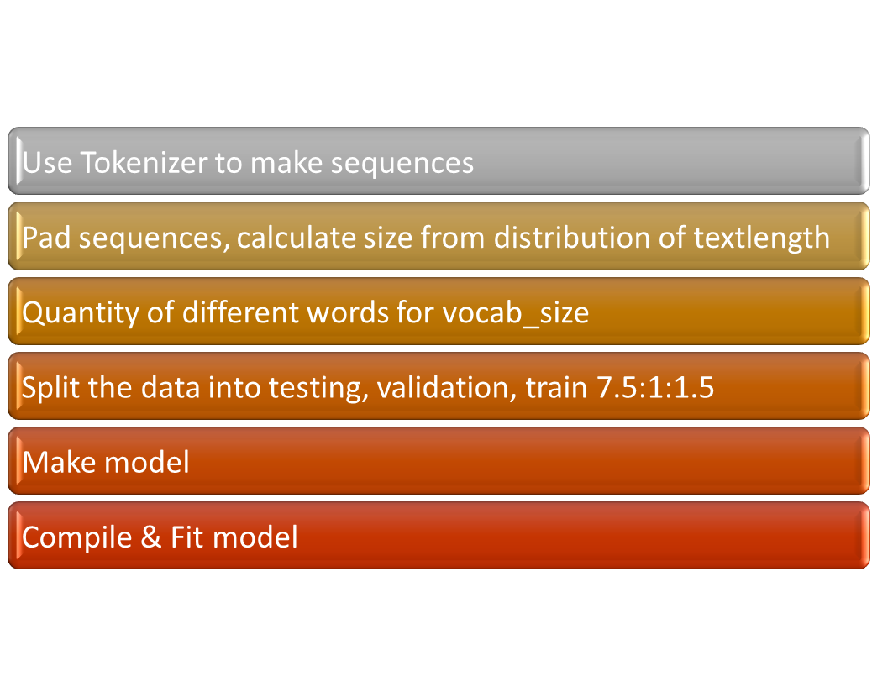





Computing

Slide 6

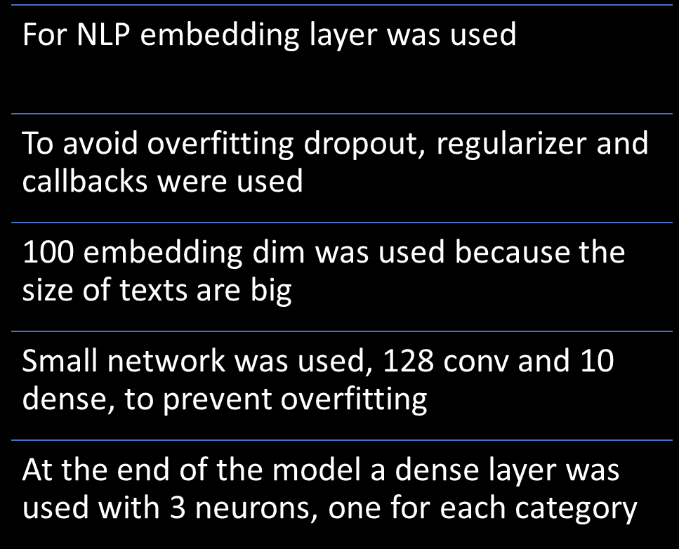
Making a model

Slide 7

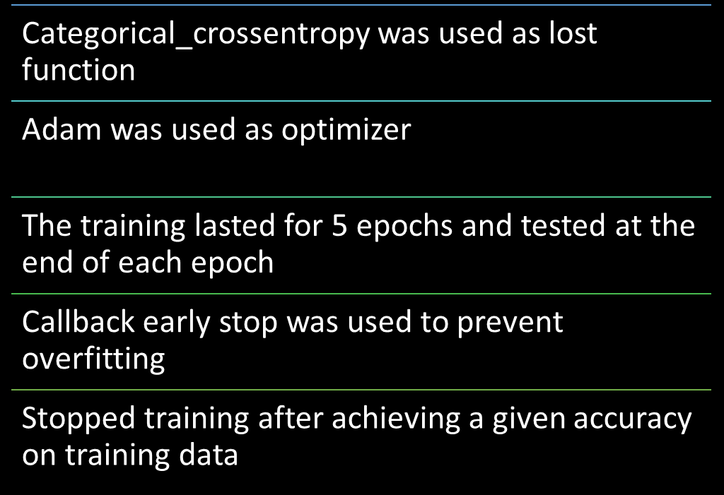
Compile & Fit model

Slide 8

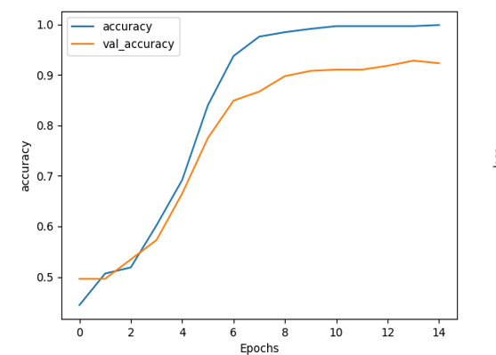
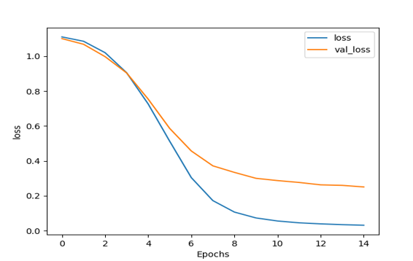




Results
Mathplotlib was used to visualize results
Accuracy on validation data achieved 92.33%

Slide 9


Webscraping

Slide 10
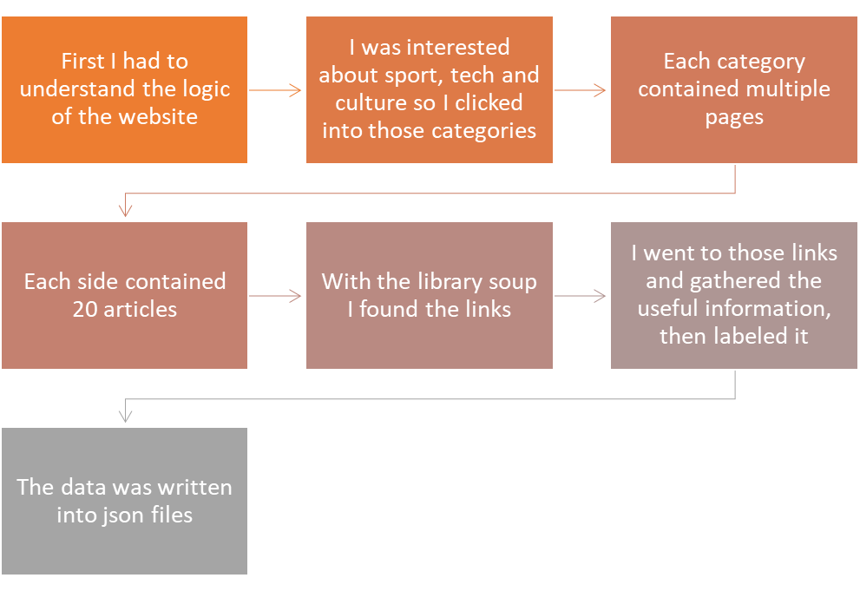
Process

Slide 11
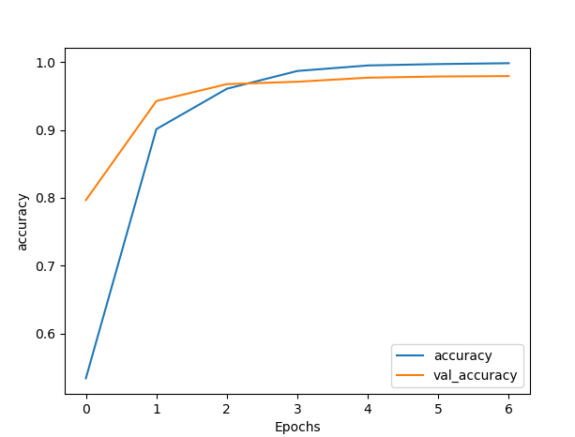
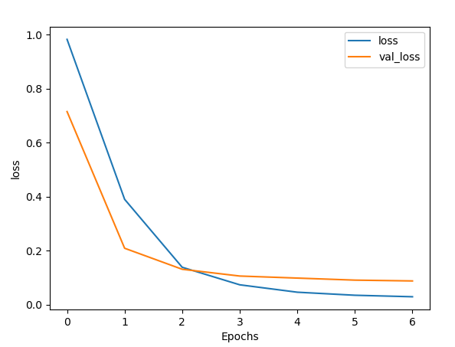
Neural network with webscraping
The given data and the webscraped data was merged
The validation accuracy achieved 97.93%

Slide 12

Suspeciously good results

Slide 13

Checking the confusion matrix
Culture data was way less than sport and tech
Use weights
Gather more culture
Use less sport and tech

Slide 14
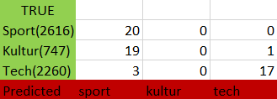
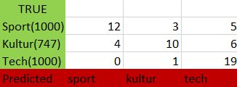
Cutting the dataset
As the sport and kultur size decreases the model performs better on kultur
The ideal split should be found where the model doesn’t overfit on the big categories but uses as much data as it can
As we can see, it performs a little bit better
→ We need more kultur data

Slide 15

SVC

Slide 16
DNN with webscraping performs the best!
Without Webscraping | Validation | Testing | Testing from HVG
SVC | 0.62 | 0.62 | 0.57
DNN | 0.81 | 0.79 | 0.37
With Webscraping | Validation | Testing | Testing from HVG
SVC | 0.56 | 0.56 | 0.42
DNN | 0.92 | 0.91 | 0.77

Slide 17
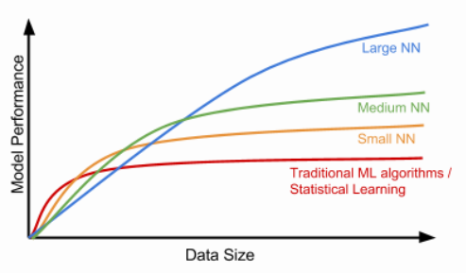
Conclusion
SVC makes better results with small dataset
As the dataset grows, the neural network becomes more accurate

Slide 18

How to make it even better
Gather more data, especially kultur category
Filter text functions shouldn’t be used if the dataset is huge enough because it loses information
Build a better filter text function specialized in Hungarian grammar
Build bigger neural network
Use pretrained embedding layer like https://fasttext.cc/docs/en/pretrained-vectors.html

Slide 19


Thanks for your attention!

