Slide 1

Text Classification
#SVM
Neural network
Webscraping
Neural network with netscraping

Slide 2


Neural network
Preprocessing
Statistics
Computing
Results

Slide 3

Preprocessing
Read data from csv to pandas
01
Replace category names with integers
02
Shuffle the dataset
03
Transform pandas to numpy
04
Make categorical variables from topic
05
Remove special characters
06
Remove suffixes
07

Slide 4
Statistics
Get some statistical data from the dataset
Length of text distribution
Categorical distribution
Quantity of different words

Slide 5
Computing
Use Tokenizer to make sequences
Pad sequences, calculate size from distribution of textlength
Quantity of different words for vocab_size
Split the data into testing and training 7:3
Make model
Compile & Fit model

Slide 6

Making a model
For NLP embedding layer was used
To avoid overfitting dropout, regularizer and callbacks were used
50 embedding dim was used because the size of texts are big
Small network was used, 16 conv and 16 dense, to prevent overfitting
At the end of the model a dense layer was used with 3 neurons, one for each category

Slide 7

Compile & Fit model
Categorical_crossentropy was used as lost function
Adam was used as optimizer
The training lasted for 15 epochs and tested at the end of each epoch
Callback was used to prevent overfitting
Stopped training after achieving a given accuracy on training data

Slide 8
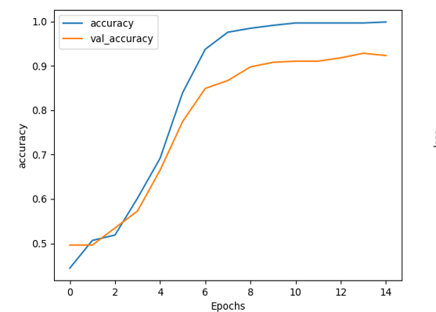
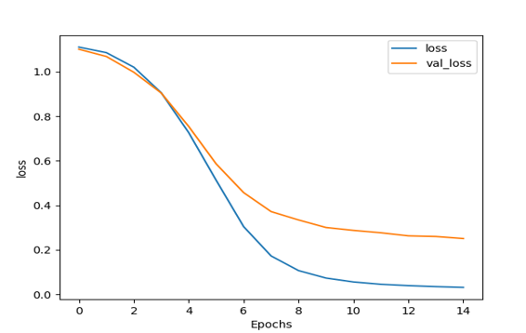
Results
Mathplotlib was used to visualize results
Accuracy on test data achieved 92.33%

Slide 9

Webscraping
The more data a neural network has, the better it performs
So I made a script that downloaded the articles from HVG.hu

Slide 10
Process
First I had to understand the logic of the website
I was interested about sport, tech and culture so I clicked into those categories
Each category contained multiple pages
Each side contained 20 articles
With the library soup I found the links
I went to those links and gathered the useful information, then labeled it
The data was written into json files

Slide 11
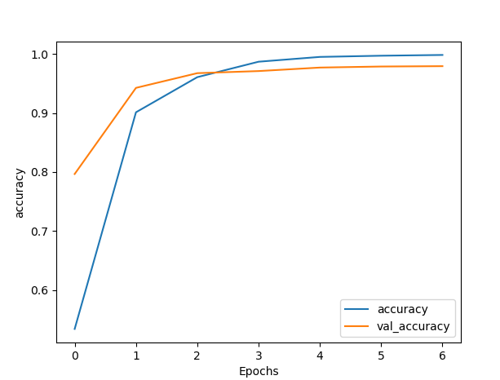
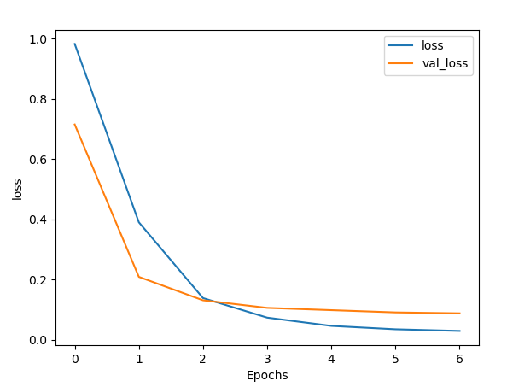
Neural network with webscraping
The given data and the webscraped data was merged
The validation accuracy achieved 97.93%

Slide 12

How to make it even better
Gather more data
Filter_text functions shouldn’t be used if the dataset is huge enough because it loses information
Build bigger neural network

