Slide 1

Exit Tickets as a method for feedback that is fast, frequent, inclusive, and acctionable
Brooke Anderson

Slide 2
Exit Tickets are formative assessment tools given at the end of class that aim to provide feedback that is:
Fast: Students can complete an Exit Ticket in a couple of minutes.
1
Frequent: Students complete Exit Tickets regularly throughout the semester.
2
Inclusive: All students provide feedback through Exit Tickets.
3
Actionable: Exit Ticket questions focus on things that can be quickly changed or addressed to improve the class.
4

Slide 3
ERHS 535: R Programming for Research
3 credit, full-semester course
Teaches students how to use the R programming language for data management, visualization, and analysis
Geared to first-year graduate students (but often includes more advanced students or postdocs)
Many students have never programmed before
“Flipped classroom”—all lectures are through videos the students watch before class, class time is used to work through coding exercises in small groups
Delivery:
Pre-pandemic: Completely in-person
2020: Completely online
2021: Mixture, with most students in-person only, a few online only, and some shifting from class to class

Slide 4
Exit Tickets are formative assessment tools given at the end of class that aim to provide feedback that is:
Fast: Each Exit Ticket includes four short questions through a Google form (link is provided in an email).
1
Frequent: Students complete Exit Tickets once a week throughout the semester.
2
Inclusive: Students are required to complete Exit Tickets as part of their participation grade (replaces taking attendance).
3
Actionable: Exit Ticket questions focus what the students have learned, what they aren’t understanding, and how the course could be more effective.
4

Slide 5
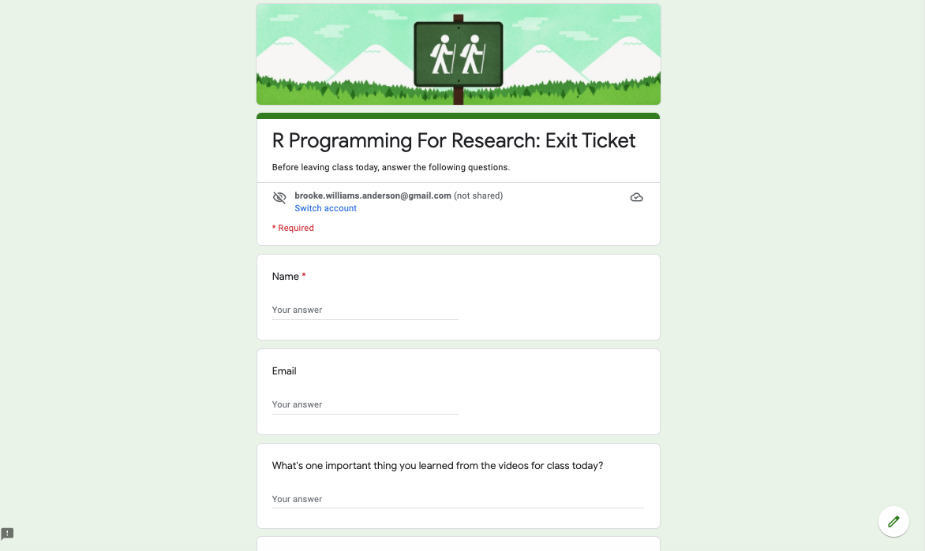

Slide 6
Exit Tickets for ERHS 535 include four questions:
What's one important thing you learned from the videos for class today?
Did you feel prepared for today's coding exercises? Why or why not?
What would help make today's videos or coding exercise more effective?
What is one thing about R that you are currently finding confusing? (This can be a specific function or a more general concept/process.)

Slide 7
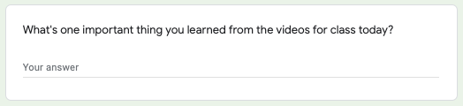
“Making really great plots!” / “I learned how to make plots with greater detail and complexity.”
“some cool ways to edit my plots using themes” / “geom themes were new to me!”
“I liked learning about using the color palettes and the scale functions.” / “using the scale_x_continous and similar functions” / “Scales in ggplot”
“Making order meaningful” / “More ways to make plots informational and easy to understand” / “I learned about how to use small multiples to visualize data, breaking a plot into multiple smaller plots based on a variable rather than just coloring things different colors.”
“N/a, still behind.” / “I did not watch the videos and will catch up on them later today.”

Slide 8
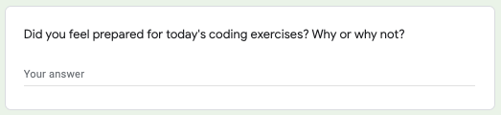
“Yes, I was able to troubleshoot some problems. I like the format of the class and the in-class exercises.” / “I felt fairly prepared because it was building on prior knowledge”
“Yes, mostly! The plotting is getting much easier but I need more practice with some other things like changing the factor levels and using geom_text.” / “Yes, I felt like we had learned all the things needed—I didn't have everything memorized, but I just had to look back sometimes to refresh how to do something.” / “Yes just struggle working through some error messages but felt like the videos prepared me well.” / “I felt prepared, just a little unsure because this is new to me”
“no because my work from last week somehow didn't save so I can't review what I did previously” / “I didn't complete the data cleaning last class so it took some extra time to set up”

Slide 9
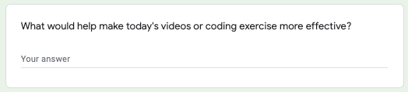
“N/a, it's great.” / “Not sure” / “All good” / “Nothing that I can think of.” / “n/a, good!” / “No feedback here.” / “Nothing, it was great!” / “I can't think of anything specific, they were great!”
“If I practiced more coding on my own it would make things easier” / “Keep practicing”
“just some more time but I usually work on this at home later” / “no complaints just wish we had more time” / “having to figure out more things on my own” / “maybe if we did the entire exercise as a class”
“More details on the specific scale functions, or just a cheatsheet for that.” / “I would like to see more examples of what R is capable of with mapping. I am only familiar with ESRI products and would like to use more of the open source R option if possible.”
“The coding exercise started a little bumpy with the csv not loading into R, but that got fixed.” / “It's sometimes hard to split screen to reference the textbook while coding. My group found it helpful to paste notes in the zoom chat to reference to the shared R Studio screen”

Slide 10
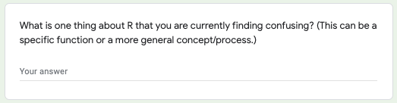
“Nothing I can think of off the top of my head.” / “Nothing really—I think I'm doing okay.” / “Nothing on this lesson!”
“Sometimes I want to pipe things and get confused on the syntax.” / “Correctly ordering the code and functions as the code gets longer. Especially with piping.” / “still a little confused about when to move ggplot() arguments to lower arguments like geom_plot()” / “I am having trouble remembering all the necessary parts of a big ggplot”
“Geom_text!” / “Some things related to how to code faceting within a ggplot is still confusing to me.” / “For this exercise, how do you change the color of the data points? We've changed color for all of the datapoint, but not when they are true/false, or you need multiple colors.”
“I just feel like my grasp isn't that good yet, but I'm getting there.”

Slide 11
Ideally, Exit Tickets can lead to actions to make the class better:
See if students are struggling—maybe we need to review or move more slowly through new material
See if specific students are behind—get in touch to address specific issues
See if there are questions multiple students have—go over and answer these in class for all students
See if there are problems with the format or content of the course material—improve this content to make it more accessible and convenient for the students

Slide 12
Example feedback:
“when we were reading in the counties, one of the code lines was "cb = TRUE", what does that mean?”: When you “read in” the counties with this command, you’re actually downloading files from the US census that have the locations of the boundaries of each county, so R can use that information to draw the map (you can think of this kind of like dot-to-dot—points all around the county boundary that are connected to draw the boundary). You can get these files at different resolutions. Higher resolutions will have more points for the county boundary, so it will draw it with more detail, but the file will also be very large. Since we’re doing things at the state level, we are getting a lot of files (one per county), but don’t need them to be very high-resolution. The `cb` option lets us ask for the smaller, lower resolution version of the files.

Slide 13
Example feedback:
“I need to clarify my understanding of using different join functions” / “still learning the join functions and why to use left, right, and full join” / “I'm a bit confused about fips and how that needs to be used when creating these graph parameters.”: It’s definitely worth reviewing the join functions at this point! If you’d like to review in the coursebook/videos, this is covered in Chapter 6, section 2: https://geanders.github.io/RProgrammingForResearch/entering-and-cleaning-data-2.html#joining-datasets. There’s also a chapter on this in R for Data Science: https://r4ds.had.co.nz/relational-data.html.
“I would like to see more examples of what R is capable of with mapping. I am only familiar with ESRI products and would like to use more of the open source R option if possible.” : There are some great resources for this! The best I think is this online book: https://geocompr.robinlovelace.net/. There’s also a series of blog posts that are very interesting starting here: https://r-spatial.org/r/2018/10/25/ggplot2-sf.html

