Slide 1
Prompts for in-course discussion

Slide 2
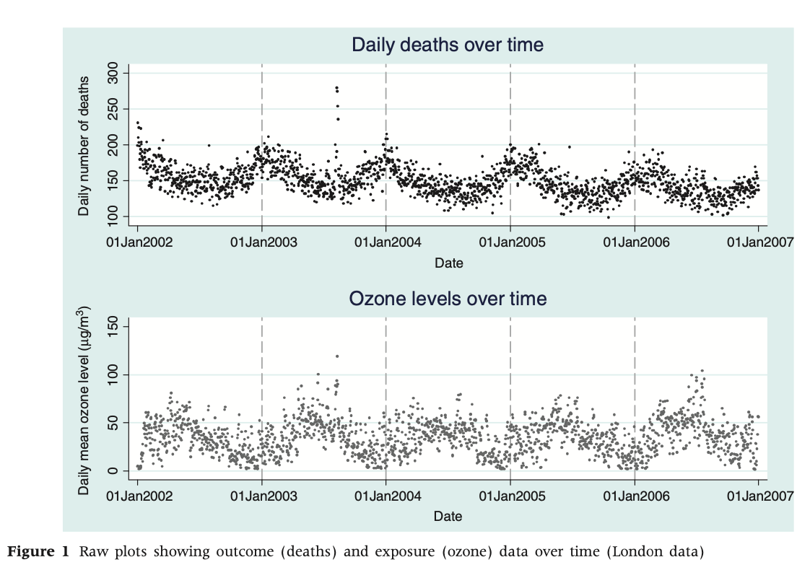
Look at the example data from Chicago in the lecture slides (slide 22) and from Figures 1 and 2 of the Bhaskaran 2012 paper. Describe any trends that you see by time. Are there seasonal patterns? Does each seasonal pattern look identical (i.e., does a winter peak in one year look identical to that in other years)? Are there any unusual (including “spiky”) short-term patterns over time?
Source: Bhaskaran et al. 2012

Slide 3
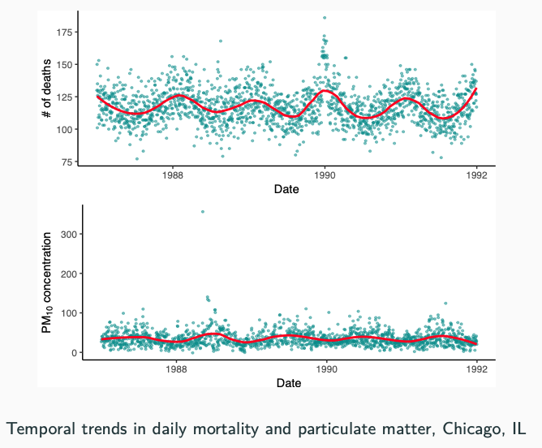
Look at the example data from Chicago in the lecture slides (slide 22) and from Figures 1 and 2 of the Bhaskaran 2012 paper. Describe any trends that you see by time. Are there seasonal patterns? Does each seasonal pattern look identical (i.e., does a winter peak in one year look identical to that in other years)? Are there any unusual (including “spiky”) short-term patterns over time?

Slide 4
Why is it important to control for any of these longer-term and seasonal patterns when looking at short-term associations between air pollution (or temperature) and mortality risk?
Develop a scenario where these longer-term and seasonal patterns, if not well-controlled, could confound the association you want to estimate.
Source: Bhaskaran et al. 2012

Slide 5
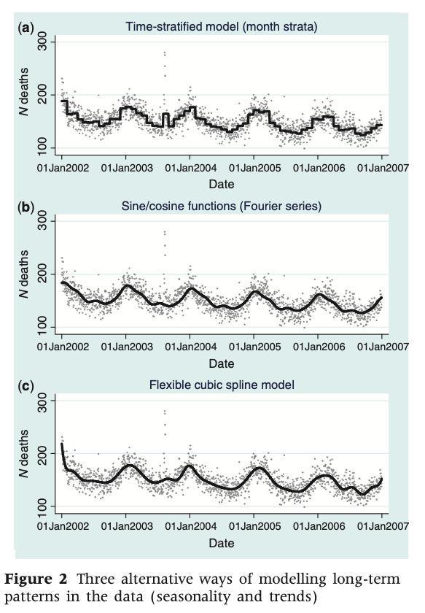
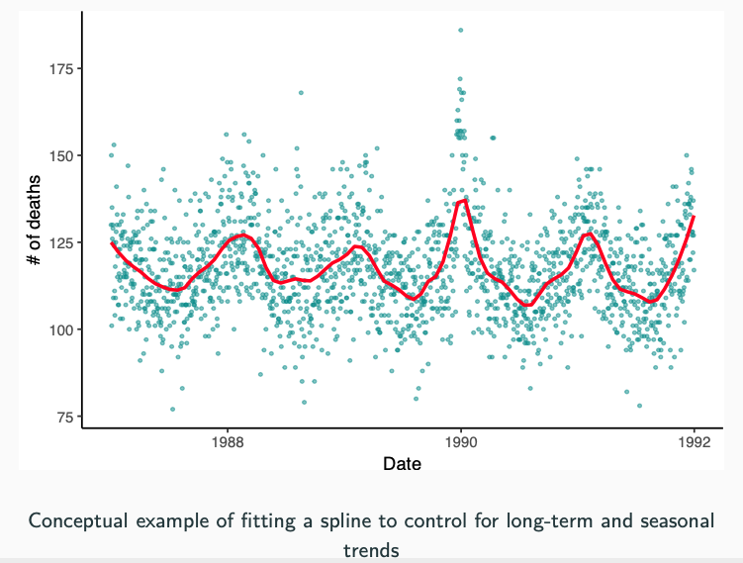
In the Bhaskaran 2012 paper, three options are listed for controlling seasonality and long-term trends. Which of these is being used in the example in slide 26 of the lecture?
Source: Bhaskaran et al. 2012

Slide 6
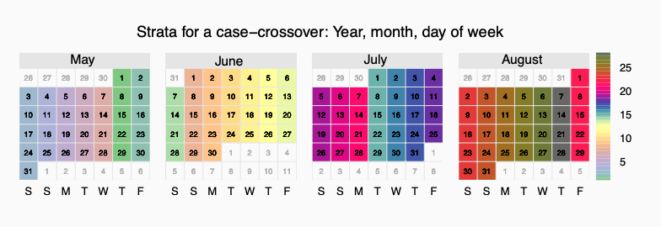
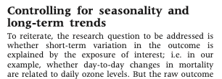
What are pluses and minuses of this method of control, compared to the time-stratified case-crossover option shown later in the slides?
Source: Bhaskaran et al. 2012
Source: Bhaskaran et al. 2012

