Slide 1

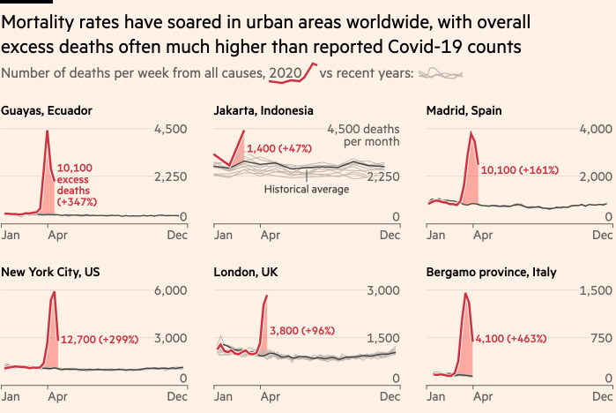
A fluid spectrum of epidemiological analyses Brooke Anderson, Colorado State University
Back of the envelope estimate
Blog post
Data journalism
Preprint article
Peer-reviewed article
Meta-analysis, systematic review
Consensus assessment
Faster to conduct, more uncertain estimate,
no review
Slower to conduct, better estimate, rigorous review

