Slide 1
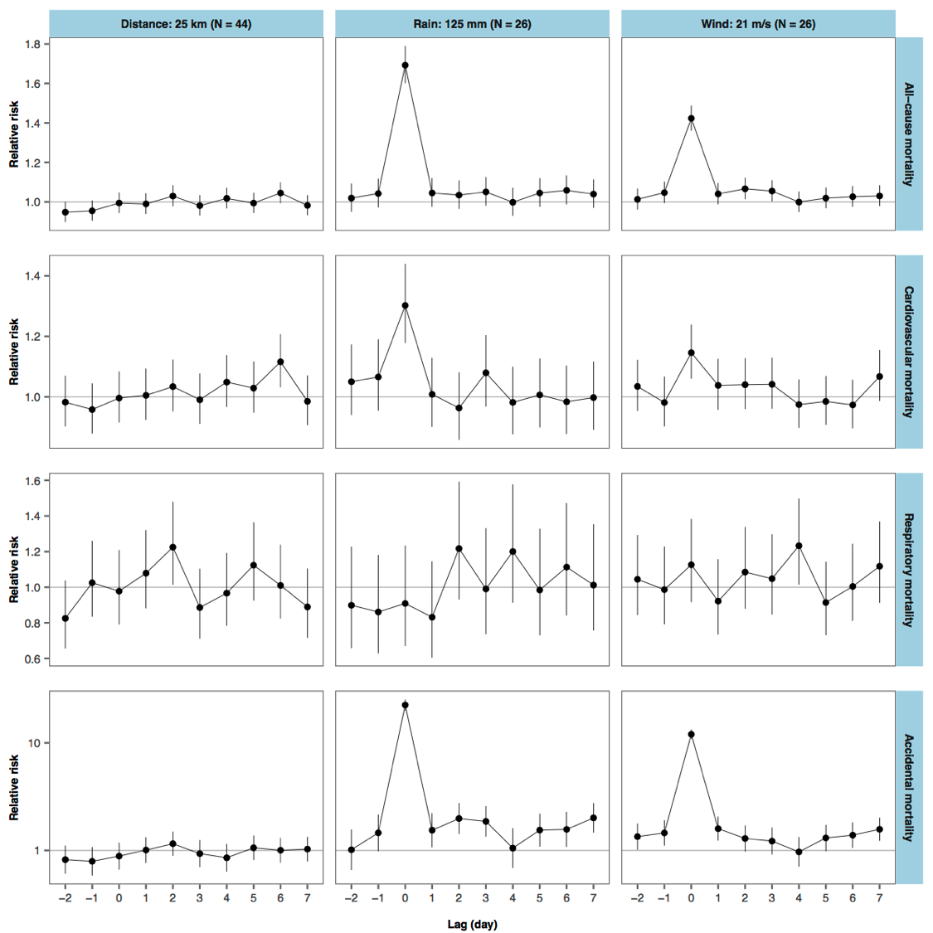
Exposure determined by distance
(<25 km to storm track)
Exposure determined by rainfall
(> 125 mm over 3-day window)
Exposure determined by wind
(> 21 m / s max. sustained winds)
10
Relative risk of
accidental mortality
1
-2 -1 0 1 2 3 4 5 6 7 -2 -1 0 1 2 3 4 5 6 7 -2 -1 0 1 2 3 4 5 6 7
Lag day since storm’s closest approach
(lag 0 = day storm was closest to community)

Slide 2
Exposure determined by wind
(> 21 m / s max. sustained winds)
1.6
1.4
Relative risk of
all-cause mortality
1.2
1.0
-2 -1 0 1 2 3 4 5 6 7
Lag day since storm’s closest approach
(lag 0 = day storm was closest to community)

Slide 4
 | Exposure to forces of nature: ICD-10 X30—X39
X30 | Exposure to excessive natural heat
X31 | Exposure to excessive natural code
X32 | Exposure to sunlight
X34 | Earthquake
X35 | Volcanic eruption
X36 | Avalanche, landslide, and other earth movements
X37 | Cataclysmic storm
X38 | Flood
X39 | Exposure to other forces of nature

Slide 6
