Slide 1
For your midterm report, please include all the code in an Appendix to the report (outside of the page limit for the main report).
You can use `purl` from `knitr` to extract an R code script with all the script in an Rmarkdown files: https://bookdown.org/yihui/rmarkdown-cookbook/purl.html
There are some ways to add an Appendix with all your code using Rmarkdown:
https://yihui.org/en/2018/09/code-appendix/

Slide 2
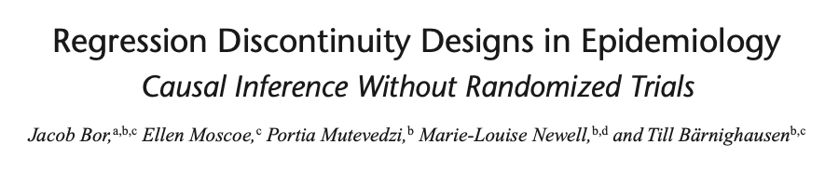
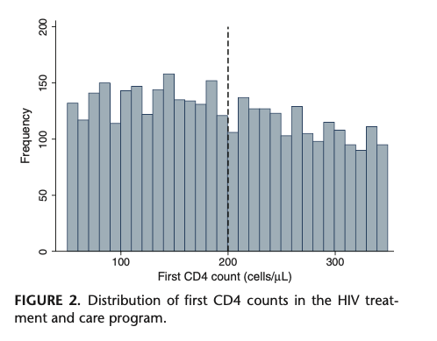
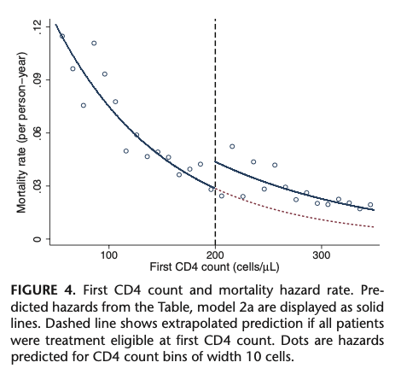

Slide 3

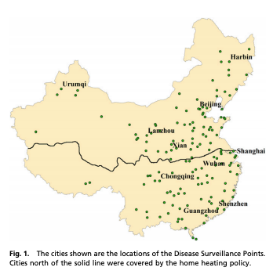
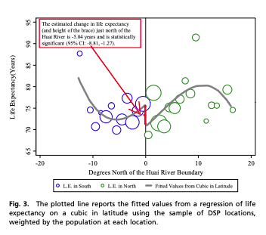

Slide 4
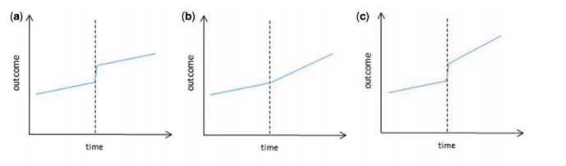
T₀
T₀
T₀
X_{t}=0
X_{t}=1
X_{t}=0
X_{t}=1
X_{t}=0
X_{t}=1
Y_{t}
Y_{t}
Y_{t}
T
T
T
Y_{t} = β₀ + β₁T + β₂X_{t}
Y_{t} = β₀ + β₁T + β₃(T-T₀)X_{t}
Y_{t} = β₀ + β₁T + β₂X_{t} + β₃(T-T₀)X_{t}
Note: A correction for the equations in the original article is available at: http://www.ag-myresearch.com/uploads/1/3/8/6/13864925/2017_lopezbernal_ije_correction.pdf

