Slide 1
ERHS 732
Week 1 Introduction

Slide 2

Air pollution and human health

Slide 3
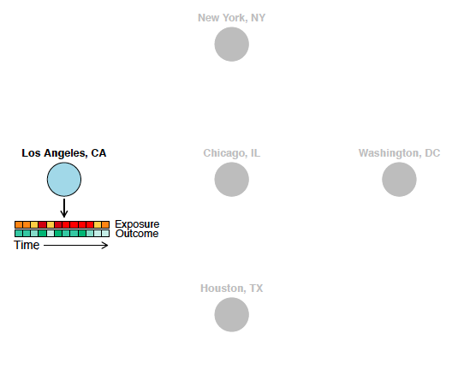
Air pollution and human health
To study how air pollution affects human health, one approach is to use time series studies.
These investigate how rates of a health outcome change from day-to-day in a city in association with changing patterns of exposure to something like ambient air pollution or outdoor temperature.
These often leverage secondary data, including insurance claims data, vital statistics, and monitoring data.

Slide 4
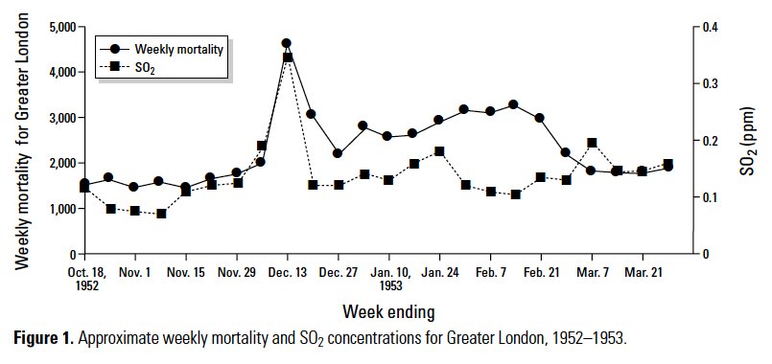
Air pollution and human health
With a very severe event, like the London Fog, the association may be obvious directly from the data.
In many cases, there are many other factors that either confound the relationship or add noise.
We will often need to build statistical models to help address other factors that may explain some of the observed variation in either the exposure or the outcome of interest.

Slide 5

Controlled experiment
In a controlled experiment, the researcher controls as many factors as possible, to allow the clearest picture of the effect of some factor of interest on an outcome of interest (for example, the effect of a drug on disease status).
In a laboratory setting, this can include controlling for the strain and age of each experimental animal and their environment and conditions during the experiment. It also includes using random assignment to help control for factors you may not have thought of.
This level of control helps to determine the effect of the one factor that is different between experimental groups (for example, the effect of the drug, if you have treated and control groups).

Slide 6
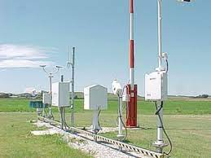
Observational study
An observational study can often allow a researcher to leverage massive relevant datasets, using data that were already collected through monitoring programs, vital statistics, or other records.
Further, an observational study often studies an association “in the wild”, rather than under controlled or otherwise unusual conditions, which can provide it with good external validity.

Slide 7
Observational study
Season of the year
However, an observational study typically cannot provide the same kind of control or randomized assignment that a controlled experiment can.
When conducting an observational study, you must think carefully about factors that could act as potential confounders, which are association with variation in both the exposure and the outcome, or as extraneous factors, which explain some of the variation in the outcome but are not associated with the exposure.
You may be able to build statistical models that will allow you to account for these factors and therefore gain knowledge from the data, even if it was not collected in a controlled setting.
Temperature
Mortality
Day of the week

Slide 8
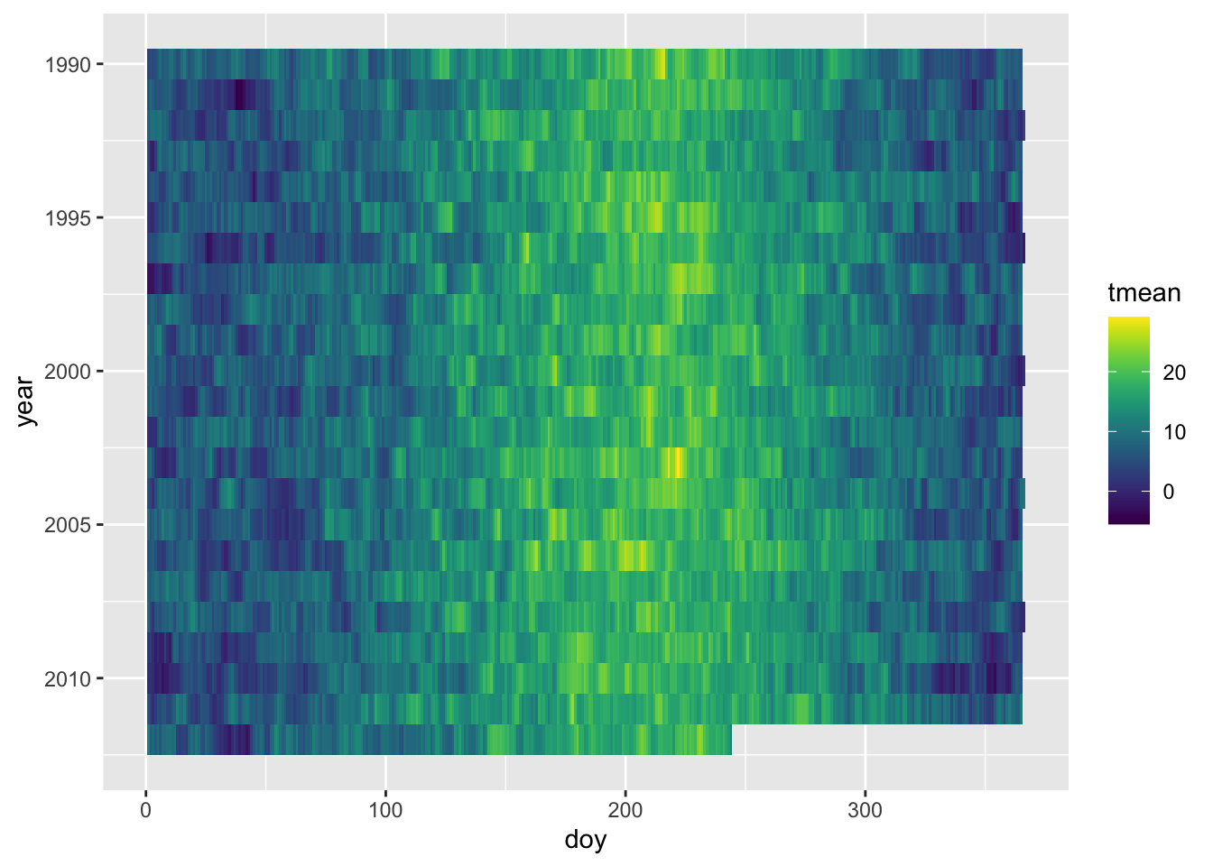
Exploratory data analysis
When you are working with secondary data for an observational study, it is critical to perform a lot of exploratory data analysis to make sure you understand major patterns of variation in the exposure and outcome of interest.
This exploratory data analysis can help you develop a framework for building a statistical model. It can help you determine which factors might be confounding or contributing noise as you model the relationship between the exposure and outcome.

