Slide 1
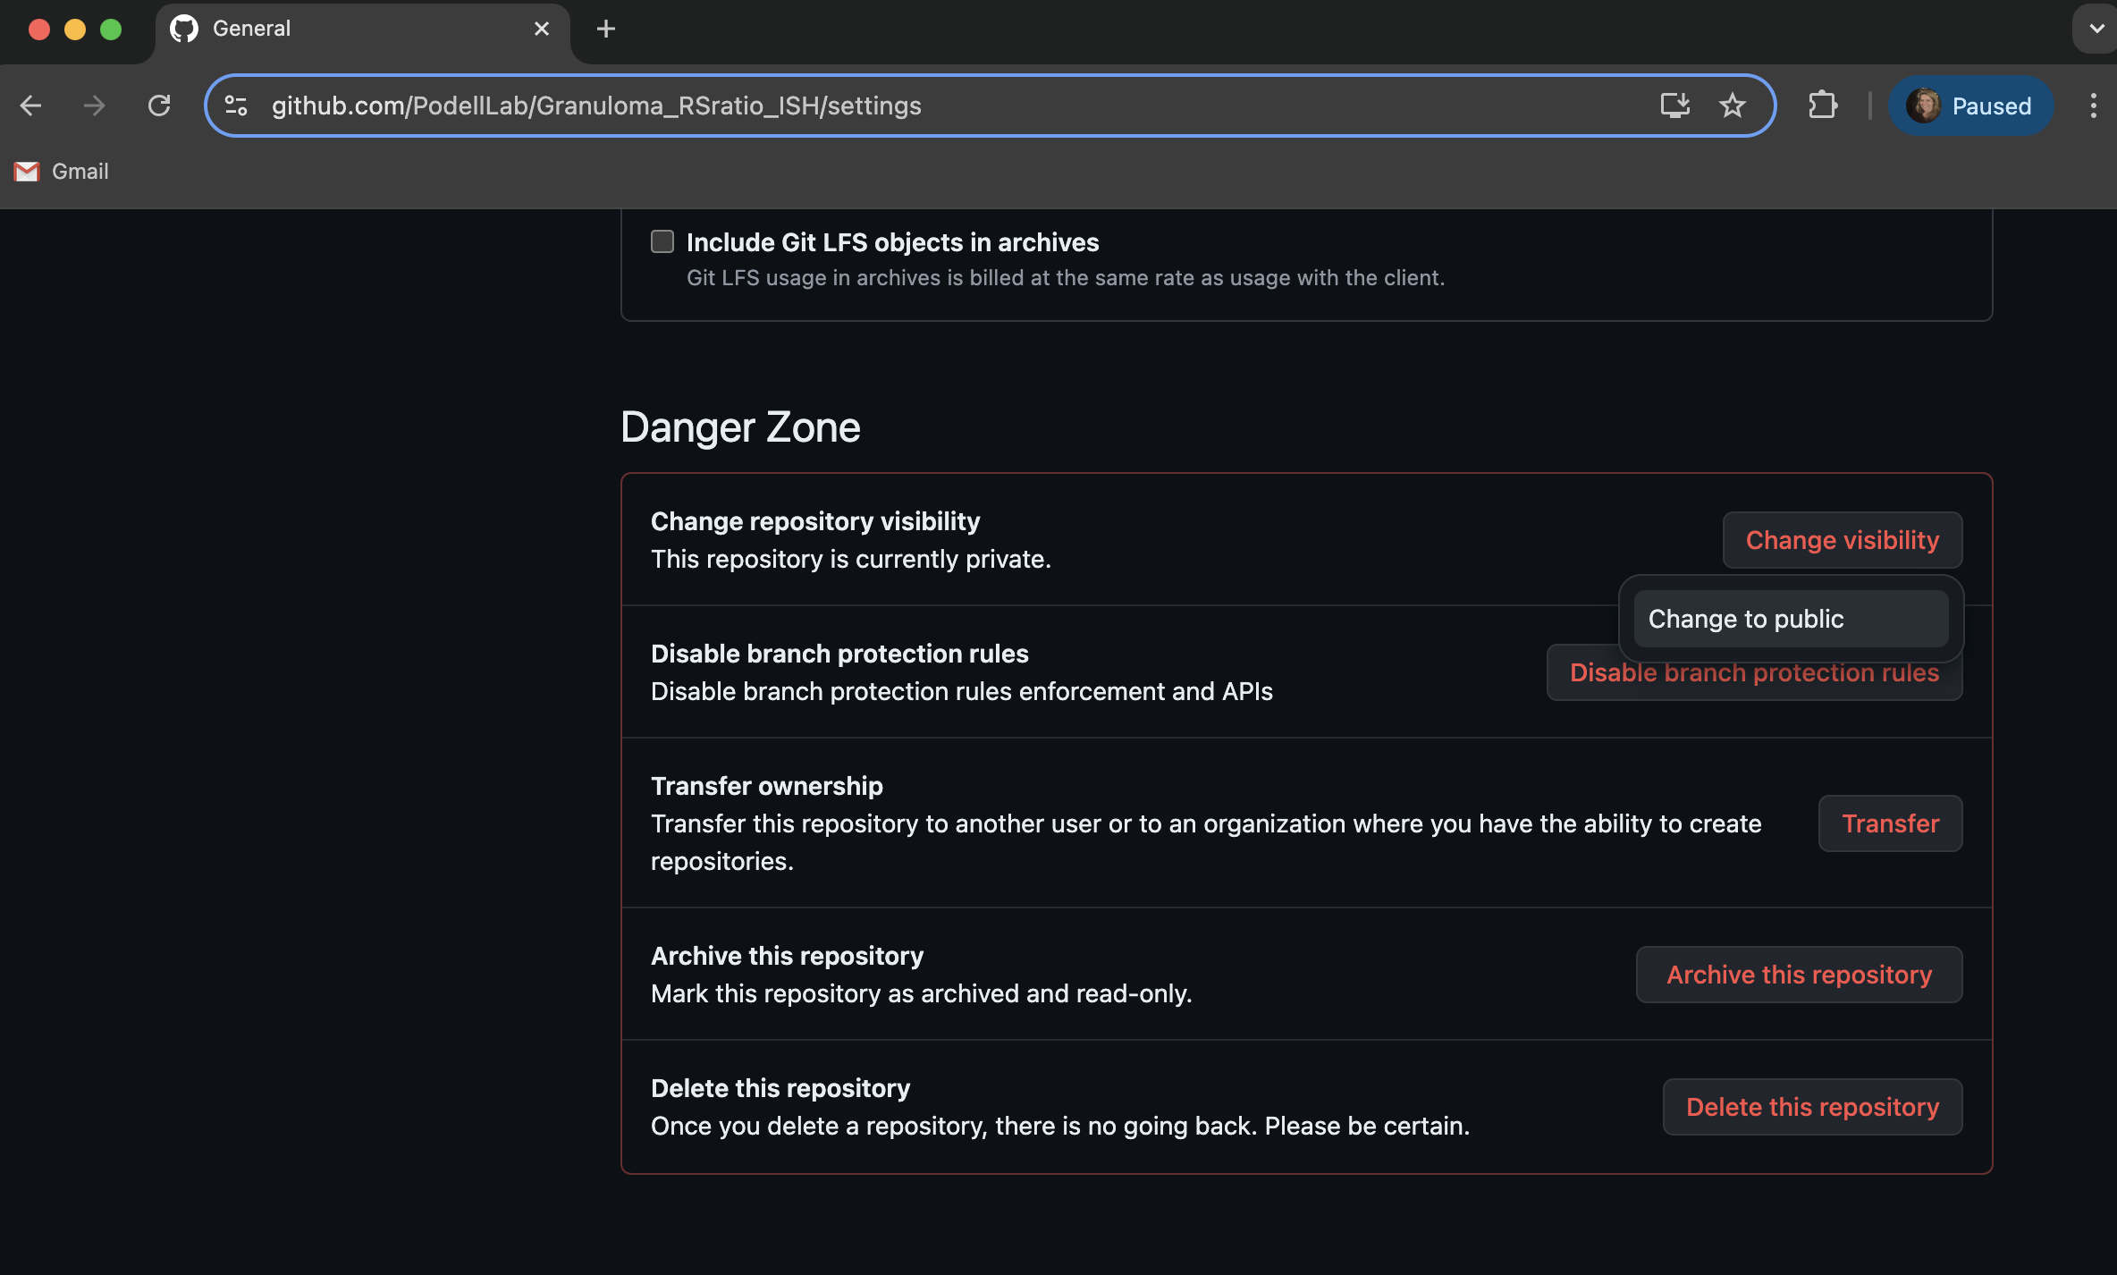

Slide 2
If you scroll down on the “Settings” page of a GitHub repository, you’ll find a section called “Danger Zone”. This section is where you can take actions like changing the repository from private to public, transferring the ownership of the repository, or deleting the repository.
To change a repository from private to public, find the section that’s labeled “Change repository visibility”. Click on “Change visibility”. This will bring up an option to “Change to public”.

Slide 3
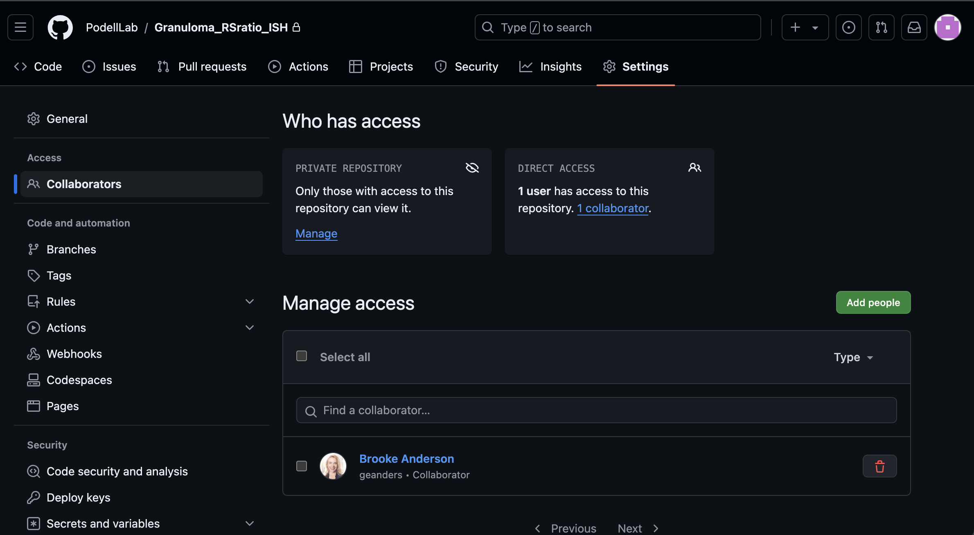
If you have ”owner” rights in a repository, you’ll be able to access a “Settings” page for the repository. You can use this section to do things like add collaborators to the project and change the visibility of the repository from public to private.
To add new collaborators, you can go to the “Collaborators” section of the “Settings” page for the repository.
In this section, you can use the “Add people” button to add new collaborators. You’ll be able to look them up by their GitHub handle or the email address they used for their GitHub account.
You can also manage the collaborators for the repository. For example, you could remove a current collaborator by finding their listing and clicking on the trash can icon.

