Slide 1




Infection Net
TOKYO INSTITUTE OF TECHNOLOGY
COMPUTER SCIENCE DEPARTMENT
An augmented reality game
with Koike laboratory
Naveed Afzal
Fumito Nishi
Hoang Nguyen
Group 1:
Tokyo, 2016-02-10

Slide 2
CONTENT
Demo of our prototype.
Project overview & Subprojects assignment.
Design details of each subproject.
Implementation of the prototype.
1

Slide 3
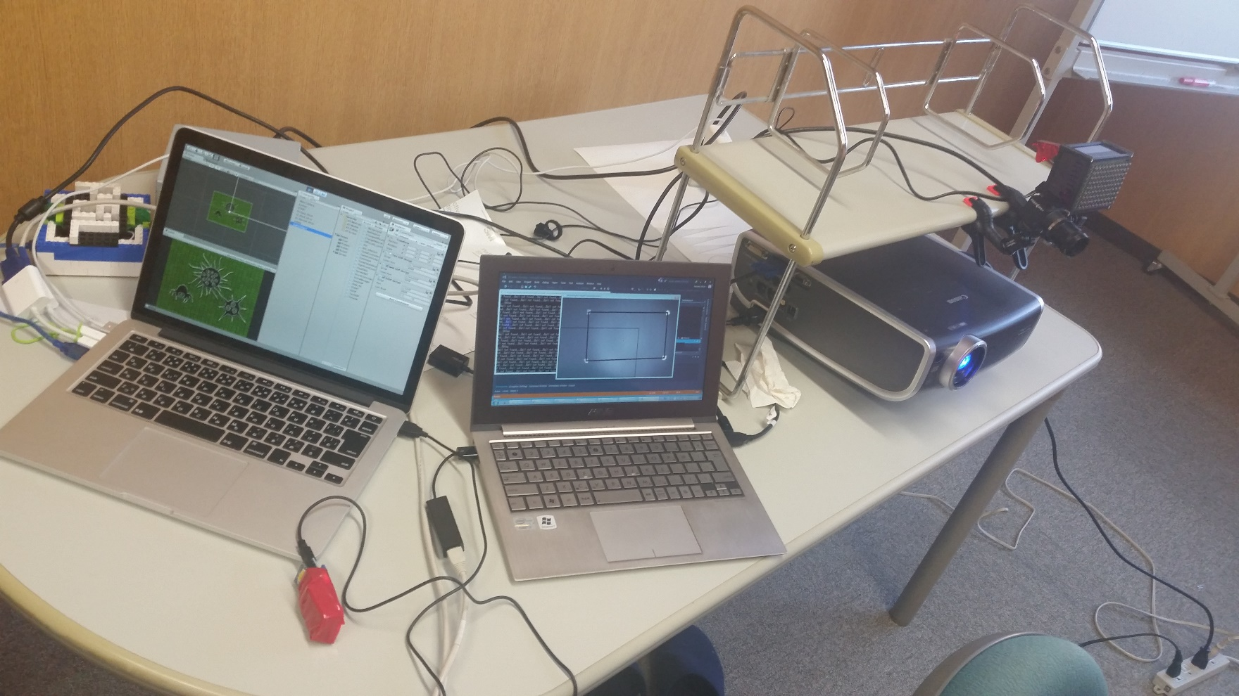
PROTOTYPE DEMO \ Setup
IR Camera to track ball position (2D).
Sensors to detect: Falling, collision, single tap, double tap.
2

Slide 4
PROTOTYPE DEMO \ Video
Hitting nodes to stop the disease spreading.
Spin ball and hit nodes to earn extra bonus.
Double tap the ball to activate Power Ball when it is available.
[DEMO VIDEO]
3

Slide 5






PROJECT OVERVIEW \ Top Level
OpenCV: Ball tracking
Unity: Infection Net Game
UDP
Naveed
UDP
Nishi
Hoang
Arduino: Collision detection
4

Slide 6
DESIGN DETAIL \ OpenCV: Ball tracking
Naveed Afzal
Two modes of operation:
Screen size
from Game
Calibration
Tracking
Determines camera shutter speed, binarizing threshold, region detection thresholds.
System detects 4 small sized regions on screen as 4 corner point.
Calculate homographic transformation from distorted image to rectangular Unity game.
Sets up appropriate parameters for detecting the ball corresponding with its size.
Systems tracks the ball position and send the transformed coordinate tuple (x, y) to Unity game machine using UDP protocol.
5

Slide 7
DESIGN DETAIL \ OpenCV: Ball tracking
Naveed Afzal
OpenCV Loop:
Calculate frame rate & Update timer
Capture & Process images
Validate Input
Detect and Track Regions
Networking
Render Image
6

Slide 8
DESIGN DETAIL \ Unity: Infection Net
Fumito Nishi
Agenda:
Implemented a simple point clicking game.
Implemented the Infection Net game with Unity.
Why the game?
Throwing ball to “destroy” something is “intuitive”.
Inspired by Epidemic Network model.
Throwing ball to “kill off” disease is fun!
7

Slide 9
DESIGN DETAIL \ Unity: Infection Net
Fumito Nishi
Game design:
Model Classes: Node, Network, Game.
View and Controller are supported by Unity (C# script).
Game rule:
Infection spreads once a hit, but if the ball spin is detected, the infection is not spread.
Kill ball can eliminate the infected node.
Game score is determined by the number of survivors.
8

Slide 10
DESIGN DETAIL \ Arduino: Digital ball
Hoang Nguyen
Hardware:
Arduino Fio, Xbee S2, Sparkfun’s 6DOF sensor.
XBIB-U-DEV Rev.3, Xbee S2 (Connect to game PC).
Functions:
Accelerometer: Detect free fall motion, collision, user’s tap and double tap using RMS of gx, gy, gz.
Gyroscope: Convert to quaternions and use the rotation component to measure spin.
9

Slide 11


DESIGN DETAIL \ Arduino: Digital ball
Hoang Nguyen
State-based motion detection:
delay
C
E
F
g_rms > col_thresh
g_rms $≈0$
g_rms $≈0$
timeout
T
delay
g_rms > tap_thresh
DT
validate few next values (j = 5)
g_rms > tap_thresh
within time frame
10

Slide 12
THANK YOU FOR LISTENING
PBL Fall 2015: Infection Net – An augmented reality game.
This presentation file and source code is available at:
https://github.com/gear/PLB-2015F-ARGame

