Slide 1
Deep Learning for NLP Recurrent Neural Networks
Nils Reimers
Course-Website: www.deeplearning4nlp.com

Slide 2
When you start with Deep Learning…
… start with the most simple approach!
These complex approaches sound quite cool, but …
… when you just adapt them, they will often fail to learn the task
… you have no idea why they will not produce reasonable output
… there is no easy way to debug complex Deep Neural Networks
The difference between simple and complex networks are not so large
Results on Stanford Sentiment Treebank (Socher 2013):
Average of word embeddings: 73.3%
Recursive Network: 79.0%
Recursive Neural Tensor Networks: 80.7%

Slide 3
Semantic Text Similarity
0 … 1
Cosine Similarity
Average
Weighted Average
Doc2Vec
Average
Weighted Average Doc2Vec
Embeddings
Embeddings
This is sentence 1
This is sentence 2

Slide 4
Semantic Text Similarity
0 … 1
Single Sigmoid
Dense Hidden Layer
Average
Weighted Average
Doc2Vec
Average
Weighted Average
Doc2Vec
Embeddings
Embeddings
This is sentence 1
This is sentence 2

Slide 5
Semantic Text Similarity
0 … 1
Single Sigmoid
Dense Hidden Layer
Conv. Layer + Max Pooling
Recursive NN
LSTM
Conv. Layer + Max Pooling
Recursive NN
LSTM
Embeddings
Embeddings
This is sentence 1
This is sentence 2

Slide 6
Recommended Readings
http://karpathy.github.io/2015/05/21/rnn-effectiveness/
Video: https://skillsmatter.com/skillscasts/6611-visualizing-and-understanding-recurrent-networks
http://colah.github.io/posts/2015-08-Understanding-LSTMs/
C224d Lecture 7: https://www.youtube.com/watch?v=rFVYTydGLr4

Slide 7
Models Overview
Word Classifcation
SENNA
Convolutional Neural Networks
Recurrent Neural Networks
Sentence Classification
Recursive Neural Networks,
Convolutional Neural Networks
Recurrent Neural Networks
Document Classification
Bag of Words with Deep Feed Forward Network
(Convolutional Neural Network)
Recurrent Neural Network
Generative Models
Recurrent Neural Network

Slide 8
Excursion: Language Model
Compute the probability of a sentence
Useful in machine translation
Word ordering: p(the cat is small) > p(small the cat is)
Word choice: p(walking home after school) > p(walking house after school)

Slide 9



Excursion: Language Model
unigram language model:
bigram language model:
Such models can also be used to generate new sentences
Sample word w_{i} with probability
Longer n-gram models give a better accuracy
Required training data &model size increases extremely
Long term relationships impossible to capture
p(I grew up in France and lived there until I was 18. Therefore I speak fluent French) > p(I grew up in France and lived there until I was 18. Therefore I speak fluent English)

Slide 10
Excursion: Language Models
Performance increases with longer n-grams
There are a lot of n-grams
500 000 German words (according to Duden)
2-grams: 250 billion combinations
3-grams: > 10¹⁷ combinations
4-grams: > 10²² combinations
Gigantic training corpus & RAM requirement
“Using one machine with 140GB RAM for 2.8 days, we built an unpruned model on 126 billion tokens” (Heafield et al.)

Slide 11

Recurrent Neural Network
o_{t}
o₀
o₁
o₂
o_{t}
Recurrent Neural Network have an internal state
State is passed from input x_{t} to x_{t+1}
Img Source: http://colah.github.io/posts/2015-08-Understanding-LSTMs/

Slide 12
Language Models with RNN
Let x₀, x₁, x₂… denote words (or characters)
Let o₀, o₁, o₂… denote the probability of the sentence
Memory requirement scales nicely (linear with the number of word embeddings / number of character)
o_{t}
o₀
o₁
o₂
o_{t}

Slide 13
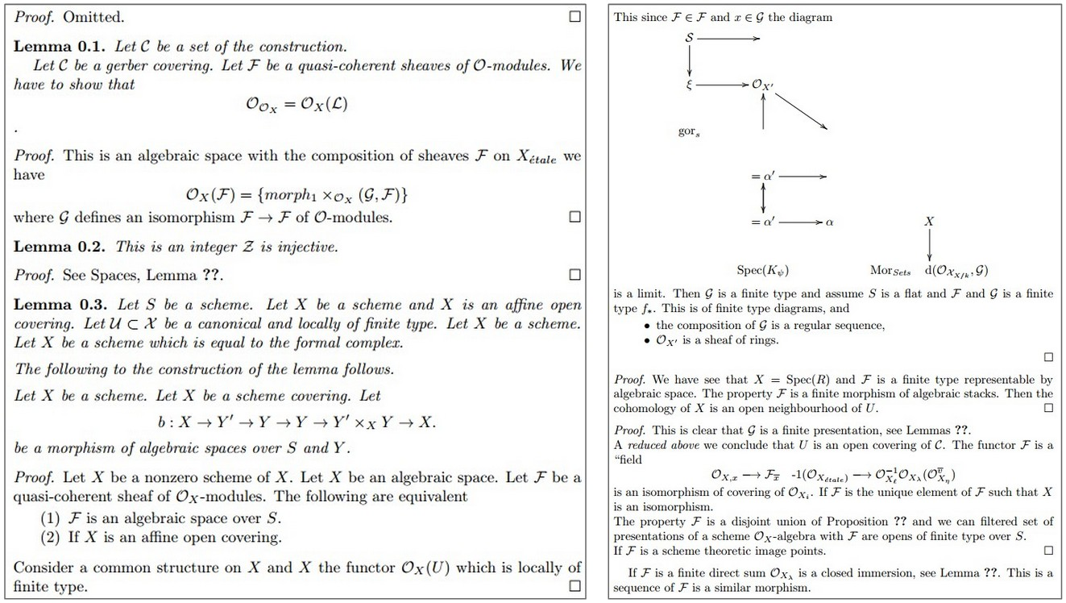
RNN as Generative Language Models
Generated LaTeX-Code from an Character-RNN
Img Source: http://karpathy.github.io/2015/05/21/rnn-effectiveness/

Slide 14
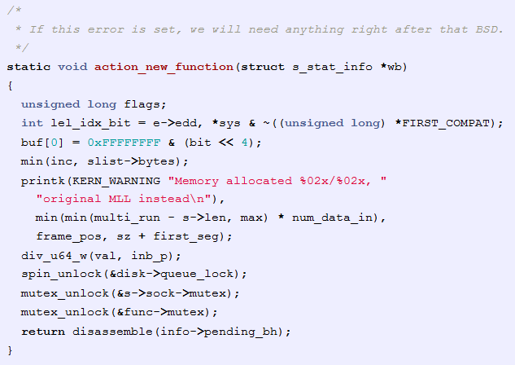
RNN as Generative Language Models
Generated C-Code from an Character-RNN
Img Source: http://karpathy.github.io/2015/05/21/rnn-effectiveness/

Slide 15
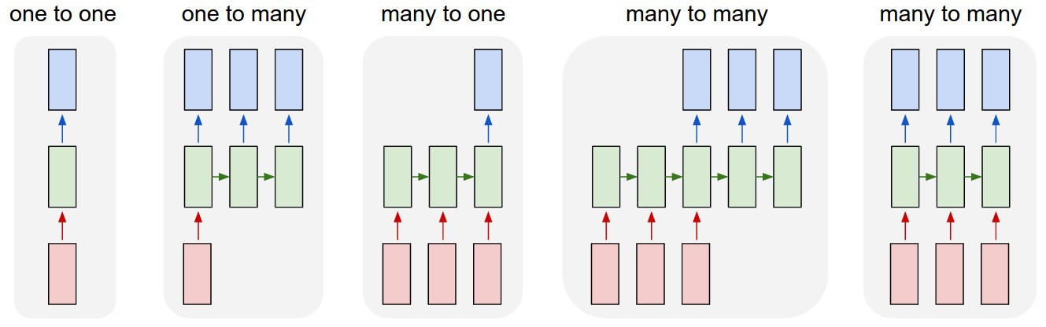
Topologies of Recurrent Neural Network
(1) (2) (3) (4) (5)
1) Common Neural Network (e.g. feed forward network)
2) Prediction of future states base on single observation
3) Sentiment classification
4) Machine translation
5) Simultaneous interpretation
Img Source: http://karpathy.github.io/2015/05/21/rnn-effectiveness/

Slide 16
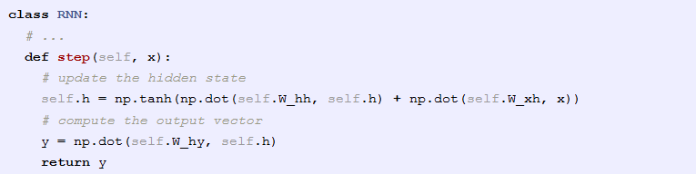

(Vanilla) RNN
Compute the hidden state:
Compute the output:
Img Source: http://karpathy.github.io/2015/05/21/rnn-effectiveness/

Slide 17
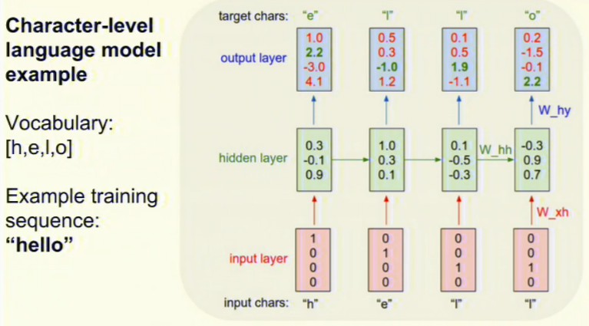
(Vanilla) RNN
Img Source: http://karpathy.github.io/2015/05/21/rnn-effectiveness/

Slide 18
No Magic Involved (in Theory)
You unroll your data in time
You compute the gradients
You use back propagation to train your network
Karpathy presents a Python implementation for Char-RNN with 112 lines
Training RNNs is hard:
Inputs from many time steps ago can modify output
Vanishing / Exploding Gradient Problem
Vanishing gradients can be solved by Gated-RNNs like Long-Short-Term-Memory (LSTM) Models
LSTM became popular 2015 in NLP

Slide 19
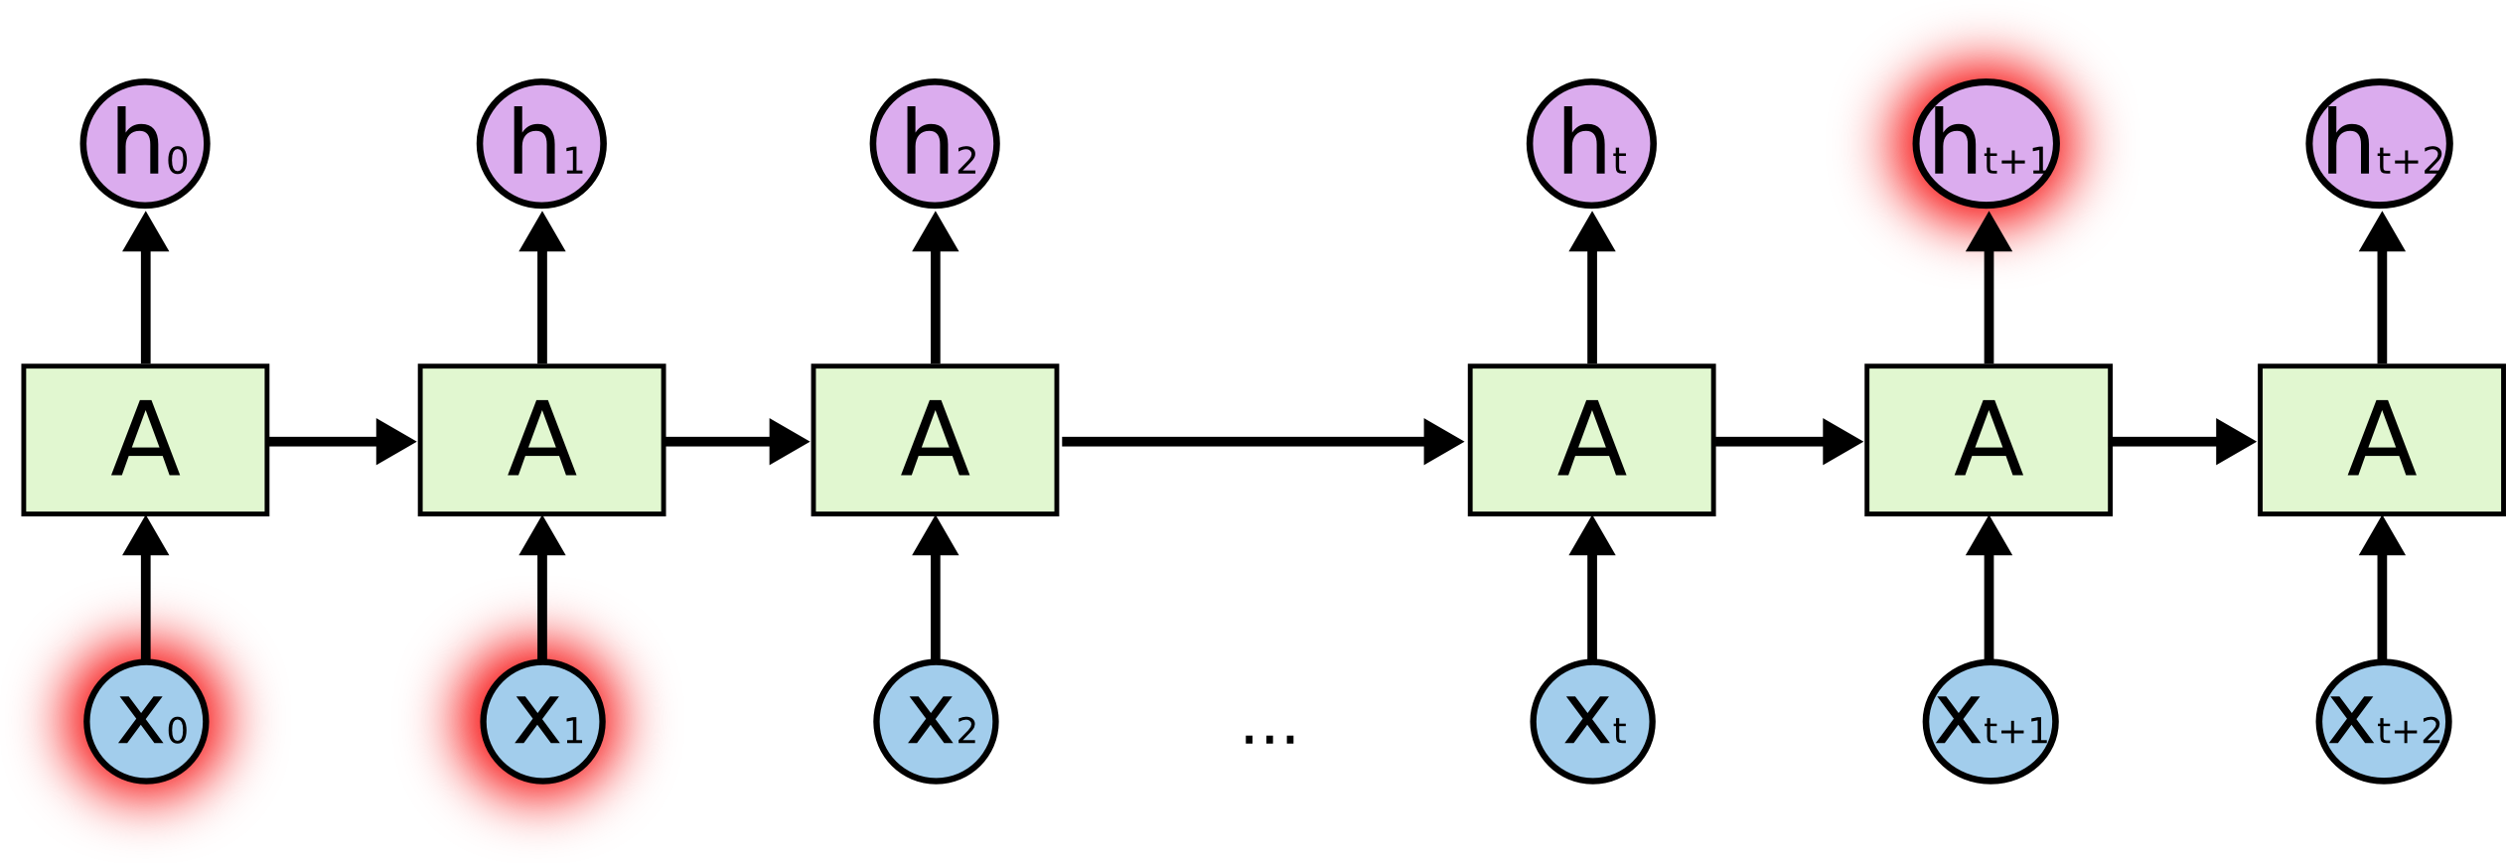
Long-Short-Term Memory (LSTM)
Long-term dependencies: I grew up in France and lived there until I was 18. Therefore I speak fluent ???
Presented (vanilla) RNN is unable to learn long term dependencies
Issue: More recent input data has higher influence on the output
Long-Short-Term Memory (LSTM) models solves this problem
Img Source: http://colah.github.io/posts/2015-08-Understanding-LSTMs/

Slide 20

LSTM Model
The LSTM model implements a forget-gate and an add-gate
The models learns when to forget something and when to update internal storage
Img Source: http://colah.github.io/posts/2015-08-Understanding-LSTMs/

Slide 21
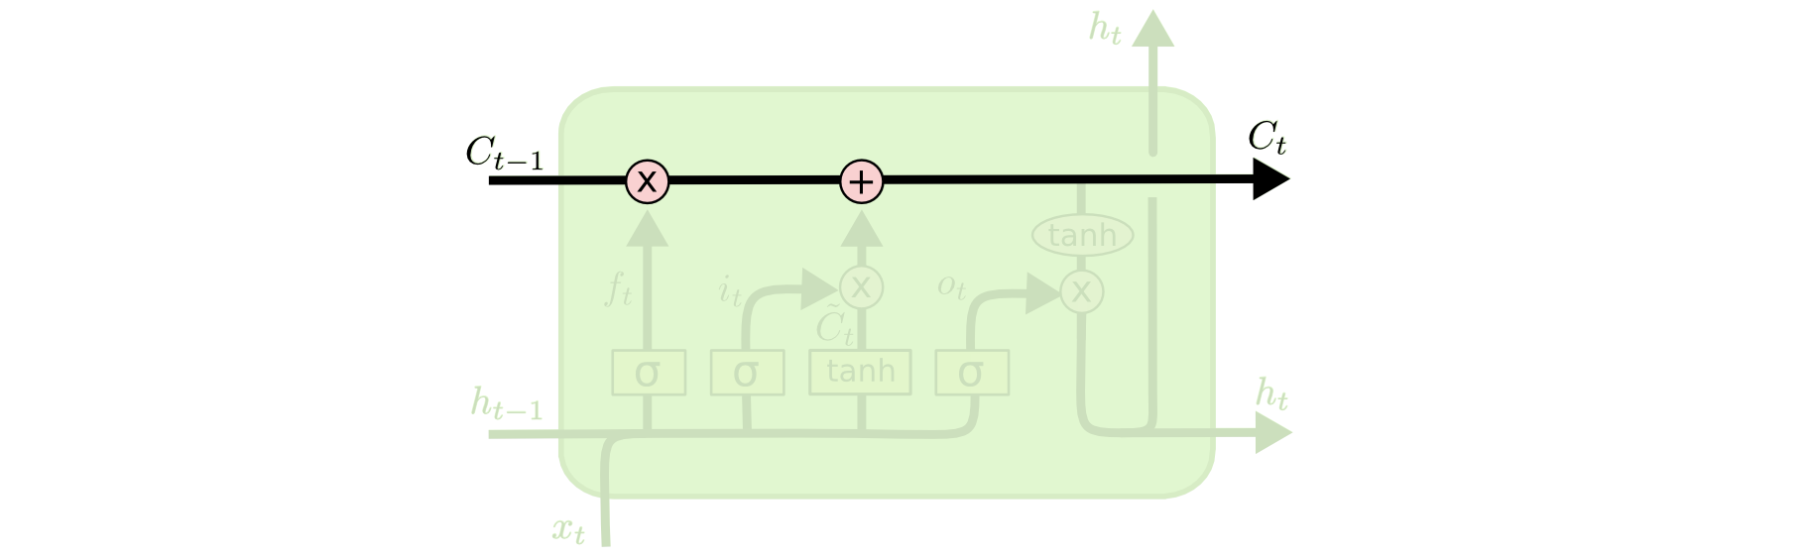
LSTM Model
Core: Cell-state C (a vector of certain size)
The model has the ability to remove or add information using Gates
Img Source: http://colah.github.io/posts/2015-08-Understanding-LSTMs/

Slide 22
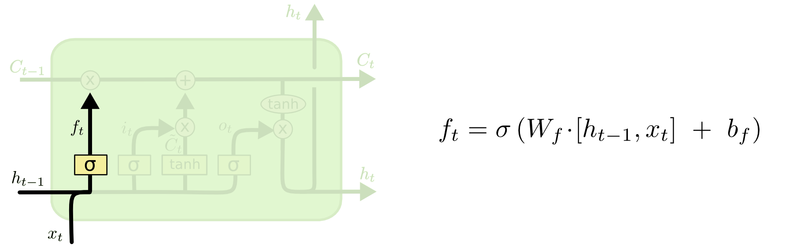
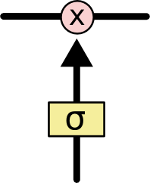
Forgot-Gate
Sigmoid function σ output a value between 0 and 1
The output is point-wise multiplied with the cell state C_{t-1}
Interpretation:
0: Let nothing through
1: Let everything through
Example: When we see a new subject, forget gender of old subject
Img Source: http://colah.github.io/posts/2015-08-Understanding-LSTMs/

Slide 23
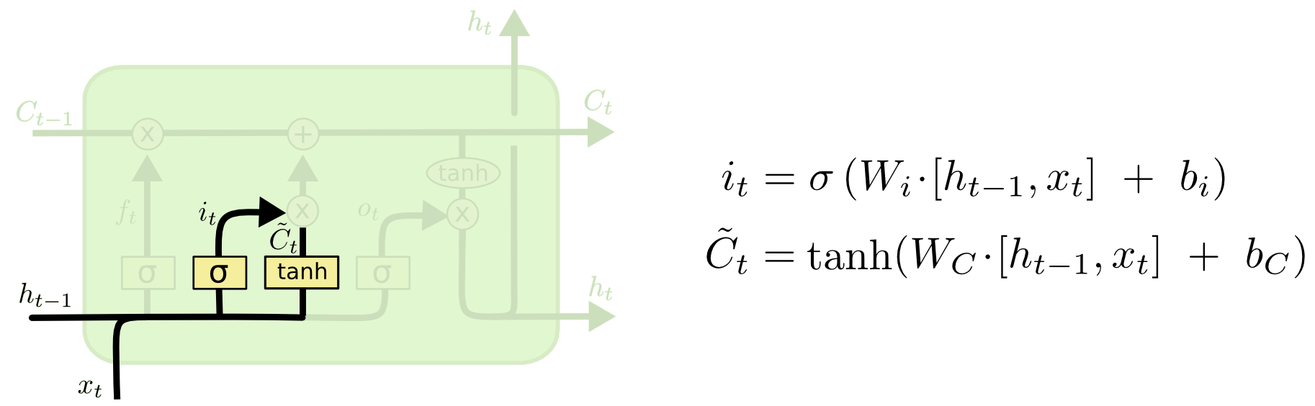
Set-Gate
Compute i_{t} which cells we want to update and to which degree (σ: 0 … 1)
Compute the new cell value using the tanh function
Img Source: http://colah.github.io/posts/2015-08-Understanding-LSTMs/

Slide 24
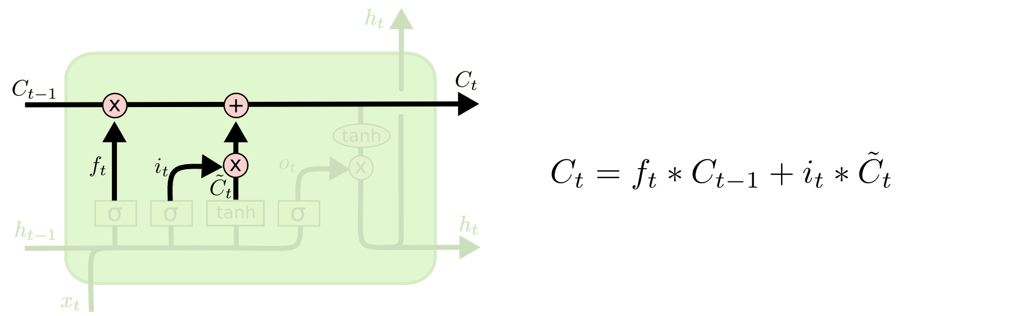
Update Internal Cell State
Forget state cells
Update state cells
Img Source: http://colah.github.io/posts/2015-08-Understanding-LSTMs/

Slide 25
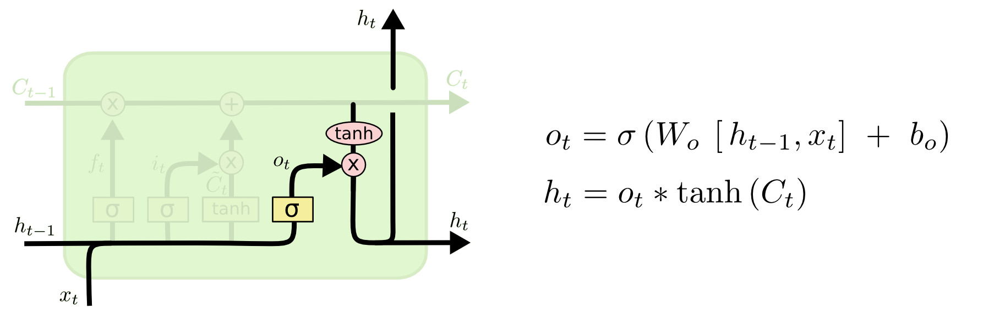
Compute Output h_{t}
We use the updated cell state C_{t} to compute the output
We might not need the complete cell state as output
Compute o_{t}, defining how relevant each cell is for the output
Pointwise multiply o_{t} with tanh(C_{t})
Cell state C_{t} and output h_{t} is passed to the next time step
Img Source: http://colah.github.io/posts/2015-08-Understanding-LSTMs/

Slide 26
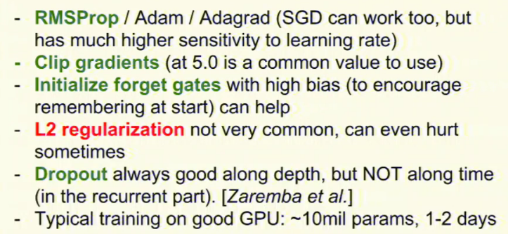
Training
Img Source: https://skillsmatter.com/skillscasts/6611-visualizing-and-understanding-recurrent-networks

Slide 27
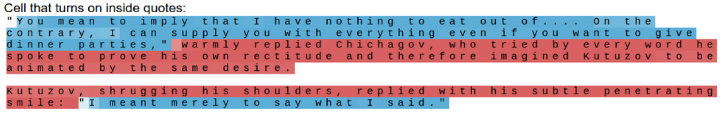
Searching for interpretable cells
Source: Karpathy et al., 2015, Visualizing and Understanding Recurrent Networks

Slide 28
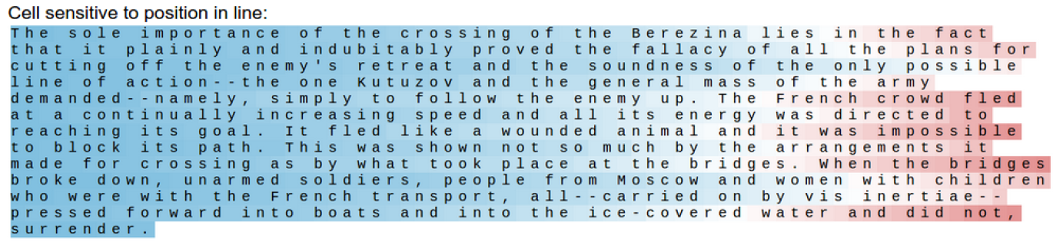
Searching for interpretable cells
Source: Karpathy et al., 2015, Visualizing and Understanding Recurrent Networks

Slide 29
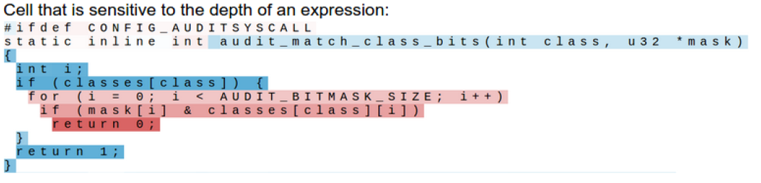
Searching for interpretable cells
Source: Karpathy et al., 2015, Visualizing and Understanding Recurrent Networks

Slide 30
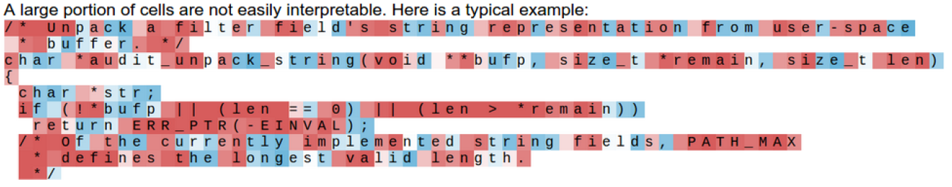
Searching for interpretable cells
Source: Karpathy et al., 2015, Visualizing and Understanding Recurrent Networks

Slide 31
Variants of LSTM
GRU
Cho et al., 2014, http://arxiv.org/pdf/1406.1078v3.pdf
Depth Gated RNN
Yao et al., 2015, http://arxiv.org/pdf/1508.03790v2.pdf
Clockwork RNN
Koutnik et al., 2014, http://arxiv.org/pdf/1402.3511v1.pdf
Does the difference matter? Not really
Greff et al., 2015, http://arxiv.org/pdf/1503.04069.pdf
Jozefowicz et al., 2015, http://jmlr.org/proceedings/papers/v37/jozefowicz15.pdf
Img Source: http://colah.github.io/posts/2015-08-Understanding-LSTMs/

Slide 32
Tree-LSTM
Kai Sheng Tai, Richard Socher, and Christopher Manning, 2015, “Improved Semantic Representations From Tree-Structured Long Short-Term Memory Networks”
Code: https://github.com/stanfordnlp/treelstm

Slide 33
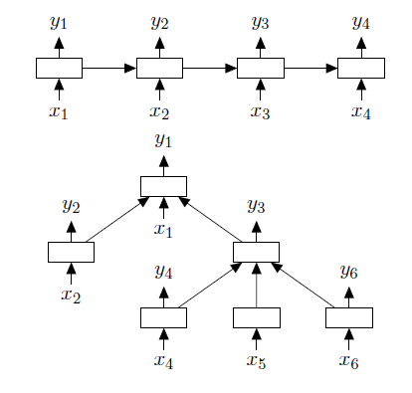
Tree-LSTM
Idea: Use a syntax tree to process the sentence instead of a sequential left-to-right approach
Source: Sheng et al., 2015, Improved Semantic Representations From Tree-Structured Long Short-Term Memory Networks

Slide 34
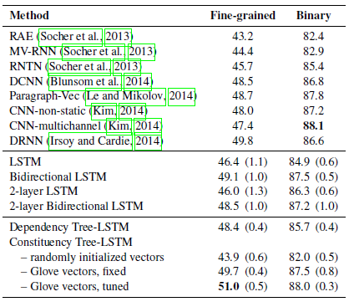
Tree-LSTM - Performance
Performance on the Stanford Sentiment Treebank
Source: Sheng et al., 2015, Improved Semantic Representations From Tree-Structured Long Short-Term Memory Networks

Slide 35
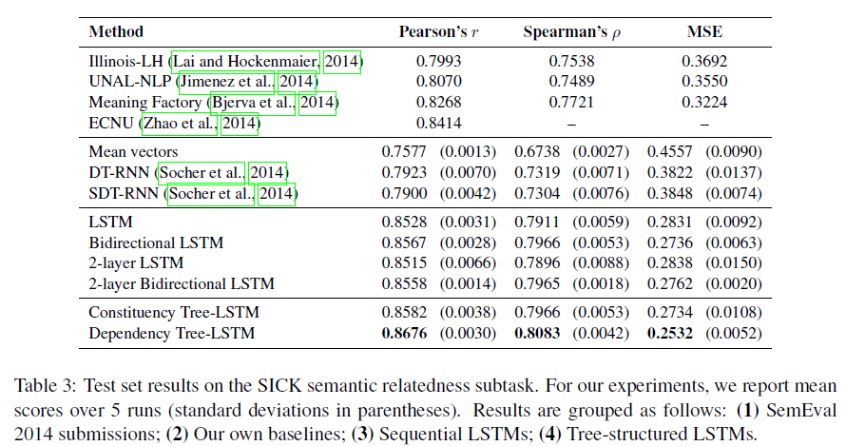
Tree-LSTM - Performance
Source: Sheng et al., 2015, Improved Semantic Representations From Tree-Structured Long Short-Term Memory Networks

Slide 36
The Future of Deep Learning

Slide 37
NLP as a Q&A-Problem?
Most NLP tasks can be modeled as a Question-Answering problem
What are the part-of-speech tags in the sentence?
What are the named entities in the sentence?
Which pronouns refer to the same entities?
What is the translated version of the sentence?
What is the major claim in the sentence?
Kumar et al. presented a general architecture for Q&A
Ask Me Anything: Dynamic Memory Networks for Natural Language Processing
http://arxiv.org/abs/1506.07285

Slide 38
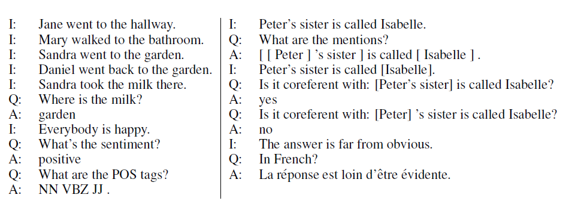
Example
Source: Kumer et al., 2015, Ask Me Anything: Dynamic Memory Networks for Natural Language Processing

Slide 39
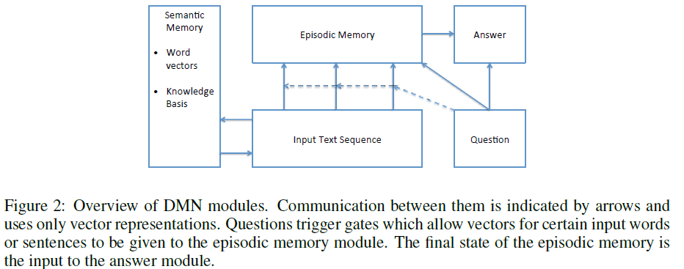
Overview of the Dynamic Memory Model
Source: Kumer et al., 2015, Ask Me Anything: Dynamic Memory Networks for Natural Language Processing

Slide 40
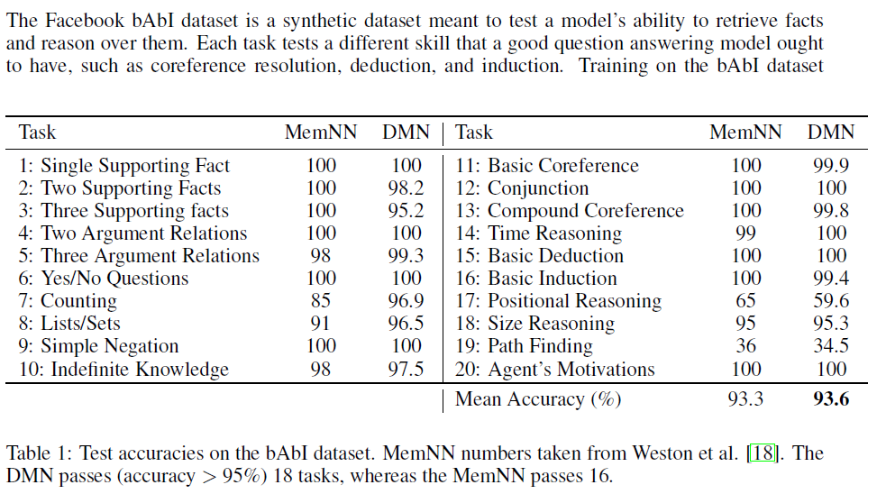
DMN – Q&A Results
Source: Kumer et al., 2015, Ask Me Anything: Dynamic Memory Networks for Natural Language Processing

Slide 41
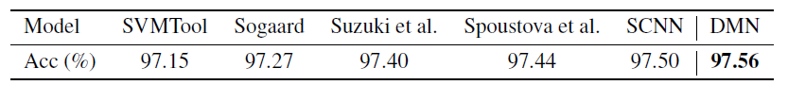
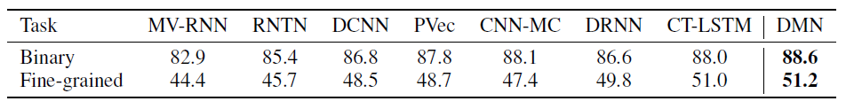
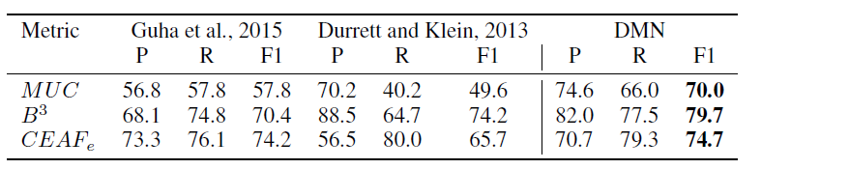
DMN – Results on NLP Tasks
POS (Wall Street Journal)
Sentiment (Stanford Sentiment Treebank)
Coreference Resolution (Dataset Gua et al., 2015)
Source: Kumer et al., 2015, Ask Me Anything: Dynamic Memory Networks for Natural Language Processing

Slide 42
Hot Future Trends in Machine Learning
Computer use 3 fundamental mechanisms:
elementary operations, logical flow control, external memory
Most machine learning algorithms only use elementary operations
flow control and external memory largely neglected in machine learning
RNN can learn how to use external memory & logical flow
Siegelmann & Sontag, 1995, showed that RNN are Turing-Complete
Hot research directions
How to use external memory for machine learning (Graves et al., 2014, Neural Turing Machines)
Development of multi-task models
Multimodal inputs and questions

