Slide 1
Show & Tell
CIVE 503 – Final Project
Anthony Truelove MASc, P.Eng.
18 March 2025

Slide 2
Contents
Motivation
Intent
Methodology
Interim Results
6 slides

Slide 3
Motivation
Surrogate modelling is seeing uptake in a wide variety of domains (including model-based design optimization).
The notions of “sampling efficiency” and “surrogate efficiency” appear in the literature, but there does not seem to be a standardized way of expressing these notions precisely.

Slide 4

Intent
Propose and test a standardized surrogate model efficiency metric.

Slide 5
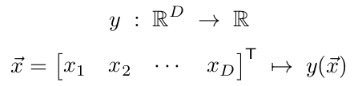


Methodology (Proposition)
Consider standard benchmark problems of the form
namely: Rastrigin, Rosenbrock, Griewank, and Styblinski–Tang.
Define surrogate utility as inverse of surrogate error, where surrogate error is
Assume surrogate cost is dominated by sampling cost (i.e., is proportional to number of samples N).
Proposition:

Slide 6
Methodology (Testing)
Full factorial experiment considering combinations of
  Benchmark problem [4]
  Sampling scheme (simple random vs latin hypercube) [2]
  Dimensionality 2 thru 6 [5]
  Number of samples up to 10^5 [16]
Monte Carlo trials for each combination considered. [50]
Each Monte Carlo trial consists of
  Sample objective ←some randomness here
  Split sample data (train, validate, test) ←some randomness here
  Train surrogate ←some randomness here
  Test surrogate, compute efficiency

Slide 7
Methodology (Testing)
Neural networks are commonly used as surrogate models in the literature, so the same is done here.
Surrogate is a dense network with D hidden layers of 100 neurons (ReLU) each.
Train/test split is 85/15, and then train is further split 85/15 into train/validation.
1
1
1
Train
Test
1
2
2
2
2
3
3
...
3
1
:
:
:
:
Train
D
Val
100
100
100
<- D times ->

Slide 8
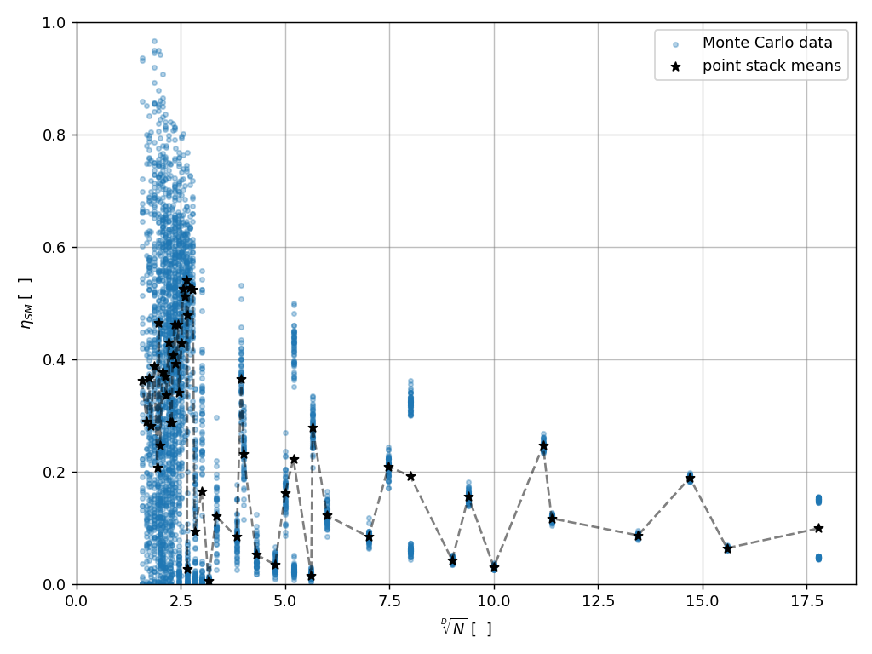
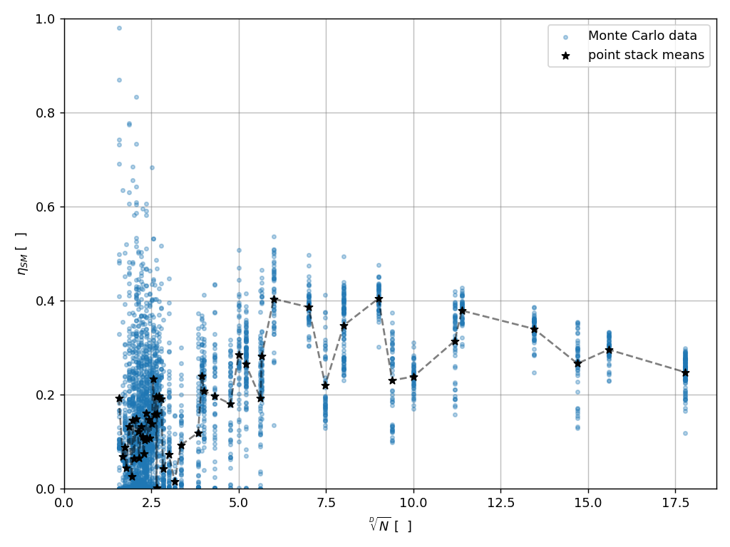
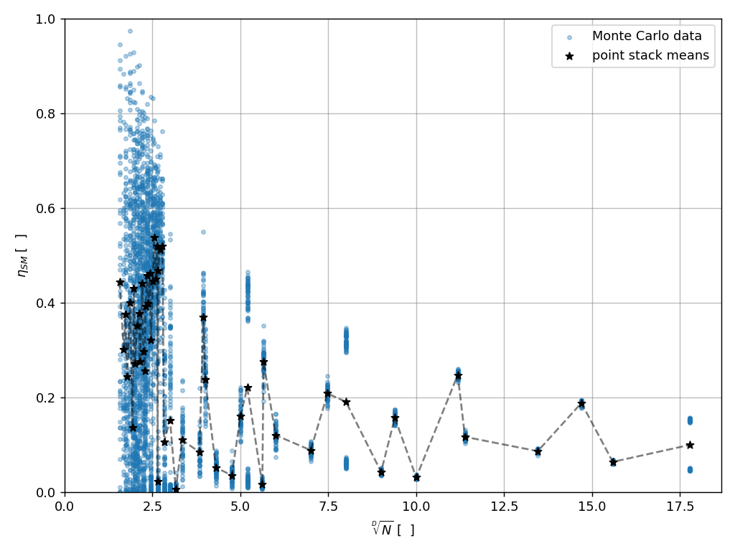

Interim Results
 | Rastrigin (R⁴→R) | Rosenbrock (R⁴→R)
Simple Random
Latin Hypercube

Slide 9

Questions?

Slide 10
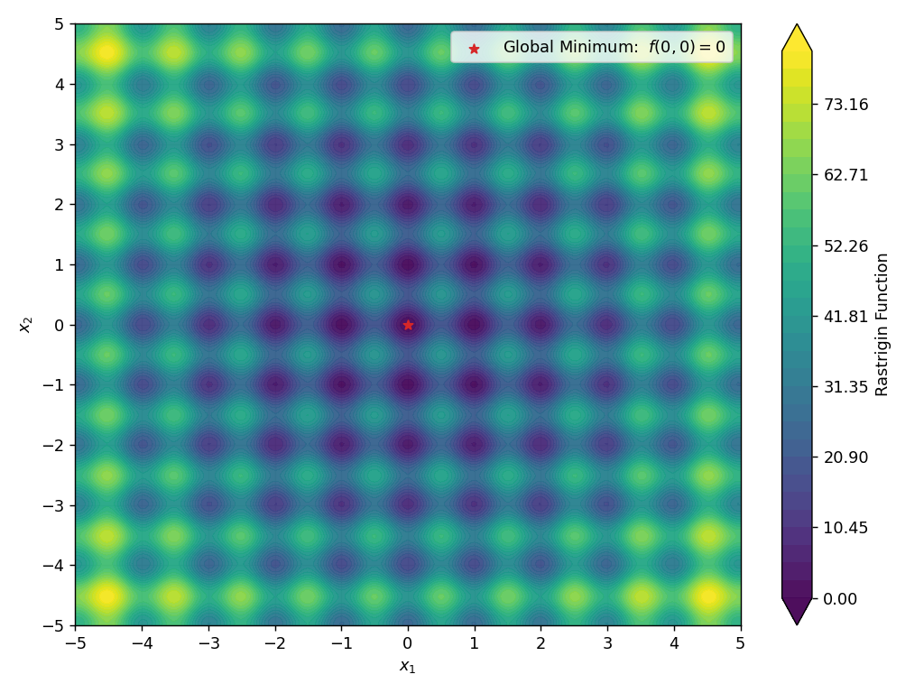
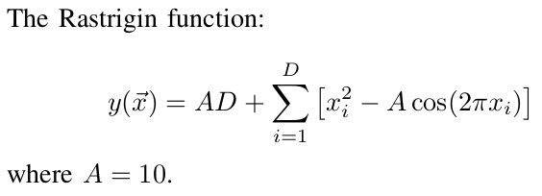
Rastrigin (R²→R)

Slide 11
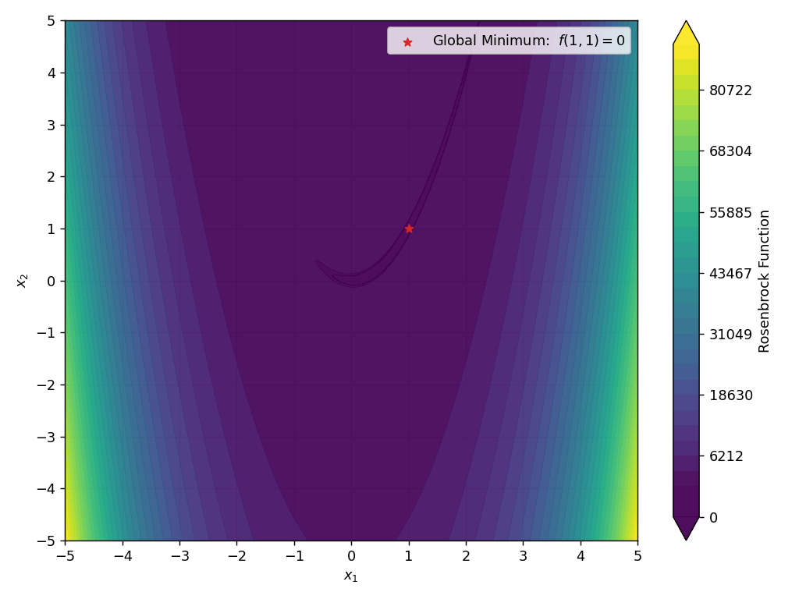
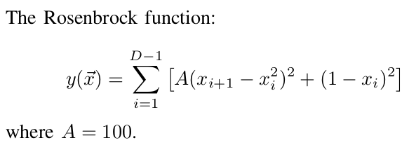
Rosenbrock (R²→R)

Slide 12
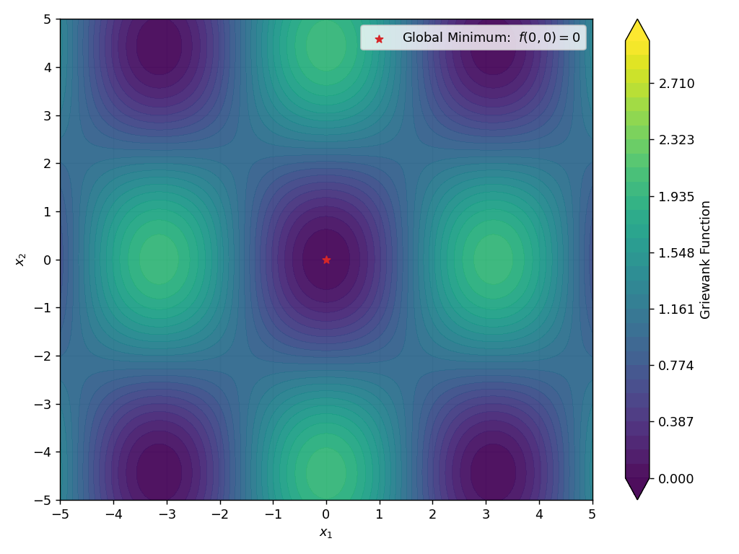
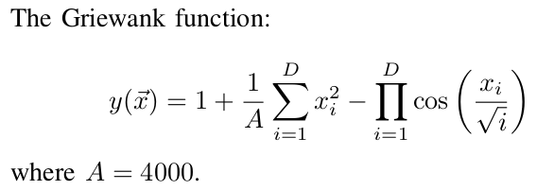
Griewank (R²→R)

Slide 13
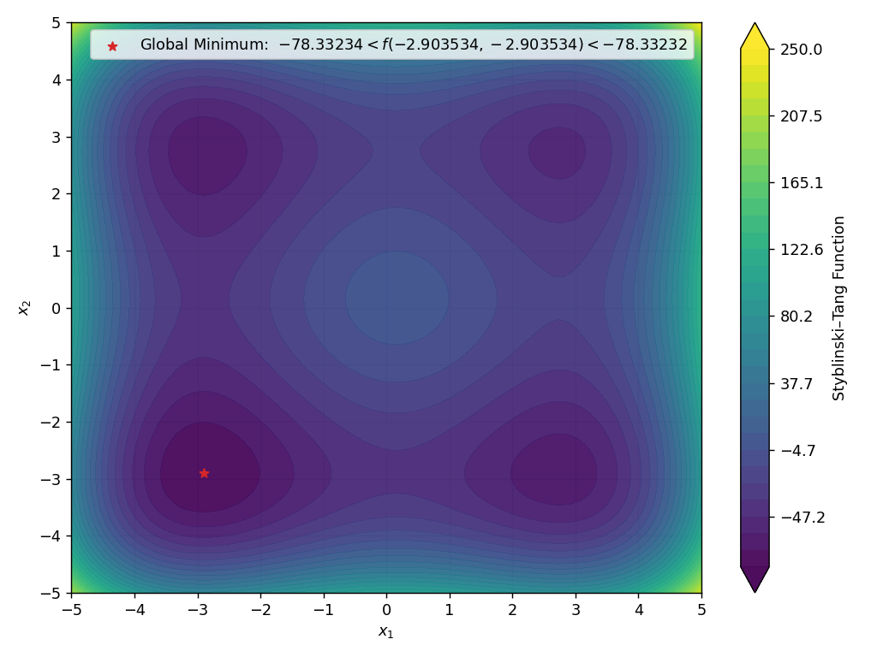
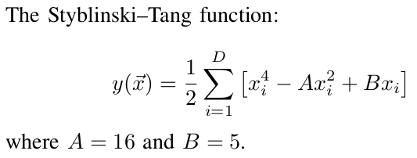
Styblinski–Tang (R²→R)

