Slide 1
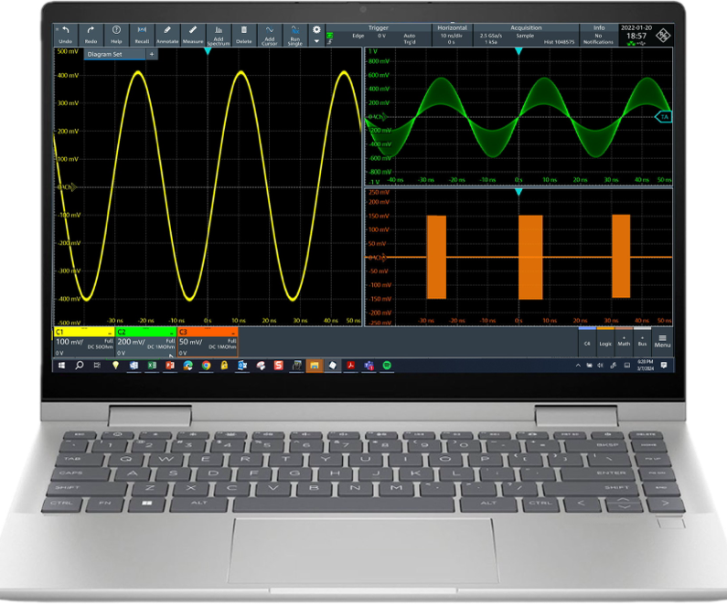
R&S®scopestudio offline scope software
Designed for the fastest oscilloscopes on the market
Luca Gragnaniello (1TDP)
COMPANY RESTRICTED

Slide 2
outline
Why do we need an offline software?
Concept of R&S®ScopeStudio
Competitor landscape
Roadmap
Summary
Live demo
COMPANY RESTRICTED

Slide 3

why using an offline software?
Use cases
Need for complex time-taking analysis
Sharing of measurements between team members
Sharing of measurements between remote locations
Need for remote/hybrid engineering work
Need for remote connection to instruments
More effort documenting away from equipment
COMPANY RESTRICTED

Slide 4

why using an offline software?
Use cases
Reload of scope waveforms for further analysis and reporting
Test & Support offline:
Measurement, cursors, track
Spectrum, Math and filtering
Zoom and annotation
Decoding
Saveset to reload waveforms into oscilloscope as settings.
PC SW synchronization of 2 instruments
Demoing an MXO UI without carrying a scope!
R&S®Scope
R&S®ScopeStudio
COMPANY RESTRICTED

Slide 5
What is ScopeStudio?
MXO firmware running on a Windows PC
UI adapted to offline purposes
No hardware dependencies
HW accelerated functions replicated in SW
Runs on Windows (incl. installer)
COMPANY RESTRICTED

Slide 6
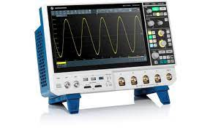
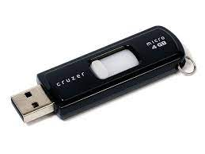
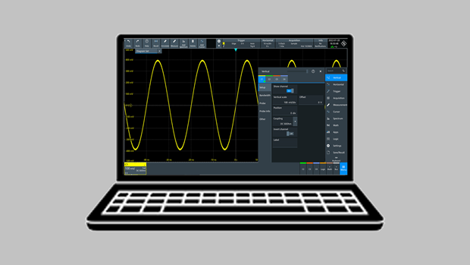
PC-based application
User PC
MS Windows 10 & 11 (No support of Linux)
64-bit,
8 GB RAM
≥ 1GB storage for install
≥ 5 GB storage (data saves)
COMPANY RESTRICTED

Slide 7
Import feature set
Waveforms
NEW! Import into channels
Import as reference
.ref (MXO)
Roadmap
RTx
.csv
Saveset
import .set MXO
Session (waveform + saveset)
NEW! import from MXO saveset
Roadmap:
into MXO
COMPANY RESTRICTED

Slide 8
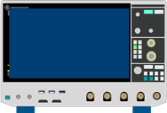

ROADMAP – EXPANDed Use models
`
File-based
Hosted connection to 1 scope
Host
connection
Synchronization of 2 scopes
COMPANY RESTRICTED

Slide 9
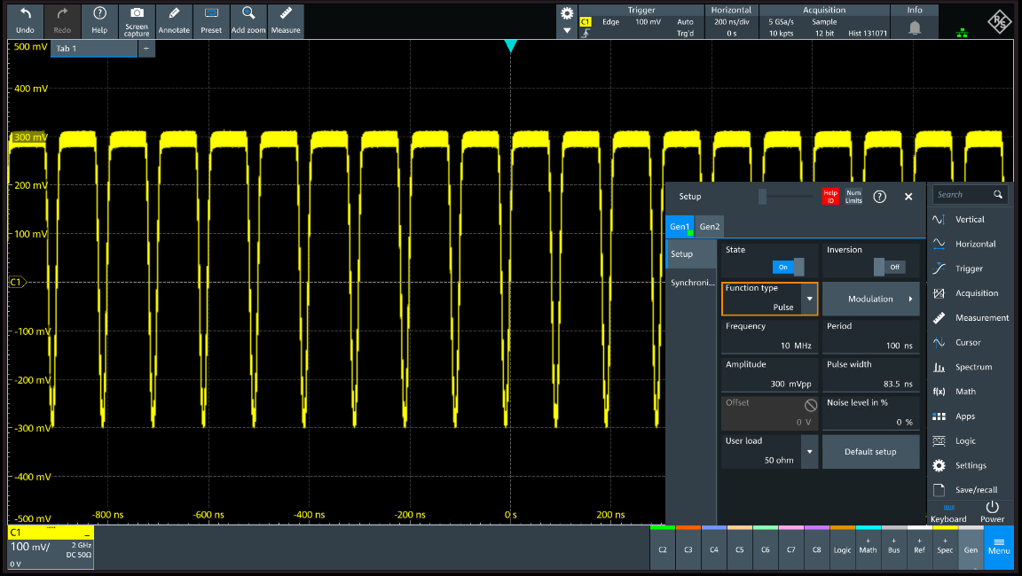
Roadmap - Generator (simulation)
COMPANY RESTRICTED

Slide 10
ScopeStudio applications options
Q1 2025:
Low-speed serial decode
Roadmap → same as MXO
Signal integrity
Eye
Jitter
De-embedding
PAM measurements
EQ
High-speed protocol T&D
Power app
COMPANY RESTRICTED

Slide 11
Competitor landscape
COMPANY RESTRICTED

Slide 12
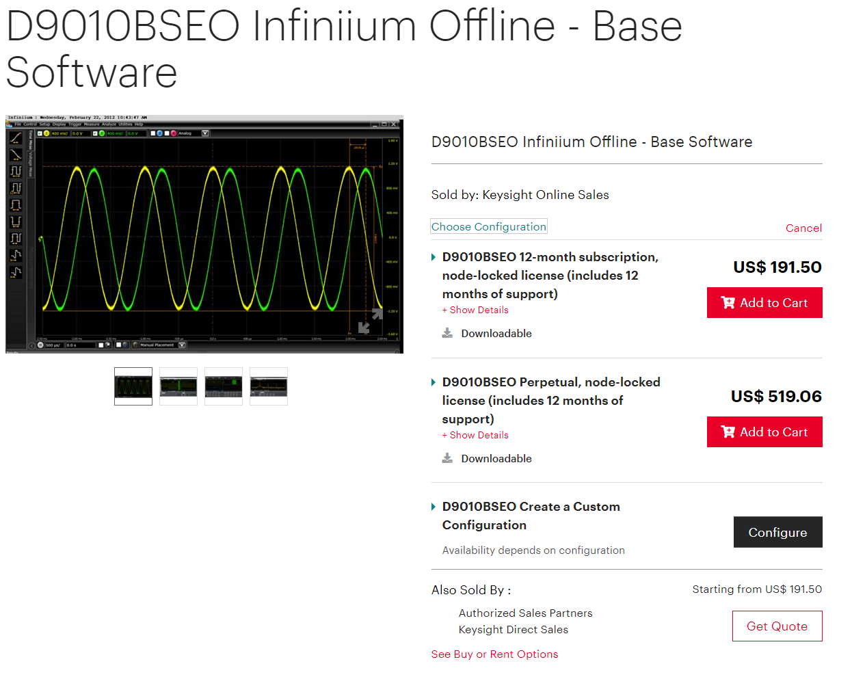
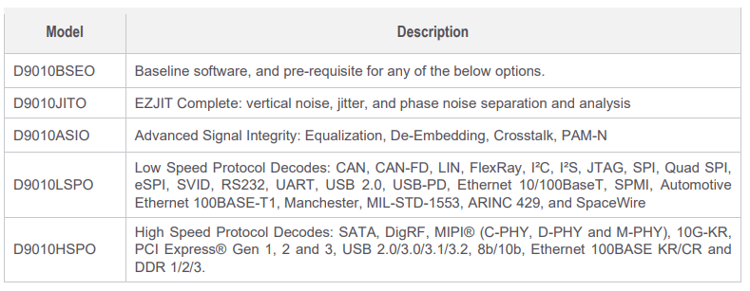
Keysight Infiniium offline
2014 intro. Well established
Extensive demo capability
MultiScope support (up to 40 ch)
The most expensive
KS Infiniium offline, Complete package, Perpetual license, Node-locked:
8379 USD
$504
$2250
$2250
$1125
+KSCare
(12, 24, 36, 60 months)
$2250
COMPANY RESTRICTED

Slide 13
KS licensing
Duration: Perpetual vs Subscription 3, 6, 12, 24, 36 months
Type: Node-locked, Transportable, USB portable, Floating single site, Floating single region, Floating worldwide
Type | Base | D9010JITO D9010ASIO D9010HSPO | D9010LSPO
Node-locked | 504 $ | 2251 $ | 1125 $
Transportable | +30%
USB portable | +30% + 187$
Floating single site | +40%
Floating single region | +60%
Floating worldwide | +80%
Price range (perpetual) vs License type
COMPANY RESTRICTED

Slide 14
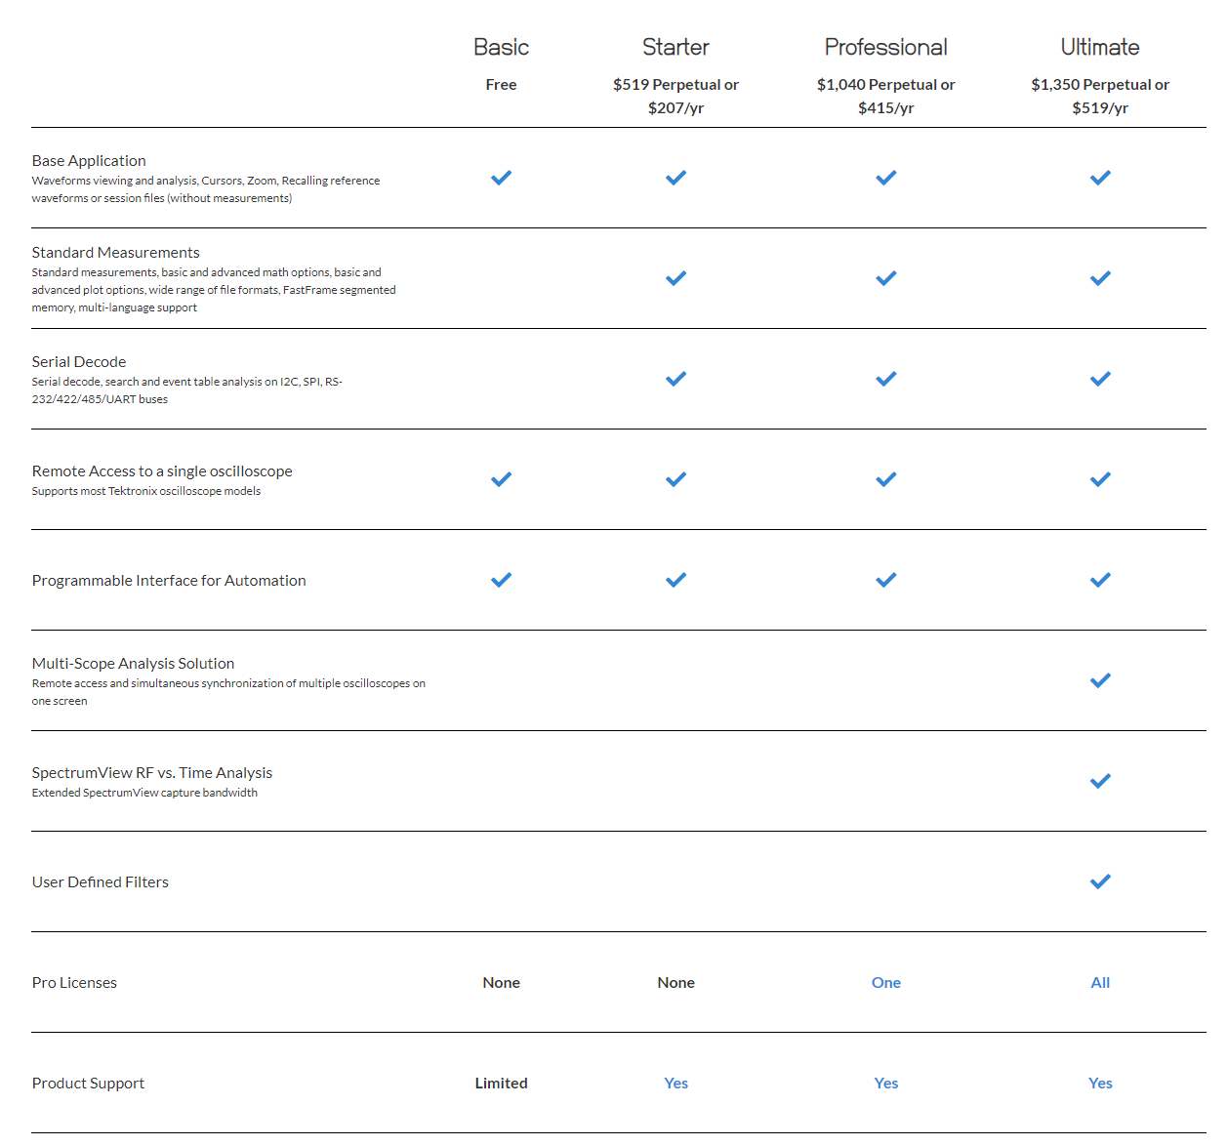
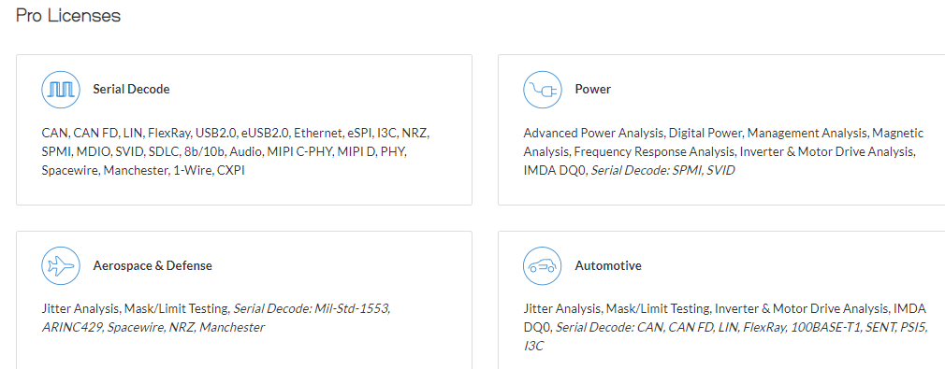
Tekscope
McDonald's Pricing Strategy
Duration: Perpetual vs 12 months (-60%, like KS)
Type: Node-locked only
Maintenance/update license limited to 1 year
Extensions sold separately on yearly basis
Only Ultimate package includes MultiScope
Pseudo-Free version
COMPANY RESTRICTED

Slide 15
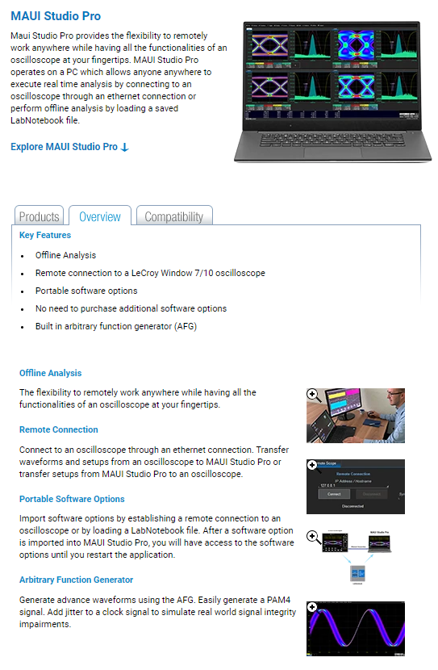
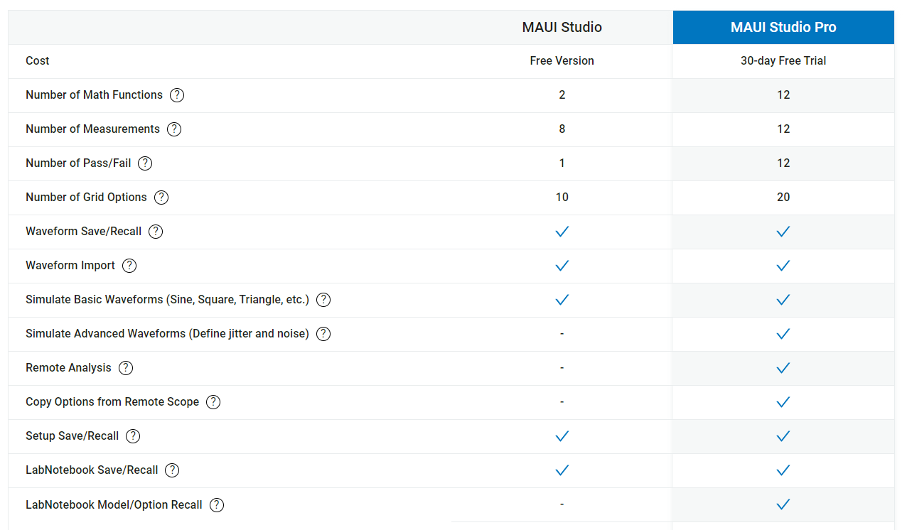
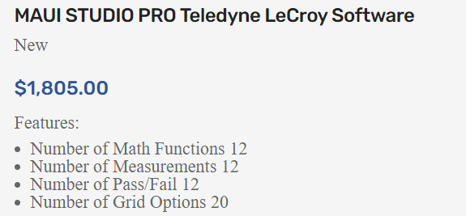

Lecroy maui studio
Strong binding with LeCroy Oscilloscope
LabNotebook Option Recall
Pseudo-Free version: no Remote Analysis
Not modular →Relatively expensive
Undisclsoed price
https://www.valuetronics.com/product/maui-studio-pro-teledyne-lecroy-software-new
COMPANY RESTRICTED

Slide 16
Product structure & timeline
COMPANY RESTRICTED

Slide 17
R&S®ScopeStudio Product structure
R&S®ScopeStudio
 | R&S®ScopeStudio 550€ + options
Waveforms import/analysis Recalling reference, savesets, session | ●
standard measurements, math options | ●
FFT | ●
Hosted mode | ●
Simulated ARB | ●
Scope Synchronization | ●
Protocols (I2C, UART, SPI, CAN FD/XL, LIN, MIL1553, ARINC, SPMI, QSPI, 100BaseT1, 10BaseT1S) | Opt. 1
Power | Opt.2
High-speed T&D | Opt.3
SI pack (Eye, Jitter) | Opt.4
COMPANY RESTRICTED

Slide 18
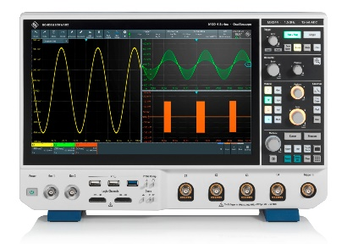
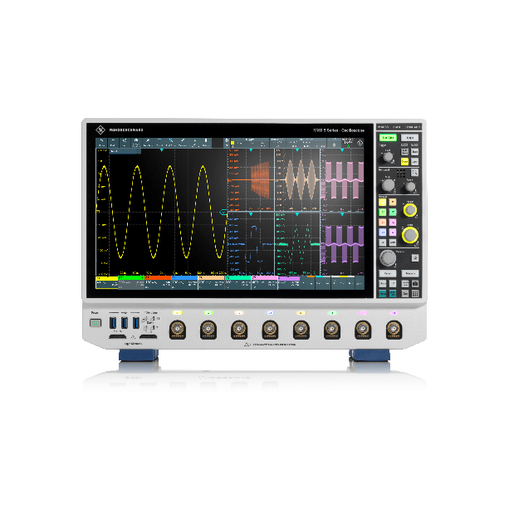
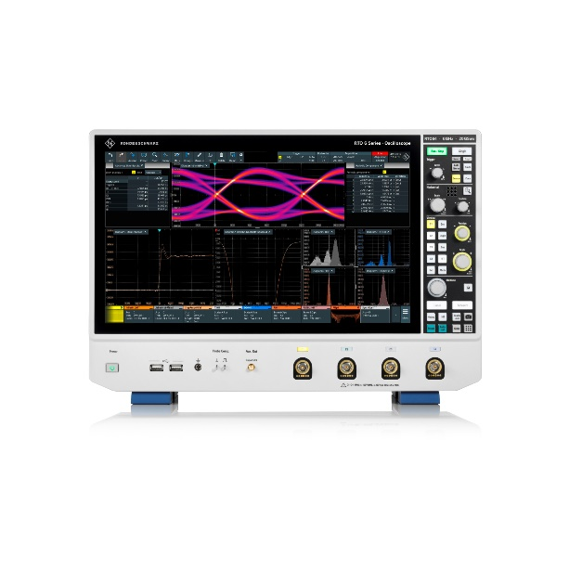
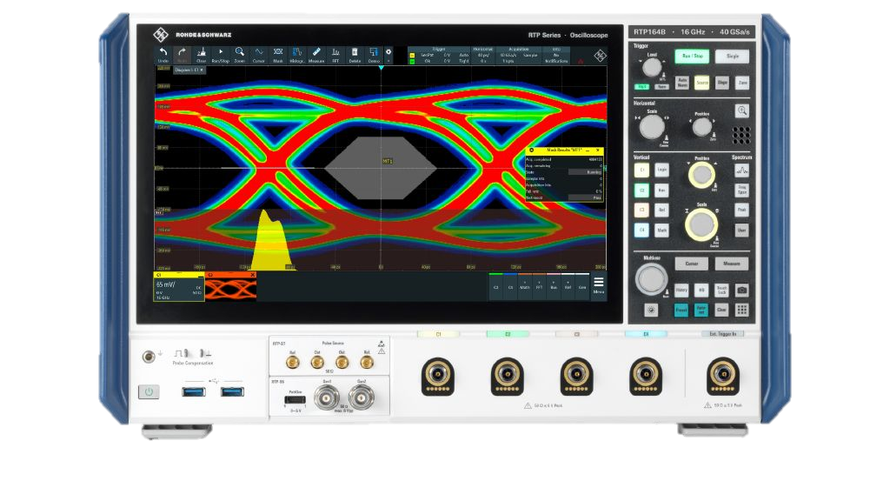
R&S®ScopeStudio key advantages
R&S®Scope
Same great UI as MXO
Clear, lean yet modular commercial proposition
One software incl. all general purpose tools
Four options for specialists
No hidden recurring costs
E.g. no maintenance, support, KS care
Good value-for-money
Designed for R&S® scopes
R&S®ScopeStudio
3.
COMPANY RESTRICTED

Slide 19
Product structure & timeline
R&S®ScopeStudio Import, Measurements, Math, FFT,
Roadmap Hosted, Simulated ARB, Scope Synchronization
Roadmap Options Protocols, Power, High-speed T&D, SI pack (Eye, Jitter)
Licensing: Node-locked (no dongle), Perpetual or timebase, free 30-days evaluation
RS Type | Material name | Material Number | Price (EUR)
MXO-PC | MXO-PC SCOPESTUDIO | 1801.9005.02 | 550
2024-09-16
2024-09-30
Q1 2025
2025
Beta Test Candidate
Loading Ref. Curves
Cursors
Zooms
Automatic Measurements
Installer
Licensing
Release Candidate
Sessions
Feature Enhancements
Hosted Mode
Protocol Decoding
Digital channel support
Import RTx waveforms
Future Enhancements
Scope Sync
Simulated Generator
Simulated Trigger / Acq
Internal Demos
version 2.3.11.x BETA
version 2.3
version 2.4
version 2.x
COMPANY RESTRICTED

Slide 20
Product structure & timeline
 | R&S®ScopeStudio 550 € + options | Available from
Waveforms import/analysis Recalling reference, savesets, session | ● | At launch (Q4 2024) October?
standard measurements, math options | ●
FFT | ●
Hosted mode | ● | Q1 2025
Simulated ARB | ● | 2025
Scope Synchronization | ● | 2025
Protocols (I2C, UART, SPI, CAN FD/XL, LIN, MIL1553, ARINC, SPMI, QSPI, 100BaseT1, 10BaseT1S) | Opt. 1 | Q1 2025 (maybe Q4 2024)
Power | Opt.2 | Growing with MXO family
High-speed T&D | Opt.3
SI pack (Eye, Jitter) | Opt.4
COMPANY RESTRICTED

Slide 21
Summary
Upcoming new R&S®ScopeStudio: offline software for remote oscilloscope analysis
Same UI as MXO → you can use it for demos!
Future app/options like MXO
Coming soon: capability to handle also RTx waveforms, Protocol option
Coming soon: Hosted mode, ARB simulation, ScopeSynch
Ready for beta tests
Launch coming soon!
COMPANY RESTRICTED

Slide 22
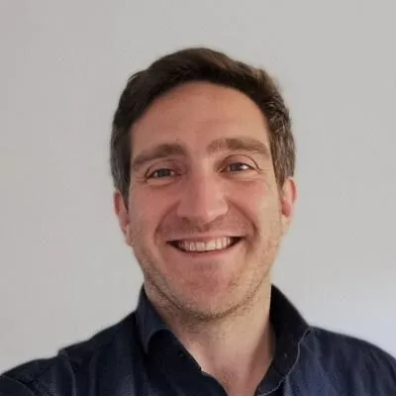
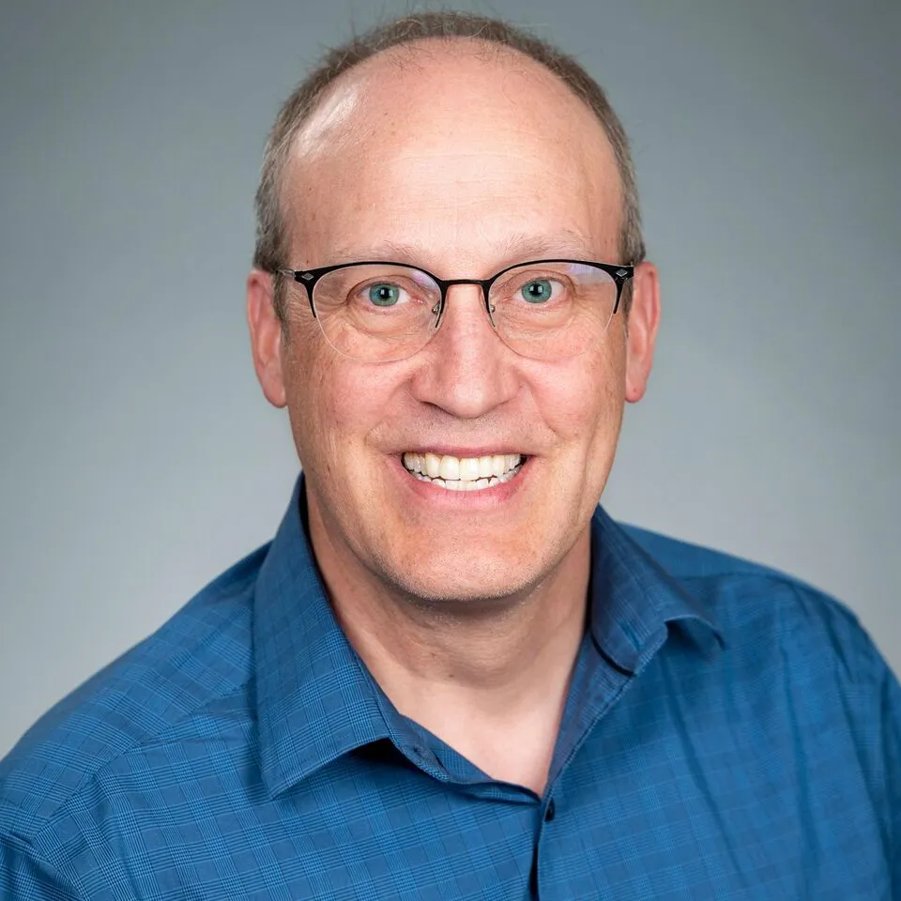
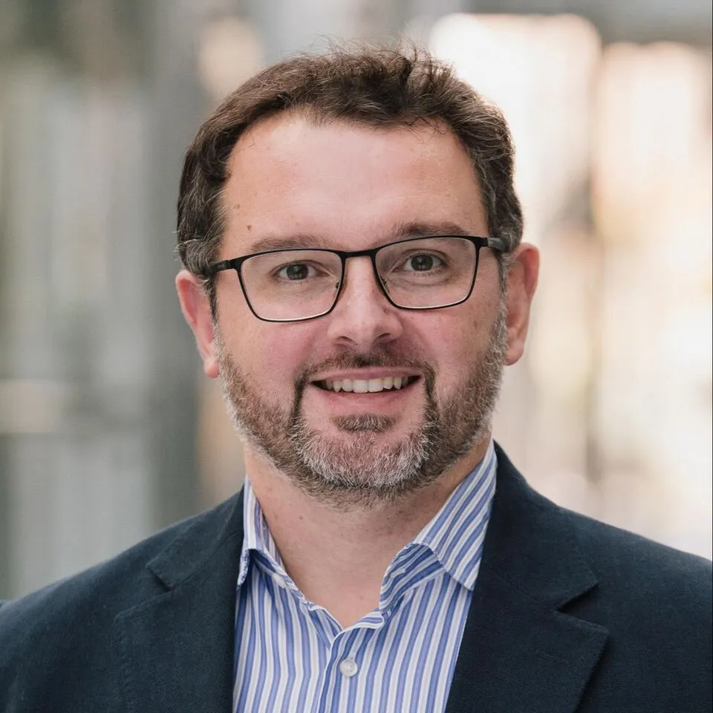
Questions? Ask the team!
Maximilian Melusin (1TD7)
Joel Woodward (1TD-A)
Luca Gragnaniello (1TDP)
COMPANY RESTRICTED

Slide 23
Ready to Try it?
Send me an e-mail: Luca.Gragnaniello@rohde-schwarz.com
COMPANY RESTRICTED

