Slide 1

Unity
Game Engine - Overview

Slide 2
What is Unity
Game Engine 2D / 3D
Developed by Unity Technologies
  → free personal (less than $100k revenue a year)
  → license

Slide 3
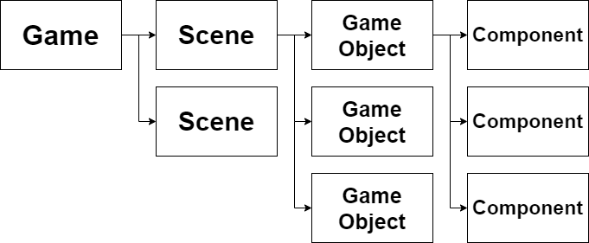
How does it work

Slide 4
More Features
Code in C#
Physics Engine
Own Renderer
Export Possibilities
  (Windows, Web, Android, ...)

Slide 5
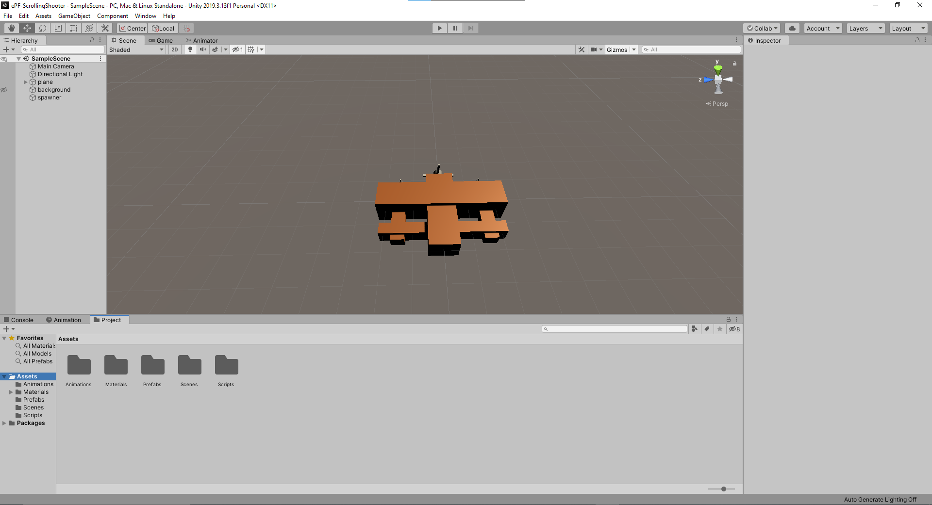
Hands On

Slide 6
Conclusion
+ Easy to use
+ high functionality
+ many resources
- license

