Slide 1
Suppose all C++ progs stopped working, then...
All cars would stop, since the MMU’s would fail
Which doesn’t matter because all TomToms would fail as well
Which doesn’t matter because all GPS satellites would drop out
So we’d stay home and watch TV, not Internet, since all routers would fail, as would all browsers
Only nothing nothing on TV, since all powerplants would fail, hence no transmissions
People wearing pacemakers would rather go to hospital then to stay home, since their devices would stop instantly
But being in hospital would be disappointing since all medical diagnostic devices would fail
Which wouldn’t matter since the doors wouldn’t open
Which would be good since the heating would fail
As in fact anything with real time controls like planes and ships
So also trains would be halted, but we’re used to that
In fact we’d run flat out of energy, solar, wind and oil and gas...

Slide 2
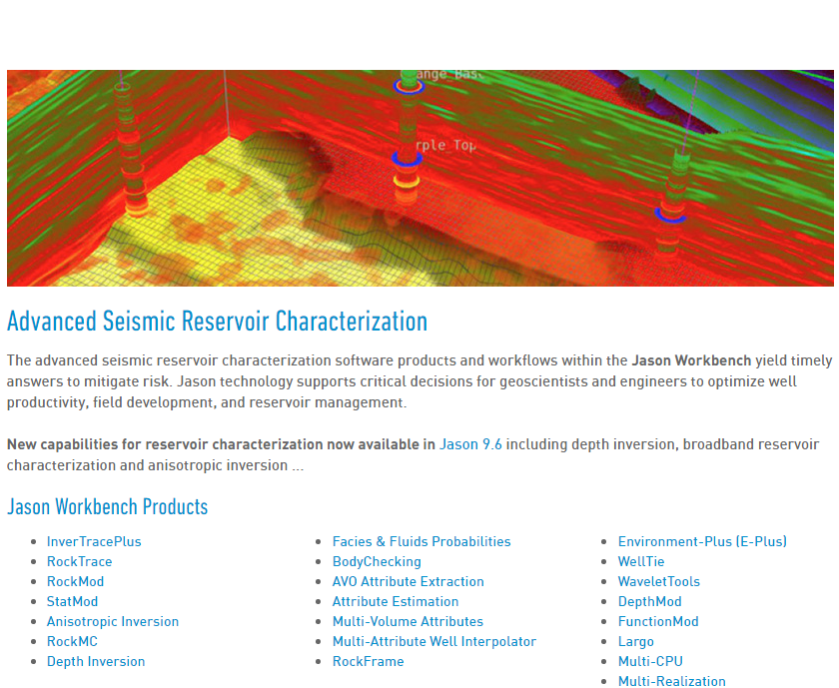
Refactoring 30 years x 20 devs worth of C++ code

Slide 3
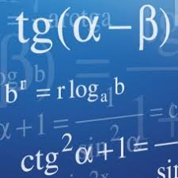
Company: Jason Geosystems
Founded in 1986
3 management / staff
2 mathematicians
20 developers all based in NL
100 consultants stationed worldwide
100 M$ market value
Sources of income:
Consultancy using own software
Licences
Customers: multinational oil companies

Slide 4
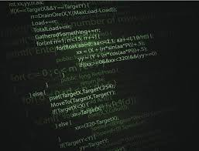
Software
JGW: 22 cooperating geoscience apps, all written in C++
300 person years
8 MB sourcecode
10 hours overnight integration + autotest
O (100 TB) + seismic data per field pre-stack
Unix / Solaris / Windows, accent on Linux
Human interfacing: command line / scripted / GUI / VR
C++ “layers”: 1986 pre-ARM -> 2018 post ISO/IEC 2017
Programming styles:
From : Fortran IV BLAS/LAPAC (goto’s with numerical labels)
Via: Mainstream OO (encaps., inherit., polymorph.)
To: Template metaprogramming
Dev. experience: 1 month -> 29+ years on the same package
Permanent hunt for experienced dev’s

Slide 5

Problems
New competitors move faster and look better, using new technologies
Even simple changes take more and more time
Each change seems to break something completely unrelated
Apps lack synergy, common datastructures, common look and feel
Typical “postdoc” matlab-style algorithmic code with one letter variables
Developers each on their own island
No overall design
No data lineage management, just hundreds of files with long names
Internal incompatibilities, e.g.
Pre-STL vs. STL containers
Polymorphic vs. template based fixed type datastructures
Fortran order vs. C order array storage
Big-endian vs. little-endian number storage
Compiler and platform differences (all autotests 3 x)
Effectively frozen: It works! Please don’t touch it!
Courage lost: NO, WE CAN’T

Slide 6

Balls OK, new tree needed
Infrastructure
Algorithms

Slide 7
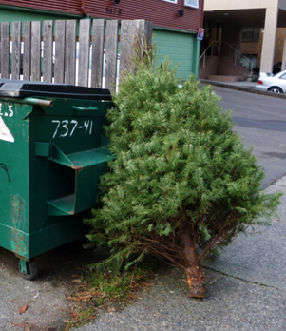


HOW?

Slide 8
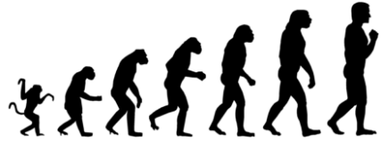
DQI (Design Quality Improvement)
No big bang. Evolutionary functional improvements grouped into projects of 4 person-months and a steady flow of releases remain leading
Inside each project, 20% of the time is devoted to infrastructure improvement, no special permission or projectnr needed, just book it on the project itself
After everly release we have a DQI step organized as a project participated in by all developers. A DQI step also takes about 10% of the calender time of a regular release

Slide 9
So like this:
RELEASE
RELEASE
RELEASE
dqi
dqi
dqi
PROJECT
PROJECT
PROJECT
dqi
dqi
dqi
PROJECT
DQI
PROJECT
DQI
PROJECT
DQI
dqi
dqi
dqi
PROJECT
PROJECT
PROJECT
TIME

Slide 10
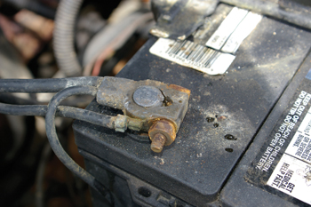
If it ain’t broke, don’t fix it
We do not touch the algorithms (balls), since they’re usually rock solid. But we may encapsulate them in a better API, e.g. suitable for scripting and autotesting
Rather than using STL directly in legacy code we use the facade pattern extensively to encapsulate STL containers in application-specific layers as they are used currently
We define a subset of C++ that’s compatible over multiple platforms, multiple compilers and multiple versions, and stick to that for at least 5 years, at least on API boundaries

Slide 11
App structure reflects org structure
App specialists
App specialists
UI
coordinator
Object
oriented
...
Script API
Function structured
...
Algorithms
coordinator
...
Tensor API
Data
coordinator
...
Hierarchical

Slide 12
During projects (20% of budget hours)
Curb expontial growth: undo code duplication, keep an eye on new employees
Refactor to common ground tensor facade if possible
Spend time on hidden quality and details
Respect the style of the code you’re working on (if present)
Try to factor out GUI and data storage from algorithms
For new modules provide an explicit command API
Walk through your code with a buddy

Slide 13

DQI during projects: pitfalls
Focussing on immediate results rather than on steady effort
Enforcing lowest common denominator coding practices
Refactoring time proven modules just because they aren’t following your favorite programming paradigm
Getting carried away by notational elegance: function chaining, operator overloading with copy on return, template metaprogramming that (almost) trips compiler
Having domain experts spend time on things like GUI coding, error handling and database integrity

Slide 14
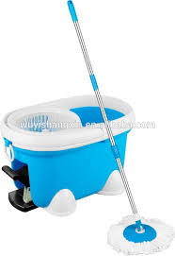
After a release (10% of budget hours)
Have the whole team clean the toilets, e.g.:
Replace returning error level by exceptions
Change containers to STL behind tensor facade
Change RAM storage order from Fortran to C
Introduce move semantics for operator returns
Align quantitative results c.q. document differences
Repair UI flaws prioritized by user feedback
Progressively replace native files by HDF5
After that: celebrate and relax!

Slide 15

DQI after release: pitfalls
Biting off more that you can chew in that 10% (Factor π)
Use that 10% for endless discussions with those few dev’s that are opposed to any change
Lack of coordination
Last minute integration testing
Maintaining that 10% too stricktly
Maintaining that 10% too loosely
No,
we can’t!

Slide 16

Signs of success
Source code size of modules shrinking by upto 90%
Design “comes together”: class hierarchies merged, enhanced use of virtual functions and polymorphism, observer pattern, stable, thin API’s
Synergy between DQI steps becomes visible, process speeds up, developers now propose steps that were first deemed infeasible
Despite DQI overhead, new versions come quicker, have less bugs, more new functionality and a better UI

Slide 17
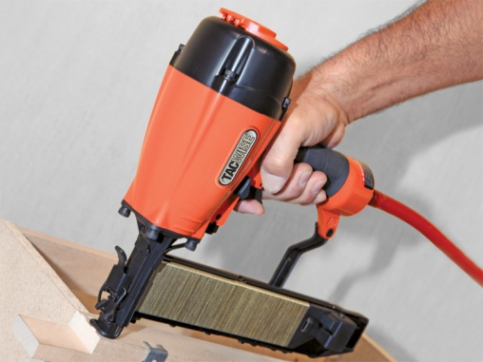
Some lessons learned unwillingly
It isn’t unethical to have a candidate C++ developer show and explain some of his/her code.
Many applicants truly believe they master C++ while not being able to distinguish int &i = j; from int i = &j;
Scripting languages aren’t always evil. Especially Python and C++ are a great combination.
Most carpenters have a nail tacker to complement their screwdriver.
Object orientation is truly great, but a means to an end.
For algorithm-type modules there’s nothing wrong with using top down functional decomposition.

Slide 18
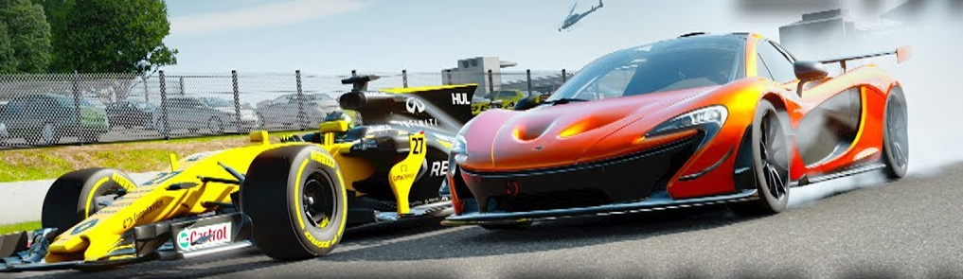
To aleviate the need for C++ devs we have to:
Make clear that C++:
Performs exactly as good as C, identical code being generated in comparable cases
Offers far better agility for large applications (hard, because most new dev’s consider 100 kB source fairly large)
Isn’t difficult, just different from knitting code for web apps
Be kind to newcomers, also on StackOverflow
Make clear Linus did his thing before C++ got standardized
Make clear e.g. ALL Arduino code is in fact C++ code

Slide 19

Predicting is hard, especially the future! Still...
C++ will be the basis of prominent technology stacks for at least 20 years
When looking for math routines (NumScrypt) for the Transcrypt Python to JS compiler,
it turned out that that the following C++ code:
Is at the heart of mainstream math libs in Python/Numpy, JavaScript, C# and F#
Is used in almost any application concerning the newest hype: ‘deeeeeeep learning’
Was written in the 1960’s in Fortran IV and was blindly ported via Algol 60 to C++
Is considered the fastest, most reliable in its kind, goto considered harmless...
if (n <= 0 || dflag == - 2.0) goto L140;
if (! (incx == incy && incx > 0)) goto L70;
nsteps = n * incx;
if (dflag < 0.) {
goto L50;
} else if (dflag == 0) {
goto L10;
}
For my students: See... Real men (M/F) put their { at the EOL ☺

Slide 20
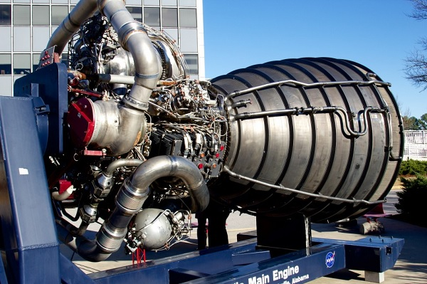
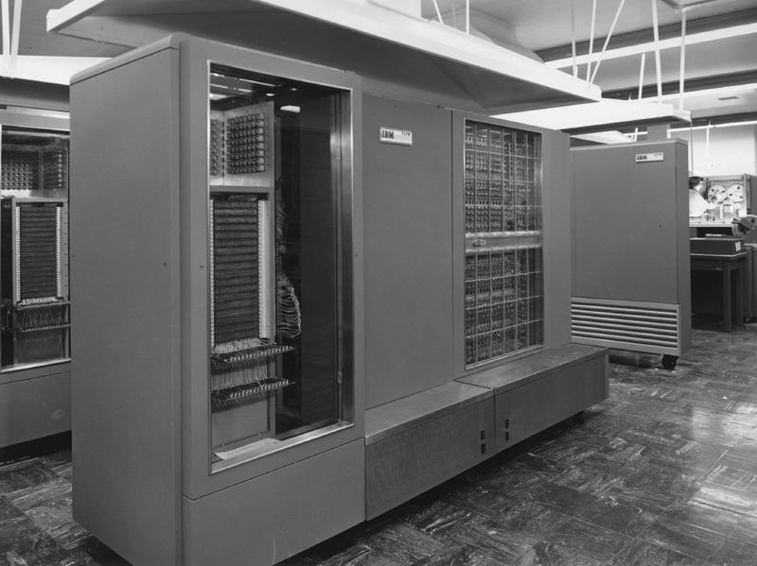
The value of proven technology
In 20 years NASA hopes to send people to Mars
They plan to use the engine on the left, by then aged 70+ years...
It’s the type that took Armstrong and Aldrin to the moon in 1969
What did a car look like in 70 years ago, so in 1948?
On the right: 4k RAM available to NASA in prep of Appollo project, your mobile holds 10,000,000 times more...

Slide 21

To anyone considering dipping a toe
It took 30+ years to fullfill C++’s promise of availability of seamlessly integrated high quality libs
It took 20+ years to solve C++’s problem of returning local tensors from overloaded operators, but now we have move semantics
It took 10+ years to run C++ in the browser, but now EmScriptEn does the trick
It’ll take 0+ years to dive into C++ rightnow and gradually discover that the water temperature is actually great
In 20+ years, it’ll be C++ flying man to Mars
Unless, of course, there are only JavaScript devs left... ☹

