Slide 1
Compression: Why? Shannon!
H = ²log S^n = n log S
H: information
S: number of symbols
n: messagelength
But what if we know what to expect?
So S = 2, n = 4 has same info content as S = 16, n = 1
Because 4 log 2 = 1 log 16
So we can e.g. code 4 bits as one hexadecimal number
4 random bits (16 r. messages):
H = - 16 * 1/16 ²log 1/16 = 4 bit
Entropy:
m: a possible message
p: probability
H = -Σ p(m) ²log p(m)

Slide 2
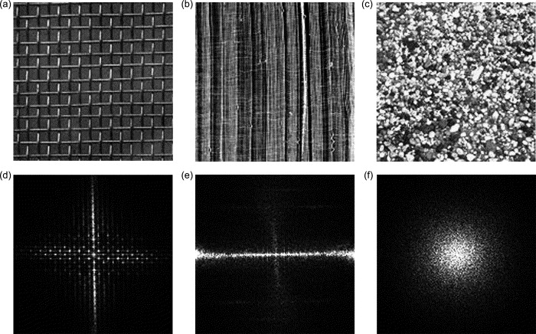
Image compression: Fourier
Time
Freq.

Slide 3
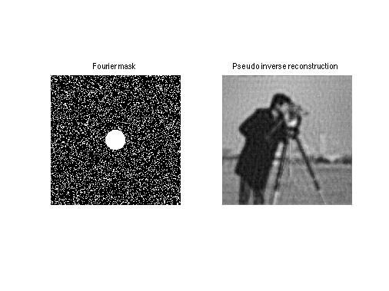
Fourier: filter out high spatial frequencies

Slide 4

Blockwise Fourier: blocking artefact

Slide 5
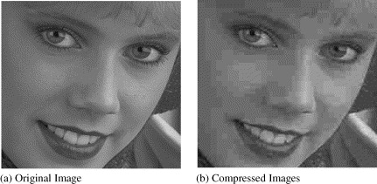
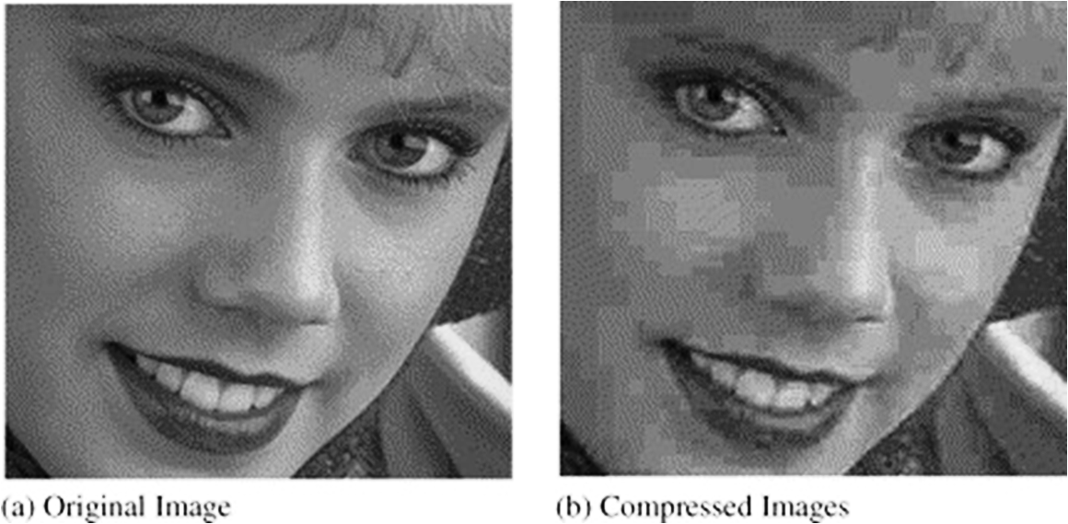
Quantisation artefact

Slide 6
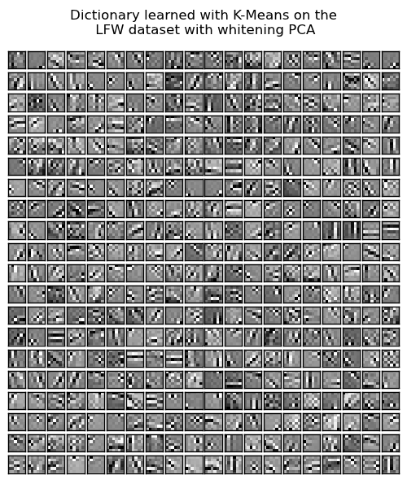
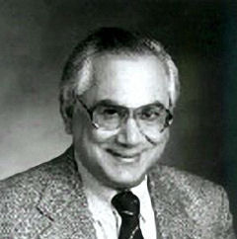
Vector quantisation

Slide 7
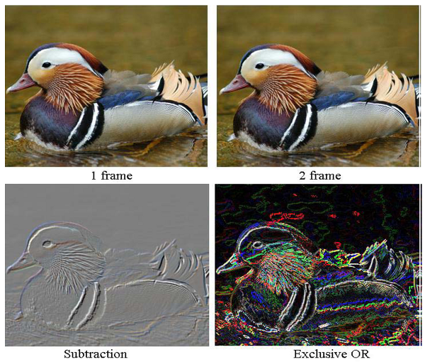
Inter-frame compression

Slide 8
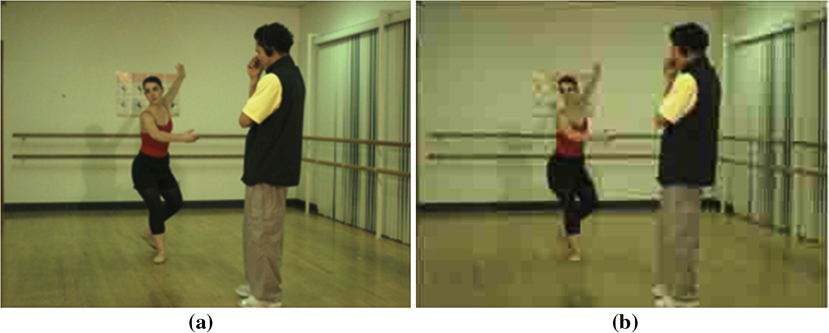
Inter-frame compression artefacts

Slide 9
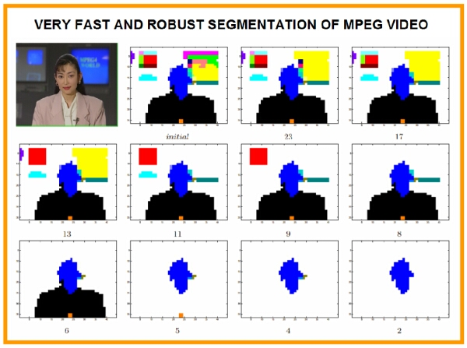
Segmentation: Use most bandwith for important parts

