Slide 1
Curved lines and planes
In many applications, curved lines and planes are needed:
Landscapes
Engineering models with fluent lines
Movement paths
A line is described by a mathematical function y = f(x)
A plane is described by a mathematical function z = f (x, y)
The explanation given here holds for lines, but the same concepts can be generalized to planes
Generally polynomial of degree n can connect n + 1 points
Example: y = f (x) = ax^n + bx^n-1 + cx^n-2 + ………. + px^1 + q
However such a polynomial tends to oscillate wildly, which is undesirable

Slide 2
Building up a line piecewise helps
The pieces have to fit together at least as follows:
Same y value at connections (no jumps)
Same y’ value at connections (first order derivative: smooth joint)
It takes polynomials of at least degree 3 to accomplish this:
y = f (x) = ax^3 + bx^2 + cx + d
( So y’ = f’(x) = 3ax^2 + 2bx + c )
To make a smooth connection:
(1) ax^3 + bx^2 + cx + d = y_left_neighbor
(2) 3ax^2 + 2bx + c = y’_left_neighbor
(3) ax^3 + bx^2 + cx + d = y_right_neighbor
(4) 3ax^2 + 2bx + c = y’_right_neighbor
4 equations with 4 unknowns have 1 exact solution!
In this way the line will go exactly through the specified points

Slide 3
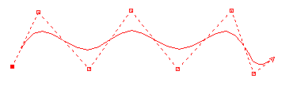
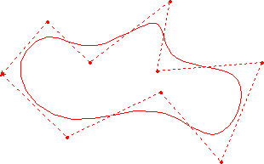
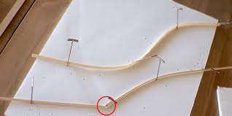
Bezier splines are another possibility Control points “attrackt” curve
A spline is a fluently bendable piece of wood

Slide 4
Mathematical description of B. spline
Capital letters denote vectors
Parameter: 0 <= t <= 1
Curves stay the same if t and t-1 are interchanged, s = t-1, rename s to t
Degree 1:
B = (1-t) A0 + t (A1)
A1
B
A0
Degree 2:
C = (1-t) B0 + t B1 = (1-t) [(1-t) A0 + t (A1)] + t [(1-t) A1 + t (A2)] ➔
C = (1-t)^2 A0 + 2t (1-t) A1 + t^2 A2
A1
A1
C
B1
A2
A0
B0
In this way the line will only approach intermediate points

Slide 5
B. spline of degree 1 (linear)

Slide 6
B. spline of degree 2 (quadratic)

Slide 7
B. spline of degree 3 (cubic)

Slide 8
B. spline of degree 4 (quartic)

