Slide 1
Displays: requirements
Resolution
Contrast
Brightness
Color rendition
Speed
Power consumption
Cost
Ruggedness
UV tolerance
Special features (3D, touch, swipe)

Slide 2
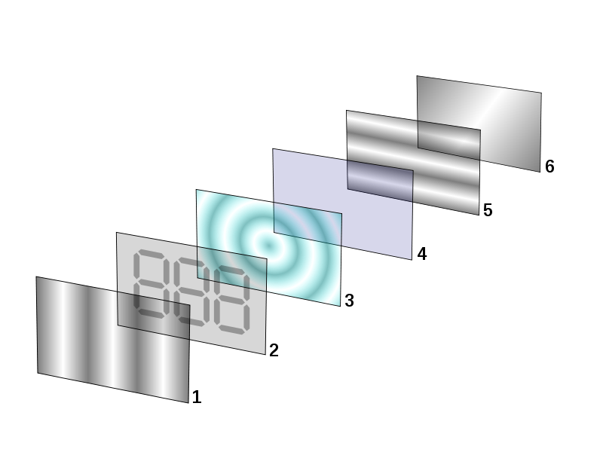
(Backlit) LCD: the common workhorse
Rotates polarisation angle of light falling through 2 perpendiculary polarized plates
Backlight: blue led with yellow phosphor give white impression, diffuser plate
Medium power consumption
(Still) limited view angle
Still a bit slow
Polarizing filter
“Per pixel” electrode
Liquid crystals rotate pol. angle
Common electrode
Polarizing filter, perpendic. to 1
Backlight or reflector

Slide 3
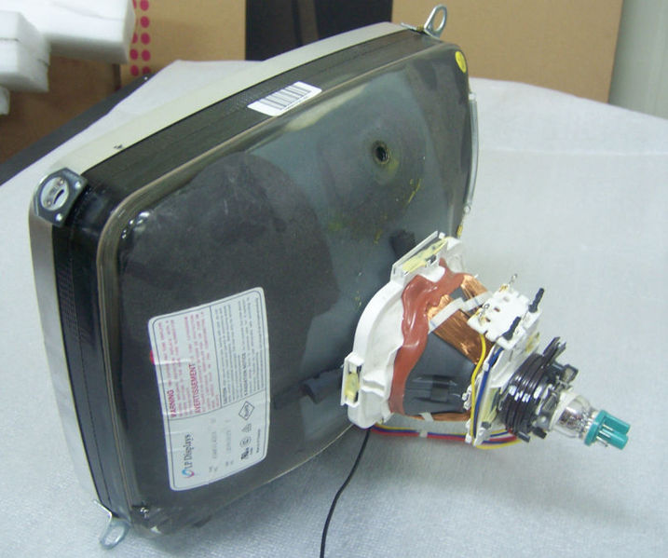
CRT: speed and vector graphics
Mass market declining
Niche markets:
High color fidelity (professional photography and video)
Wide view angle
High speed
High contrast
High resolutin
Vector displays
Light guns / light pens
Relatively low power consumption compared to high-end LCD
Can stand extreme cold and heath

Slide 4
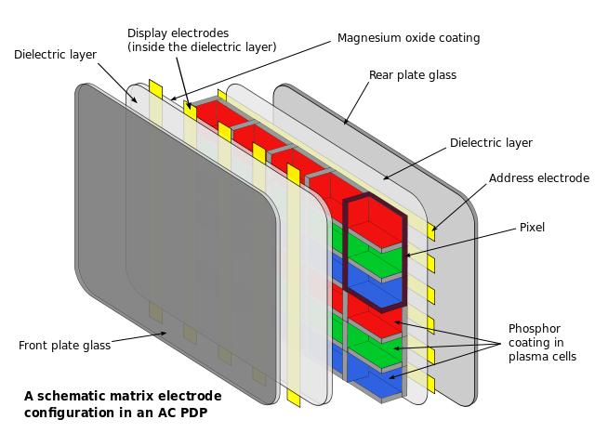
Plasma: very high contrast and speed
Cells filled with ionized gas (plasma), like TL lamp
Very high contrast, deep blacks
High speed
Wider view angle than LCD
Powerconsumption comparable to CRT
Prone to burn in and aging
Economically attractive for screendiag. > 80 cm
Good color rendition
Competed by LED

Slide 5
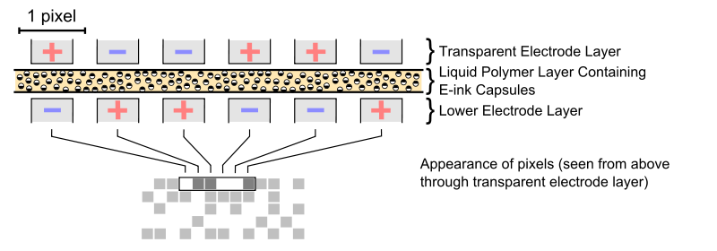
Electronic paper: low power, high contrast, readable in direct daylight
No back lighting, works with environment light, so intrinsically adaptive and low power
Can hold static text without any power consumption
Better contrast that ordinary newspaper
May be flexible (roll up)
Slow
Color just becoming available

Slide 6
Beamers: brightness and longevity?
Mostly use LCD’s with light falling through from a conventional lightbulb (longevity?)
LED’s and laser diodes on the rise
Used for smart boards, home cinema’s, promotional purposes, meeting room displays
Pico-projectors on the rise (connect to smart phone etc.)
Noise level may be important (cooling fan)
Not yet common in commercial cinema due to quality limitations, due to change

Slide 7
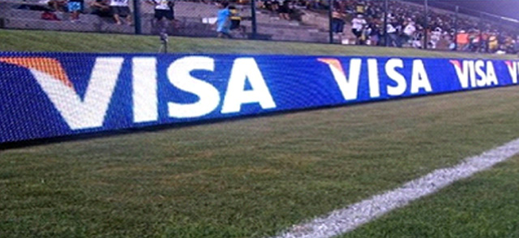
LED: big, bright and expensive
140 m² no exception
Visible even in direct sunlight
About $3000/m², but quite profitable (soccer)
Special driver software
High power consumption

Slide 8
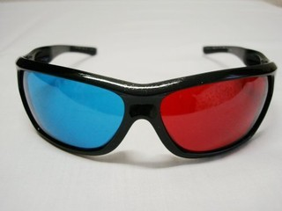
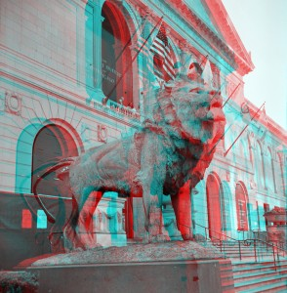
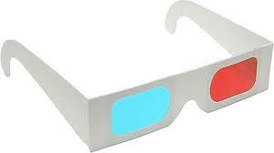
3D displays: Anaglyph
Cheap glasses
No special display
“Normal” colors visible after getting used to
Stereoscopic

Slide 9
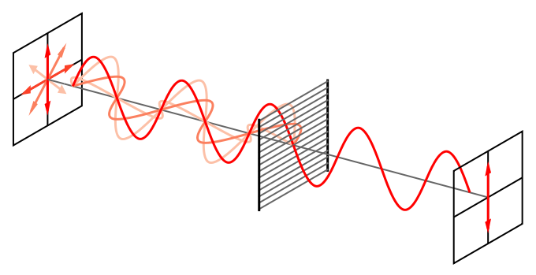
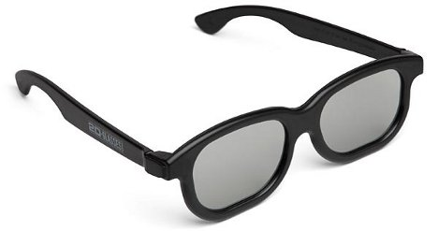
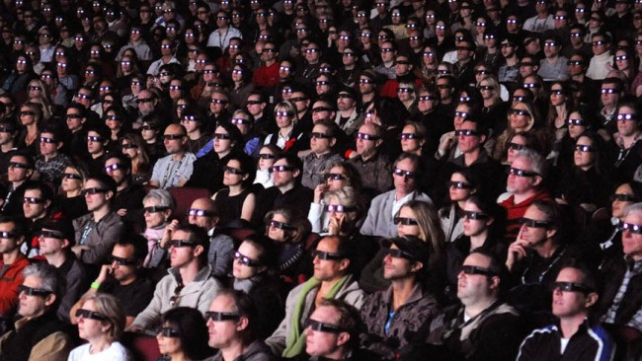
3D displays: Polarized
Good image, no false color
Special display
Medium cost glasses
Popular (cinema)
Stereoscopic

Slide 10
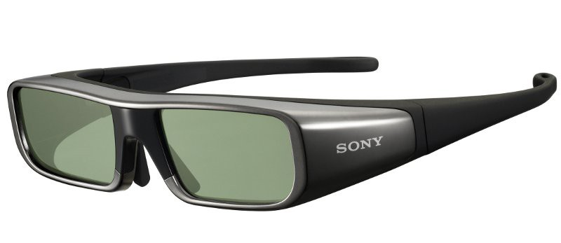
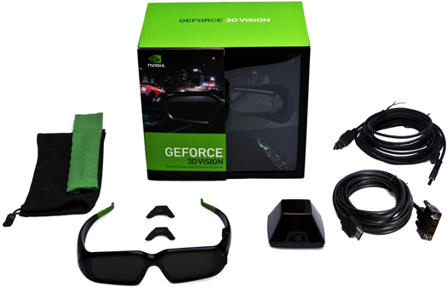
3D displays: Shutter
Good image separation
Expensive
Stereoscopic
Interface to normal display

Slide 11
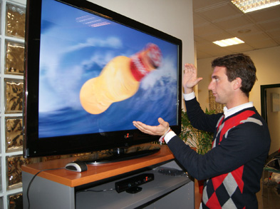
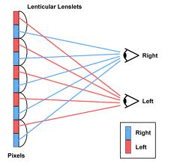
3D displays: Auto-stereoscopic
No glasses
Special expensive display
Limited view angle
Trend for television sets

Slide 12
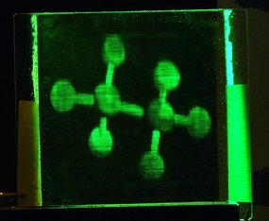
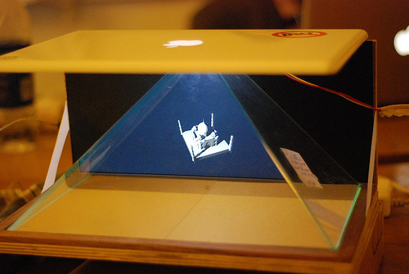
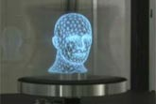
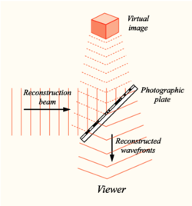
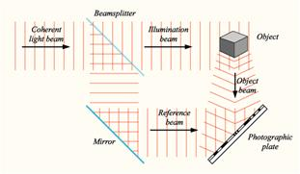
3D displays: Holographic
(ethane molecule model)
The future
Not stereoscopic but true multi-angle
Very high bandwith
Very high screenresolution needed
Outdoor settings problematic
studio
display

