Slide 1
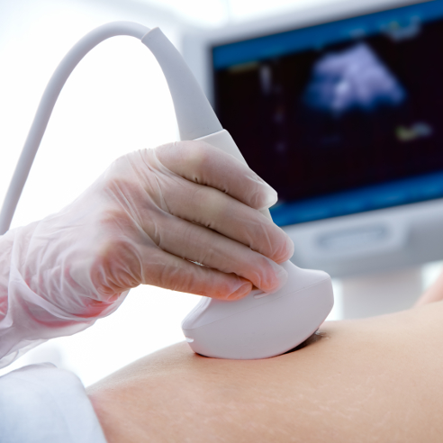
Modality: ultrasound

Slide 2
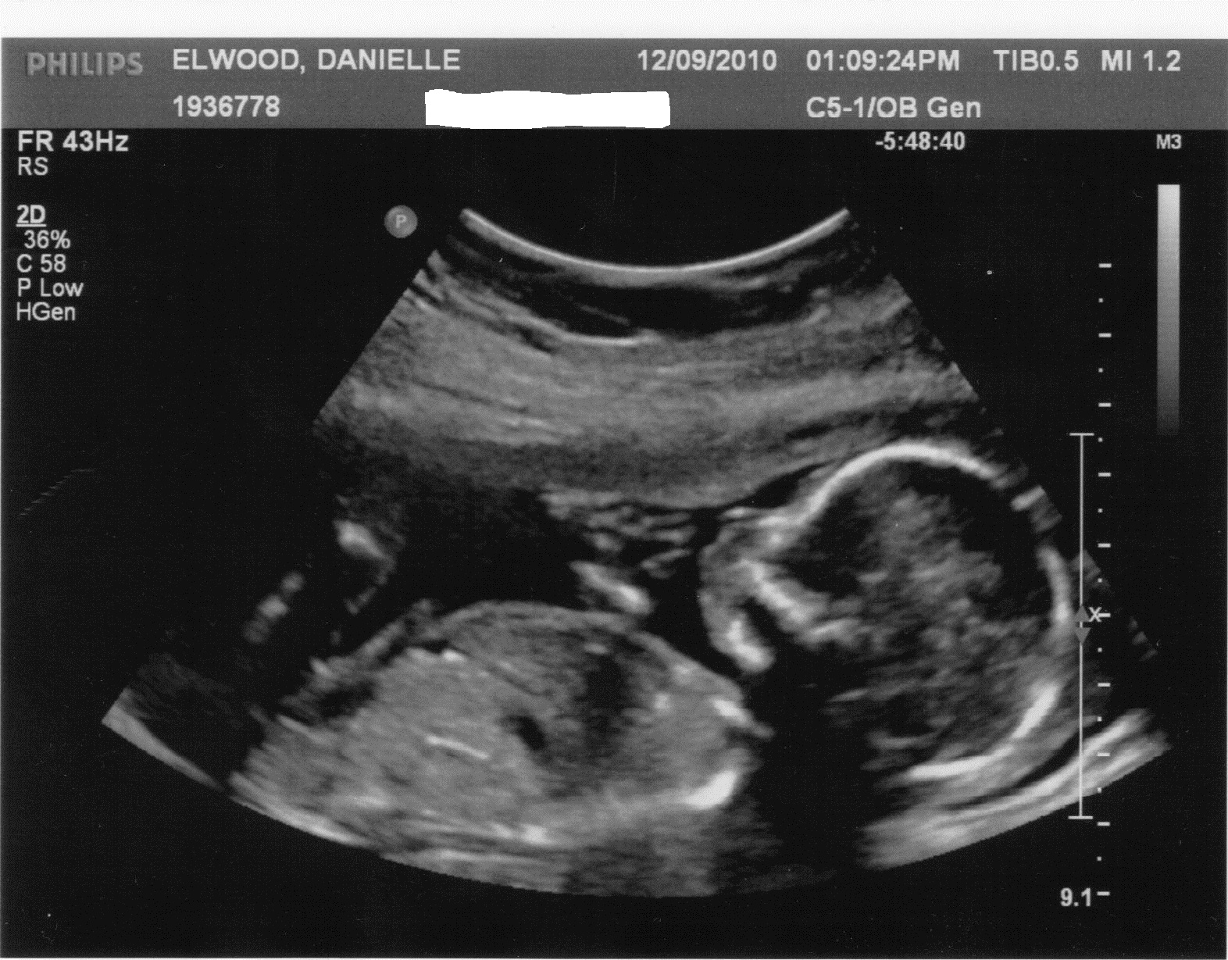
Ultrasound: 2D view

Slide 3
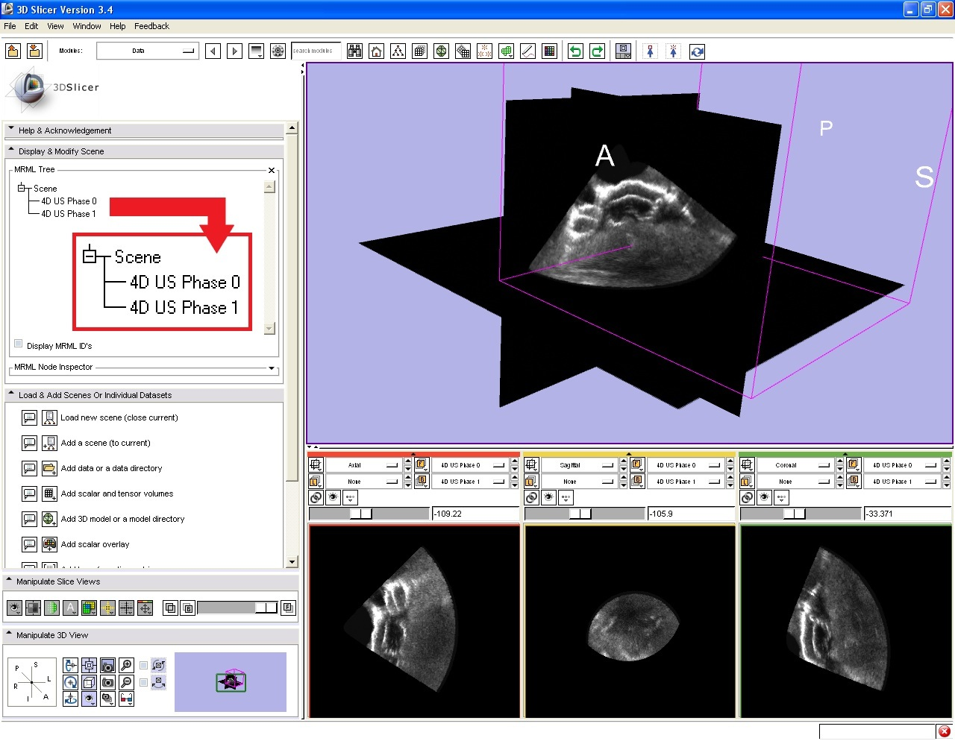
Ultrasound: sliced 3D view

Slide 4
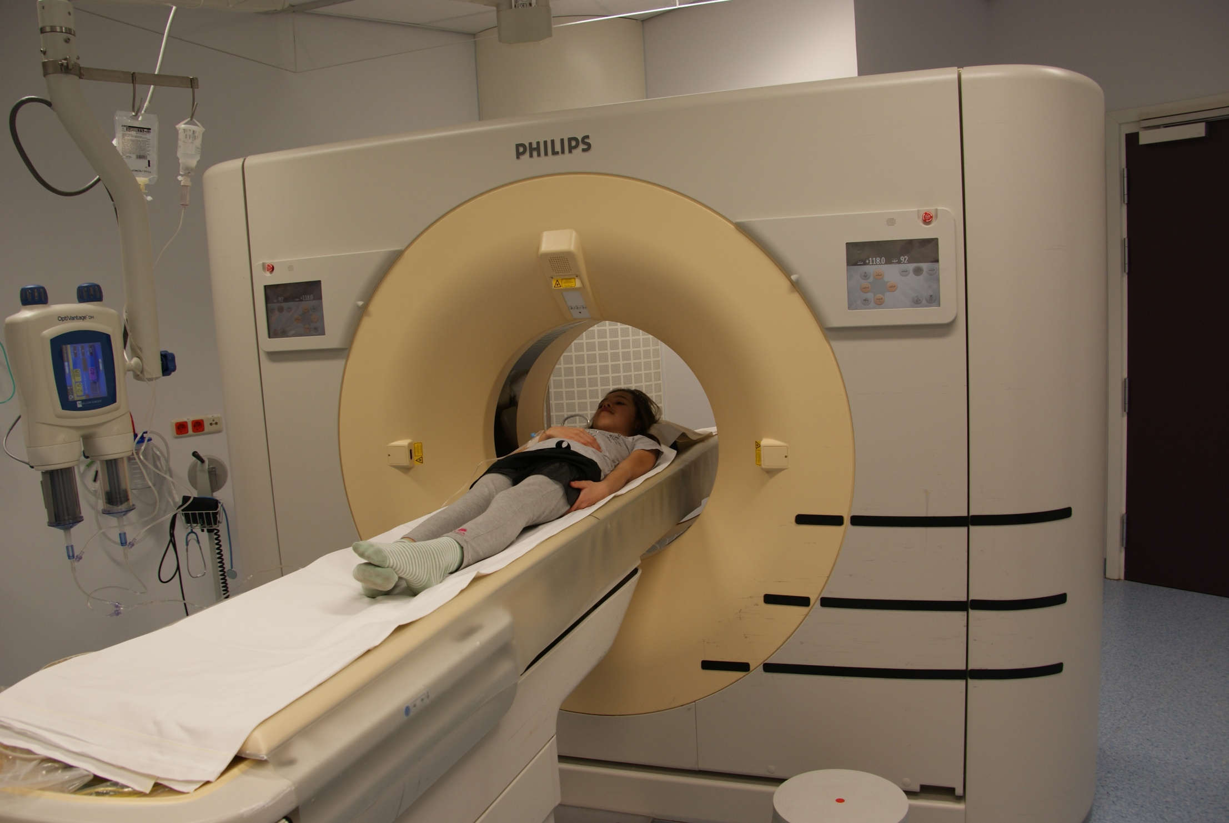
CT scan: röntgen tomography

Slide 5
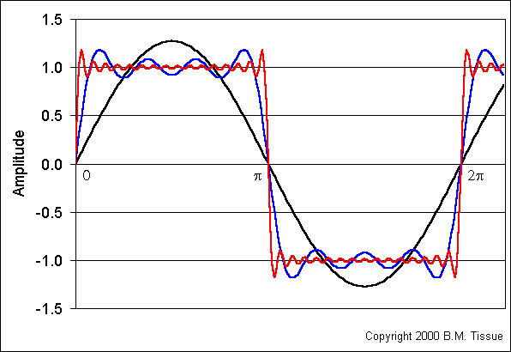
Fourier transform: 1D

Slide 6
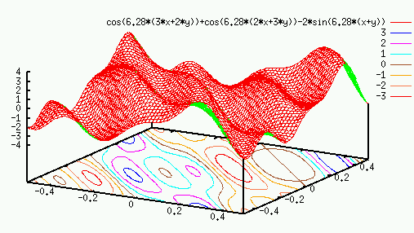
Fourier transform: 2D

Slide 7
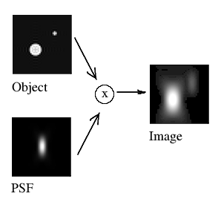
Convolution with point spread function

Slide 8

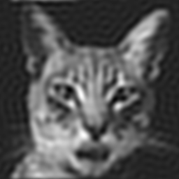
Leave out high freq’s: ringing

Slide 9
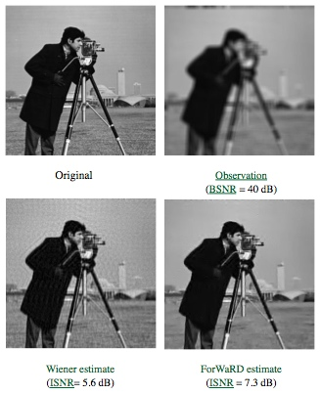
Image restauration: deconvolution

Slide 10
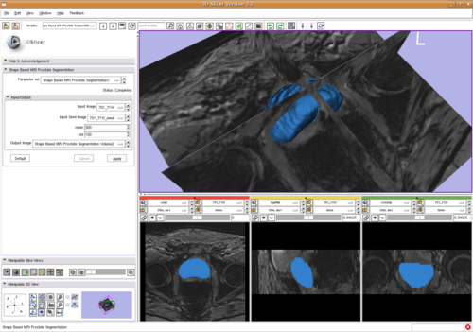
MRI scan after segmentation: modelling

Slide 11
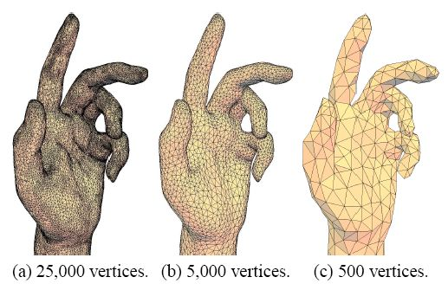
Modelling: surface mesh

Slide 12
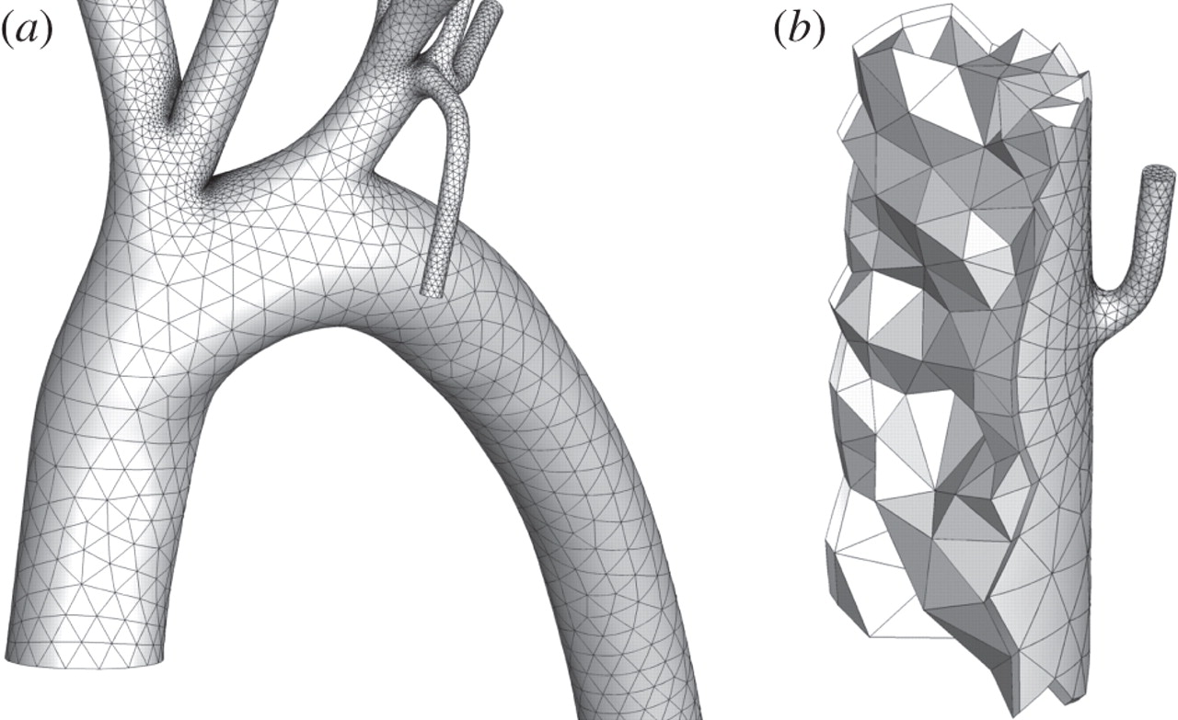
Modelling: volume mesh

Slide 13
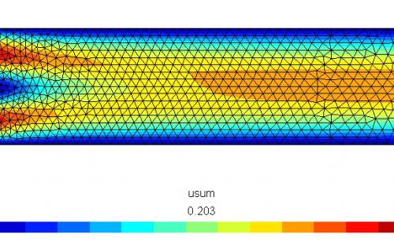
Fluid flow etc.: finite element method

Slide 14
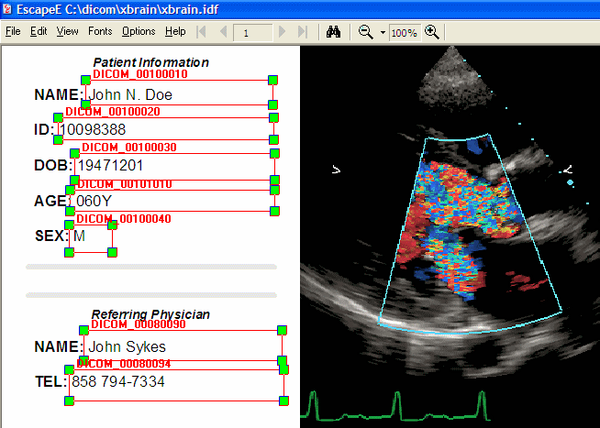
DICOM: images + patient info

