Slide 1
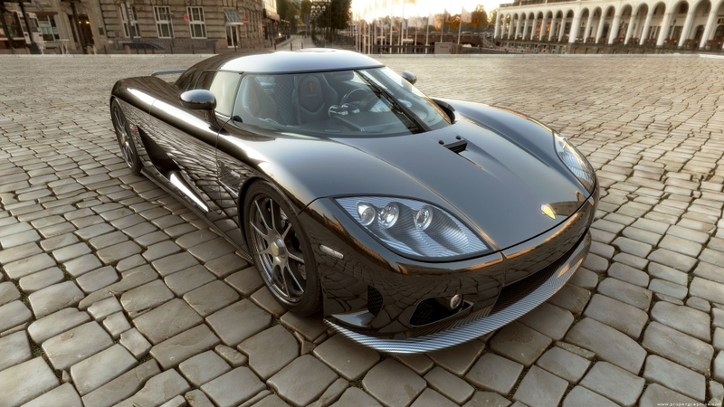
Photorealistic images: how?

Slide 2
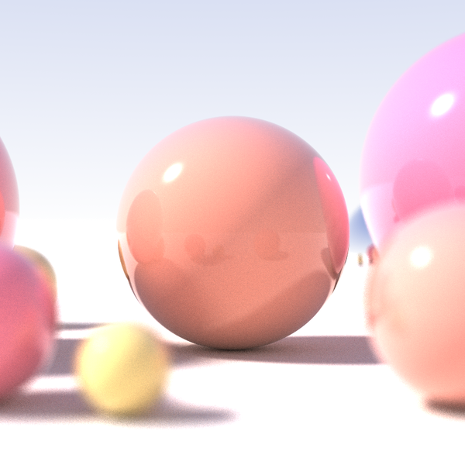
Ray tracing!

Slide 3
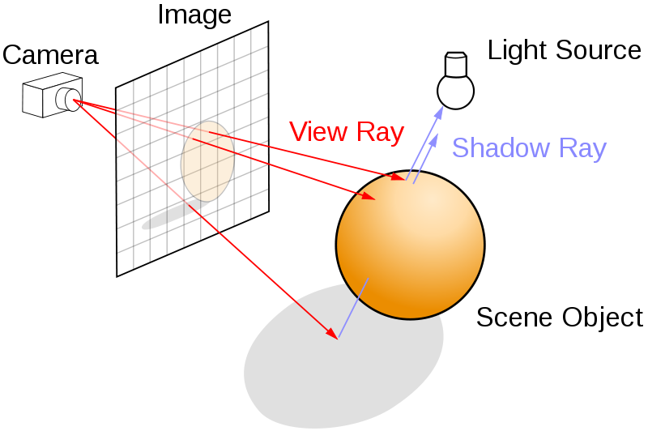
Follow a ray into the scene for each pixel

Slide 4
Raytracing: entirely diffent
No:
Triangular surface mesh
Wireframes
Transformations
Hidden line removal
Texture mapping
But:
Continuous math model
Model assembly
Follow each ray, see what it hits
Follow each ray back and let it tell the story
Number of rays == Number of pixels

Slide 5
How exactly: part 1
Procedure RenderPicture()
For each pixel on the screen,
Generate a ray R from viewing position through the point on the view
plane corresponding to this pixel.
Call the procedure RayTrace() with the arguments R and 0
Plot the pixel in the colour value returned by RayTrace()
Next pixel
End Procedure

Slide 6
How exactly: part 2
Procedure RayTrace(ray R, integer Depth) returns colour
Set the numerical variable Dis to a maximum value
Set the object pointer Obj to null
For each object in the scene
Calculate distance (from the starting point of R) of nearest
intersection of R with the object in the forward direction
If this distance is less than Dis
Update Dis to this distance
Set Obj to point to this object
End if
Next object

Slide 7
How exactly: part 3
If Obj is not null
Set position var. Pt to nearest intersection pt of R and Obj
Set the total colour C to black
For each light source in the scene
For each object in the scene
If this object blocks light coming from light source to Pt
Attenuate intensity of received light by transmittivity
of the object
End if
Next object
Calc. perceived colour of Obj at Pt due to this light source
using the value of the attenuated light intensity
Add this colour value to C
Next light source

Slide 8
How exactly: part 4
If Depth is less than a maximum value
Make 2 rays Rfl and Rfr in reflect. and refract. directions,
starting from Pt
Call RayTrace with arguments Rfl and Depth + 1
Add (the return value * reflectivity of Obj) to C
Call RayTrace with arguments Rfr and Depth + 1
Add (the return value * transmittivity of Obj) to C
End if
Else
Set the total colour C to the background colour (terminate)
End if
Return C
End Procedure

Slide 9
Pro’s and con’s of ray tracing
+
Simple in comparison to OGL way
Very realistic
-
Very time and memory consuming
Continuous math modelling and assembly is hard
Conclusion: it has its own niche (and can be combined with the “ordinary” way)

