Slide 1
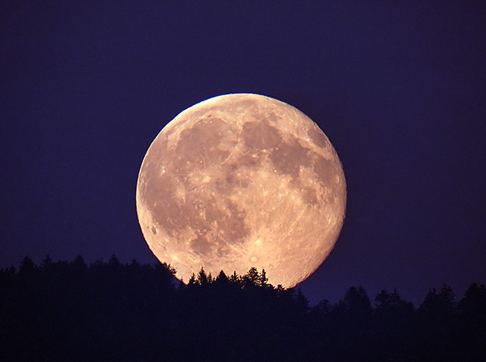
Notes:
Moon trees

Slide 2
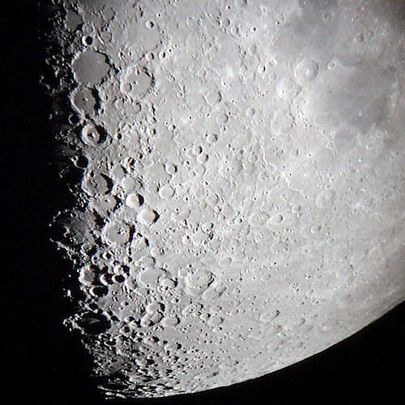
Notes:
Moon through telescope

Slide 3
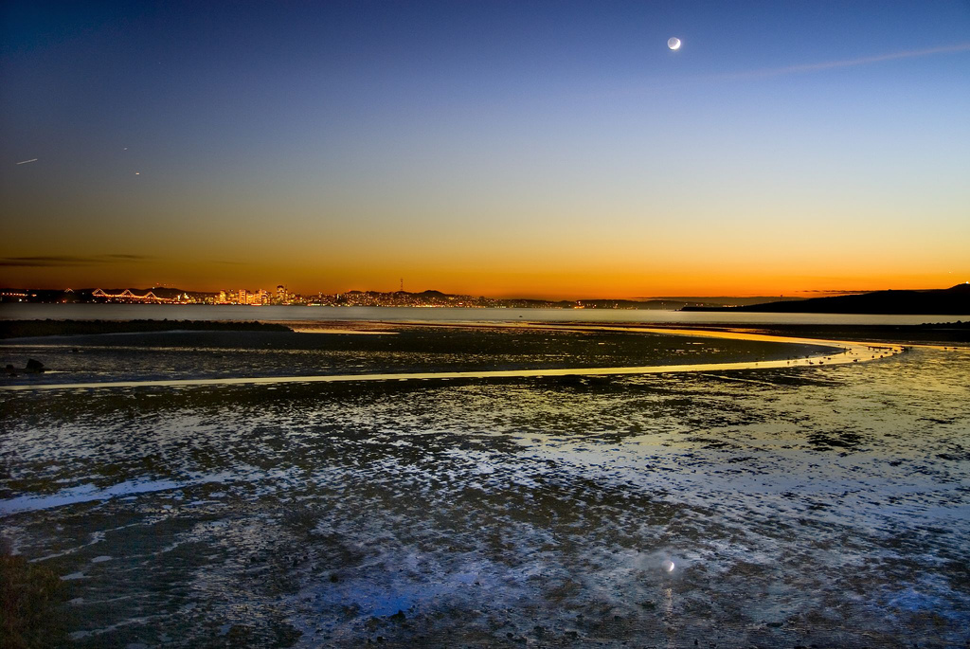
Notes:
Low tide moon

Slide 4
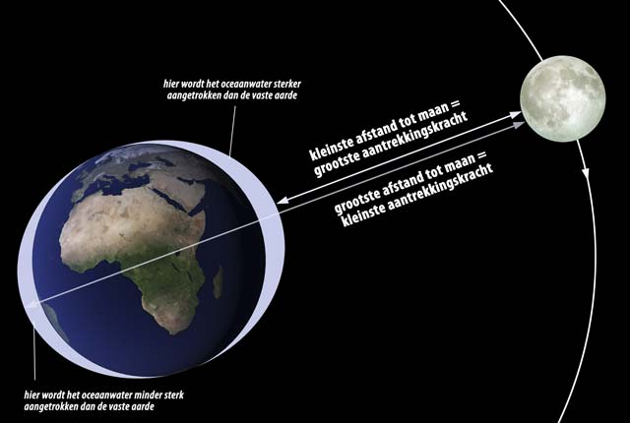
Notes:
Tides explanation

Slide 5
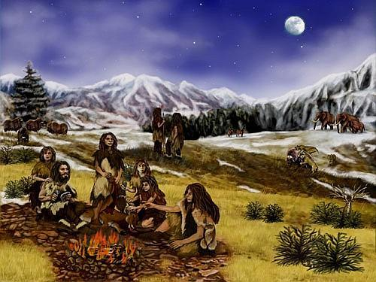
Notes:
Neandertal people

Slide 6
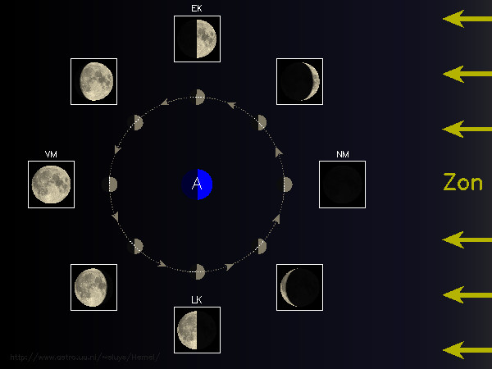
Notes:
Phases

Slide 7
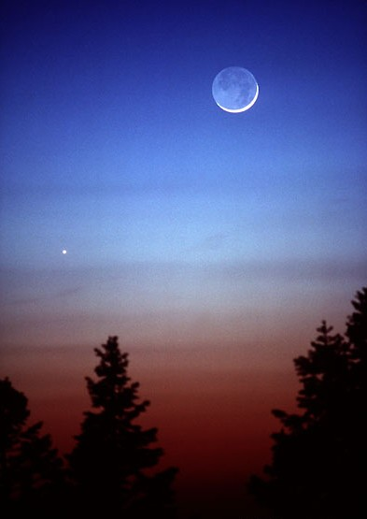
Notes:
Moon, earthshine, Venus

Slide 8
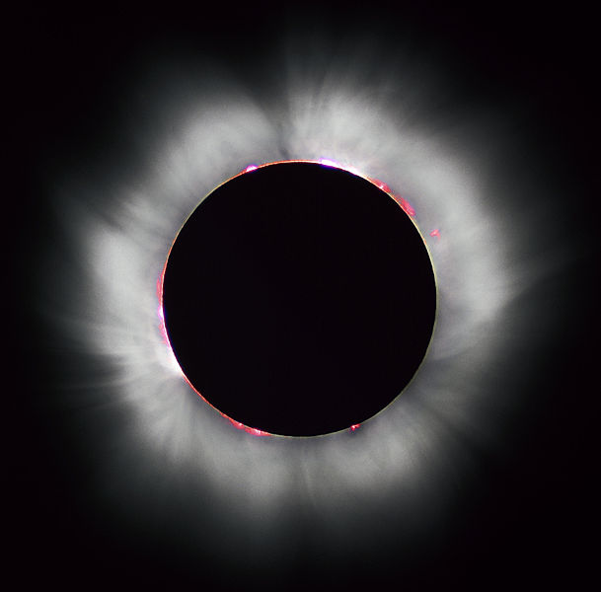
Notes:
Solar eclipse 1999

Slide 9
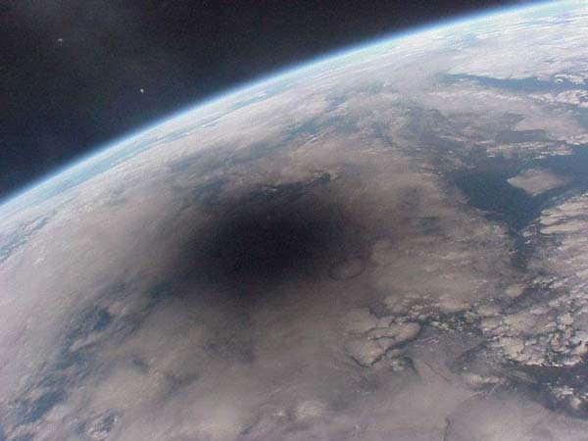
Notes:
Lunar shadow

Slide 10
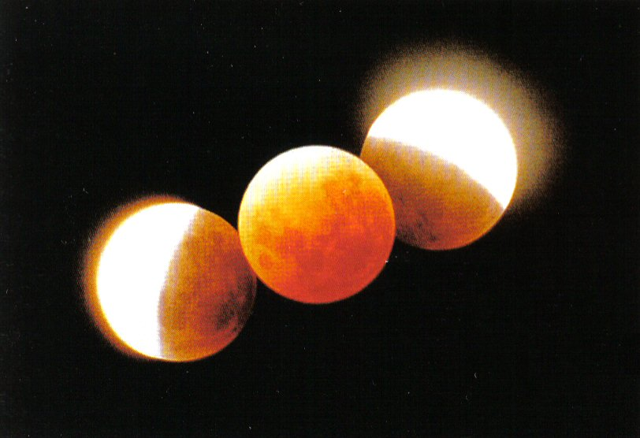
Notes:
Lunar eclipse

Slide 11
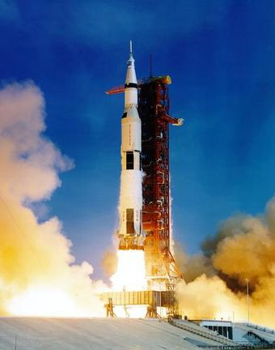
Notes:
Rocket Saturn V from far

Slide 12
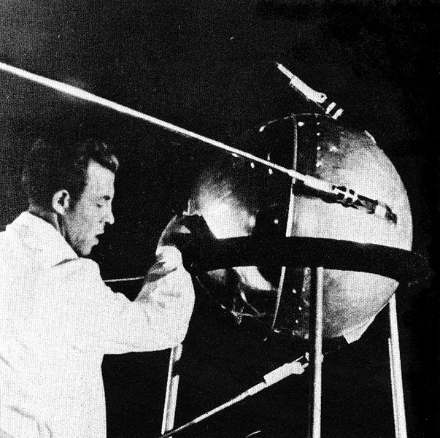
Notes:
Sputnik

Slide 13
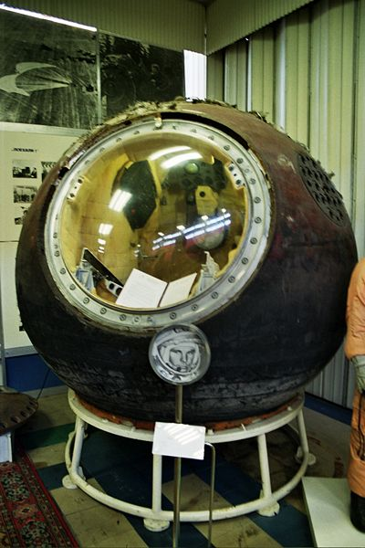
Notes:
Vostok

Slide 14
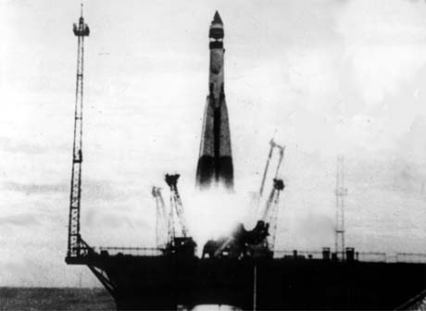
Notes:
Sputnik launch

Slide 15
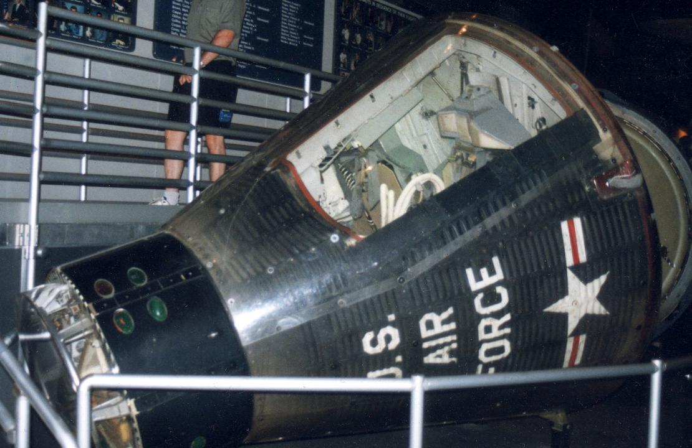
Notes:
Gemini

Slide 16
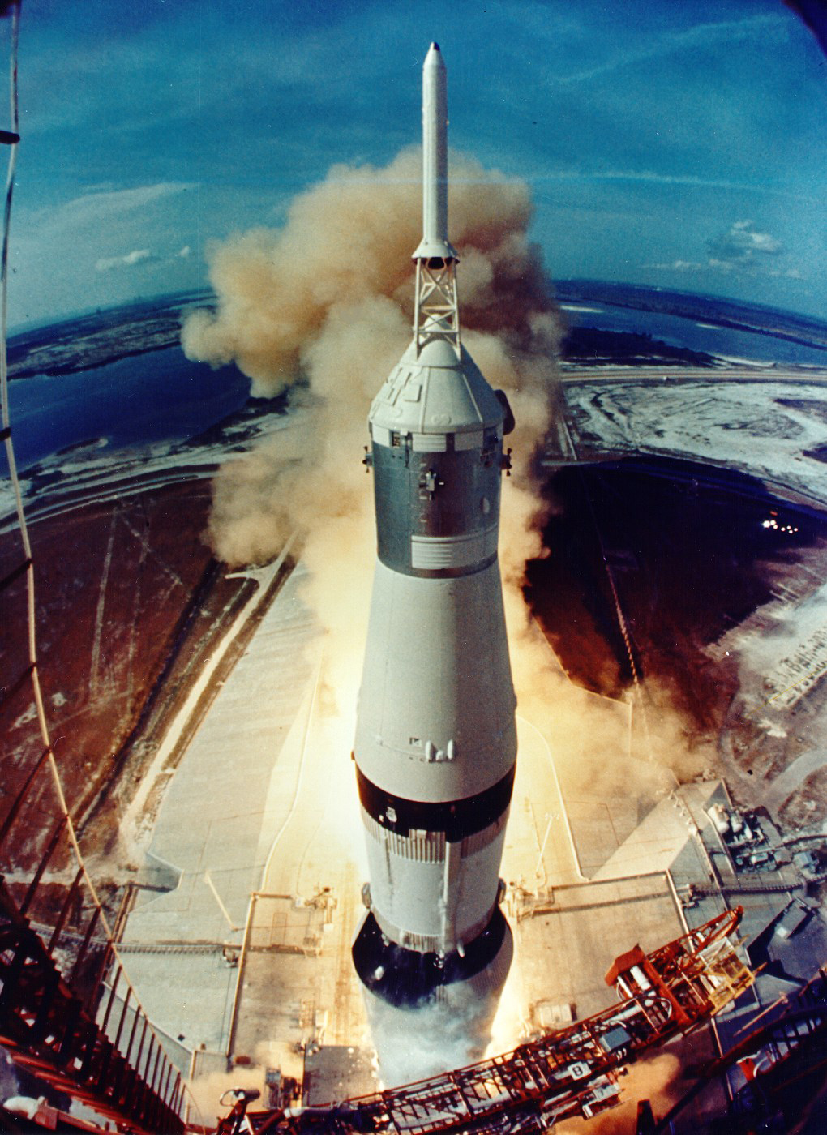
Notes:
Rocket Saturn V closeup

Slide 17
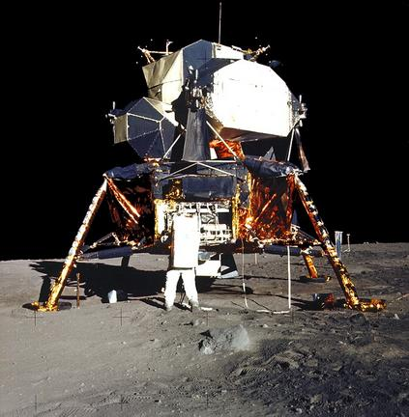
Notes:
LEM Aldrin on moon

Slide 18
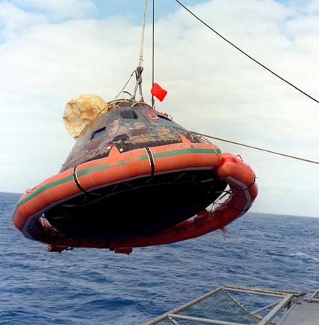
Notes:
Command Module in water

Slide 19
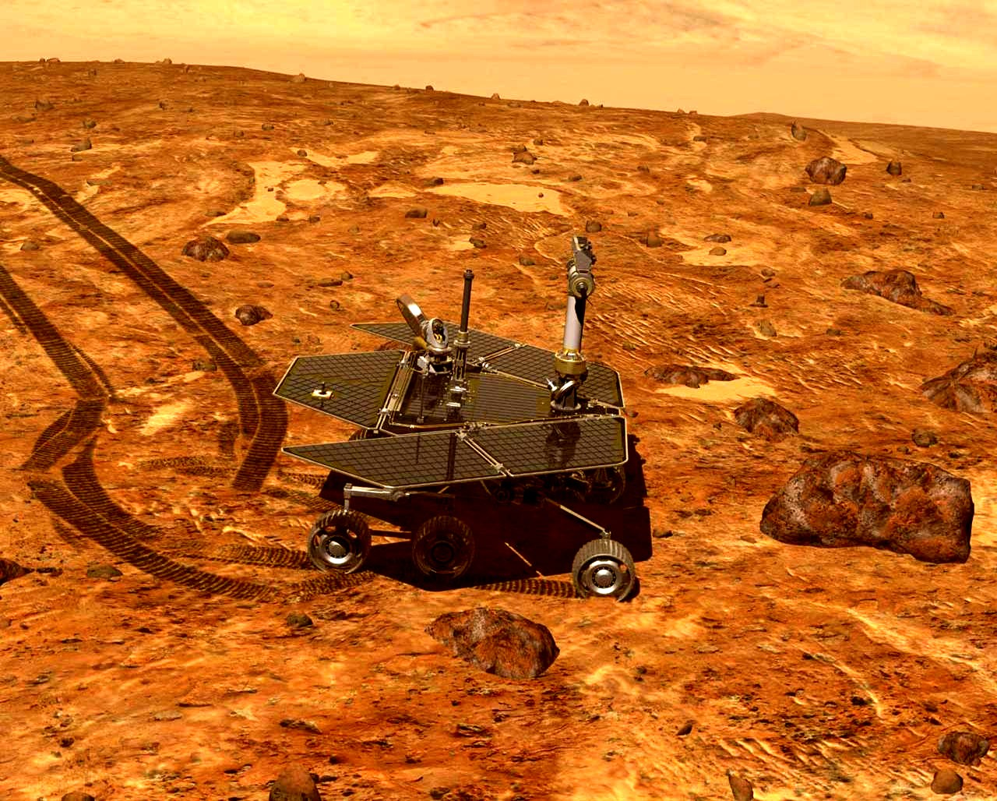
Notes:
Mars Rover

Slide 20
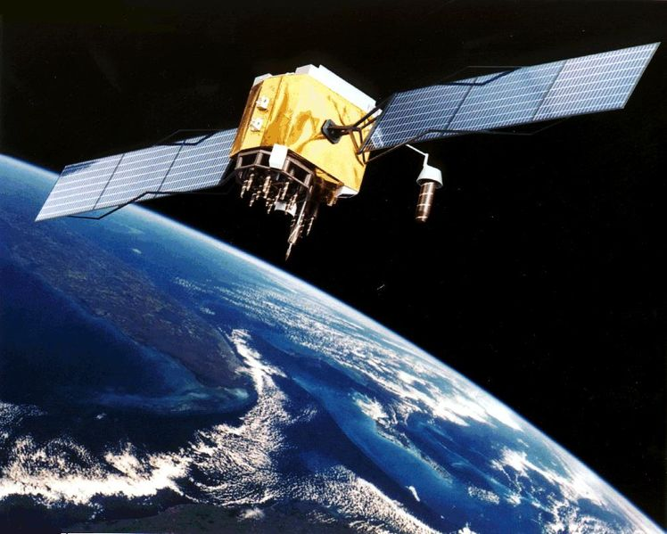
Notes:
GPS satelite

Slide 21
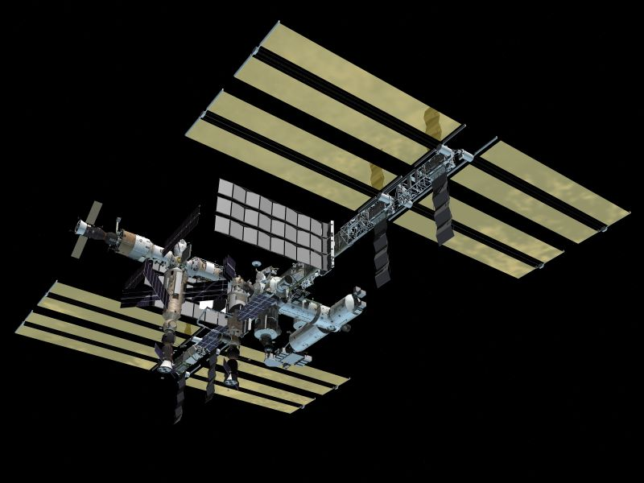
Notes:
ISS artist impression

Slide 22
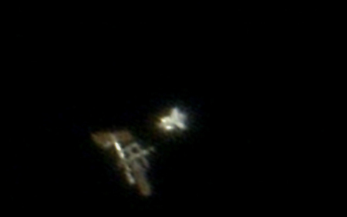
Notes:
ISS Shuttle telescope

Slide 23
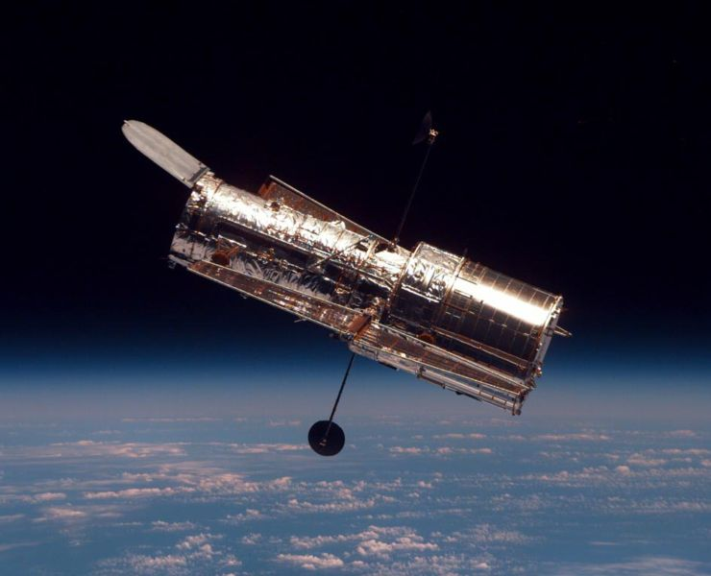
Notes:
Hubble

