Slide 1
Z-Scores: How You Can Compare Apples With Oranges
GIJC 2015 Lightning Talks
Robert Gebeloff
rgebeloff@nytimes.com
@gebeloffnyt

Slide 2
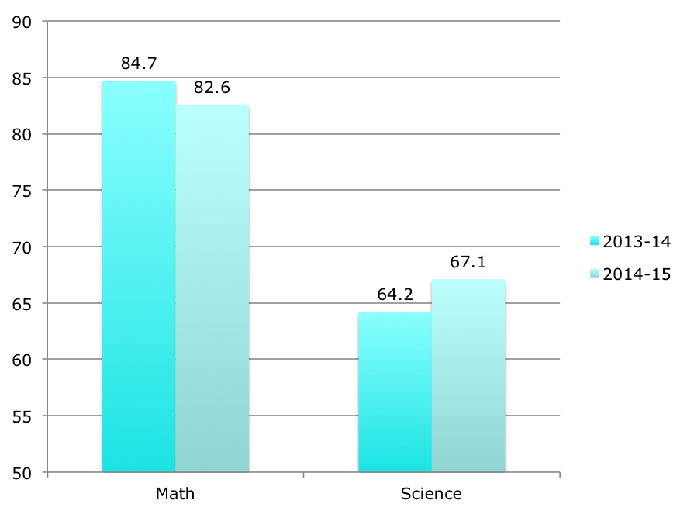
Z-Scores: How You Can Compare Apples With Oranges
This is the passing rate on Math and Science tests for a school for this year vs last year. On which test did the school improve the most?

Slide 3
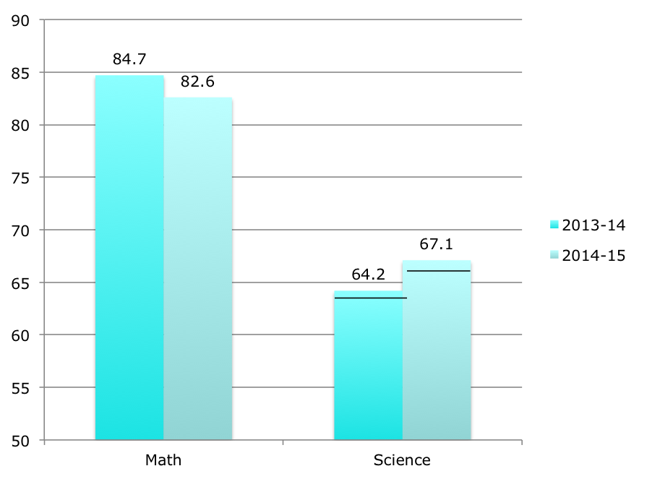
Z-Scores: How You Can Compare Apples With Oranges
If I draw some lines to show how the average school did, does the story change?

Slide 4
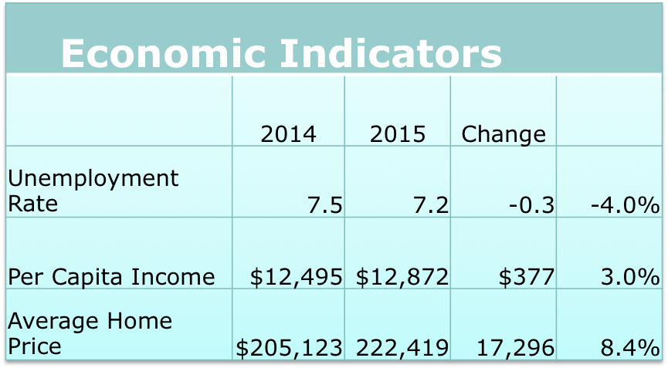
Z-Scores: How You Can Compare Apples With Oranges
How do these economic indicators compare? Are home prices doing better than the other two categories?

Slide 5
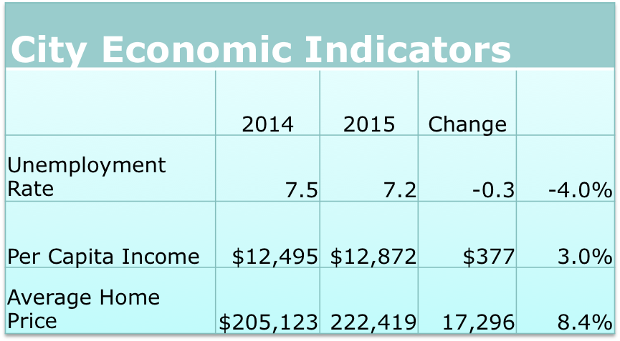
Z-Scores: How You Can Compare Apples With Oranges
You really can’t say for sure.
Each is on a different scale
There is no context through comparison

Slide 6
Z-Scores: How You Can Compare Apples With Oranges
The problem:
You want to compare two variables but you can't because they're on different scales.
You want an easier way to describe how far a value is from "normal".
You want to build an index of many variables and you want an easy, mathematically correct way of doing the combining

Slide 7
Z-Scores: How You Can Compare Apples With Oranges
Z-scores are here to help. Z-scores are a way to "standardize" your data so everything is on the same scale.

Slide 8
Z-Scores: How You Can Compare Apples With Oranges
Z-scores are here to help. Z-scores are a way to "standardize" your data so everything is on the same scale.
For any value in a distribution, the Z-score is the distance from the mean in standard deviations.

Slide 9
Z-Scores: How You Can Compare Apples With Oranges
Z-scores are here to help. Z-scores are a way to "standardize" your data so everything is on the same scale.
For any value in a distribution, the Z-score is the distance from the mean as counted in standard deviations.
Z-scores are tied to the "standard normal distribution", which means that they can easily be converted to an easy-to-understand 100-point scale.

Slide 10
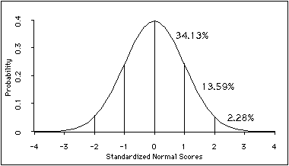
Z-Scores: How You Can Compare Apples With Oranges
The idea with z-scores is to be able to say, for example, that if a school's average test score is 1 standard deviation above the mean, that's the equivalent of performing in the 84th percentile in a normal distribution (50 +34.13).
An interactive guide to the standard normal distribution:
http://www.measuringu.com/normal_curve.php

Slide 11
Z-Scores: How You Can Compare Apples With Oranges
CUT TO SPREADSHEET….

Slide 12
Z-Scores: How You Can Compare Apples With Oranges
The formula: z = (v-avg(v))/stdev(v))
where v is the variable, avg(v) is the average of the variable and stdev(v) is the standard deviation of the variable.
In an Excel spreadsheet, the formula looks like this:
= (B2-(AVERAGE(B$2:B$783)))/STDEV(B$2:B$783)
You can then convert the z-score to the percentile value using the "Normsdist" function:
=NORMSDIST((B2-(AVERAGE(B$2:B$783)))/STDEV(B$2:B$783))

Slide 13
Z-Scores: How You Can Compare Apples With Oranges
In SQL, you can calculate z-scores using a subquery that joins the average and standard deviation to the individual values. This is an example in MySql – we are calculating z-scores for school enrollment in the year 2010 from a table called ceps:
SELECT a.school_id, a.year, enrollment,b.mean,b.standard_deviation, (enrollment-b.mean)/b.standard_deviation AS z_score
FROM ceps a
INNER JOIN (SELECT YEAR, AVG(enrollment) AS mean, STDDEV(enrollment) AS standard_deviation FROM ceps GROUP BY YEAR) b
ON a.year=b.year
WHERE a.year=2010
ORDER BY enrollment DESC

Slide 14
Z-Scores: How You Can Compare Apples With Oranges
In SPSS, go to analyze, descriptive statistics, descriptives, pick your variable and click "Save Standardized Values as Variables".
In R, you can try this: http://rtutorialseries.blogspot.com/2012/03/r-tutorial-series-centering-variables.html

Slide 15
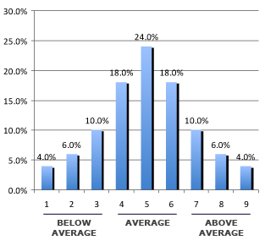
Z-Scores: How You Can Compare Apples With Oranges
Since Z-scores are tied to the normal distribution, and since you can convert them to a 100 point scale, you can then reduce the results to any scale that makes sense…

