Slide 1
Web scraping without programming Speakers: Robert Gebeloff – rgebeloff@nytimes.com Tom Johnson – tom@jtjohnson.com

Slide 2
Outline
Overall Process (TJ
Productivity tips
All tools are good, but have limits.
Objective(s)
What kind of data? Where would it live?
File types? Containing what data types/formats?
What analytic tools for the data?
PDF extinction example
Demo Tools (RG)
Show how to get at underlying data, e.g. “Inspector” or “codebeautify”
HTML Table Plugins
Down Them All
Import.io (or Silk)
Chrome Scraper – involves more bit of coding
Tips and Resources (Both)
Questions (Both)
NICAR Denver – March 2016

Slide 3
HTML to Excel
You see a data table on the Web, but when you try to copy and paste it into Excel, you lose the formatting….

Slide 4
HTML to Excel
You see a data table on the Web, and want to get it into Excel….

Slide 5
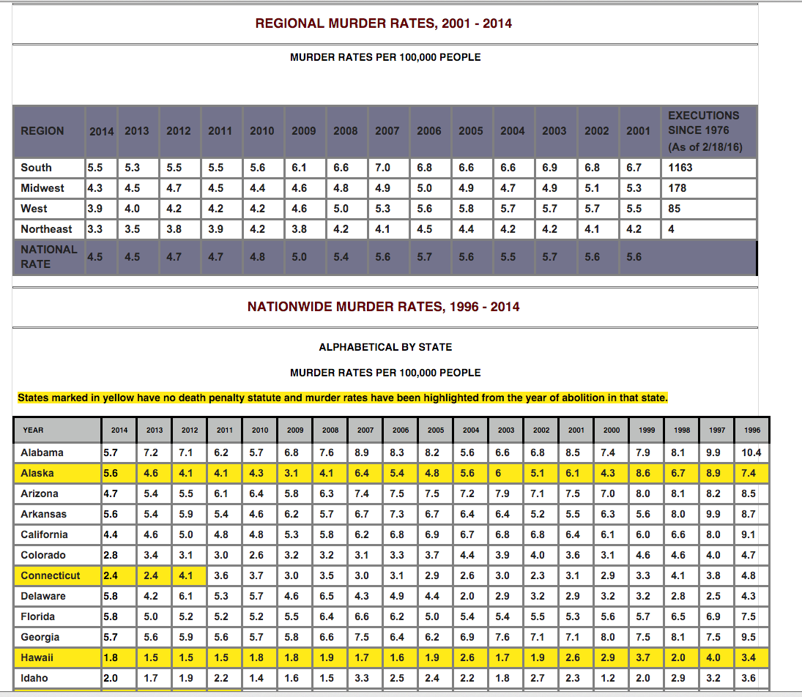
HTML to Excel

Slide 6
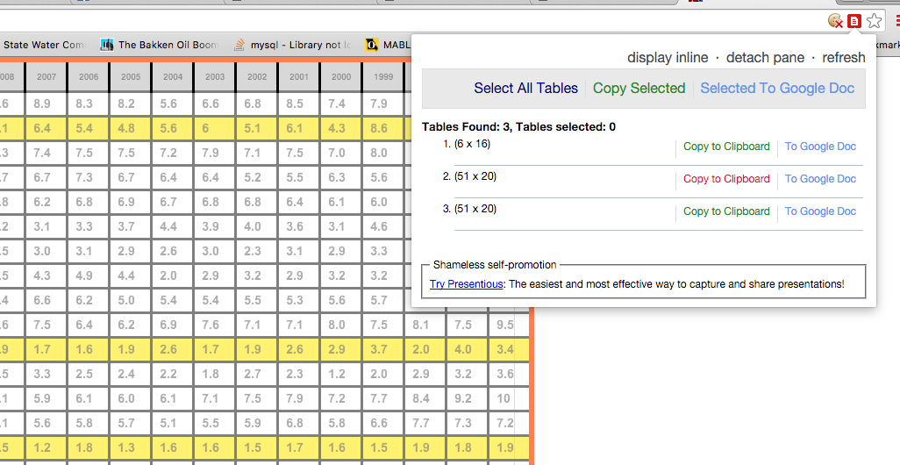
HTML to Excel
Chrome Table Capture:

Slide 7
HTML to Excel
Chrome Table Capture:

Slide 8
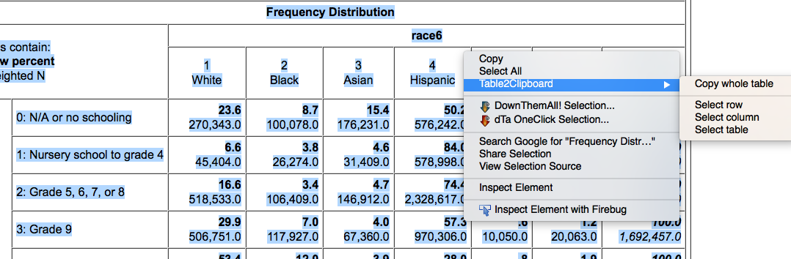
HTML to Excel
Also, Firefox Table2Clipboard:

Slide 9
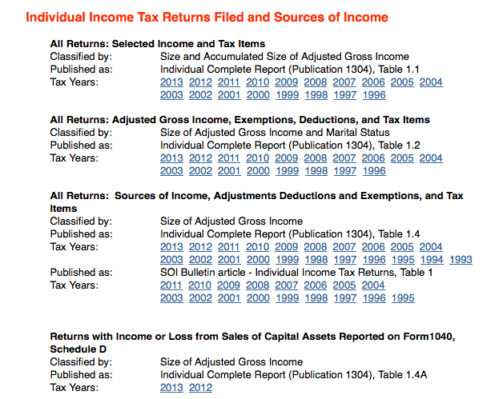
Down Them All!

Slide 10

Down Them All!
When you hover over links, you can see the file naming convention the page uses:
Table 1:
Table 2:
So we want all files that end with 11si.xls…

Slide 11
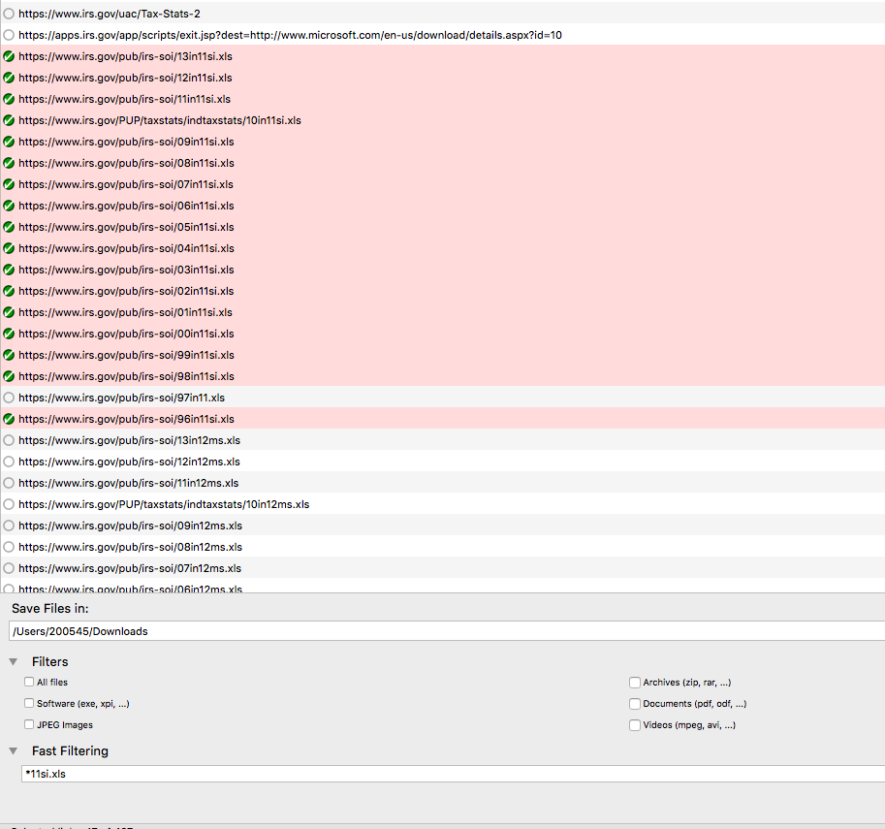
Down Them All!

Slide 12
CometDocs
One of many, and perhaps the easiest, way to deal with tables in PDFs. See my longer discussion…

Slide 13
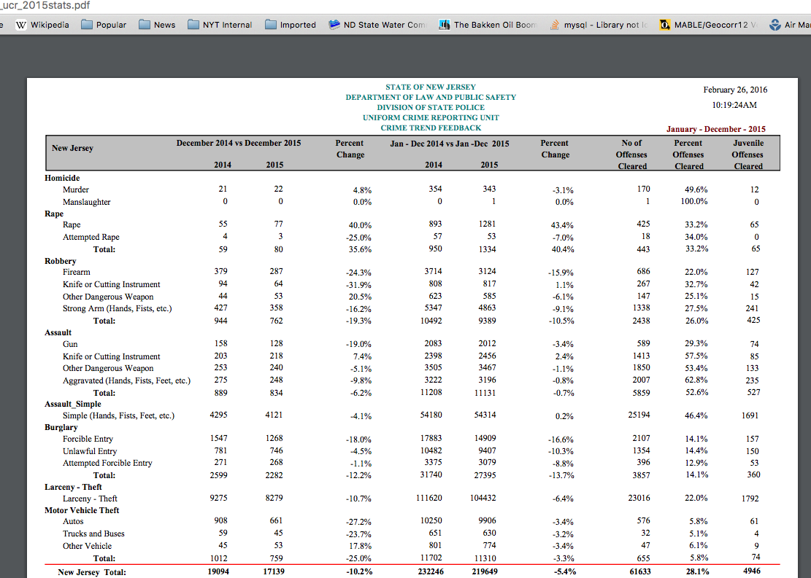

Slide 14
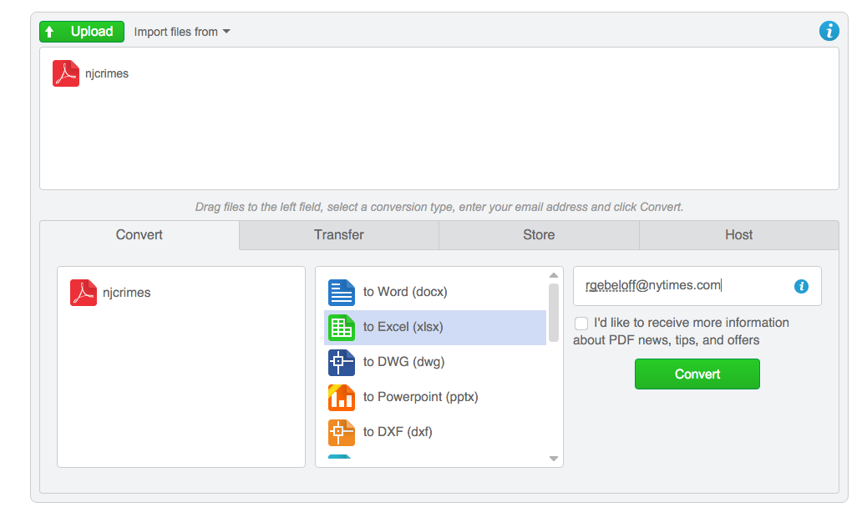

Slide 15
Import.IO
There’s no full substitute for being able to program your own scraper. But tools such as this can work well in many cases.
We’ll follow the first part of the tutorial

Slide 16
Scraping w/o Programming
GRAND FINALE
Scrape data from a map!
Convert webby xml data to easier to deal with CSV!
Bonus: Convert some json too!
We’ll follow an example I created for a class I taught last year….

