Slide 1
Micro Computer Systems I Final Project

Slide 2
Coin Sorter and Counter Machine

Slide 3
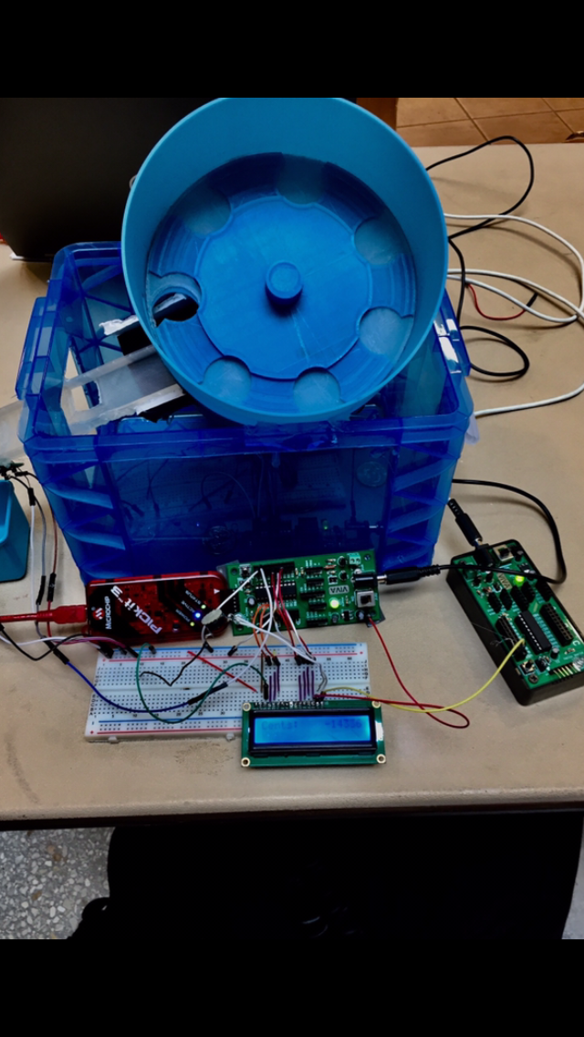

Slide 4
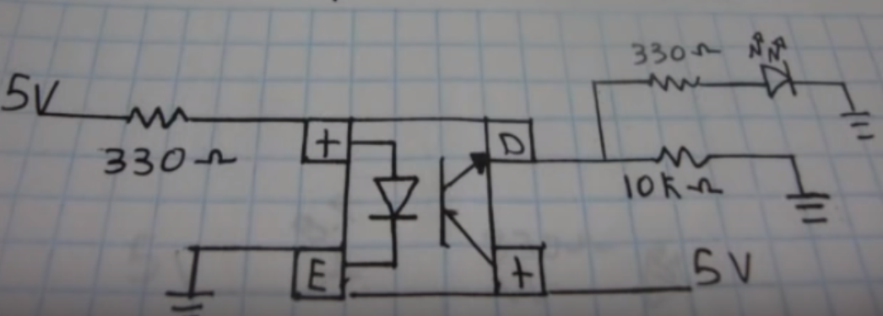
Sensor circuit diagram

Slide 5
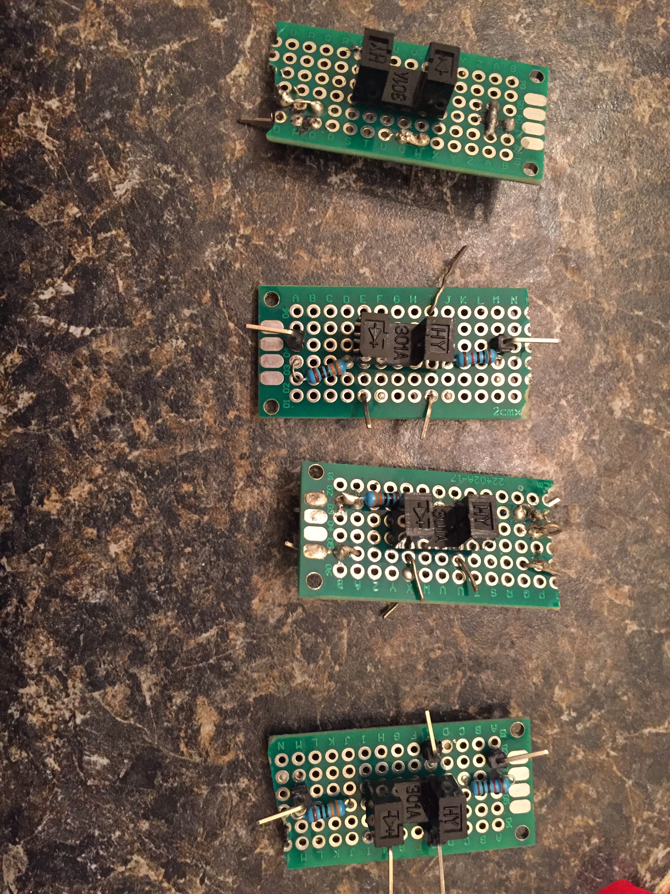
Circuits for each sensor using prototype breadborads

Slide 6
Description
This machine has the capability to sort and count coins by using a mechanism where the coins will be sorted by size and counted every time they fall into their corresponding box.

Slide 7
Team Members
Gerardo Bilbatua
Mukunda Subedi
Hector Tenorio

Slide 8
Modules and Devices Used
12V DC motor
Photo Interrupter sensor (A2D)
Viva Board (PIC16F1829)
LCD display (12C )
DC motor is controlled by PWM which rotates a disk and sends the coins to a rail where they fall because of their varied sizes, and pass through a photo interrupter sensor for detection. Finally the number of coins per each box are displayed on a LCD display so we can know the exact amount counted.

Slide 9
Problems that we encountered
Allocating​ ​time​ ​to​ ​meet.
It took us longer than expected to build the mechanism parts using 3D printer.
We had a trouble with LCD and with an analog reading.

Slide 10
Lesson Learned
The measurements of holes on a rail has to be perfect in order to sort the coins correctly.
We can pretty much manipulate the coding as we desire.
“This was a very fun project to work on!”

