Slide 1
Chapter two
Relational Data Model

Slide 2
Cont…
A relational model is a model that is perceived by the user as table.
Relation: Two dimensional table
Stores information or data in the form of tables (rows and columns)
A row of the table is called tuple(equivalent to record)
A column of a table is called attribute( equivalent to fields)
Data value is the value of the Attribute

Slide 3
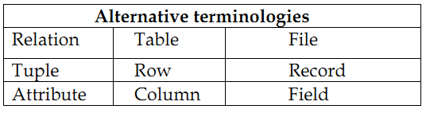
Cont…
The tables seem to be independent but are related some how.
No physical consideration of the storage is required by the user
Many tables are merged together to come up with a new virtual view of the relationship

Slide 4
Cont…
The rows represent records (collections of information about separate items)
The columns represent fields (particular attributes of a record)
Conducts searches by using data in specified columns of one table to find additional data in another table

Slide 5
Properties of Relational Databases
Each row of a table is uniquely identified by a PRIMARY KEY composed of one or more columns
Each tuple in a relation must be unique
Group of columns, that uniquely identifies a row in a table is called a CANDIDATE KEY
ENTITY INTEGRITY RULE of the model states that no component of the primary key may contain a NULL value

Slide 6
Cont…
A column or combination of columns that matches the primary key of another table is called a FOREIGN KEY.
The REFERENTIAL INTEGRITY RULE of the model states that, for every foreign key value in a table there must be a corresponding primary key value in another table in the database or it should be NULL.
All tables are LOGICAL ENTITIES
A table is either a BASE TABLES (Named Relations) or VIEWS (Unnamed Relations)

Slide 7
Cont…
Only Base Tables are physically stores
VIEWS are derived from BASE TABLES with SQL instructions like: [SELECT .. FROM .. WHERE .. ORDER BY]
Order of rows and columns is immaterial
Entries with repeating groups are said to be un-normalized
Entries are single-valued
Each column (field or attribute) has a distinct name

Slide 8
Building Blocks of the Relational Data Model
Entities: real world physical or logical object
Attributes: properties used to describe each Entity or real world object.
Relationship: the association between Entities
Constraints: rules that should be obeyed while manipulating the data.

Slide 9
The ENTITIES
The ENTITIES (persons, places, things etc.) which the organization has to deal with.
The name given to an entity should always be a singular noun descriptive of each item to be stored in it. E.g.: student NOT students.
Every relation has a schema, which describes the columns, or fields
The relation itself corresponds to our familiar notion of a table

Slide 10
ATTRIBUTES
The items of information which characterize and describe these entities.
Attributes are pieces of information ABOUT entities.
The analysis must of course identify those which are actually relevant to the proposed application

Slide 11
Cont…
Attribute name (be explanatory words or phrases)
The domain from which attribute values are taken (A DOMAIN is a set of values from which attribute values may be taken.)
Each attribute has values taken from a domain.
For example, the domain of Name is string and that for salary is real

Slide 12
Cont…
Whether the attribute is part of the entity identifier (attributes which just describe an entity and those which help to identify it uniquely)
Whether it is permanent or time-varying (which attributes may change their values over time)
Whether it is required or optional for the entity (whose values will sometimes be unknown or irrelevant)

Slide 13
Types of Attributes
Simple (atomic) Vs Composite attributes
Simple : contains a single value (not divided into sub parts)
E.g. Age, gender
Composite: Divided into sub parts (composed of other attributes)
E.g. Name, address

Slide 14
Cont…
Single-valued Vs multi-valued attributes
Single-valued : have only single value(the value may change but has only one value at one time)
E.g. Name, Sex, Id. No. color_of_eyes
Multi-Valued: have more than one value
E.g. Address, dependent-name
Person may have several college degrees

Slide 15
Cont…
Stored vs. Derived Attribute
Stored : not possible to derive or compute
E.g. Name, Address
Derived: The value may be derived (computed) from the values of other attributes.
E.g. Age (current year – year of birth)
Length of employment (current date- start date)
Profit (earning-cost)
G.P.A (grade point/credit hours)

Slide 16
Cont…
Null Values
NULL applies to attributes which are not applicable or which do not have values.
You may enter the value NA (meaning not applicable)
Value of a key attribute can not be null.
Default value - assumed value if no explicit value

Slide 17
RELATIONSHIPS
The RELATIONSHIPS between entities which exist and must be taken into account when processing information.
One external event or process may affect several related entities.
Related entities require setting of LINKS from one part of the database to another.
A relationship should be named by a word or phrase which explains its function

Slide 18
Cont…
Role names are different from the names of entities forming the relationship: one entity may take on many roles, the same role may be played by different entities
An important point about a relationship is how many entities participate in it.
The number of entities participating in a relationship is called the DEGREE of the relationship.

Slide 19
Cont…
UNARY/RECURSIVE RELATIONSHIP: Single entity
BINARY RELATIONSHIPS: Two entities associated
TERNARY RELATIONSHIP: Three entities associated
N-NARY RELATIONSHIP: arbitrary number of entity sets

Slide 20
Cont…
The number of instances participating or associated with a single instance from another entity in a relationship is called the CARDINALITY of the relationship.
ONE-TO-ONE, e.g. Building - Location,
ONE-TO-MANY, e.g. hospital - patient,
MANY-TO-ONE, e.g. Employee - Department
MANY-TO-MANY, e.g. Author - Book.

Slide 21
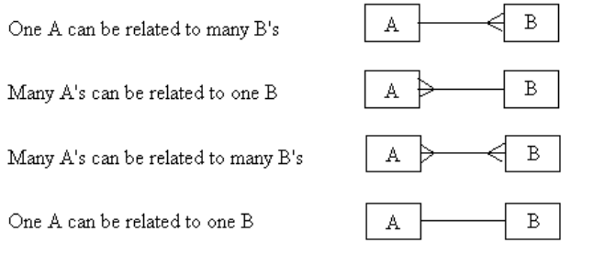
Cont…

Slide 22
Relational Constraints/Integrity Rules
Relational Integrity
Domain Integrity: No value of the attribute should be beyond the allowable limits
Entity Integrity: In a base relation, no attribute of a primary key can be null

Slide 23
Cont…
Referential Integrity: If a foreign key exists in a relation, either the foreign key value must match a candidate key in its home relation or the foreign key value must be null foreign key to primary key match-ups
Enterprise Integrity: Additional rules specified by the users or database administrators of a database are incorporated

Slide 24
Key constraints
Super Key: an attribute or set of attributes that uniquely identifies a tuple within a relation.
Candidate Key: a super key such that no proper subset of that collection is a Super Key within the relation.
A candidate key has two properties:
Uniqueness
Irreducibility
If a candidate key consists of more than one attribute it is called composite key.

Slide 25
Cont…
Primary Key: the candidate key that is selected to identify tuples uniquely within the relation.
The entire set of attributes in a relation can be considered as a primary case in a worst case.
Foreign Key: an attribute, or set of attributes, within one relation that matches the candidate key of some relation.
A foreign key is a link between different relations to create the view or the unnamed relation

Slide 26
Relational languages and views
The languages in relational database management systems are the DDL and the DML that are used to define or create the database and perform manipulation on the database.
We have the two kinds of relation in relational database.
The difference is on how the relation is created, used and updated

Slide 27
Cont…
Base Relation
A Named Relation corresponding to an entity in the conceptual schema, whose tuples are physically stored in the database.
View
Is the dynamic result of one or more relational operations operating on the base relations to produce another virtual relation.
So a view virtually derived relation that does not necessarily exist in the database but can be produced upon request by a particular user at the time of request.

Slide 28
Purpose of a view
Hides unnecessary information from users
Provide powerful flexibility and security
Provide customized view of the database for users
A view of one base relation can be updated.
Update on views derived from various relations is not allowed
Update on view with aggregation and summary is not allowed.

Slide 29
Schemas and Instances and Database State
Schemas
Schema describes how data is to be structured, defined at set-up time, rarely changes
Database Schema (intension): specifies name of relation, plus name and type of each column.
refer to a description of database (or intention)
specified during database design
should not be changed unless during maintenance
Schema Diagrams
convention to display some aspect of a schema visually
Schema Construct
refers to each object in the schema (e.g. STUDENT)
E.g.: STUNEDT (FName,LName,Id,Year,Dept,Sex)

Slide 30
Three-Schema Architecture
Internal schema (or internal level)
Internal schema describes the physical storage, structure of the database (data storage, access paths)
Conceptual schema (or conceptual level)
describes the structure of the entire database
hides the details of physical storage structures
concentrates on the describing entities, data types, relationships, operations, and constraints

Slide 31
Cont…
External schema (or view-level)
includes a number of external schema or user view
each view describes subset of database needed by a particular user
High Level data model or an implementation data model can be used here

Slide 32
Instances
Database state (snapshot or extension): is the collection of data in the database at a particular point of time (snap-shot).
Refers to the actual data in the database at a specific time
State of database is changed any time we add or delete a record
Valid state: the state that satisfies the structure and constraints specified in the schema and is enforced by DBMS

Slide 33
Cont…
Instance is actual data of database at some point in time, changes rapidly
To define a new database, we specify its database schema to the DBMS (database is empty)
database is initialized when we first load it with data

Slide 34
Database Design
Database design consists of several tasks:
Requirements Analysis,
Conceptual Design, and Schema Refinement,
Logical Design,
Physical Design and
Tuning (Modification)

Slide 35
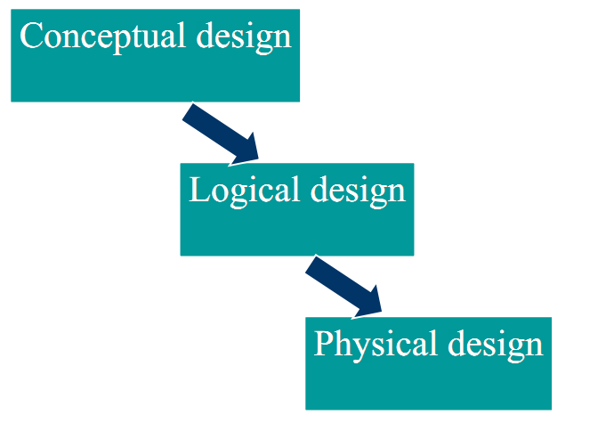
The Three levels of Database Design

Slide 36
Conceptual Database Design
Conceptual design is the process of constructing a model of the information used in an enterprise, independent of any physical considerations.
It is the source of information for the logical design phase.
Community User’s view
After the completion of Conceptual Design one has to go for refinement of the schema, which is verification of Entities, Attributes, and Relationships

Slide 37
Logical Database Design
Logical design is the process of constructing a model of the information used in an enterprise based on a specific data model (e.g. relational, hierarchical or network or object), but independent of a particular DBMS and other physical considerations.
Normalization process
Discover new entities
Revise attributes

Slide 38
Physical Database Design
Physical design is the process of producing a description of the implementation of the database on secondary storage.
defines specific storage or access methods used by database
Describes the storage structures and access methods.
Tailored to a specific DBMS system -- Characteristics are function of DBMS and operating systems
Includes estimate of storage space

