Slide 1
Industrial Control System Security
CySec3074
Fundamental of ICS

Slide 2
Fundamental of ICS

Slide 3
Introduction to ICS Cyber Security
Industrial Control Systems (ICS) are used in critical infrastructure sectors such as energy, water treatment, transportation, and manufacturing.
As these systems become increasingly interconnected, they face growing cyber threats.
ICS Cyber Security focuses on protecting these systems while ensuring operational resilience, reliability, and safety.

Slide 4
Role of ICS in Critical Infrastructure
ICS plays a crucial role in ensuring the smooth operation of industries that provide essential services to society.
Energy: Ensures power generation, distribution, and grid stability.
Water: Controls water treatment and distribution systems, ensuring clean water is available.
Transportation: Manages traffic control, signaling, and automated systems for rail and air traffic.
Manufacturing: Automates and controls production lines, reducing errors and increasing efficiency.

Slide 5
Why is ICS Security Important?
As ICS systems become more interconnected with corporate IT networks and the internet, they become more vulnerable to cyber-attacks.
A failure or disruption in ICS can have wide-reaching effects, potentially causing financial losses, environmental damage, or threats to public safety.
Therefore, securing ICS is paramount to protecting both the industrial sector and broader society.

Slide 6
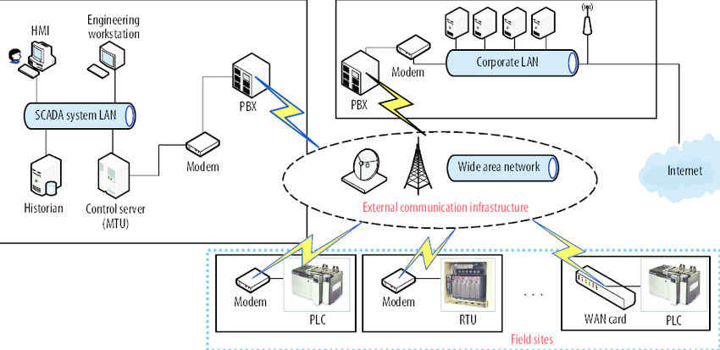
Components of an ICS Environment
ICS environments consist of interconnected hardware and software components that enable industrial automation. The key elements include:
SCADA (Supervisory Control and Data Acquisition):
A system that enables operators to monitor and control industrial processes from a central location.
It collects data from remote locations and allows operators to make real-time decisions to ensure operations are running smoothly.
Commonly used in industries like energy, water, and telecommunications.

Slide 7
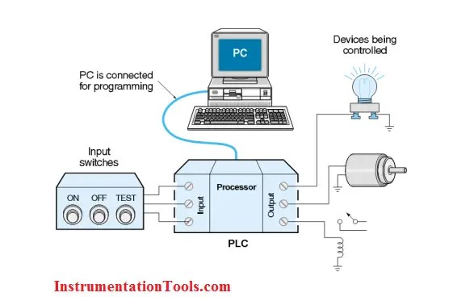
Cont…Components of an ICS Environment
PLC (Programmable Logic Controllers):
Specialized computers used to control machinery and processes in manufacturing environments.
They manage operations like controlling the speed of motors, the flow of materials, and the function of valves.
Widely used in automated production lines and critical infrastructure.

Slide 8
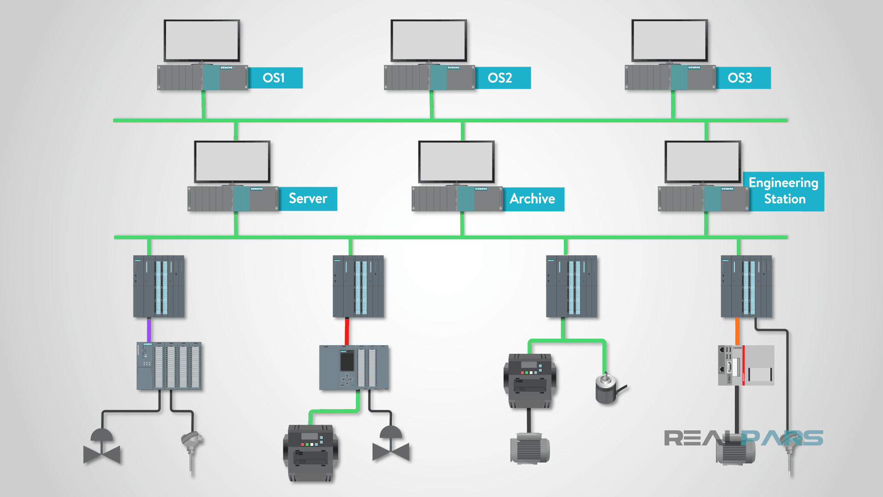
Cont…Components of an ICS Environment
DCS (Distributed Control Systems):
A control system that is used for managing industrial processes in a distributed manner.
Unlike SCADA, which is centralized, a DCS relies on a network of controllers distributed throughout a facility, all working together to control processes.
DCS systems are used in chemical plants, oil refineries, and other complex industrial operations.

Slide 9
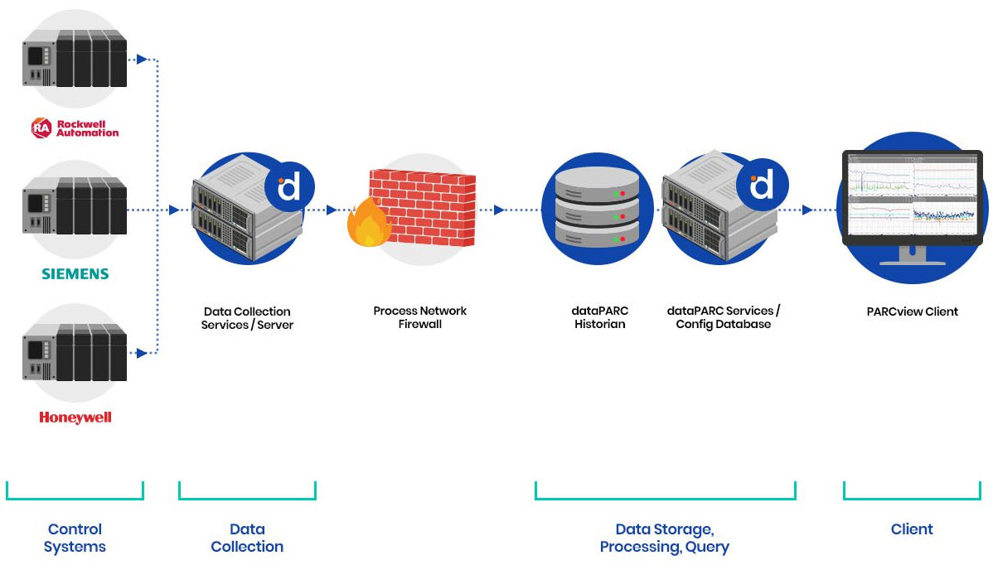
Cont…Components of an ICS Environment
Historian
In manufacturing, an operational historian is a time-series database application that is developed for operational process data.
Historian software is often embedded or used in conjunction with standard DCS and PLC control systems to provide enhanced data capture, validation, compression, and aggregation capabilities

Slide 10
Cont…Components of an ICS Environment
Industrial IoT (IIoT) Devices
IIoT introduces smart sensors and connected devices in ICS.
Expands the attack surface due to wireless connectivity and cloud integration.
Human-Machine Interface (HMI)
Provides operators with real-time visualization of industrial processes.
If compromised, attackers can manipulate industrial operations.
Remote Terminal Units (RTUs)
RTUs communicate with sensors and actuators in remote locations.
They relay data back to central control systems.

Slide 11
Common Cyber Threats in ICS
Cybersecurity Threats to ICS Industrial Control Systems (ICS) face a variety of cyber threats that can lead to significant damage if not properly managed.
These threats not only compromise the integrity and availability of critical systems but can also affect the safety of personnel, environmental stability, and public infrastructure.

Slide 12
Cont…Common Cyber Threats in ICS
Cyber Attacks
Malware:
Software designed to disrupt or damage ICS operations.
Examples include viruses, worms, and ransomware. Malware can disrupt critical processes or cause systems to shut down.
Ransomware:
A type of malware that encrypts data or locks systems, demanding a ransom for restoration.
Targeting ICS could halt industrial operations, causing significant losses.
.
Advanced Persistent Threats (APTs):
Long-term targeted attacks that infiltrate ICS to gather sensitive information or cause harm over time.
These attacks can remain undetected for months or even years, making them difficult to mitigate.

Slide 13
Cont…Common Cyber Threats in ICS
Insider Threats
Malicious insiders: Employees or contractors with authorized access who intentionally sabotage or manipulate ICS for personal gain or revenge
Unintentional insider threats: Employees who unknowingly compromise security, often due to lack of awareness or human error, such as clicking on a phishing email or mishandling sensitive data.

Slide 14
Cont…Common Cyber Threats in ICS
Supply Chain Attacks
Vulnerabilities in Third-Party Vendors:
Many ICS systems rely on third-party hardware, software, and services.
An attack targeting a vendor can affect multiple organizations that use their products or services, potentially leading to widespread security breaches in ICS networks.
Malware Insertion:
Malware can be introduced into ICS systems during the manufacturing or installation phase of system components.
Example: SolarWinds Attack (2020) affected government and industrial networks and as seen in attacks Stuxnet

Slide 15
Cont…Common Cyber Threats in ICS
Physical Threats
Sabotage:
Malicious individuals may physically damage ICS hardware or processes, either inside or outside the organization.
This could involve damaging equipment, tampering with components, or causing intentional downtime.
Theft:
Physical theft of critical assets like control systems, network equipment, or proprietary data could be ancestor to a larger cyber attack.

Slide 16
Cont…Common Cyber Threats in ICS
Network-Based Attacks
Man-in-the-Middle (MitM) Attacks:
Intercept and manipulate communication between ICS components.
Denial-of-Service (DoS) Attacks:
Overload ICS networks, causing service disruptions.
Zero-Day Exploits
Hackers exploit unknown vulnerabilities in ICS firmware or software before patches are available.

Slide 17
ICS Security Challenges
Industrial Control Systems (ICS) face unique challenges when it comes to cybersecurity due to their specialized nature, dependence on legacy systems, and the critical functions they serve in infrastructure.
Legacy Systems and Equipment
Outdated Technology:
Many ICS components, such as PLCs and SCADA systems, are based on decades-old technology and were never designed with cybersecurity in mind.
These legacy systems often lack basic security features such as encryption, patch management, and robust access controls.
Difficulty in Patching and Upgrades:
Updating or replacing legacy systems can be expensive, disruptive, and technically challenging, especially if they are deeply integrated into operational processes.
Some systems cannot be easily patched or updated because doing so might risk halting critical industrial operations.

Slide 18
Cont…ICS Security Challenges
Lack of Cybersecurity Awareness
Different Priorities:
ICS environments typically prioritize operational continuity and system availability over cybersecurity.
The focus has traditionally been on ensuring uptime and physical safety, rather than on the cyber risks that are now emerging as a primary concern.
Limited Security Training:
Personnel operating ICS networks may not always have a strong cybersecurity background, which makes it difficult for them to recognize cyber threats or apply best practices.
Training and awareness programs are often insufficient.

Slide 19
Cont…ICS Security Challenges
Integration of IT and OT (Operational Technology)
Convergence of IT and OT:
As businesses modernize, the convergence of IT networks (used for business operations like email, file sharing, etc.) and OT networks (used to control industrial processes) increases the exposure of ICS to cyber threats.
This convergence can introduce vulnerabilities, as IT networks are generally more open to the internet and more vulnerable to cyber attacks.
Network Visibility and Control:
The integration often reduces visibility and control over ICS traffic.
IT personnel may not fully understand the requirements or specific needs of ICS, and vice versa, making it difficult to implement appropriate security measures across both networks.

Slide 20
Cont…ICS Security Challenges
Limited Resources and Budget for Security
Cost Considerations:
Many organizations face budget constraints that limit investments in ICS cybersecurity.
ICS systems are critical to operations, but security measures—such as advanced threat detection systems, intrusion prevention systems, and regular security audits—are often seen as secondary to maintaining operational processes.
Complexity in Securing ICS:
The security measures required to protect ICS are more complex than traditional IT security because of the unique nature of industrial environments.
Implementing security in real-time, continuous operations without interrupting the processes can be a daunting task.

Slide 21
Cont…ICS Security Challenges
Regulatory and Compliance Gaps
Lack of Industry-Specific Regulations:
While certain sectors (like energy and water) have regulatory frameworks (e.g., NERC CIP for power grids), many industries still lack stringent regulations for securing ICS.
This can lead to inconsistent cybersecurity practices and varying levels of protection across organizations.
Difficulty in Meeting Standards:
Even where regulations exist, compliance can be difficult.
ICS systems often do not meet the required standards for cybersecurity, either because they were designed before the standards were created or because achieving compliance would require significant changes to infrastructure.

Slide 22
Cont…ICS Security Challenges
Remote Access and Third-Party Vendors
Remote Access Vulnerabilities:
ICS systems often require remote access for troubleshooting, maintenance, or monitoring.
This remote access can be a vulnerability if not secured properly.
Can exploit this access point, using techniques like VPN compromise, phishing, or exploiting weak credentials.
Third-Party Vendor Risks:
Many ICS environments depend on third-party vendors for software, hardware, or service contracts.
If these vendors’ systems are compromised, it can lead to an attack on the ICS infrastructure.
For example, an attack on a vendor’s supply chain could lead to the introduction of malware into the ICS environment (like the Stuxnet attack).

Slide 23
Cont…ICS Security Challenges
Difficulty in Detecting Attacks
Anomaly Detection in ICS:
Unlike traditional IT systems, ICS systems are often designed to operate with minimal deviation.
This makes it difficult to detect unusual or anomalous behavior.
Cyberattacks on ICS may not immediately disrupt system performance, which can delay detection and response.
Lack of Effective Monitoring:
Many ICS environments do not have sufficient monitoring capabilities.
There is often little or no logging of activities, making it hard to track unauthorized access or unusual behavior.
Even when monitoring is in place, it may not have the specificity or granularity needed to detect ICS-specific threats.

Slide 24
Summery of Cybersecurity Challenges in ICS
Unlike traditional IT systems, securing ICS presents unique challenges:
Availability vs. Security
ICS prioritizes availability (99.999% uptime) over security.
Downtime can lead to catastrophic failures (e.g., power grid blackouts).
Legacy Systems with Poor Security
Many ICS components run on outdated operating systems (e.g., Windows XP).
Lack of encryption and authentication mechanisms.
IT-OT Convergence
Increased integration between Operational Technology (OT) and Information Technology (IT) expands attack surfaces.
Traditional IT security tools (e.g., antivirus) are not always compatible with ICS.

Slide 25
Cont…Summery of Cybersecurity Challenges in ICS
Use of Insecure Industrial Protocols
ICS uses legacy protocols (Modbus, DNP3, BACnet) that lack security features like encryption or authentication.
Attackers can easily spoof commands or inject malicious data.
Limited Patching and Maintenance
ICS devices operate 24/7, making regular updates difficult.
Applying patches requires extensive testing to avoid operational disruptions.

Slide 26
Summery of Cybersecurity Challenges in ICS
Securing ICS is a complex, ongoing challenge that requires addressing both technological and organizational difficulties.
With legacy systems, limited resources, regulatory gaps, and the integration of IT and OT, ICS security demands specialized knowledge, continuous vigilance, and a multi-layered security approach.
These challenges highlight the need for tailored cybersecurity strategies, enhanced awareness, and collaborative efforts across industries to strengthen the resilience of ICS environments against evolving cyber threats.

Slide 27
ICS Cyber Security Best Practices
To mitigate risks, organizations should adopt a layered security approach:
Network Segmentation
Air-gap critical ICS networks from external connections.
Use firewalls and demilitarized zones (DMZs) to separate IT and OT networks.
Implement unidirectional security gateways for safe data transfer.
Secure Authentication and Access Control
Enforce role-based access control (RBAC).
Implement multi-factor authentication (MFA).
Disable default credentials and unused accounts.
Patch and Vulnerability Management
Regularly update ICS software, firmware, and operating systems.
Conduct risk-based patching to minimize operational impact.

Slide 28
Cont…ICS Cyber Security Best Practices
Intrusion Detection and Monitoring
Deploy Intrusion Detection Systems (IDS) and Security Information and Event Management (SIEM).
Use behavioral anomaly detection to identify suspicious activity.
Secure Communication and Encryption
Implement VPNs and secure tunnels for remote access.
Encrypt SCADA and PLC traffic using secure protocols (e.g., Transport Layer security(TLS)).
Physical Security Measures
Restrict physical access to control rooms, HMIs, and PLCs.
Deploy CCTV monitoring and biometric authentication.

Slide 29
Cont…ICS Cyber Security Best Practices
Incident Response and Disaster Recovery
Develop and test an ICS-specific incident response plan.
Implement regular backups with offline storage.
Establish forensic capabilities for post-incident investigation.
Security Awareness and Training
Conduct regular cybersecurity training for ICS engineers and operators.
Simulate phishing and social engineering attacks to improve awareness.

Slide 30
ICS Cybersecurity Standards and Frameworks
Organizations should comply with industry best practices and frameworks, such as:
NIST Special Publication 800-82
Provides guidelines for securing ICS.
Recommends network segmentation, monitoring, and secure access control.
IEC 62443 (ISA/IEC 62443)
International standard for industrial automation security.
Covers risk assessment, secure development, and lifecycle management.
NERC CIP (North American Electric Reliability Corporation Critical Infrastructure Protection)
Mandatory cybersecurity standards for the power sector.
Focuses on asset identification, security controls, and incident response
ISO 27019
Information security guidelines specific to energy sector ICS.
MITRE ATT&CK for ICS
A framework detailing tactics, techniques, and procedures (TTPs) used by attackers targeting ICS.

Slide 31
Case Studies and Real-World Attacks
Stuxnet (2010)
First known cyberweapon targeting Iran’s nuclear centrifuges.
Exploited zero-day vulnerabilities to spread via USB drives.
Ukraine Power Grid Attacks (2015 & 2016)
Attackers used BlackEnergy malware to shut down parts of Ukraine’s power grid.
Emphasized the need for ICS network segmentation and monitoring.
Colonial Pipeline Ransomware Attack (2021)
Ransomware attack forced shutdown of the largest US fuel pipeline.
Highlighted the risks of IT-OT integration and inadequate incident response.

Slide 32
Operation, Design and Vulnerability of Industrial Control Systems

Slide 33
Operation of Industrial Control Systems
Basic ICS Workflow
Data Acquisition
Sensors and RTUs collect data from the industrial environment (e.g., temperature, pressure, speed).
This data is transmitted to controllers (PLCs, DCS) for processing.
Processing & Control Decision
The controller (PLC or DCS) processes the data based on predefined logic or algorithms.
If conditions meet certain thresholds, the system takes appropriate actions.
Actuation & Process Execution
Control commands are sent to actuators (motors, valves, switches).
This alters the industrial process to maintain optimal conditions.
Monitoring & Feedback Loop
SCADA and HMI systems provide real-time monitoring of operations.
Operators can adjust parameters or respond to alerts if required.

Slide 34
Types of ICS Operations
Continuous Process Control
Found in industries like oil refineries, chemical plants, and power generation.
Involves maintaining variables within set parameters (e.g., temperature, flow rate).
Discrete Control
Common in manufacturing, automotive, and assembly lines.
Focuses on on/off operations (e.g., moving conveyor belts, robotic arms).
Batch Processing
Used in pharmaceuticals, food processing, and chemical industries.
Controls a series of steps in a predefined sequence to produce a batch of products.

Slide 35
ICS Communication & Networking
ICS relies on various communication protocols to transfer data between components
Common ICS Communication Protocols
Modbus: A widely used open protocol for industrial communication.
DNP3 (Distributed Network Protocol): Used in electric utilities and water management.
PROFINET & PROFIBUS: Used for automation in manufacturing.
EtherNet/IP & OPC-UA: Industrial Ethernet-based communication.
Network Architecture
ICS networks are typically designed with multiple layers:
Field Level: Sensors and actuators communicate with controllers.
Control Level: PLCs and DCS manage real-time control.
Supervisory Level: SCADA and HMI oversee operations.
Enterprise Level: IT systems analyze production data for decision-making.

Slide 36
Cont…ICS Communication & Networking
Importance of ICS in Industry
Enhances Efficiency: Automates processes to improve productivity.
Ensures Safety: Monitors critical variables to prevent hazardous situations.
Reduces Downtime: Enables predictive maintenance and quick response to faults.
Optimizes Resource Usage: Controls energy and material consumption efficiently.

Slide 37
Industrial Control System (ICS) Design
Overview of ICS Design
Designing an Industrial Control System (ICS) involves integrating hardware, software, and communication protocols to ensure automation, monitoring, and control of industrial processes.
The design must prioritize real-time performance, reliability, scalability, and security while meeting industry-specific requirements.
Key Considerations in ICS Design
✅ System Architecture: Defines how ICS components interact. ✅ Scalability & Redundancy: Ensures long-term growth and fault tolerance. ✅ Security & Resilience: Protects against cyber and physical threats. ✅ Compliance & Standards: Meets industry regulations (e.g., NIST, IEC 62443).

Slide 38
ICS Architecture Design
ICS design is typically based on the Purdue Model (ISA-95), which segments operations into different network layers to improve security and functionality.
Design Goal: Prevent IT/OT convergence risks by segmenting networks and securing communication pathways.
Purdue Model for ICS Design
Level | Description | Key Components
Level 5 (Enterprise IT) | Business applications, cloud computing | ERP, Data Analytics, AI/ML
Level 4 (IT Network) | Corporate systems managing production | MES, Databases, IT Servers
Level 3 (Operations & Control) | Interface between IT & ICS | SCADA, HMI, Engineering Workstations
Level 2 (Supervisory Control) | Direct industrial process control | DCS, PLC Programming, Historian
Level 1 (Control Devices) | Controls automated processes | PLCs, RTUs, Embedded Controllers
Level 0 (Field Devices) | Sensors and actuators in the physical process | Motors, Valves, Flowmeters

Slide 39
Core Components of ICS Design
Industrial Control Devices
ICS design integrates different control devices depending on the industry and application.
Design Goal: Select devices based on process complexity, environment, and communication need
Device | Function
Programmable Logic Controller (PLC) | Automates industrial processes at the equipment level.
Remote Terminal Unit (RTU) | Connects remote field devices to SCADA via wireless communication.
Supervisory Control and Data Acquisition (SCADA) | Centralized system for real-time monitoring and control.
Distributed Control System (DCS) | Manages continuous processes (e.g., oil refining, power plants).
Human-Machine Interface (HMI) | Provides operators with real-time data visualization and control.

Slide 40
Cont…Core Components of ICS Design
2. ICS Network Design & Communication Protocols
ICS networks rely on real-time, deterministic communication protocols to connect devices and systems
Design Goal: Choose a network based on latency, bandwidth, and security requirements.
Wired & Wireless ICS Network Types
Network Type | Usage | Examples
Ethernet-Based (Industrial Ethernet, Modbus TCP, EtherNet/IP) | High-speed factory automation, SCADA connectivity | Ethernet/IP, PROFINET, Modbus TCP
Serial Communication (RS-485, RS-232) | Legacy systems, low-speed device control | Modbus RTU, DNP3
Wireless (Wi-Fi, Zigbee, LTE, 5G) | Remote monitoring, mobile assets | WirelessHART, ISA100
Fiber Optics | High-speed, long-distance communication | Ethernet Fiber, Industrial WAN

Slide 41
Cont…Core Components of ICS Design
2. ICS Network Design & Communication Protocols
Best Practice: Use secure protocols (OPC-UA, MQTT with TLS) and implement network segmentation.
Common ICS Communication Protocols
Protocol | Industry Application | Security Concern
Modbus (TCP/RTU) | Industrial automation | Unencrypted, easily spoofed
DNP3 | Electric utilities, SCADA | Improved security but some legacy weaknesses
PROFINET & PROFIBUS | Manufacturing & process control | High-speed but lacks encryption
OPC-UA | Secure industrial IoT communication | Built-in encryption & authentication

Slide 42
ICS Cybersecurity Design
ICS design must consider cybersecurity to protect critical infrastructure from cyber threats.
A. ICS Network Segmentation (Zoning & DMZs)
Separate IT and OT Networks: Use firewalls and air-gaps to prevent IT threats from affecting ICS.
Create Industrial DMZ (IDMZ): Secure communication between IT and OT.
Use VLANs & Firewalls: Restrict unauthorized access between network layers
B. ICS Security Best Practices
✅ Access Control: Use role-based access (RBAC) and multi-factor authentication (MFA). ✅ Network Hardening: Disable unused ports, protocols, and services on ICS devices. ✅ Patch Management: Securely update ICS software while minimizing downtime. ✅ Intrusion Detection Systems (IDS): Deploy ICS-specific IDS (e.g., Nozomi Networks, Dragos).
Best Practice: Implement zero-trust architecture to limit access to critical ICS components.

Slide 43
Redundancy & High Availability in ICS Design
ICS must be designed for high availability (HA) and fault tolerance to prevent downtime in critical processes.
A. Redundancy Strategies
Type | Description
Controller Redundancy | Dual PLCs or DCS controllers for failover.
Network Redundancy | Dual-ring Ethernet, redundant fiber links to prevent network failures.
Power Redundancy | Uninterruptible Power Supply (UPS) and backup generators.
Data Redundancy | Multiple SCADA historians for data reliability.
Best Practice: Use hot standby configurations for instant failover in case of failure.

Slide 44
Compliance & ICS Design Standards
ICS must comply with industry regulations to ensure safety, reliability, and security.
Standard | Purpose | Applicable Industries
ISA/IEC 62443 | ICS cybersecurity framework | All ICS industries
NIST 800-82 | Guide to securing ICS | Power, water, manufacturing
ISO 27001 | Information security management | IT-OT integration
NERC-CIP | Critical infrastructure protection | Electric power grid
API 1164 | Pipeline cybersecurity | Oil & Gas
Best Practice: Regular audits and compliance reviews to meet regulatory requirements..

Slide 45
Future Trends in ICS Design
Integration of Industrial IoT (IIoT)
Smart Sensors & Edge Computing: Real-time analytics and AI-driven optimization.
Cloud-Based SCADA: Secure cloud storage and remote monitoring.
B. AI & Predictive Maintenance
AI-powered anomaly detection in ICS networks.
Predictive maintenance models to reduce unplanned downtime.
C. 5G & Private LTE for ICS
Low-latency wireless ICS networks for large-scale industries.
Challenge: Balancing connectivity, security, and legacy system compatibility

Slide 46
Conclusion
Designing an Industrial Control System (ICS) requires a structured approach that balances real-time automation, security, redundancy, and compliance.
Modern ICS designs integrate secure communication protocols, network segmentation, and cloud-based monitoring to improve efficiency while mitigating cyber threats.

Slide 47
Categories of ICS Vulnerabilities
ICS vulnerabilities can be categorized into hardware, software, network, and human-related weaknesses.
Category | Description | Examples
Hardware Vulnerabilities | Weaknesses in ICS devices | Legacy PLCs, lack of encryption in sensors
Software Vulnerabilities | Bugs and flaws in ICS software | Unpatched SCADA systems, insecure firmware
Network Vulnerabilities | Insecure communication protocols | Use of Modbus RTU, lack of network segmentation
Human/Operational Vulnerabilities | Weak security practices | Default passwords, lack of security training

Slide 48
Common ICS Vulnerabilities
Legacy Systems & Outdated Technology
❌ Problem: Many ICS devices (PLCs, RTUs, DCS) were designed decades ago without security in mind. 🔍 Example: Some PLCs still run on Windows XP, which is no longer supported with security updates. ✅ Mitigation:
Upgrade to secure firmware and modern ICS devices.
Implement compensating security controls if upgrades aren’t feasible.
B. Weak or Default Credentials
❌ Problem: Many ICS devices ship with default passwords, which are often never changed. 🔍 Example: Attackers use "admin:admin" or "1234" to access SCADA systems. ✅ Mitigation:
Enforce strong password policies and change default credentials.
Use multi-factor authentication (MFA) where possible.

Slide 49
Cont…Common ICS Vulnerabilities
C. Insecure Communication Protocols
❌ Problem: Many ICS protocols were designed for functionality over security, lacking encryption and authentication. 🔍 Example:
Modbus RTU, DNP3, BACnet, PROFINET can be spoofed or manipulated.
Cleartext transmission of commands allows attackers to intercept and alter data. ✅ Mitigation:
Use secure protocols like OPC-UA with TLS encryption.
Implement VPNs and firewalls to protect ICS traffic.
D. Lack of Network Segmentation
❌ Problem: ICS and IT networks are often interconnected, exposing critical infrastructure to cyber threats. 🔍 Example: A hacker gains access to an office computer and moves laterally into the ICS network. ✅ Mitigation:
Segment ICS networks from IT networks using firewalls and air gaps.
Implement an Industrial Demilitarized Zone (IDMZ) to isolate control systems.

Slide 50
Cont…Common ICS Vulnerabilities
E. Poor Patch Management
❌ Problem: Many ICS environments delay or avoid patching due to concerns about system downtime. 🔍 Example: The WannaCry ransomware attack exploited unpatched Windows systems in ICS environments. ✅ Mitigation:
Use risk-based patching strategies with thorough testing before deployment.
Apply virtual patching through intrusion prevention systems (IPS) if direct patching isn’t feasible.
F. Insider Threats & Human Error
❌ Problem: Employees or contractors may intentionally or unintentionally compromise ICS security. 🔍 Example:
An employee clicks on a phishing email, leading to malware infection.
A disgruntled insider sabotages SCADA configurations. ✅ Mitigation:
Conduct security awareness training for ICS personnel.
Implement strict access controls (least privilege principle).

Slide 51
Cont…Common ICS Vulnerabilities
G. Remote Access & Supply Chain Risks
❌ Problem: ICS devices often use remote access without proper security controls. 🔍 Example: The Colonial Pipeline ransomware attack (2021) exploited a VPN with no multi-factor authentication. ✅ Mitigation:
Use secure remote access solutions (VPNs with MFA, jump servers).
Vet third-party vendors and require compliance with security policies.

Slide 52
ICS-Specific Cyber Threats
Ransomware & Malware Attacks
Attackers encrypt ICS data and demand ransom payments.
Example: Ekans (Snake) malware specifically targets ICS environments.
Mitigation:
Implement air-gapped backups and endpoint detection solutions.
B. SCADA System Exploits
Attackers manipulate SCADA software to disrupt operations.
Example: Stuxnet (2010) targeted Siemens PLCs in Iran’s nuclear program.
Mitigation:
Harden SCADA configurations and monitor for anomalies.

Slide 53
Cont…ICS-Specific Cyber Threats
C. Man-in-the-Middle (MITM) Attacks
Attackers intercept ICS communication to alter commands.
Example: Modbus TCP attacks allow unauthorized command injection.
Mitigation:
Use encrypted communication (TLS, VPNs, IPSec).
D. Denial-of-Service (DoS) Attacks
Attackers overload ICS networks, causing disruptions.
Example: DNP3 flooding attacks overwhelm power grid control systems.
Mitigation:
Implement rate-limiting and firewalls to block excessive traffic.

Slide 54
ICS Security Best Practices
Network Hardening
✅ Use Firewalls & IDS/IPS to detect and block unauthorized access. ✅ Implement VLANs & Zoning to segment networks properly. ✅ Disable Unused Ports & Services to reduce attack surface.
B. Access Control & Authentication
✅ Apply Role-Based Access Control (RBAC) to limit user permissions. ✅ Enforce Multi-Factor Authentication (MFA) for remote access. ✅ Monitor Privileged Accounts for suspicious activity.

Slide 55
Cont…ICS Security Best Practices
C. System Hardening & Patch Management
✅ Apply Security Patches Regularly, prioritizing critical vulnerabilities. ✅ Use Virtual Patching for legacy ICS components. ✅ Restrict USB & External Media to prevent malware infections.
D. Incident Response & Monitoring
✅ Deploy Security Information and Event Management (SIEM) for real-time alerts. ✅ Conduct Regular Security Audits & Penetration Testing on ICS infrastructure. ✅ Develop an ICS Incident Response Plan for cyberattack scenarios.

Slide 56
Cont…ICS Security Best Practices
E. Secure Remote Access & Supply Chain Security
✅ Restrict Vendor Access and require strong authentication. ✅ Monitor and Log All Remote Sessions for suspicious activity. ✅ Vet Suppliers & Contractors to ensure they follow cybersecurity best practices.

Slide 57
ICS Security Frameworks & Compliance Standards
Framework/Standard | Purpose | Industry
NIST 800-82 | ICS cybersecurity best practices | All ICS
ISA/IEC 62443 | Security lifecycle for ICS | Manufacturing, energy
NERC-CIP | Critical infrastructure protection | Power grid
ISO 27001 | Information security management | IT-OT integration
MITRE ATT&CK for ICS | Cyber threat detection framework | All ICS
🔹 Recommendation: Follow NIST 800-82 and IEC 62443 to build a strong ICS security posture.

Slide 58
Conclusion
Industrial Control Systems (ICS) are increasingly targeted by cyber threats due to legacy vulnerabilities, weak authentication, unpatched systems, and insecure networks.
A multi-layered security approach—including network segmentation, patch management, intrusion detection, and access control—is critical for protecting ICS environments.

