Slide 1
Chapter One
Introduction

Slide 2
1.1 What is communication
Communication is simply the act of transferring information from one place to another.
Although this is a simple definition, when we think about how we may communicate the subject becomes a lot more complex.
There are various categories of communication and more than one may occur at any time.
The different categories of communication are:
Spoken or verbal communication:
face-to-face, telephone, radio or television or other media.
Non-verbal communication:
body language, gestures, how we dress or act – even our scent.
Written communication
letters, e-mails, books, magazines, the Internet or via other media.
Visualizations:
graphs, charts, maps, logos and other visualizations can communicate messages.

Slide 3
Communication theory states that communication involves a sender and a receiver (or receivers) conveying information through a communication channel.
The desired outcome or goal of any communication process is understanding.
The process of interpersonal communication cannot be regarded as a phenomena which simply 'happens', but should be seen as a process which involves participants negotiating their role in this process, whether consciously or unconsciously.
In face-to-face communication the roles of the sender and receiver are not distinct as both parties communicate with each other, even if in very subtle ways such as through eye-contact (or lack of) and general body language.
There are many other obvious ways that we communicate (perhaps even unintentionally) with others, for example the tone of our voice can give clues to our mood or emotional state, whilst hand signals or gestures can add to a spoken message.

Slide 4
1.2 History and Overview of Networks
Each of the past three centuries has been dominated by a single technology.
The 18th century was the era of great mechanical system accompanying the industrial revolution
The 19th century was the age of the steam engine
During the 20th century the key technology was information gathering, processing and distribution.
In the 20th century, we saw
the installation of worldwide telephone networks,
the invention of radio and television,
the birth and unprecedented growth of the computer industry and
the launching of communication satellites

Slide 5
As the ability to gather ,process and distribute information grows, the demand for even more sophisticated information processing grows even faster.
What are the factors ( forces ) for growing the architecture and evolution of data communication ?
1.traffic growth
2.development of new service
3. advance in technology
This demand creates a rapid technology progress which allows companies to have branches in different part of the world and see and control their current status at the push of the button.

Slide 6
Computer network is a collection of autonomous computers interconnected by a single technology.
Computer networks emerge relatively in the late 1960s.
They have inherited many useful properties from their predecessors namely older and more widely used telephone networks.
However, computer networks have brought something new in to the world of communication, namely the practical inexhaustible store of information accumulated by human existence during the several thousand years of its existence.

Slide 7
1.3 The Impact of Network on Daily Life
Among all of the essentials for human existence, the need to interact with others ranks just below our need to sustain life.
Communication is almost as important to us as our reliance on air, water, food, and shelter.
The methods that we use to share ideas and information are constantly changing and evolving.
Whereas the human network was once limited to face-to-face conversations, media breakthroughs continue to extend the reach of our communications.
From the printing press to television, each new development has improved and enhanced our communication.
As with every advance in communication technology, the creation and interconnection of robust data networks is having a profound effect.

Slide 8
Early data networks were limited to exchanging character-based information between connected computer systems.
Current networks have evolved to carry voice, video streams, text, and graphics between many different types of devices.
Previously separate and distinct communication forms have converged onto a common platform.
This platform provides access to a wide range of alternative and new communication methods that enable people to interact directly with each other almost instantaneously.
The immediate nature of communications over the Internet encourages the formation of global communities.
These communities foster social interaction that is independent of location or time zone.
In general computer network is changing our day to day life whether knowingly or unknowingly.

Slide 9
It is incredible how quickly the Internet became an integral part of our daily routines.
The complex interconnection of electronic devices and media that comprise the network is transparent to the millions of users who make it a valued and personal part of their lives.
Data networks that were once the transport of information from business to business have been repurposed to improve the quality of life for people everywhere.
In the course of a day, resources available through the Internet can help you:
Decide what to wear using online current weather conditions.
Find the least congested route to your destination, displaying weather and traffic video from webcams.
Check your bank balance and pay bills electronically.

Slide 10
Receive and send e-mail, or make an Internet phone call, at an Internet cafe over lunch.
Obtain health information and nutritional advice from experts all over the world, and post to a forum to share related health or treatment information.
Download new recipes and cooking techniques to create a spectacular dinner.
Post and share your photographs, home videos, and experiences with friends or with the world.

Slide 11
1.4 The network as a platform
Being able to reliably communicate to anyone, anywhere, is becoming increasingly important to our personal and business lives.
In order to support the immediate delivery of the millions of messages being exchanged between people all over the world, we rely on a web of interconnected networks.
These data or information networks vary in size and capabilities, but all networks have four basic elements in common:
Rules or agreements to govern how the messages are sent, directed, received and interpreted
The messages or units of information that travel from one device to another
A means of interconnecting these devices - a medium that can transport the messages from one device to another
Devices on the network that exchange messages with each other

Slide 12
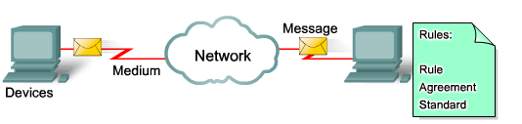
The standardization of the various elements of the network enables equipment and devices created by different companies to work together.
Experts in various technologies can contribute their best ideas on how to develop an efficient network, without regard to the brand or manufacturer of the equipment.
1.4 Network Role and Elements

Slide 13
The diagram shows elements of a typical network, including devices, media, and services, tied together by rules, that work together to send messages.
We use the word messages as a term that encompasses web pages,
e-mail, instant messages, telephone calls, and other forms of communication enabled by the Internet.

Slide 14
1.5 Network Architecture and characteristics
Networks must support a wide range of applications and services, as well as operate over many different types of physical infrastructures.
The term network architecture, in this context, refers to both the technologies that support the infrastructure and the programmed services and protocols that move the messages across that infrastructure.
As the Internet, and networks in general, evolve, we are discovering that there are four basic characteristics that the underlying architectures need to address in order to meet user expectations:
fault tolerance,
scalability,
quality of service, and
security.

Slide 15
Fault Tolerance
The expectation that the Internet is always available to the millions of users who rely on it requires a network architecture that is designed and built to be fault tolerant.
A fault tolerant network is one that limits the impact of a hardware or software failure and can recover quickly when such a failure occurs.
These networks depend on redundant links, or paths, between the source and destination of a message.
If one link or path fails, processes ensure that messages can be instantly routed over a different link transparent to the users on either end.
Both the physical infrastructures and the logical processes that direct the messages through the network are designed to accommodate this redundancy.
This is a basic premise of the architecture of current networks.

Slide 16
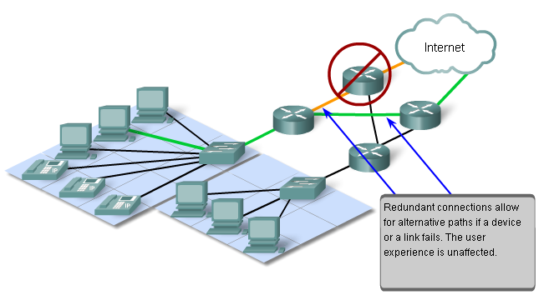

Slide 17
Scalability
A scalable network can expand quickly to support new users and applications without impacting the performance of the service being delivered to existing users.
Thousands of new users and service providers connect to the Internet each week.
The ability of the network to support these new interconnections depends on a hierarchical layered design for the underlying physical infrastructure and logical architecture.
The operation at each layer enables users or service providers to be inserted without causing disruption to the entire network.
Technology developments are constantly increasing the message carrying capabilities and performance of the physical infrastructure components at every layer.
These developments, along with new methods to identify and locate individual users within an internetwork, are enabling the Internet to keep pace with user demand.

Slide 18
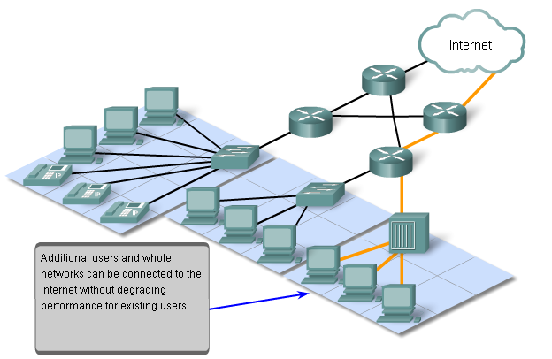

Slide 19
Quality of Service (QoS)
The Internet is currently providing an acceptable level of fault tolerance and scalability for its users.
But new applications available to users over internetworks create higher expectations for the quality of the delivered services.
Voice and live video transmissions require a level of consistent quality and uninterrupted delivery that was not necessary for traditional computer applications.
Quality of these services is measured against the quality of experiencing the same audio or video presentation in person.
Traditional voice and video networks are designed to support a single type of transmission, and are therefore able to produce an acceptable level of quality.
New requirements to support this quality of service over a converged network are changing the way network architectures are designed and implemented.

Slide 20
Security
The Internet has evolved from a tightly controlled internetwork of educational and government organizations to a widely accessible means for transmission of business and personal communications.
As a result, the security requirements of the network have changed.
The security and privacy expectations that result from the use of internetworks to exchange confidential and business critical information exceed what the current architecture can deliver.
Rapid expansion in communication areas that were not served by traditional data networks is increasing the need to embed security into the network architecture.
As a result, much effort is being devoted to this area of research and development.
In the meantime, many tools and procedures are being implemented to combat inherent security flaws in the network architecture.

Slide 21
A Fault Tolerant Network Architecture
The Internet, in its early inception, was the result of research funded by the United States Department of Defense (DoD).
Its primary goal was to have a communications medium that could withstand the destruction of numerous sites and transmission facilities without disruption of service.
It only follows that fault tolerance was the focus of the effort of the initial internetwork design work.
Early network researchers looked at the existing communication networks, which were primarily for the transmission of voice traffic, to determine what could be done to improve the fault tolerance level.

Slide 22
Circuit switching Vs packet switching networks.
WAN telecommunication system can be classified as circuit switching and packet switching networks.
Two different switching technologies
Circuit switching
Packet switching

Slide 23
Circuit switching
Circuit switching:
There is a dedicated communication path between two stations (end-to-end)
The path is a connected sequence of links between network nodes. On each physical link, a logical channel is dedicated to the connection.
Communication via circuit switching has three phases:
Circuit establishment (link by link)
Before any signals can be transmitted, an end-to-end (station-to-station) circuit must be established.
Data transfer
Circuit disconnect
Deallocate the dedicated resources
The switches must know how to find the route to the destination and how to allocate bandwidth (channel) to establish a connection.

Slide 24
Circuit switching
Inefficiency
Channel capacity is dedicated for the whole duration of a connection
If no data, capacity is wasted
Delay
Long initial delay: circuit establishment takes time
Developed for voice traffic (public telephone network) but can also applied to data traffic.
For voice connections, the resulting circuit will enjoy a high percentage of utilization because most of the time one party or the other is talking.
But how about data connections?

Slide 25
Packet switching
Packet switching is designed to address the problems of circuit switching.
Packet switching was designed to provide a more efficient facility than circuit-switching for burst data traffic.
With packet switching, a station transmits data in small blocks, called packets.
Each packet contains some portion of the user data plus control info needed for proper functioning of the network.

Slide 26
packet-switching
A key distinguishing element of packet-switching networks is whether the internal operation is datagram or virtual circuit (VC).
With internal VCs, a route is defined between two endpoints and all packets for that VC follow the same route.
With internal diagrams, each packet is treated independently, and packets intended for the same destination may follow different routes.
Examples of packet switching networks are X.25, Frame Relay, ATM and IP.

Slide 27
Circuit Switched Connection-oriented Networks
To understand the challenge that the DoD researchers were faced with, it is necessary to look at how early telephone systems work.
When a person makes a call using a traditional telephone set, the call first goes through a setup process, where all of the telephone switching locations between the person and the phone set that they are calling are identified.
A temporary path, or circuit, is created through the various switching locations to use for the duration of the telephone call.
If any link or device participating in the circuit fails, the call is dropped.
To reconnect, a new call must be made, and a new circuit created between the source telephone set and the destination.

Slide 28
This type of connection-oriented network is called a circuit-switched network.
Early circuit switched networks did not dynamically recreate dropped circuits.
In order to recover from failure, new calls had to be initiated and new circuits built end-to-end.
Many circuit switched networks give priority to maintaining existing circuit connections, at the expense of new circuit requests.
In this type of connection-oriented network, once a circuit is established, even if no communication is occurring between the persons on either end of the call, the circuit remains connected and resources reserved until one of the parties disconnects the call.

Slide 29
Since there is a finite capacity to create new circuits, it is possible to occasionally get a message that all circuits are busy and a call cannot be placed.
The cost to create many alternate paths with enough capacity to support a large number of simultaneous circuits, and the technologies necessary to dynamically recreate dropped circuits in the event of a failure, led the DoD to consider other types of networks.

Slide 30
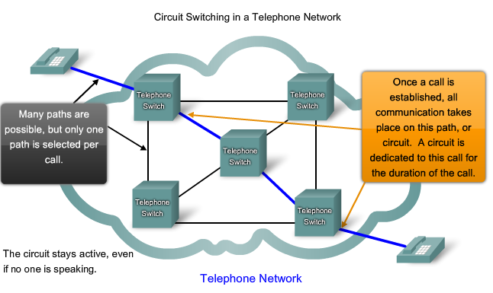

Slide 31
Packet Switched Connectionless Networks
In the search for a network that could withstand the loss of a significant amount of its transmission and switching facilities, the early Internet designers reevaluated early research regarding packet switched networks.
The premise for this type of networks is that a single message can be broken into multiple message blocks.
Individual blocks containing addressing information indicate both their origination point and their final destination.
Using this embedded information, these message blocks, called packets, can be sent through the network along various paths, and can be reassembled into the original message upon reaching their destination.

Slide 32
Utilizing Packets
The devices within the network itself are unaware of the content of the individual packets, only visible is the address of the final destination and the next device in the path to that destination.
No reserved circuit is built between sender and receiver. Each packet is sent independently from one switching location to another.
At each location, a routing decision is made as to which path to use to forward the packet towards its final destination.
If a previously used path is no longer available, the routing function can dynamically choose the next best available path.
Because the messages are sent in pieces, rather than as a single complete message, the few packets that may be lost in the advent of a failure can be retransmitted to the destination along a different path.
In many cases, the destination device is unaware that any failure or rerouting has occurred.

Slide 33
The DoD researchers realized that a packet switched connectionless network had the features necessary to support a resilient, fault tolerant network architecture.
The need for a single, reserved circuit from end-to-end does not exist in a packet switched network.
Any piece of a message can be sent through the network using any available path.
Packets containing pieces of messages from different sources can travel the network at the same time.
The problem of underutilized or idle circuits is eliminated -- all available resources can be used at any time to deliver packets to their final destination.
By providing a method to dynamically use redundant paths, without intervention by the user, the Internet has become a fault tolerant, scalable method of communications.

Slide 34
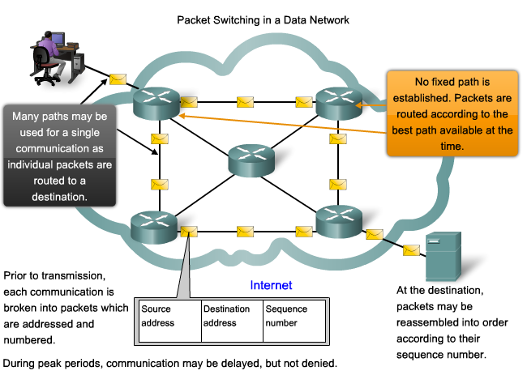

Slide 35
Connection-oriented Networks
Although packet-switched connectionless networks met the needs of the DoD, and continue to be the primary infrastructure for today's Internet, there are some benefits to a connection-oriented system like the circuit-switched telephone system.
Because resources at the various switching locations are dedicated to providing a finite number of circuits, the quality and consistency of messages transmitted across a connection-oriented network can be guaranteed.
Another benefit is that the provider of the service can charge the users of the network for the period of time that the connection is active.
The ability to charge users for active connections through the network is a fundamental premise of the telecommunication service industry.

Slide 36
A scalable network Architecture
The fact that the Internet is able to expand at the rate that it is, without seriously impacting the performance experienced by individual users, is a function of the design of the protocols and underlying technologies on which it is built.
The Internet, which is actually a collection of interconnected private and public networks, has a hierarchical layered structure for addressing, for naming and for connectivity services.
At each level or layer of the hierarchy, individual network operators maintain peering relationships with other operators at the same level.
As a result, network traffic that is destined for local or regional services does not need to traverse to a central point for distribution.
Common services can be duplicated in different regions, thereby keeping traffic off the higher level backbone networks.

Slide 37
Although there is no single organization that regulates the Internet, the operators of the many individual networks that provide Internet connectivity cooperate to follow accepted standards and protocols.
The adherence to standards enables the manufacturers of hardware and software to concentrate on product improvements in the areas of performance and capacity, knowing that the new products can integrate with and enhance the existing infrastructure.
The current Internet architecture, while highly scalable, may not always be able to keep up with the pace of user demand.
New protocols and addressing structures are under development to meet the increasing rate at which Internet applications and services are being added.

Slide 38
Providing a quality of service
Networks must provide secure, predictable, measurable, and, at times, guaranteed services.
The packet-switched network architecture does not guarantee that all packets that comprise a particular message will arrive on time, in their correct in order, or even that they will arrive at all.
Networks also need mechanisms to manage congested network traffic. Congestion is caused when the demand on the network resources exceeds the available capacity.
If all networks had infinite resources, there would not be a need to use QoS mechanisms to ensure quality of service.
Unfortunately, that is not the case. There are some constraints on network resources that cannot be avoided.

Slide 39
Constraints include technology limitations, costs, and the local availability of high-bandwidth service.
Network bandwidth is the measure of the data carrying capacity of the network. When simultaneous communications are attempted across the network, the demand for network bandwidth can exceed its availability.
The obvious fix for this situation is to increase the amount of available bandwidth. But, because of the previously stated constraints, this is not always possible.
In most cases, when the volume of packets is greater than what can be transported across the network, devices queue the packets in memory until resources become available to transmit them.
Queuing packets causes delay. If the number of packets to be queued continues to increase, the memory queues fill up and packets are dropped.

Slide 40
Achieving the required Quality of Service (QoS) by managing the delay and packet loss parameters on a network becomes the secret to a successful end-to-end application quality solution.
Thus, ensuring QoS requires a set of techniques to manage the utilization of network resources.
In order to maintain a high quality of service for applications that require it, it is necessary to prioritize which types of data packets must be delivered at the expense of other types of packets that can be delayed or dropped.

Slide 41
Classification
Ideally, we would like to assign a precise priority for each type of communication.
Currently, this is neither practical nor possible. Therefore, we classify applications in categories based on specific quality of service requirements.
To create QoS classifications of data, we use a combination of communication characteristics and the relative importance assigned to the application.
We then treat all data within the same classification according to the same rules.
For example, communication that is time-sensitive or important would be classified differently from communication that can wait or is of lesser importance.

Slide 42
Assigning priorities
The characteristics of the information being communicated also affect its management.
For example, the delivery of a movie uses a relatively large amount of network resources when it is delivered continuously without interruption.
Other types of service - e-mail, for example - are not nearly as demanding on the network.
In one company, an administrator might decide to allocate the greatest share of the network resources to the movie, believing that this is the priority for his customers.
This administrator may decide that the impact will be minimal if e-mail users have to wait a few additional seconds for their e-mail to arrive.
In another company, the quality of a video stream is not as important as critical process control information that operates the manufacturing machinery.

Slide 43
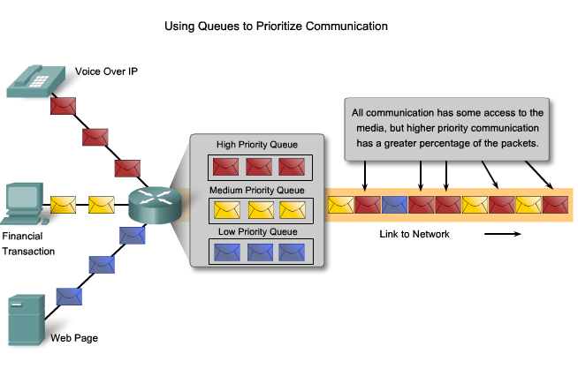

Slide 44
QoS mechanisms enable the establishment of queue management strategies that enforce priorities for different classifications of application data.
Without properly designed and implemented QoS mechanisms, data packets will be dropped without consideration of the application characteristics or priority.
Examples of priority decisions for an organization might include:
Time-sensitive communication - increase priority for services like telephony or video distribution.
Non time-sensitive communication - decrease priority for web page retrieval or e-mail.
High importance to organization - increase priority for production control or business transaction data.
Undesirable communication - decrease priority or block unwanted activity, like peer-to-peer file sharing or live entertainment.

Slide 45
The Quality of Service a network can offer is a vital issue, and in some situations, it is crucial.
Imagine the consequences of a dropped distress call to an emergency response center, or of a lost control signal to an automated piece of heavy machinery.
A key responsibility for the network managers in an organization is to establish a Quality of Service policy and ensure that the mechanisms are in place to meet that goal.

Slide 46
1.6 Computer Network Vs Human Network

Slide 47
Computer Networks
Human Network
Generally regarded as a social structure composed of individuals, business partners, friends or other organizations connected through technology, using devices such as PCs, cell phones, PDAs and digital TV
Evidence can be found in the rapid rise of social networking
people are now more than ever inextricably linked through e-mail, photographs, wikis, blogs, podcasts, instant messaging and more
Societal shifts that the human network has yielded are:
added transparency to organizations,
the decentralization of power from traditional institutions
The democratization of established social structures

Slide 48
Computer Networks
A system in which a number of independent computers are linked together to share data and peripherals, such as hard disks and printers
The term network can also be defined as a set of different types , terminals, telephones and other communication equipments , connected by data communication links, which allow the network components to work together
The network components may be located within a small area or spread over many remote location hold the network hold together

Slide 49
Why Computer Networks
Sharing information/data
Sharing hardware and software
Centralizing administration and support

Slide 50
Why Computer Networks
More specifically, computers that are part of a network can share:
Documents (memo, spreadsheets, invoices, and so on)
E-mail messages
Word-processing software
Project-tracking software
Illustrations, photographs, videos, and audio files
Live audio and video broadcasts
Printers.
Fax machines
Modems
CD-ROM drives and other removable drives, such as Zip drives
Hard drives
So many more…

