Slide 1
Partitioner
Introduction
Architecture and basic function
Xinxin Liu
UPAO Team Cobra
2025-06-04

Slide 2
Agenda
Partitioner in PCG
Partitioner Role
Partitioner Table
Interactions with other microservices
Partitioner Architecture
Partition Distribution Algorithms
Important functions and submodules

Slide 3
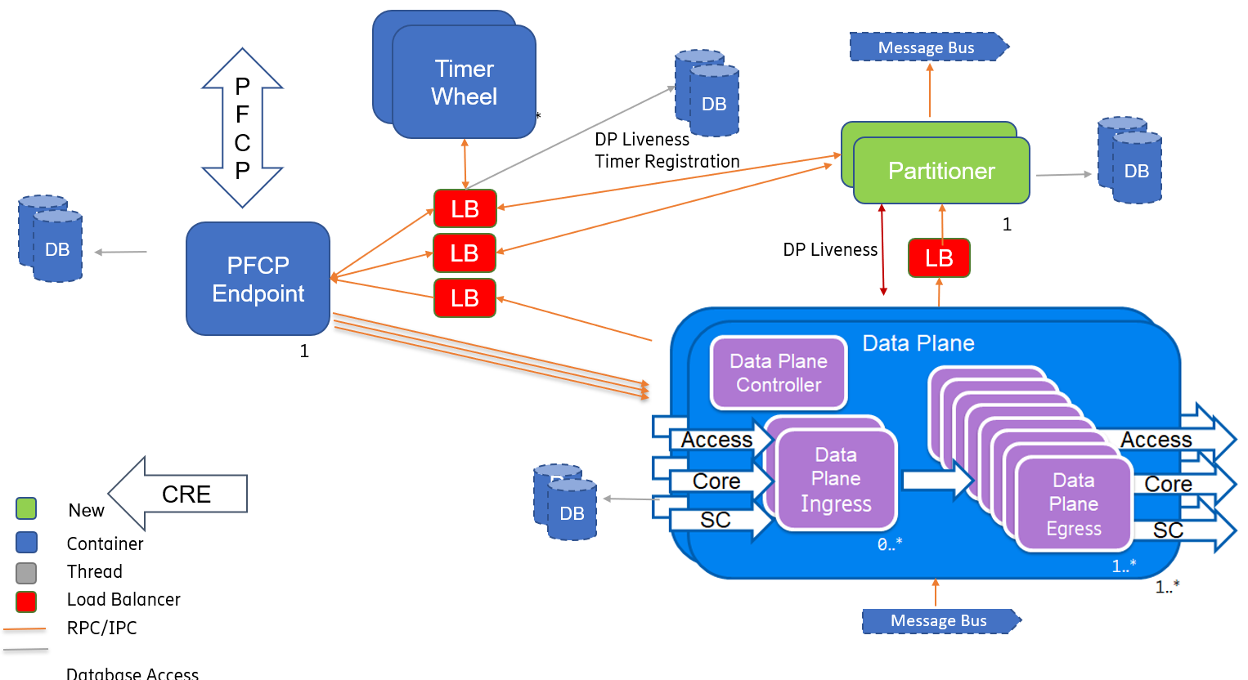
Partitioner in PCG

Slide 4
Partitioner Role
1st level mapping:
Sessions<-->Partitions
DP-Instances
Partitions
0
Entity#1
1
2
3
4
Entity#2
5
Load
Balancer
…
Load
Balancer
UE
Sessions
Entity#3
Entity#n
8191
Partitioner monitor DP instance’s state, and maintain the load-balancer’s result after each DP instances state changed.
2nd level mapping:
Partitions<-->DP instances
Notes:
Partition Table as Load Balancer

Slide 5
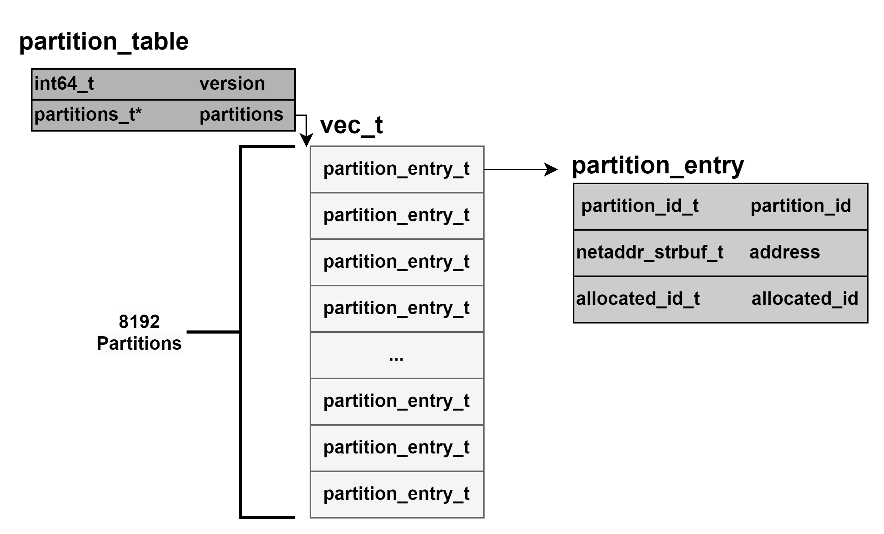
What’s the Partition Table
Notes:
Partition Table contains 8192 entries, each entry contains the allocated DP instance’s info, such as IP address

Slide 6
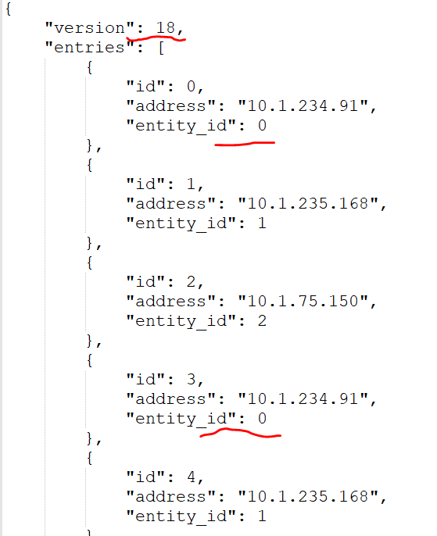
Partitioner table
Total: 8192

Slide 7
Partitioner Architecture
kvdb
partitioner
partitioner-main
db
id-health-check
Partition table
Partition
distribution
partitioner-kafka
kafka
TW
readiness
entity
update-table
msgbus_subject_partition_table
msgbus_subject_entity_removed
liveness
registration
deregistration
get-table
HTTP/HTTPs
UDP/HTTP/HTTPs
DP
PEP
RA
Kafka
Function Call
Msgbus
Notes:
Submodules
id-health-check: ID re-used / bitset leak

Slide 8
Partitioner Architecture
kvdb
DP <--> Partitioner
  Registration & De-Registration
  Supervison
  Get Table
  Msgbus Consumer: TableUpdate & Entity Removal
PEP <--> Partitioner
  Msgbus Consumer: TableUpdate
  Get Table
RA <--> Partitioner
  Msgbus Consumer: TableUpdate & Entity Removal
TW <--> Partitioner
  Timer
DB <--> Partitioner
  Partition Entity
  PartitionTable
partitioner
partitioner-main
db
id-health-check
Partition table
Partition
distribution
partitioner-kafka
kafka
TW
readiness
entity
update-table
msgbus_subject_partition_table
msgbus_subject_entity_removed
liveness
registration
deregistration
get-table
HTTP/HTTPs
UDP/HTTP/HTTPs
DP
PEP
RA
Kafka
Function Call
Msgbus
Notes:
Submodules
id-health-check: ID re-used / bitset leak

Slide 9
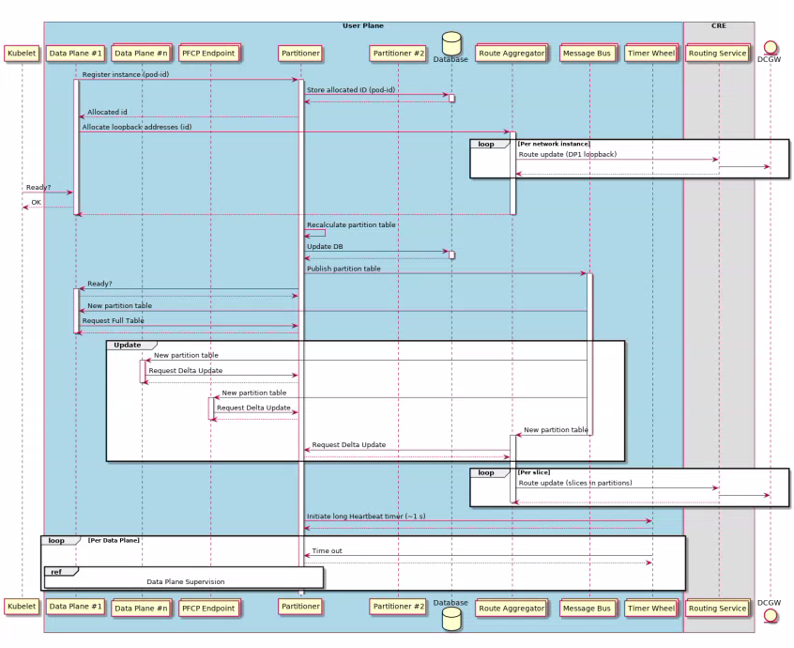

Slide 10
Partitions Distribution Algorithms
Round-Robin (Configurable)
    Partitions: 0 | 1 | 2 | 3 | 4 | 5 | 6 | 7 | 8 | … | 8191
  Allocated ID: 0 | 1 | 2 | 0 | 1 | 2 | 0 | 1 | 2 | … | 0
  Scale Out(3->4): 0 | 1 | 2 | 3 | 0 | 1 | 2 | 3 | 0 | … | 3
  Scale In(3->2): 0 | 1 | 0 | 1 | 0 | 1 | 0 | 1 | 0 | … | 1
Cherry-pick (Default)
    Partitions: 0 | 1 | 2 | 3 | 4 | 5 | 6 | 7 | 8 | … | 8189 | 8190 | 8191
  Allocated ID: 0 | 1 | 2 | 0 | 1 | 2 | 0 | 1 | 2 | … | 1 | 2 | 0
  Scale Out(3->4): 0 | 1 | 2 | 3 | 1 | 2 | 0 | 3 | 2 | … | 1 | 2 | 3
  Scale In(3->2): 0 | 1 | 1 | 0 | 1 | 0 | 0 | 1 | 1 | … | 1 | 1 | 0

Slide 11
Partitions Distribution Algorithms
Partition n. | DP1 | DP2 | DP3
0
1
2
3
4
5
6
7
8
…..
8190
8191
Cherry-pick (Default)
Assigned
Assigned
Assigned
Assigned
Assigned
Assigned
Assigned
Assigned
Assigned
Assigned
Assigned
Assigned

Slide 12
Partitions Distribution Algorithms
Partition n. | DP1 | DP2 | DP3 | DP4
0
1
2
3
4
5
6
7
8
…..
8190
8191
Cherry-pick (Default)
Scale out. (3->4)
Assigned
Assigned
Assigned
Assigned
Assigned
Assigned
Assigned
Assigned
Assigned
Assigned
Assigned
Assigned

Slide 13
Partitions Distribution Algorithms
Partition n. | DP1 | DP2 | DP3
0
1
2
3
4
5
6
7
8
…..
8190
8191
Cherry-pick (Default)
Scale out (3->2)
Assigned
Assigned
Assigned
Assigned
Assigned
Assigned
Assigned
Assigned
Assigned
Assigned
Assigned
Assigned

Slide 14
Partitions Distribution Algorithms
Partition n. | DP1 | DP2
0
1
2
3
4
5
6
7
8
…..
8190
8191
Cherry-pick (Default)
Assigned
Assigned
Assigned
Assigned
Assigned
Assigned
Assigned
Assigned
Assigned
Assigned
Assigned
Assigned

Slide 15
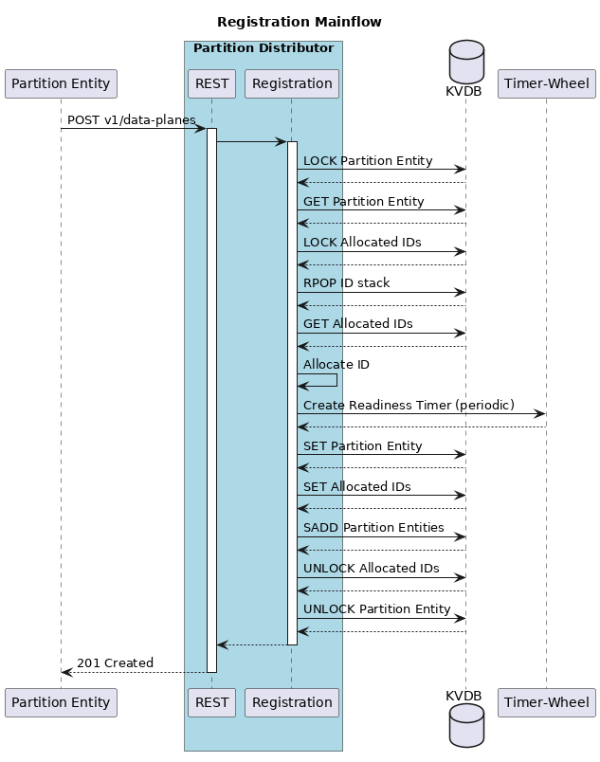
registration
URI | Description | Callback
"/v1/data-planes" | DATAPLANES_REGISTER | partitioner_on_register_request()

Slide 16
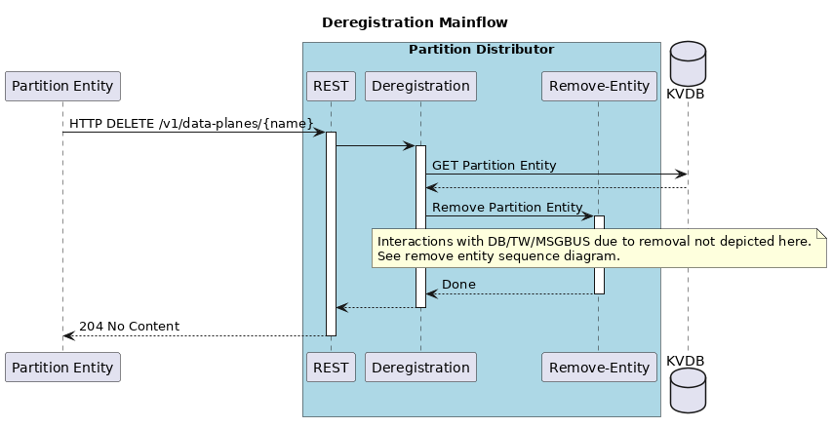
deregistration
URI | Description | Callback
"/v1/data-planes/{id}" | DATAPLANES_DEREGISTER | partitioner_on_deregister_request()

Slide 17
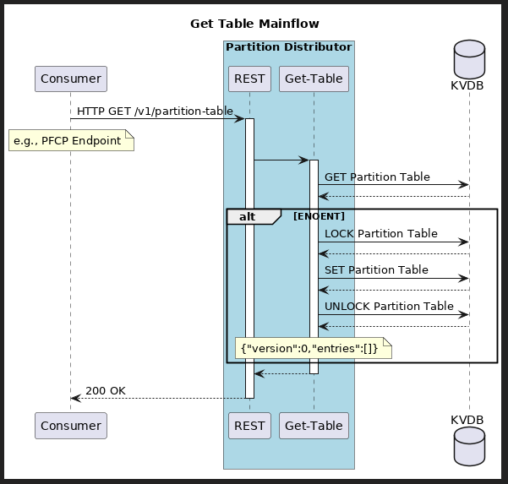
get_table
URI | Description | Callback
"/v1/partition-table" | PARTITION_TABLE | partitioner_on_get_table_request()

Slide 18
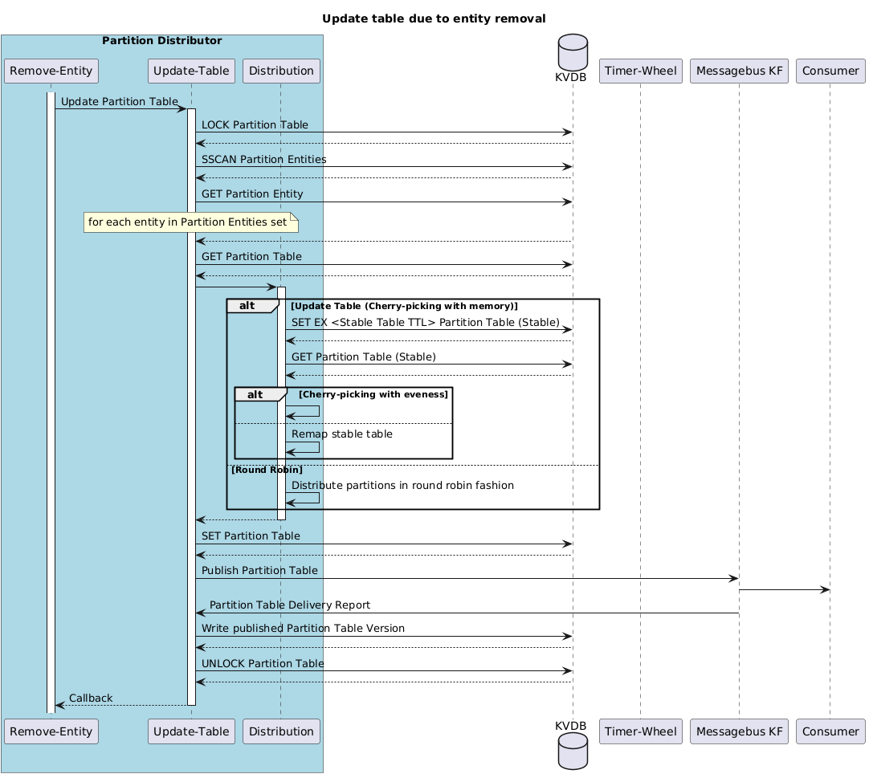
update_table

Slide 19
timer wheel timers
URI | Description | Callback | Timer Type
"/v1/timers/readiness" | TW_TIMER_TYPE_READINESS | partitioner_readiness_tw_timer_timeout_cb() | TW_FLAG_PERIODIC
"/v1/timers/liveness" | TIMER_TYPE_LIVENESS | partitioner_liveness_tw_timer_timeout_cb() | TW_FLAG_PERIODIC
"/v1/timers/gain_grace_period" | TIMER_TYPE_GAIN_GRACE_PERIOD | partitioner_gain_grace_period_tw_timer_timeout_cb() | TW_FLAG_NONE
"/v1/timers/id_health_check" | TIMER_TYPE_ID_HEALTH_CHECK | partitioner_id_health_check_tw_timer_timeout_cb() | TW_FLAG_NONE

Slide 20
Code
Recordings
https://play.ericsson.net/playlist/dedicated/1_jc5eb03e/

