Slide 1

Authentication & Authorization Mechanisms in the Web of Things Monika Singh monika.singh@tum.de

Slide 2
Flexibilty of Things Description
Comparison of the security scheme mentioned in the Things Description with the implementation done in the node-wot

Slide 3
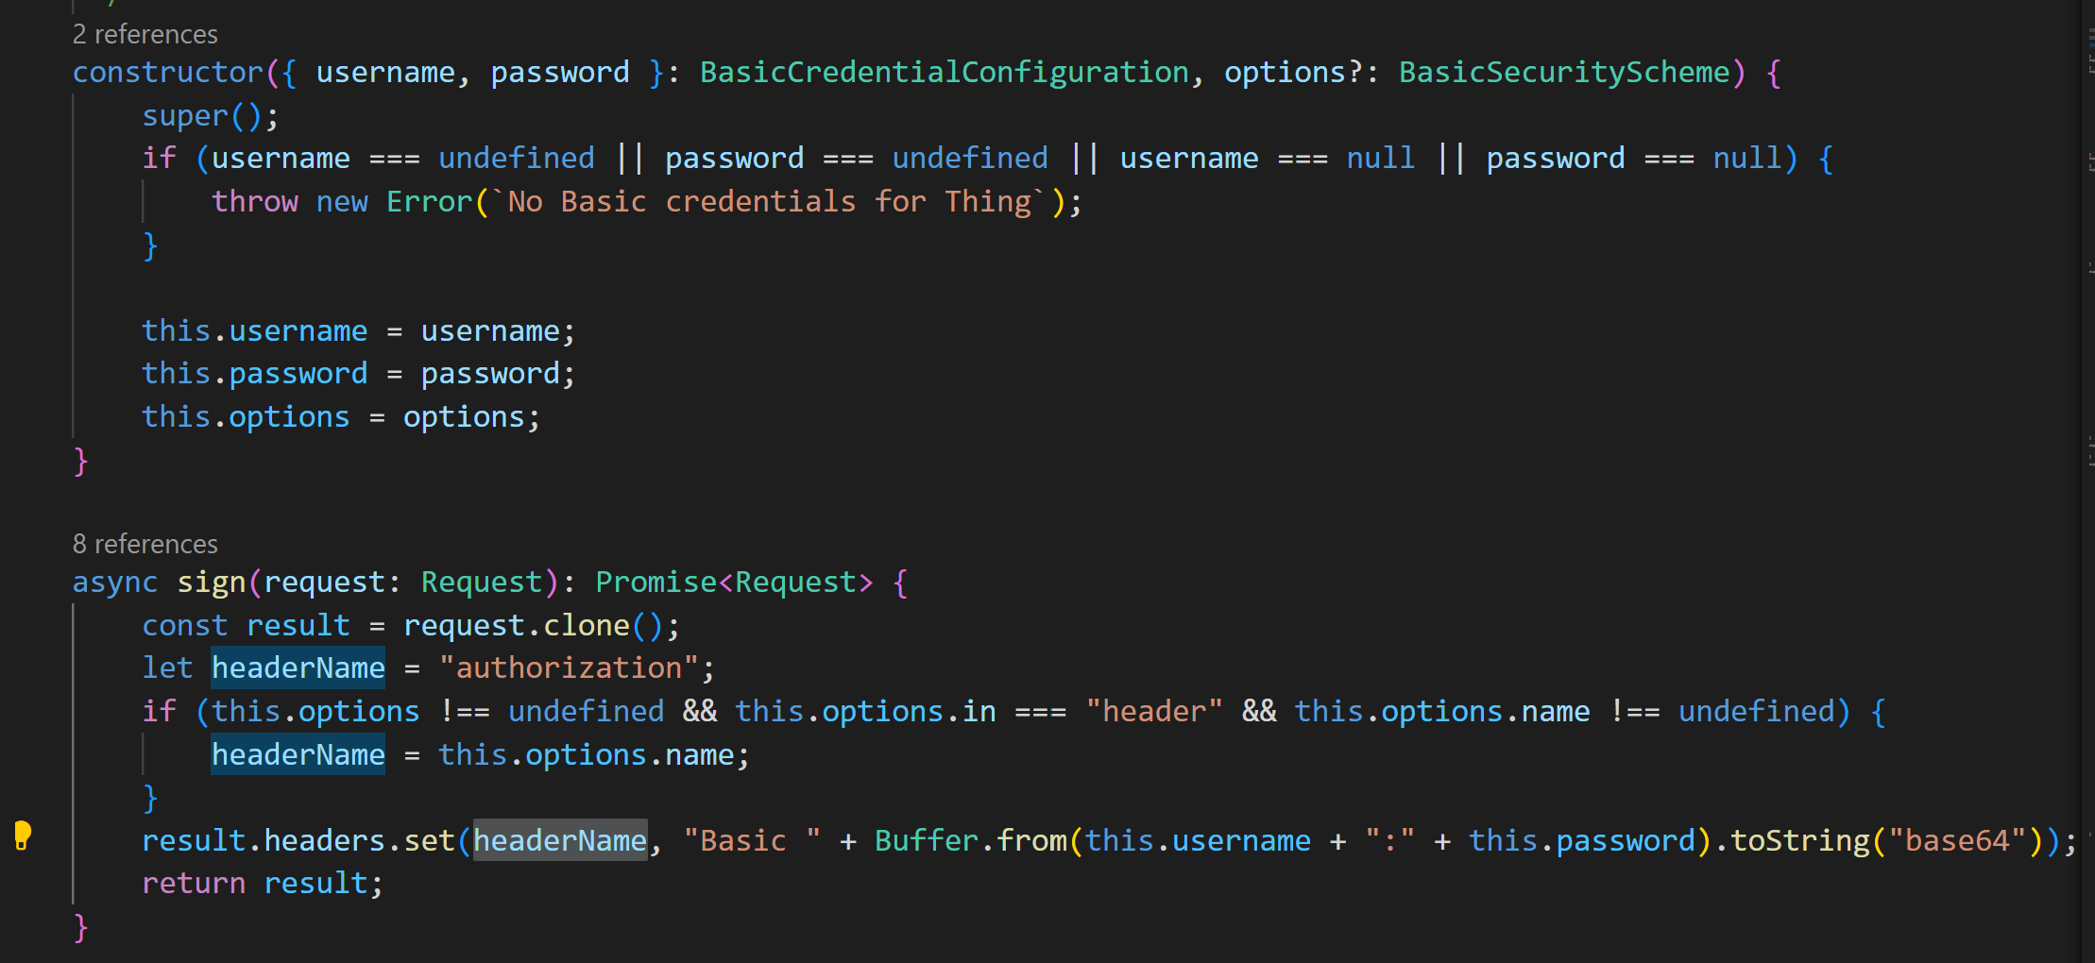
Flexibilty of Things Description: Basic Authentication
Basic Authentication
Basic Auth is only implemented for the ‘in‘: ‘header‘. It uses basic-auth library which extracts the credential from the Authorization field in the header. [1.1]
File name: credentials.ts(line 49 to 57) [1.3]
The field name: authorization is hardcoded. It does not provide the flexibilty for the user to chose a different name.
File name: credentials.ts(line 49 to 57) [1.3]
In node-wot, it is implemented for producer(HTTP protocol) and consumer(HTTP protocol) [1.2]

Slide 4
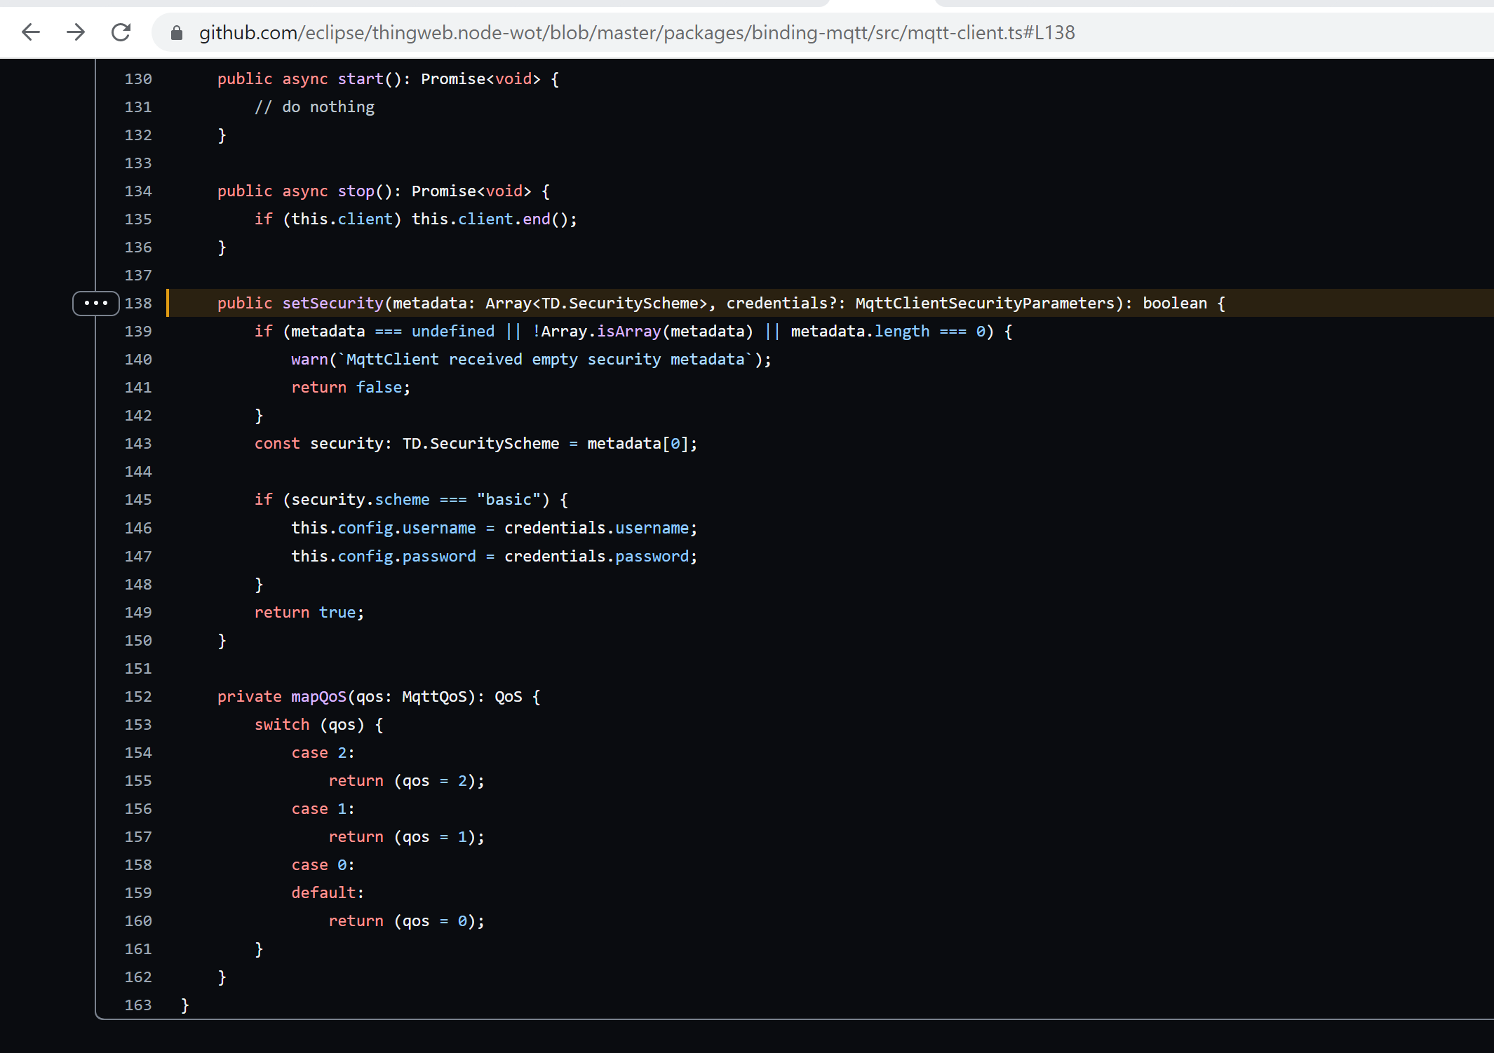
Flexibilty of Things Description: Basic Authentication
In node-wot, it is implemented for consumer(MQTT) [1.4]
Suggestion: In case of wrong credentials where one of producer and consumer are not using node-wot, node-wot should send a www-authenticate header indicating the authentication mechanism used.

Slide 5
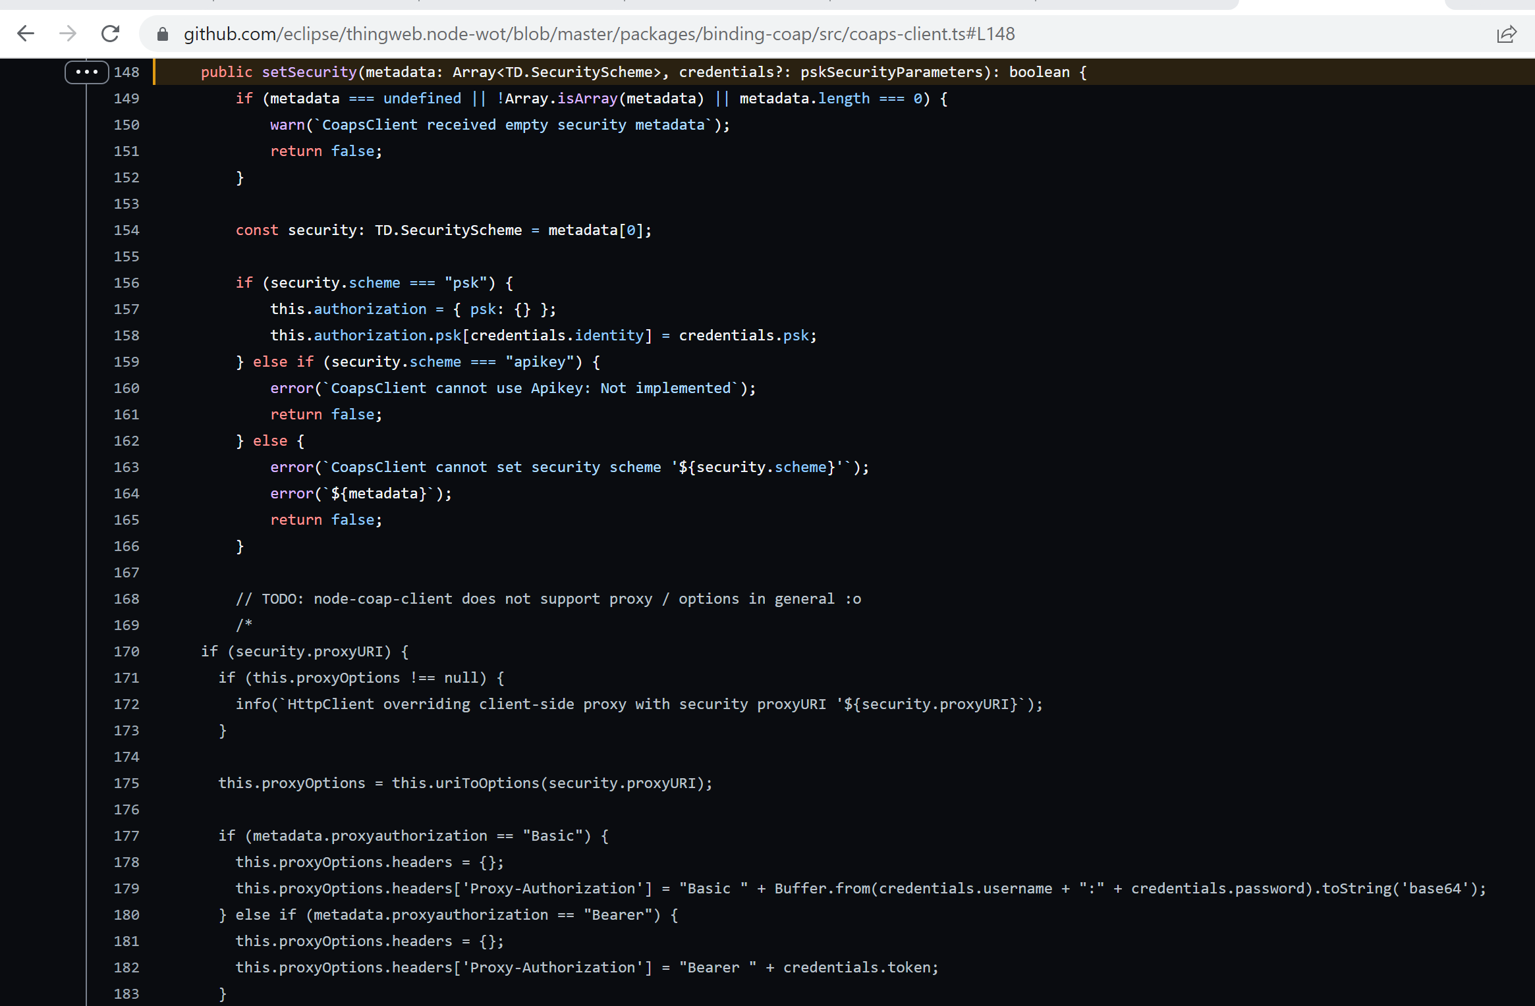
Flexibilty of Things Description: Pre-Shared Key
In node-wot, it is only implemented for CoAP consumer [2.1]
Other security scheme is not implemented for CoAP

Slide 6
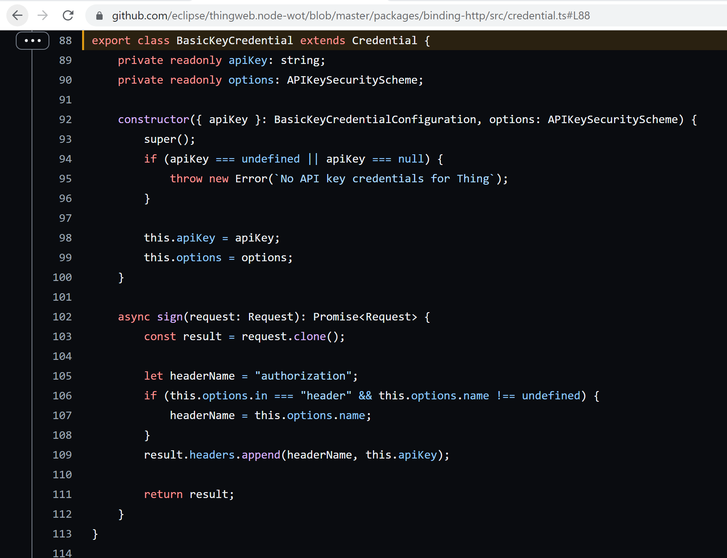
Flexibilty of Things Description: API Key
In node-wot, it is only implemented for the ‘in‘: ‘header‘. [3.1]
The field name: authorization is hardcoded. It does not provide the flexibilty for the user to chose a different name.
File name: credentials.ts(line 102 to 111) [1.3]
In node-wot, it is only Implemented for consumer(HTTP protocol) [1.2]
Suggestion: There should be 1 parameter in the Things descriptions which can be used to set the expiry of the key.

Slide 7
Flexibilty of Things Description: Digest Authentication
In node-wot Digest is not implemented yet [1.2]
Suggestions:
There should 1 parameter in Things Description which should be used to give the flexibilty to chose the algorithm like MD5 SHA256 etc like it is done for bearer token scheme [4.1]
There should be some support for negotiations of parameters like algorithm, nonce, opaque parameter which is used to calculate the final response value.
Things Description can have some optional parameters like opaque and realm which are used to calculate the digest value and can be static(based on the requirement of the application).
Section 3.4 of rfc7616 states all the necessary rules required for the Authorization header [4.2]

Slide 8
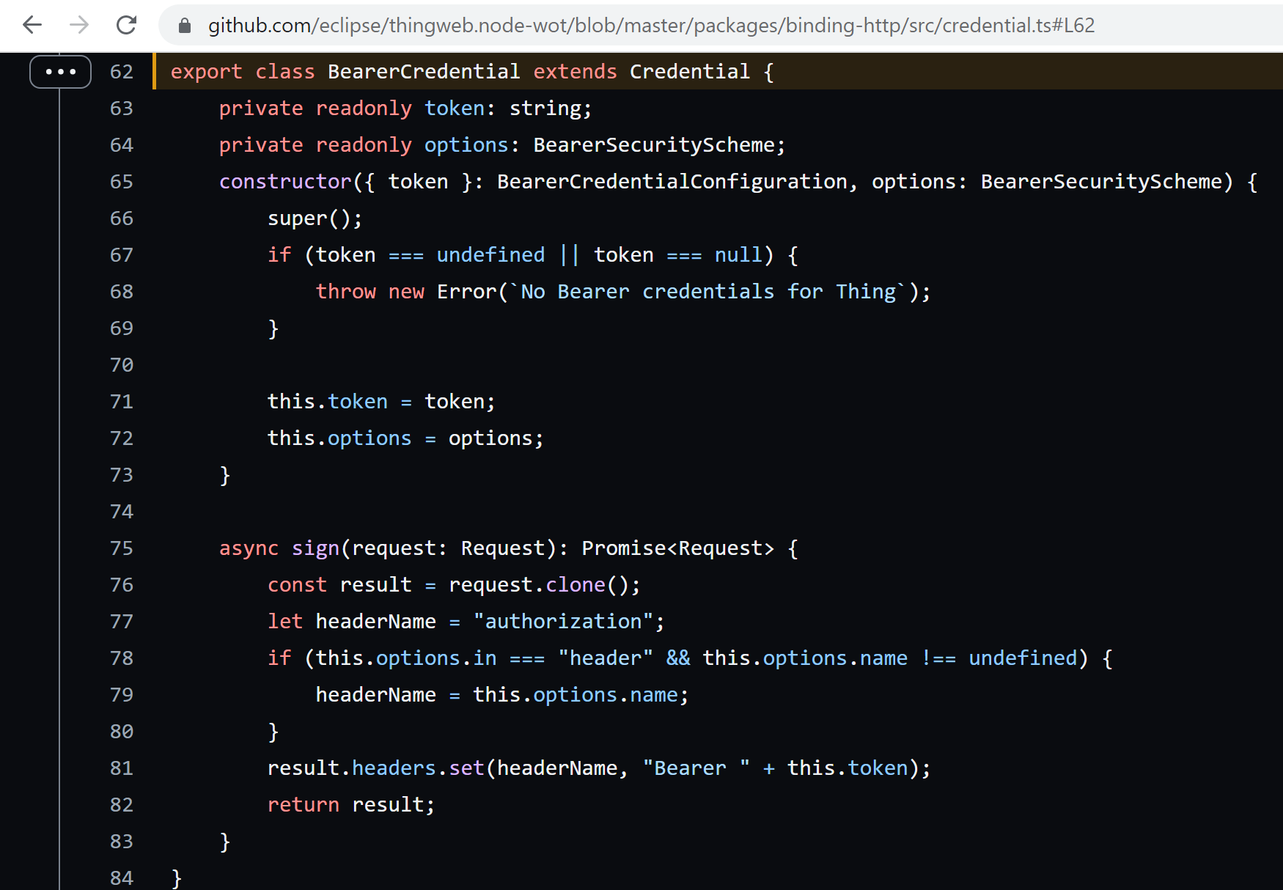
Flexibilty of Things Description: Bearer Token
In node-wot, it is implemented for both producer (HTTP Protocol) and consumer(HTTP Protocol) [1.2]
The token can be only be sent via header i.e in: header [5.1]
The field name: authorization is hardcoded. It does not provide the flexibilty for the user to chose a different name. [5.1]

Slide 9
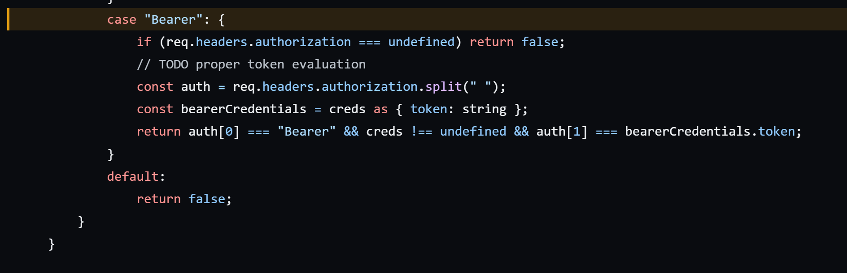
Flexibilty of Things Description: Bearer Token
Token evalution is not done [5.2] like CWT token is created in a certain way and can be verified by the producer to check if it is comming from a authenticated consumer.
In node-wot, only comparision of token is done [5.2]. Parmeter like algo, authorization, format is not been implemented.

Slide 10
Flexibilty of Things Description: OAuth2
In node-wot, it is only implemented for consumer(HTTP protocol) [1.2]
Client credential and Resource Owner credential flow is implemented in node-wot [6.1]
For some server, the parameter like clientId, clientSecret has to be sent in body for client credential flow which is not implemented yet.[6.2]
Error response is not done completely [6.3]
Suggestion: To distinguish between these server there should be a parameter stating where should the credential be send like the in parameter for other schemes.

Slide 11
Flexibilty of Things Description
Combo and Auto Security scheme is not implemented.
Suggestion: In node-wot, anyone can view the TD. There is no Security scheme verification done to fetch the TD. The Things Description contains alot of information, specially once combo security scheme is implemented, any attacker can see the weak points in TD. So there should be a security check done if the security parameter is defined in the TD.

Slide 12
Thank you

Slide 13
References
Basic Authentication
https://www.npmjs.com/package/basic-auth
https://github.com/eclipse/thingweb.node-wot/blob/master/packages/binding-http/README.md#feature-matrix
https://github.com/eclipse/thingweb.node-wot/blob/b174a3b5eceb5b784457c820bce1b8614e53fa7c/packages/binding-http/src/credential.ts#L49
https://github.com/eclipse/thingweb.node-wot/blob/b174a3b5eceb5b784457c820bce1b8614e53fa7c/packages/binding-mqtt/src/mqtt-client.ts#L138
Pre-Shared Key
https://github.com/eclipse/thingweb.node-wot/blob/b174a3b5eceb5b784457c820bce1b8614e53fa7c/packages/binding-coap/src/coaps-client.ts#L148
API Key
https://github.com/eclipse/thingweb.node-wot/blob/b174a3b5eceb5b784457c820bce1b8614e53fa7c/packages/binding-http/src/credential.ts#L88
Digest Authentication
https://www.rfc-editor.org/rfc/rfc7616#section-3.7
https://www.rfc-editor.org/rfc/rfc7616#section-3.4
Bearer Token
https://github.com/eclipse/thingweb.node-wot/blob/b174a3b5eceb5b784457c820bce1b8614e53fa7c/packages/binding-http/src/credential.ts#L62
https://github.com/eclipse/thingweb.node-wot/blob/b174a3b5eceb5b784457c820bce1b8614e53fa7c/packages/binding-http/src/http-server.ts#L453
OAuth2
https://github.com/eclipse/thingweb.node-wot/tree/master/packages/binding-http#oauth20
thingweb.node-wot/oauth-manager.ts at b174a3b5eceb5b784457c820bce1b8614e53fa7c · eclipse/thingweb.node-wot · GitHub
https://github.com/eclipse/thingweb.node-wot/blob/b174a3b5eceb5b784457c820bce1b8614e53fa7c/packages/binding-http/src/http-server.ts#L445

