Slide 1
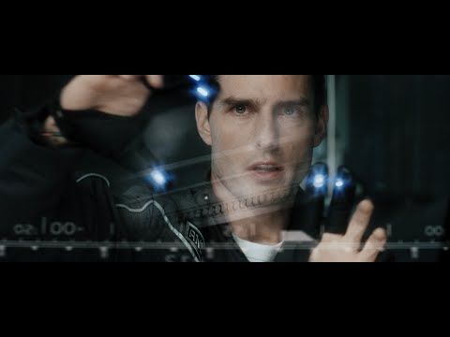
Notes:
Earlier in the semester we watched this clip of Tom Cruise manipulating a screen with just gestures in Minority Report.
Commercially used gesture and voice manipulated interfaces like this still seem like the stuff of scifi, but we’re setting out to bring that technology much closer to home. Instead of gesture interfaces for identifying crime, we’d like to introduce a gesture and voice driven system for more naturally controlling how we give live presentations.

Slide 2
Smart Slides
Gila Schein, Gaby Ecanow, Marlena Gomez
Notes:
This led us to our project idea – Smart Slides! I’m Gila, and together with Gaby and Marlena we’ll walk through our design of a handsfree, multi-modal interface for slideshow presentations.

Slide 3
Make a 6-minute video
Content:
Problem scenario. Describe a scenario that illustrates the problem you are tackling in your term project. A scenario is a concrete, realistic story involving a user with a goal to satisfy, and outlines the tasks that they need to perform in order to achieve that goal. Illustrate the scenario with a storyboard: images showing the scenario you described. The storyboard should show the actions that the user is performing and how the interface appears over the course of the scenario. Be as concrete as possible about the gestures or speech , or ... that the user is performing and the resulting outcomes.
Proposed solution. Concisely explain the vision behind your solution to the problem. What does your solution improve upon, or why does it enable the user to achieve their goals in an easier / more efficient / more enjoyable way?
Implementation plan. Describe how you plan to build your system. You should include: a system diagram showing how the user’s input will flow through your system, the libraries and packages you plan to integrate into your system, and the components that you will be building yourself. Check any libraries you plan to use to ensure as best you can that (a) they do what you need to do, and (b) they will work with whatever operating system, browser, etc., you have. Now is the time to see if you’re going to have compatibility problems. Be sure to explain why you need the library you mention: know what it does and why it’s useful to you.
Explain the current status of your implementation. Do you have all of the hardware and software your project requires? Have you started testing any of the outside libraries or services (e.g., speech recognition) that you intend to use?
If you need to collect training data, explain how you plan to collect it.
Evaluation. Describe how you plan to evaluate your completed system in terms of usability and/or
recognition. What tasks will the user perform and what baseline(s) will you compare against?
Use your time well: the clearer your presentation, the more useful feedback you will get on possible features or usability issues of your designs.

Slide 4
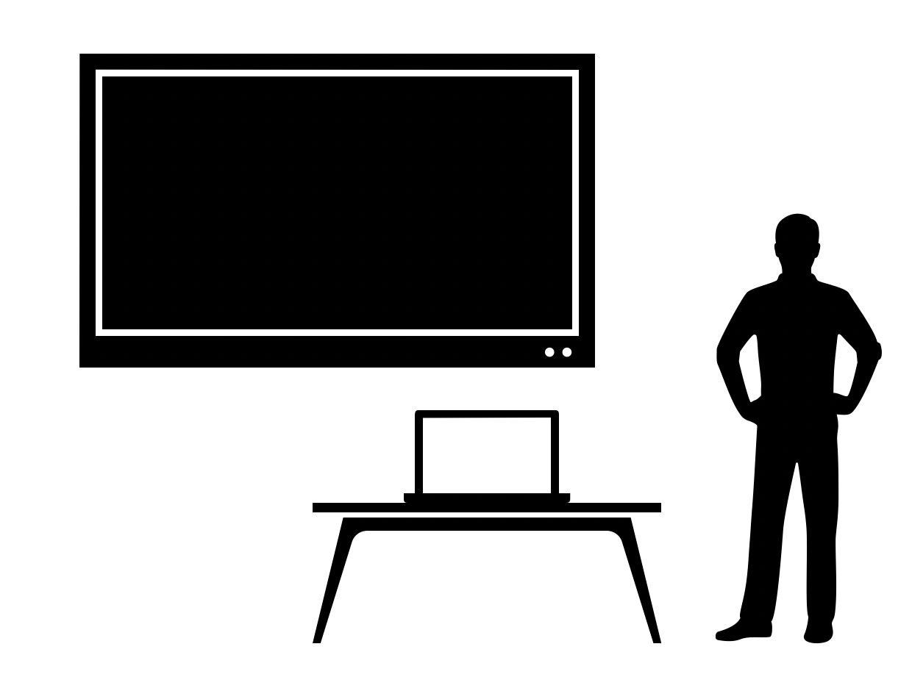
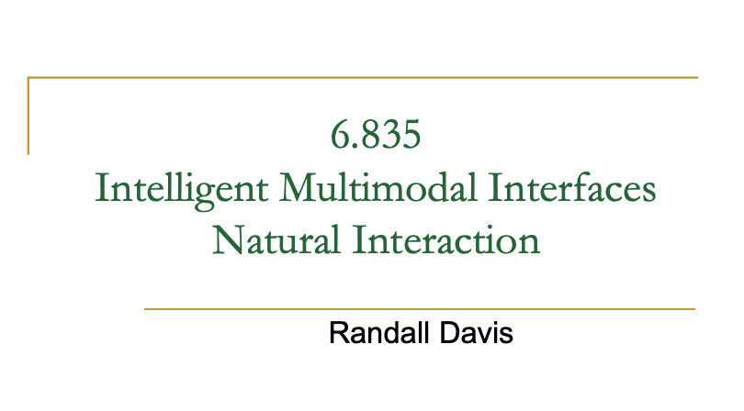
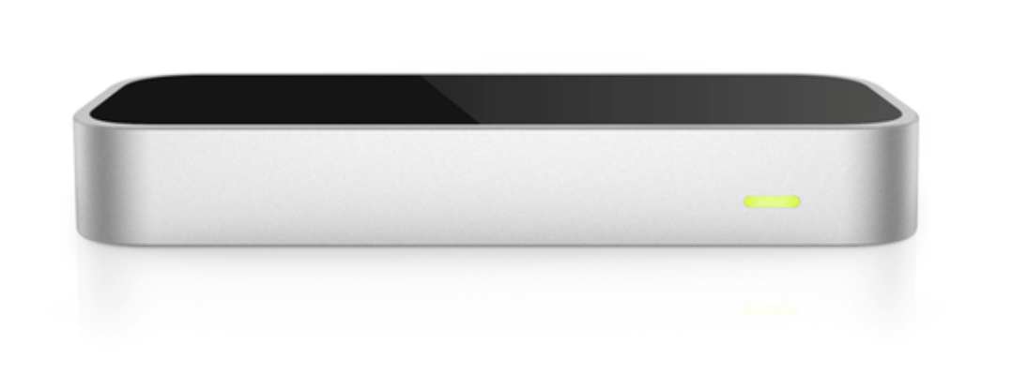
Problem Scenario
Notes:
Picture Professor Davis lecturing in 32-141, tied to his computer buttons in order to change slides, cue animations, or play videos (when it works). Or imagine yourself in the last presentation you gave - perhaps you had to mutter “next slide” under your breath so your classmate could change the screen, or maybe you needed to fiddle with the remote or walk up to your computer to manually command the system. Beyond that, in current presentation modes, the speaker often has to turn their back to the audience to highlight displayed information through laser use or pointing.
With today’s technology, we should not be tied to computer buttons or handheld devices to give presentations full of twists, turns, and interruptions. With Smart Slides and its integration of live video and voice tracking, a speaker can smoothly navigate a dynamic presentation, consistently facing the audience, while in the spotlight.

Slide 5
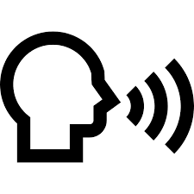

Proposed Solution
Gestures
next slide
previous slide
cue animation
highlight text
create a circle
laser pointer
Speech: key phrases
“next slide”
“previous slide”
“highlight this”
“create a circle here”
“go to (title of slide)”
“laser”
Notes:
Smart Slides will have two input modalities it recognizes: gesture and speech. To navigate the slide deck with gesture the presenter can use their hand and swipe to the right to move to the next slide, swipe to the left to move to the previous slide, or swipe up to cue an animation on the slide.
Additionally, the presenter can move through the slide deck with speech by saying “next slide” “previous slide” or the title of the specific slide to jump to.
More complex slide interactions involve speech and gesturing together. For example, to highlight text the presenter can say “highlight this” and point to the text on the computer slide where a highlight should be added. Similarly, a presenter can say “circle this” while making a circling gesture where they want a circle object to be added. The presenter can also use the cursor on the computer as a laser pointer by saying the keyword “laser” and then using a pointing gesture to control the cursor position.

Slide 6
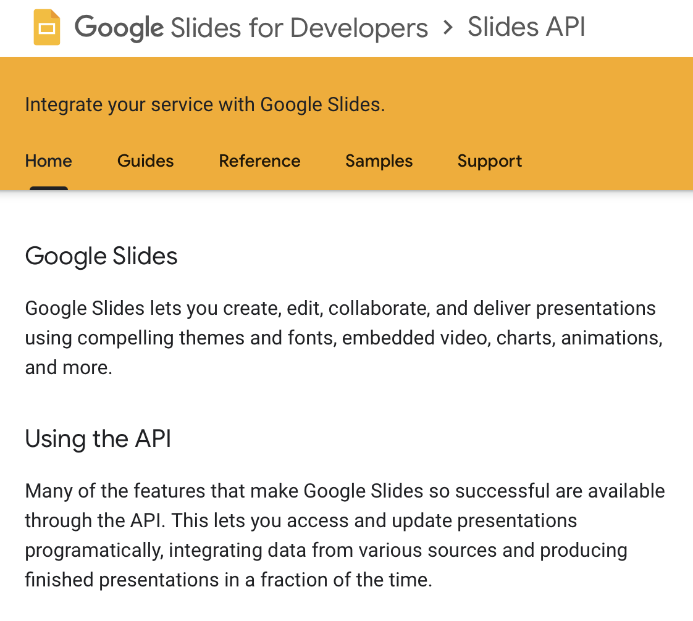
Implementation Plan
Notes:
Our implementation plan is as follows: Users will need to premake their slides using our custom software linking Google Slides to our recognition system. Google makes this easy by providing a Google Slides API for developers in JavaScript. Users will also be able to toggle on and off what gestures and voice triggers they would like to include.

Slide 7
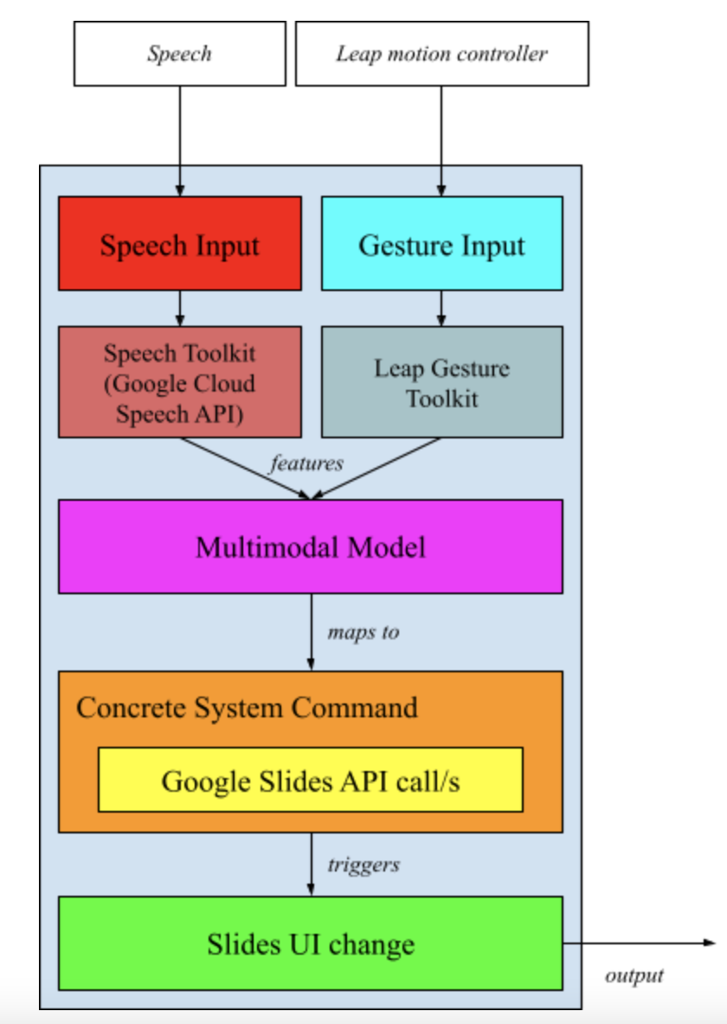
Implementation Plan
May use MP3’s speech recognition instead of Google Cloud Speech API
A classification model mapping
{T, G} → system command
T = transcript
G = gesture
Custom wrapper over Google Slides API
Notes:
During the live presentation, we’ll get the raw speech and motion input, which we’ll pass into separate toolkits for preprocessing.
We originally planned to use the Google Cloud Speech API for recognising speech input, but may instead reuse the library from MiniProject 3.
Our current plan is to use the leap motion gesture toolkit. The Leap is especially useful for a couple reasons: First, it’s compactness and versatility will help make the system widely useful. For example, each classroom at a university could be equipped with a leap, similar to how most classrooms already have HDMI adaptor. Second, Leap comes with an extensive library of recorded gestures, which will make preprocessing much easier. Finally, because it only records hand gestures, users will not feel the extra burden of having full pose recordings or RGB video captured during their presentations.
Backups in case of potential incompatibility or new requirements include OpenPose and openFrameworks. We would love to hear if anyone has had experience working with either on MacOS.
After preprocessing, we plan to pass the gesture and transcript into a classification model which outputs a concrete Smart Slides command. Using the command, we would make the appropriate calls to the Google Slides API to dynamically update the Slides in real time.

Slide 8
Evaluation
The system will be tested by us and 3 naive users in a variety of classrooms
Quantitative
Goal: > 80 % accuracy
Accuracy = (2*precision*recall) /
(precision + recall)
Latency: reaction < 1 sec
Qualitative
User surveys
Gesture and speech intuitiveness
General feedback
Notes:
In evaluating our system, we will perform presentations ourselves using the system and have 3 naive users give presentations using the system as well. In this sampling of tests, multiple classrooms will be used, chosen specifically to vary conditions such as lighting and distance from the sensor.
Our goal is > 80% accuracy, where accuracy is measured as a function of precision and recall - (2*precision*recall)/(precision+recall).
In testing our accuracy, we recognize a true positive as the system correctly identifying an intentional gesture.
A true negative is when our system does not classify a gesture that was not performed.
A false positive is when our system identifies a gesture that was unintentional.
Lastly, a false negative is when our system does not recognize an intentional gesture.
With these values, we will calculate precision, recall, and finally our accuracy.
We also want the latency of the interaction between the presenter and slide show to be as seamless as possible, and our goal is for the time between any gesture or speech trigger and an action in the slide show to take less than 1 second
Our qualitative evaluation will consist of surveying the users on the relative intuitiveness of the gesture and speech interactions and how the users felt overall about the usefulness of the system.

Slide 9
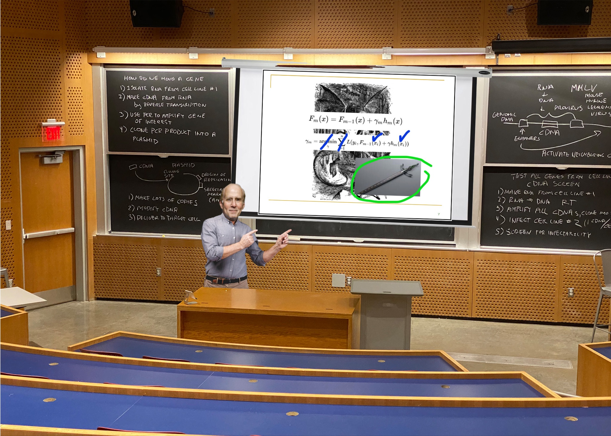
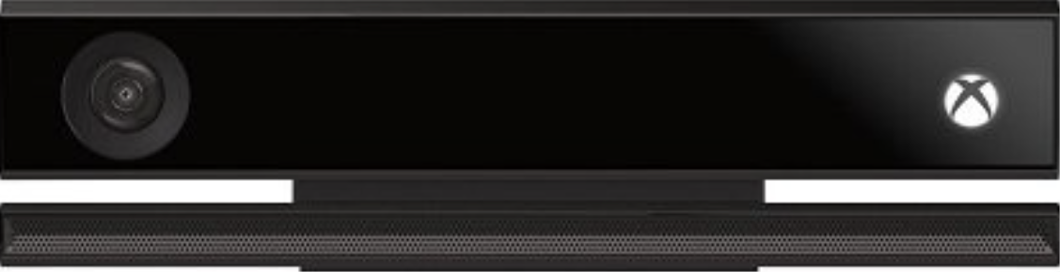
That side of the room, what is this?!
Notes:
Thank you for listening. We’re excited to field questions and receive feedback.

