Slide 1
SmartSlides Implementation Studio
Gaby Ecanow, Marlena Gomez, Gila Schein
Notes:
Gila:
Smart Slides is a handsfree, multi-modal system for dynamically controlling slideshow presentations. Let’s walk through SmartSlides behind the scenes…

Slide 2
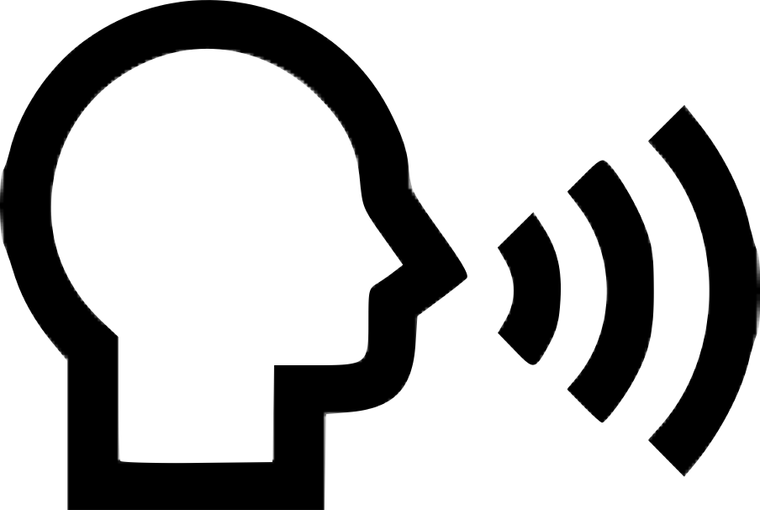

System Inputs
Speech Commands
Start presentation
Cue a laser pointer
Create a circle
Highlight text
Gesture Commands
Control the laser pointer
Swipe up with right/left hands to navigate slides forward and backwards
Notes:
Gila:
SmartSlides has two forms of input in addition to the baseline mouse clicks which usually control presentations. These are speech and gesture. Using WebKit Speech Recognition and the Leap Motion’s Gesture Toolkit, we created an interface that allows users to dynamically command their slideshows while in presentation mode. Specifically, speakers can start their presentations, turn on a laser pointer, create circles on their slides in specific locations, and highlight texts or areas on their slides using simple speech commands and hand positioning. Further, speakers can freely control the laser pointer and swipe in the air to navigate slides.

Slide 3
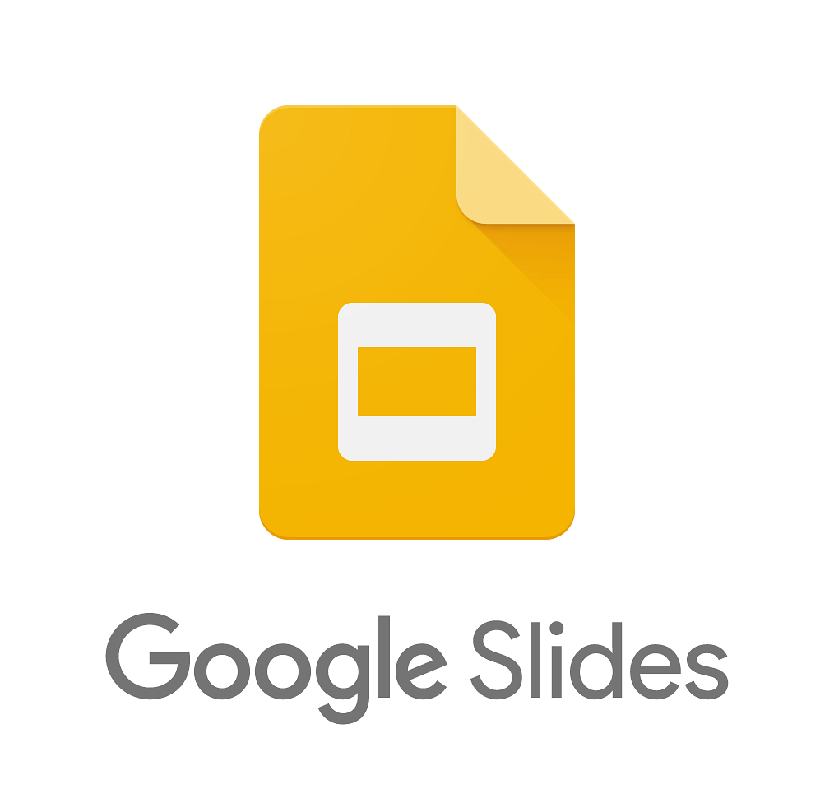
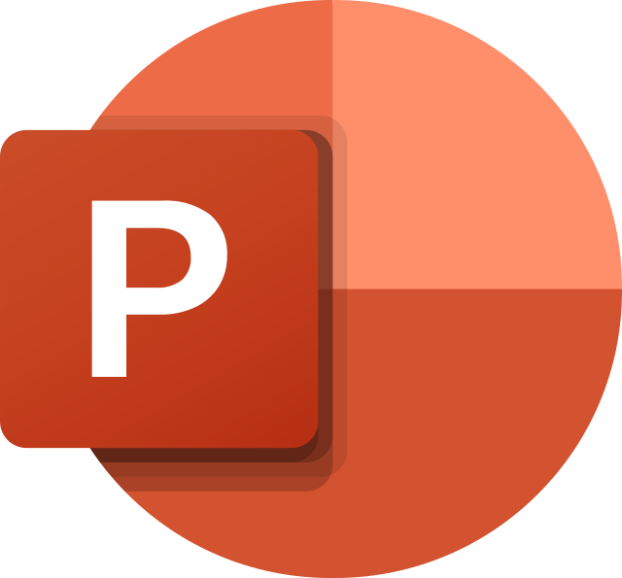

Slides Integration
SmartSlides
S
S
Notes:
Gila:
To integrate a slides presentation, we automatically convert it to a powerpoint using the Slides API, and then convert that to HTML, which we can then embed directly in our site. As we’ll discuss more later, it’s surprisingly impossible to go directly from slides to fully-manipulatable HTML, which is why we go through powerpoint.

Slide 4
Project Roadmap
Initial speech and gesture implementation
First round of user studies and feedback interviews
Integration Google Slides & Powerpoint presentations
- Iterating on end-to-end UI
- Third round of user studies
- Implementing additional features and customizations
Google Slides API Deep Dive
Revamping of UI, speech commands, and gesture inputs
Addition of highlight and circle controls on slides
Notes:
Gaby:
Before we show our implementation studio user study, here’s a quick roadmap recap:
Last time we presented our system, we did not yet have an integrated slides presentation, and the gesture and speech recognition did not yet have UI outputs.
Now, we can integrate Google slides, powerpoint, or keynote presentations, we’ve connected our speech and gesture recognition to the slideshow control, and we also added real time highlighting and circle drawing. You’ll see these in action when we show our user study video on the next slide.
Next up, we plan to iterate on the end-to-end UI, after which we’ll do a third user study, and then based on that feed we’ll implement additional features and customizations.
Now, let’s watch our current end-to-end system in action!

Slide 5

User Demonstration

Slide 6
User Feedback
Swiping hand left and right is more natural than up to navigate slides
Gesture-command previous slide feature would be useful
Highlight feature was not intuitive to use
Interested in using our system for his next class presentation!
Notes:
Gila:
Our user gave valuable feedback regarding the different components of our system, which we have already begun to tweak for our project. The first was that swiping left and right would be a more natural hand motion for switching a slide back and forth. We originally chose the “up” motion because it had the highest accuracy when measuring with precision and recall formulas. However, we understand the tradeoff between a slightly lower accuracy system and user intuitiveness, so we have already changed this control. Now, a right swipe with the right hand moves to the next slide, and a left swipe with the left hand links the command to navigate to the previous slide.
Unfortunately, our methodology of queueing left and right keyboard button presses from gestures was unsuccessful in this iteration of the project, so our slide navigation temporarily takes advantage of simulated clicking, which only controls the “next slide” and not “previous slide” functionality. We plan to fine-tune this process for the final implementation.
Lastly, our user found that the highlight feature was not intuitive to use, which you can see in the video. We have begun to experiment with alternative methods to highlighting and additional instructions to clarify the process.

Slide 7
Discussion
Challenges
Google Slides API security walls
Poor gesture recognition
Unresponsive key-press simulation
Our Fixes
Integrating Google Slides and Powerpoint slideshows in html form
Redesign gesture commands
Prompting clicking through gestures
Notes:
Gaby:
For this round of development, the biggest challenge was still embedding the presentation. After many attempts, we found that Google’s security is just too strong. So, we decided to use the Slides export to powerpoint feature. With powerpoints, we can then export to HTML and use in our site directly. On the bright side, this workaround means our system now supports Google slides, powerpoint, and keynote presentations! To make this feel seamless for the user, we’re working on fully automating the process of converting to HTML.
Even with the embedded slides HTML, though, keypresses are still a bit unresponsive, so if anyone has experience working with programmatic keypresses, we’d love to hear your feedback!

Slide 8
Questions
Should the final product include the SPEECH DEBUG output at the bottom of the screen, or would that be distracting for users?
Are there any additional gestures or speech commands you’d find helpful when giving a presentation?
How to resolve broken programmatic keypresses?
Notes:
Gaby:
Finally, some more concluding questions we have:
Should the final product have SPEECH DEBUG output?
Are there any additional gestures or speech commands you’d find helpful when giving a presentation?
Again, if anyone has suggestions for fixing our programmatic keypresses, we’d love to get your input!

