Slide 1
User Research
By: user

Slide 2
Definition
User research focuses on understanding a user’s:
Behaviors
Needs
Motivations
through interviews, surveys, usability evaluations and other forms of feedback methodologies.

Slide 3
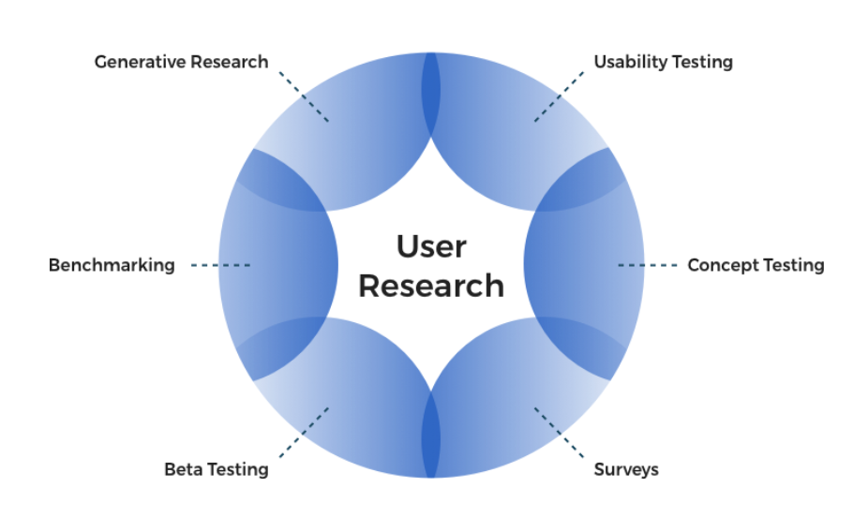

Slide 4
Thank you for listening!

