Slide 1
Machine Learning
Machine Learning teaches machines to learn from data and make decisions with minimal human intervention.
Examples:
Face unlock on phones
Friend & ad recommendations
Product suggestions
Fraud detection in banking

Slide 2
More Real World Examples
Machine learning is so extensive that you probably use it numerous times a day without even knowing it.
Smartphones detecting faces while taking photos or unlocking themselves
Facebook, LinkedIn or any other social media site recommending your friends and ads you might be interested in
Amazon recommending you the products based on your browsing history
Banks using Machine Learning to detect Fraud transactions in real-time

Slide 3
Main Types of ML
1. Supervised Learning: Input + known output → predict output
- Regression (numbers)
- Classification (categories)
2. Unsupervised Learning: No labels, find structure
- Clustering
- Dimensionality Reduction
3. Reinforcement Learning: Learn by reward/punishment

Slide 4
Regression Types
1. Linear Regression — Straight line fit
2. Multiple Linear Regression — Multiple inputs
3. Polynomial Regression — Curved fit
4. Ridge Regression — L2 regularization
5. Lasso Regression — L1 regularization
6. Elastic Net — Combines Ridge & Lasso
7. Logistic Regression — For classification
8. Stepwise, Quantile, SVR, Decision Trees

Slide 5
Regression is a type of supervised machine learning used to predict a continuous numeric value based on input variables (features). It finds patterns or relationships between independent variables (X) and a dependent variable (Y).
Examples:
Predicting house prices from area, rooms, and location.
Estimating sales from advertising spend and season.
Forecasting temperature, salary, or stock prices.
Regression is used for:
Forecasting (sales, demand, stock price, etc.)
Optimization (marketing spend vs ROI)
Trend analysis (how one factor affects another)

Slide 6
Type of Regression | Example
1. Linear Regression | Predicting house price by area.
2. Multiple Linear Regression | Predicting car price by age, mileage, brand.
3. Polynomial Regression | Modeling population growth.
4. Ridge Regression (L2) | Predicting sales with many ads metrics.
5. Lasso Regression (L1) | Simplifying credit risk model.
6. Elastic Net | Text or gene data regression.
7. Logistic Regression | Will customer buy? (0/1).
8. Stepwise Regression | Marketing factor selection.
9. Quantile Regression | Predicting median house prices.
10. SVR (Support Vector Regression) | Predicting stock returns.
11. Decision Tree Regression | Predict electricity usage.

Slide 7
Classification
Classification predicts categories from input features.
Types:
• Binary: Spam/Not Spam
• Multiclass: Cat/Dog/Bird
• Multilabel: Sports & Politics
• Ordinal: Poor–Average–Good–Excellent
• Imbalanced: Fraud detection

Slide 8
Unsupervised Learning
Unsupervised learning finds hidden patterns in unlabeled data.
Now, there’s no teacher — we give the machine data without answers,
and it tries to find hidden patterns or natural groups on its own.
Types:
Clustering — Groups similar items
Dimensionality Reduction — Simplifies features (e.g., PCA)
Association Rule Learning — Finds relationships
Anomaly Detection — Finds outliers
Auto Encoders — Compress & reconstruct data
Density Estimation — Learns data distribution

Slide 9
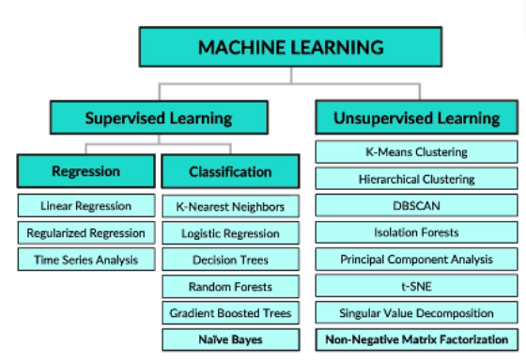
Main Algorithms

Slide 10
General Flow for Any Machine Learning Project Problem → Data → Clean → Split → Model → Train → Predict → Evaluate → Tune → Deploy → Monitor
1. Define the Problem
Clearly state what you want to predict or discover.
Identify whether it’s:
Supervised learning (known labels → regression/classification)
Unsupervised learning (no labels → clustering/dimensionality reduction)
Reinforcement learning (learn from reward/punishment)
Example: Predict house prices (regression), classify spam emails (classification), or group customers (clustering).

Slide 11
2. Collect & Load Data
Gather data from databases, files, APIs, or sensors.
Load into pandas (Python) or IDataView (ML.NET).
Ensure data is sufficient and relevant.

Slide 12
3. Explore and Understand the Data (EDA)
Summarize dataset (shape, mean, median, unique values).
Visualize with histograms, scatter plots, and heatmaps.
Detect patterns, relationships, outliers, and data imbalance.
📊 Tools: matplotlib, seaborn, pandas profiling, ML.NET Data Preview

Slide 13
4. Clean & Preprocess Data
Handle missing values (fillna(), imputation).
Remove duplicates, fix inconsistent formatting.
Encode categorical features (LabelEncoder, OneHotEncoder).
Scale/normalize numeric values.
Split features (X) and target (y)
💡 Goal: Convert messy raw data into clean, numeric, model-ready format.

Slide 14
5. Split Data
Divide dataset into:
Training set → to learn (70–80%)
Validation set → to tune hyperparameters (10–15%)
Test set → to evaluate final performance (10–15%)

Slide 15
6. Select and Build Model
Choose suitable algorithm for your problem type:
Regression → Linear, Ridge, RandomForestRegressor
Classification → Logistic, DecisionTree, SVM
Clustering → KMeans, DBSCAN
NLP → Transformer, Naive Bayes
Image → CNN
In ML.NET: choose trainer (SdcaRegressionTrainer, FastTree, etc.)

Slide 16
7. Train Model
Fit the model on training data.
Learn relationships or patterns.
Example:
model.fit(X_train, y_train)

Slide 17
8. Predict (Inference Phase)
Use the trained model to make predictions on test/unseen data.
Compare predicted vs actual results.
📘 Example:
y_pred = model.predict(X_test)

Slide 18
9. Evaluate Model Performance
Choose metric based on task:
Regression → RMSE, MAE, R²
Classification → Accuracy, Precision, Recall, F1
Clustering → Silhouette Score
Analyze confusion matrix or residuals.

Slide 19
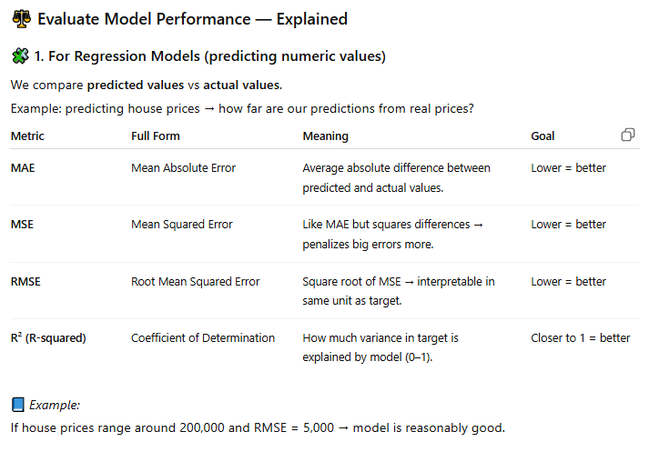

Slide 20
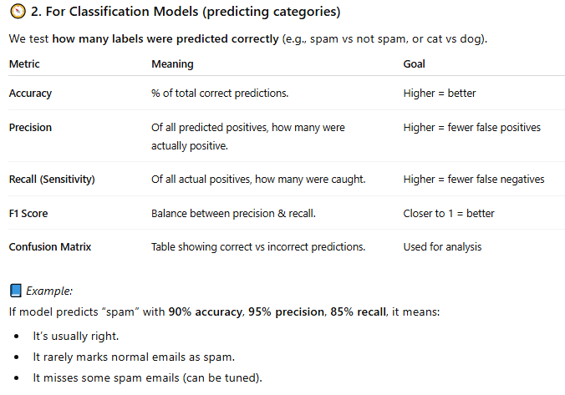

Slide 21
Python vs C#
Python:
• Rich ML ecosystem (scikit-learn, PyTorch)
• Easy data handling (pandas, matplotlib)
• Ideal for EDA and learning
• Industry standard for ML
C#:
• Good for production integration
• ML.NET, LightGBM support
• Can use ONNX models from Python

Slide 22
Why Choose Python for ML
Richest ML ecosystem
Fastest learning curve
Industry standard for ML
Superior visualization tools
Easy integration with .NET via ONNX

Slide 23
Popular ML Libraries
scikit-learn — Classical ML
TensorFlow / Keras — Deep learning
PyTorch — Dynamic deep learning
LightGBM / XGBoost / CatBoost — Gradient boosting
spaCy / Transformers — NLP
These libraries cover most ML workflows from data prep to modeling.

