Slide 1
Machine Learning
Machine Learning teaches machines to learn from data and make decisions with minimal human intervention.
Examples:
Face unlock on phones
Friend & ad recommendations
Product suggestions
Fraud detection in banking

Slide 2
Machine learning is so extensive that you probably use it numerous times a day without even knowing it. From unlocking your mobile phones using your face to giving your attendance using a biometric machine, machine learning is being used in almost every stage.

Slide 3
More Real World Examples
Smartphones detecting faces while taking photos or unlocking themselves
Facebook, LinkedIn or any other social media site recommending your friends and ads you might be interested in
Amazon recommending you the products based on your browsing history
Banks using Machine Learning to detect Fraud transactions in real-time

Slide 4
Main Types of ML
1. Supervised Learning: Input + known output → predict output
- Regression (numbers)
- Classification (categories)
2. Unsupervised Learning: No labels, find structure
- Clustering
- Dimensionality Reduction
3. Reinforcement Learning: Learn by reward/punishment

Slide 5
Regression Types
1. Linear Regression — Straight line fit
2. Multiple Linear Regression — Multiple inputs
3. Polynomial Regression — Curved fit
4. Ridge Regression — L2 regularization
5. Lasso Regression — L1 regularization
6. Elastic Net — Combines Ridge & Lasso
7. Logistic Regression — For classification
8. Stepwise, Quantile, SVR, Decision Trees

Slide 6
Classification
Classification predicts categories from input features.
Types:
• Binary: Spam/Not Spam
• Multiclass: Cat/Dog/Bird
• Multilabel: Sports & Politics
• Ordinal: Poor–Average–Good–Excellent
• Imbalanced: Fraud detection

Slide 7
Unsupervised Learning
Unsupervised learning finds hidden patterns in unlabeled data.
Now, there’s no teacher — we give the machine data without answers,
and it tries to find hidden patterns or natural groups on its own.
Types:
Clustering — Groups similar items
Dimensionality Reduction — Simplifies features (e.g., PCA)
Association Rule Learning — Finds relationships
Anomaly Detection — Finds outliers
Auto Encoders — Compress & reconstruct data
Density Estimation — Learns data distribution

Slide 8
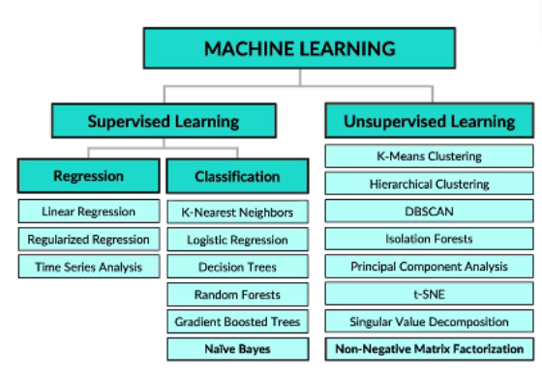
Main Algorithms

Slide 9
Python vs C#
Python:
• Rich ML ecosystem (scikit-learn, PyTorch)
• Easy data handling (pandas, matplotlib)
• Ideal for EDA and learning
• Industry standard for ML
C#:
• Good for production integration
• ML.NET, LightGBM support
• Can use ONNX models from Python

Slide 10
Why Choose Python for ML
🟩 Richest ML ecosystem
🟦 Fastest learning curve
🟨 Industry standard for ML
🟧 Superior visualization tools
🟥 Easy integration with .NET via ONNX

Slide 11
Popular ML Libraries
• scikit-learn — Classical ML
• TensorFlow / Keras — Deep learning
• PyTorch — Dynamic deep learning
• LightGBM / XGBoost / CatBoost — Gradient boosting
• spaCy / Transformers — NLP
These libraries cover most ML workflows from data prep to modeling.

