Slide 1



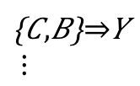

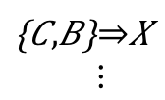
1) Obtaining
revision history
and interaction history
3) Extracting assoc. rules
4) Calculating metrics
2) Concatenating
two histories
association rules
Precision
Recall
$$\left\{A,B\right\}⇒X$$
$$\left\{A,B\right\}⇒Z$$
$$\left\{C,B\right\}⇒Y$$
$$⋮$$
$$\left\{C,B\right\}⇒X \\ ⋮$$
co-ref
co-chg

