Slide 1
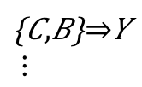

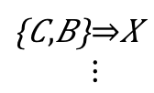

Extracting 2 assoc. rules from the concatenated history
association rules
$$\left\{A,B\right\}⇒X$$
$$\left\{A,B\right\}⇒Z$$
$$\left\{C,B\right\}⇒Y$$
$$⋮$$
$$\left\{C,B\right\}⇒X \\ ⋮$$
co-ref
co-chg
2) Perform change recommendation
and calculate metrics
No.1
Y
No.1
Z
No.2
X
No.2
X
…
co-ref
…
co-chg
MRR
Recall
MRR
Recall

