Slide 1



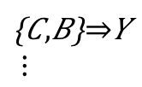

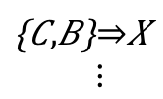

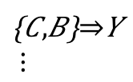
1) Obtaining
revision history
and interaction history
3) Extracting assoc. rules
2) Concatenating
two histories
association rules
$$\left\{A,B\right\}⇒X$$
$$\left\{A,B\right\}⇒Z$$
$$\left\{C,B\right\}⇒Y$$
$$⋮$$
$$\left\{C,B\right\}⇒X \\ ⋮$$
co-ref
co-chg
4) Perform change recommendation
5) Calculating metrics
$$\left\{A,B\right\}⇒X$$
Change
MRR
Recall
A
$$\left\{C,B\right\}⇒Y$$
$$⋮$$
B
X
co-ref

