Slide 1

Investigation on how different DBMSs handle "physical memory exceeding"
Mahmoud Mohsen
mahmoud.mohsen@st.ovgu.de

Slide 2
Contents
Introduction and motivation.
Background.
Executing the expirement.
Results and conclusion.

Slide 3
Introduction & motivation
Different solutions of managing data.
Time is money.
One Technology to outperform all.

Slide 4
Background
Memory,physical memory, virtual memory.
Disk-based vs main-memorybased DBMSs.
Memory mapped-files.
Anticaching.
TPC-H Benchmark.

Slide 5
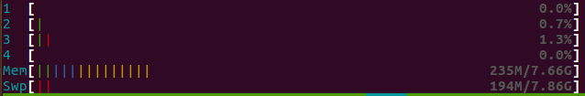
Memory, Physical memory, Virtual memory

Slide 6
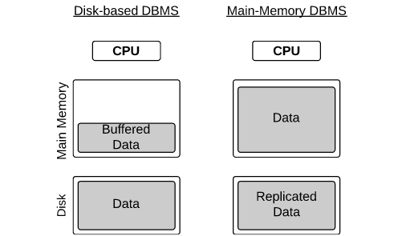
Disk-based vs main-memory based

Slide 7
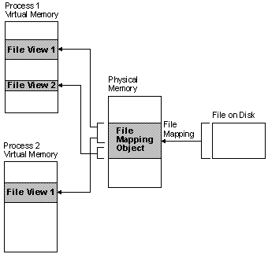
Memory-maped & swaping
Source: https://msdn.microsoft.com/de-de/library/windows/desktop/aa366556(v=vs.85).aspx

Slide 8


Anticaching

Slide 9
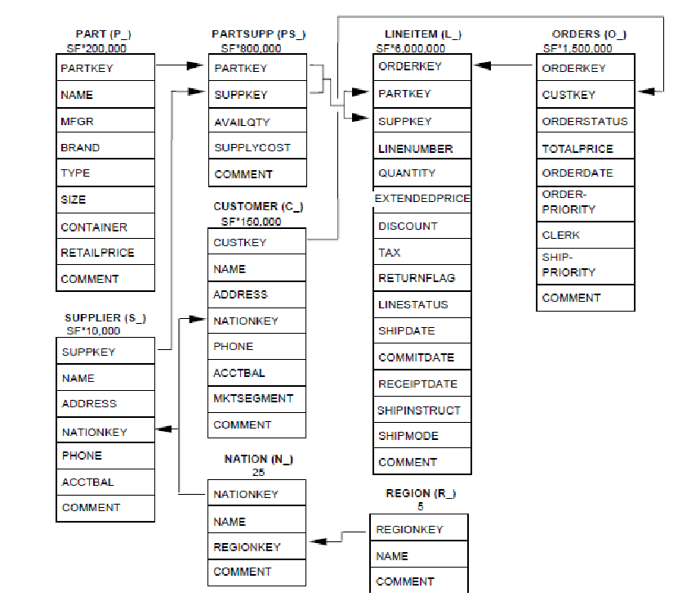
TPC-H Benchmark(1)
Source: https://www.researchgate.net/figure/263366661_fig2_Figure-5-The-TPC-H-Schema

Slide 10
TPC-H Benchmark(2)
select
sum(l_extendedprice * l_discount) as revenue
from
lineitem
where
l_shipdate >= '1994-01-01'
and l_shipdate < '1995-01-01'
and l_discount between .06 - 0.01 and .06 + 0.01
and l_quantity < 24

Slide 11
Executing the expirement(Overview)
Choosing DBMSs.
Choosing the way of execution (manual vs automated).
Hardware information.
Generating the TPC-H Tables.
How it works.

Slide 12
Executing the expirement(Choosing DBMS)
Disk-based: Mysql(innoDB) Engine.
OS swapping: Mysql(Memory) Engine.
Memory-maped files: Monetdb.
Anti-caching: Voltdb.

Slide 13
Executing the expirement(Hardware info)
CPU:
CPU name: Intel(R) Xeon(R) CPU E5-2609 v2 @ 2.50GHz.
Number of cores: 8.
Physical memory:
252 G

Slide 14
Executing the expirement(Way of Execution)
(manual vs automated).
Using R.

Slide 15
Executing the expirement(Generating Tables)
Using dbgen for generating the table.
bash script to easify the process.
Used scaling factors.

Slide 16
Executing the expirement(How it works)
Specify parameters ( start scaling factor, path to tables…...)
Load the tables.
Execute the query number 6 of the tpch.
Measure the time of execution.
Measure how much data is processed.
Calculate throughput = total data processed / time.
Write results to csv files.
Remove the tables.

Slide 17
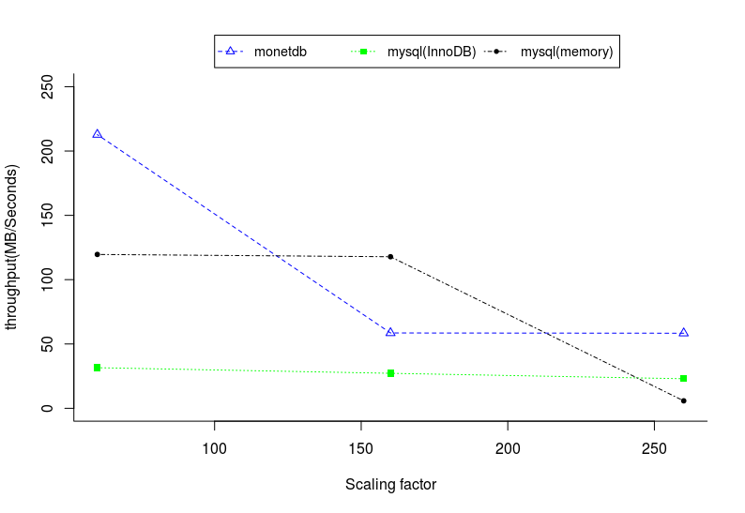
Results & Conclusion(1)

Slide 18
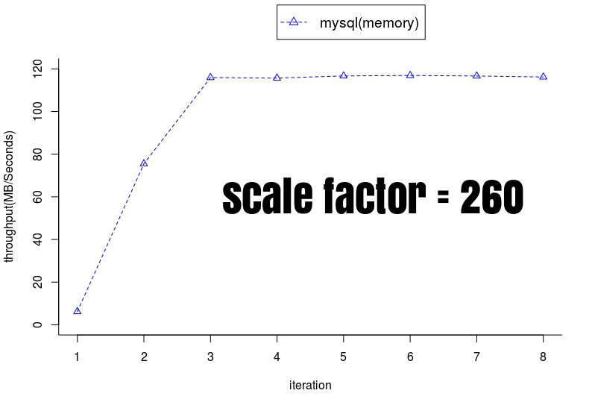
Results & Conclusion(2)

Slide 19
Results & Conclusion(3)
So, one system to outperform all?
Noooo.
Where can I find the code?
http://git.iti.cs.ovgu.de/pinnecke/COOPeR/tree/master/code/main_memory_expirement

Slide 20

Questions

