Slide 1
Genotype
LALI-type
Environment
Phenotype
Developmental Noise

Slide 2
Step 0 | Identifying the location of gecko phenotypes in phenotype space We measure the fractional area and eccentricity of each gecko pattern to find its location in [FA,EE] phenotype space.
Step 1 | Generating the phenotype cloud of a single LALI-type L Through numerical simulations with fixed LALI-type L₁ (same genotype and environment for each LALI-type), but varied random initial conditions. In this way, we obtained the set of phenotypes generated by a single LALI-type due to developmental noise (red lines), thus determining the ‘phenotype cloud’ of L₁ (red points).
Step 2 | Generating the r % neutral region of a phenotype P We systematically search a larger region of LALI-space to find all the LALI-types L (variation in genotype and environmental conditions, e.g. L₁ and L₂) likely to yield phenotype P. The set of LALI-types containing the phenotype P in their r% phenotype cloud is the “r% neutral region of P” (sketched in gray, with two example LALI-types L₁ and L₂).

Slide 3
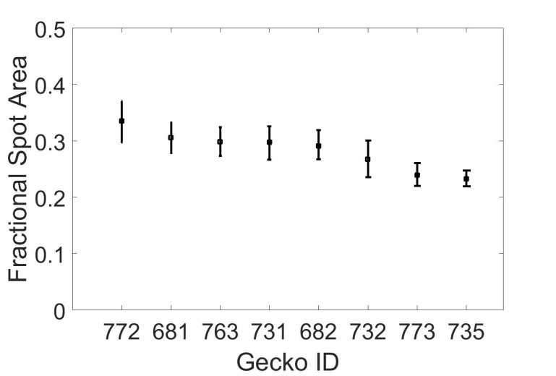
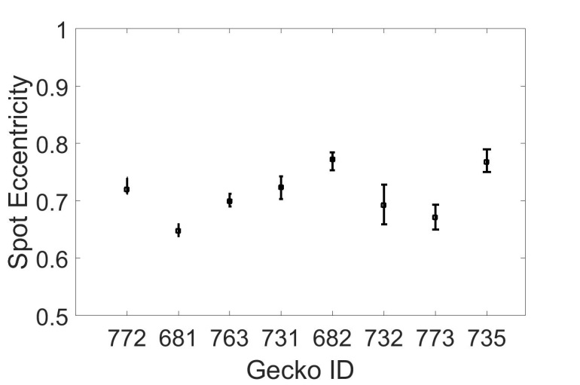
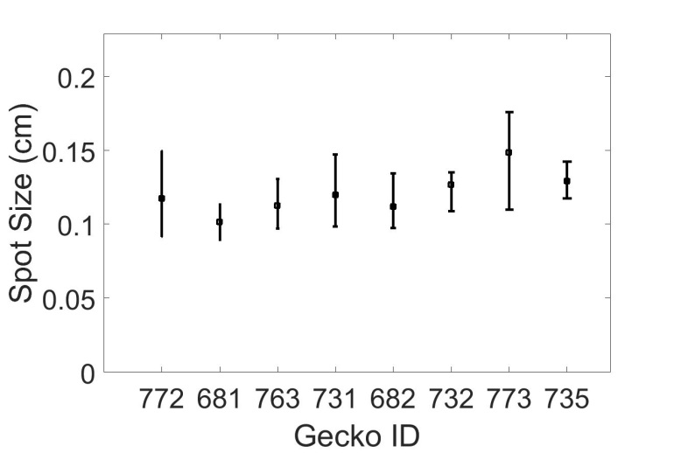
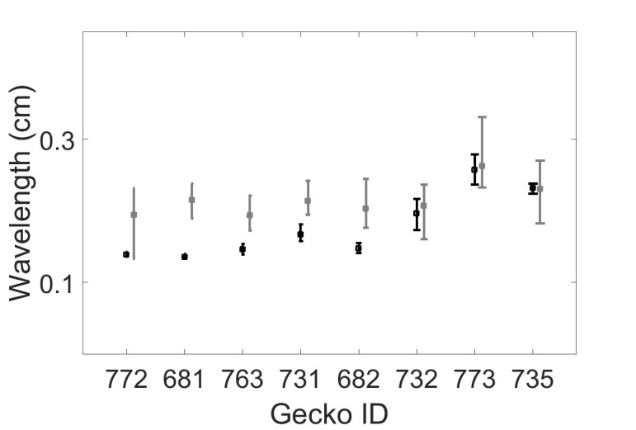
A | B
C | D

Slide 4
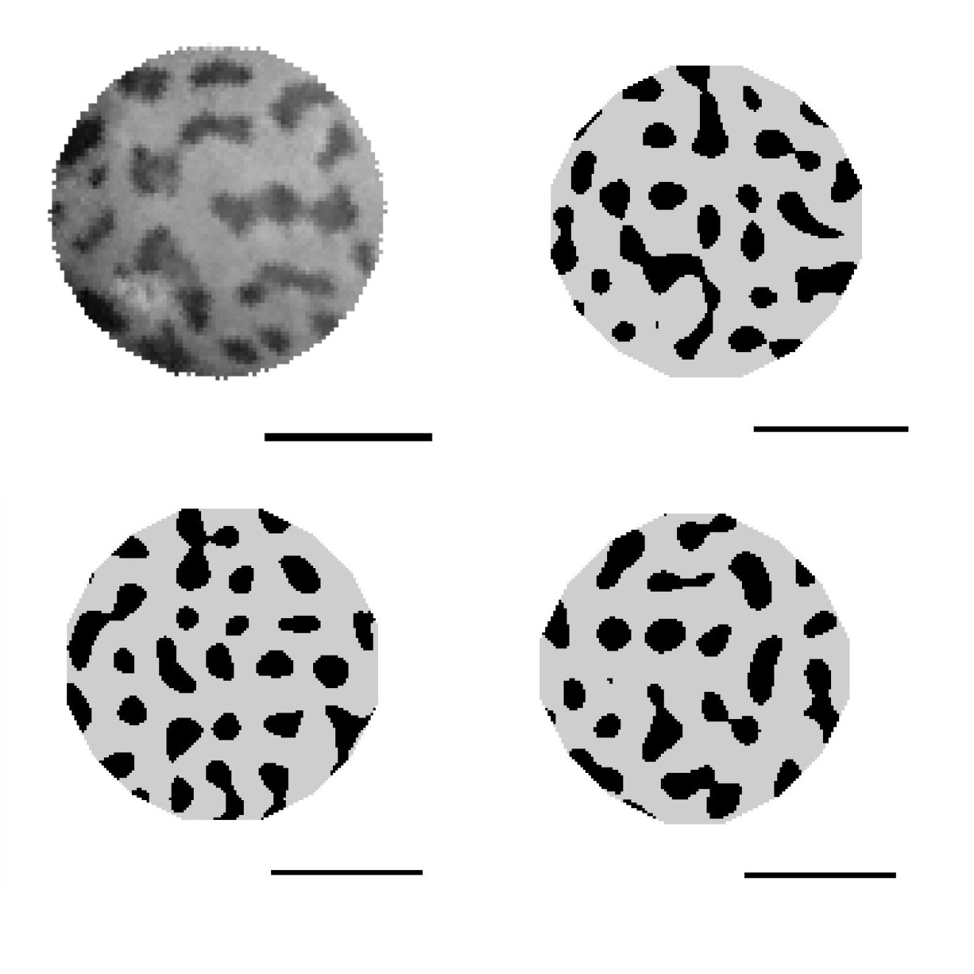
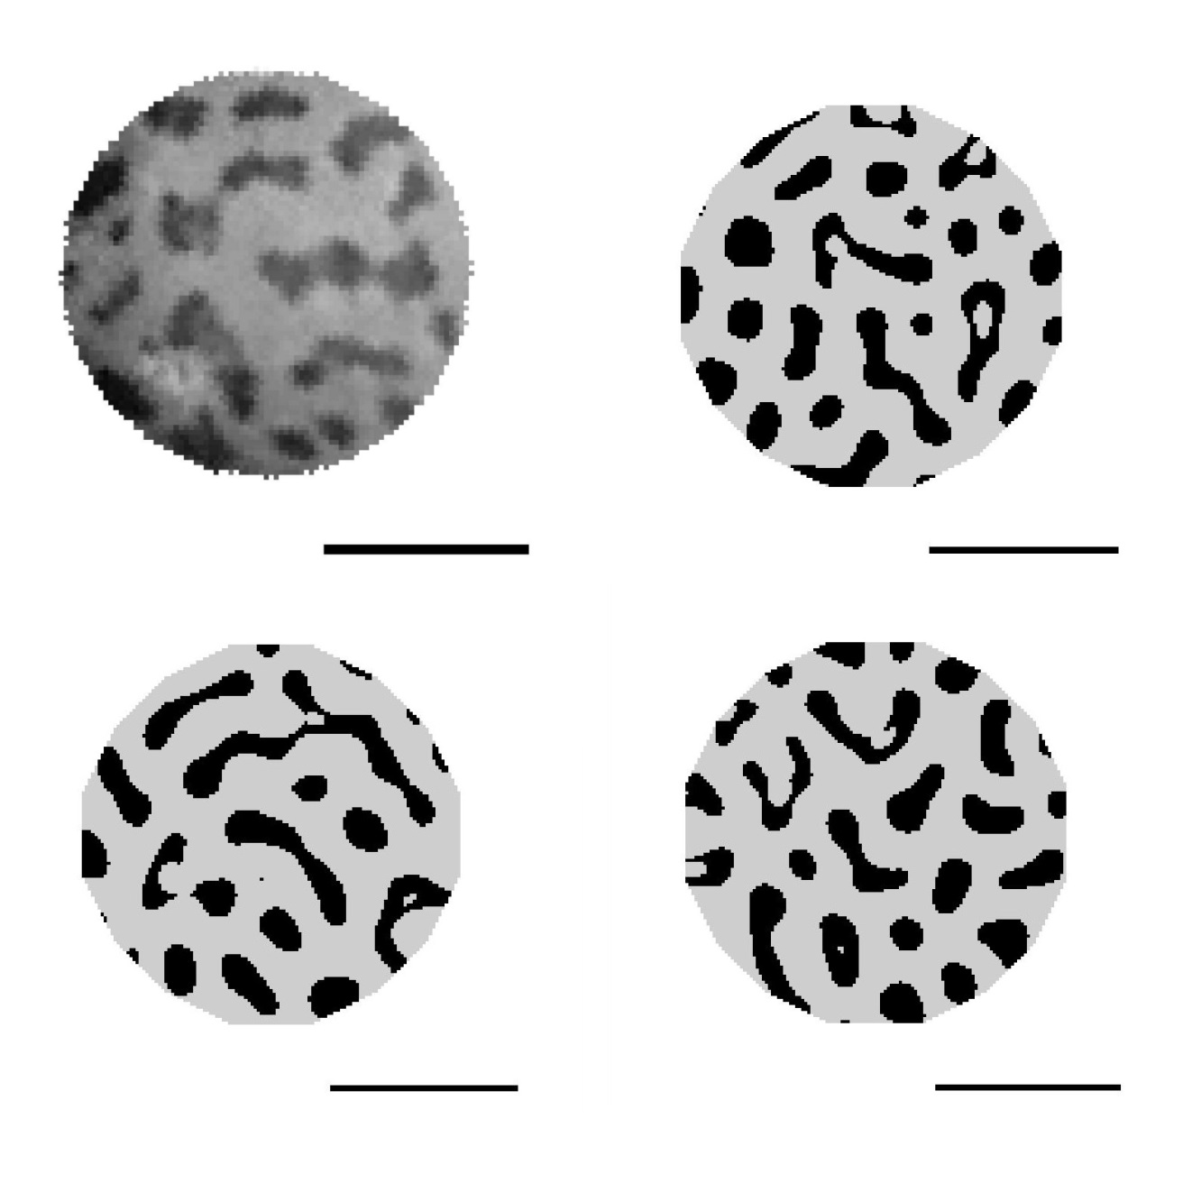
A | B
C | D

Slide 5
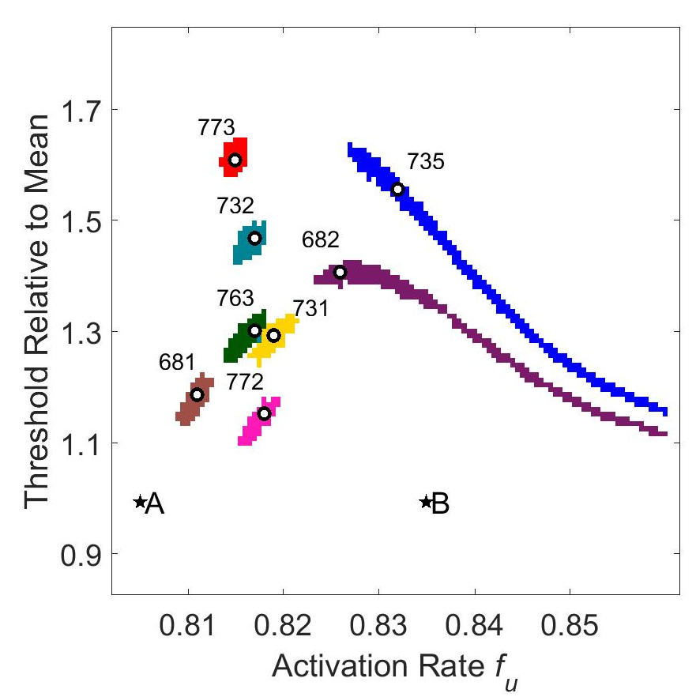
A | B

Slide 6
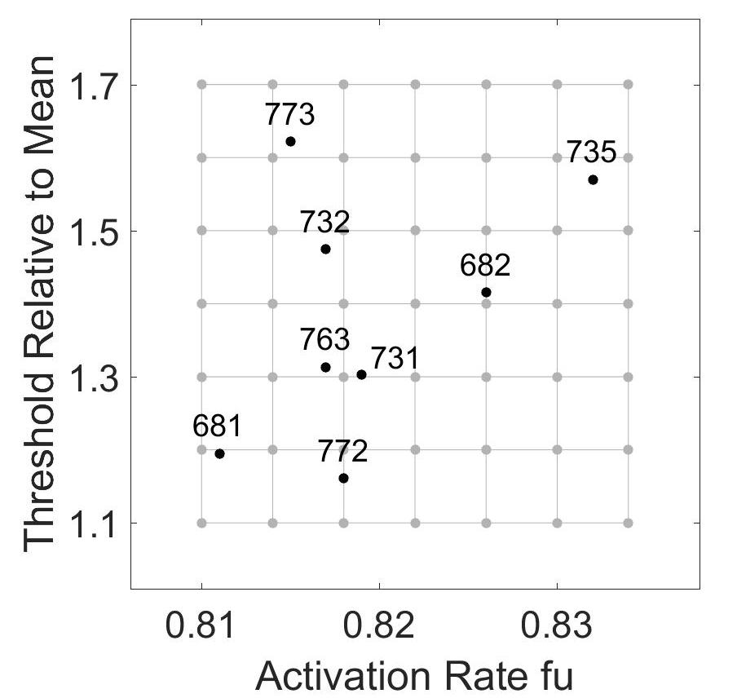
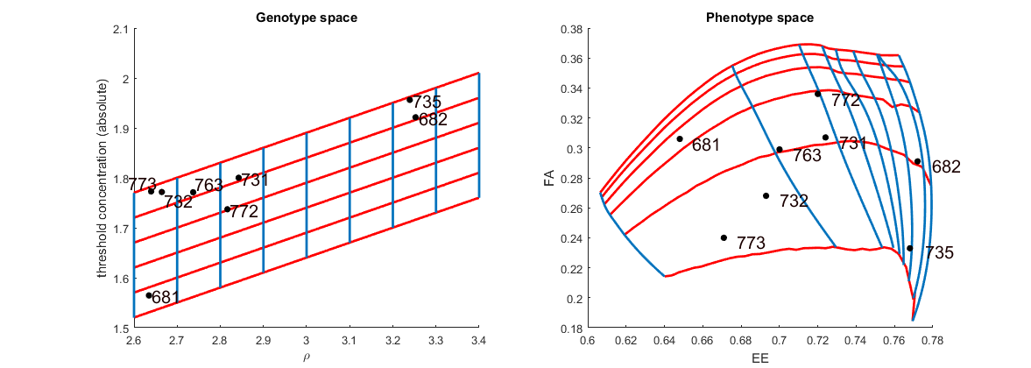
A | B
C | D

Slide 7
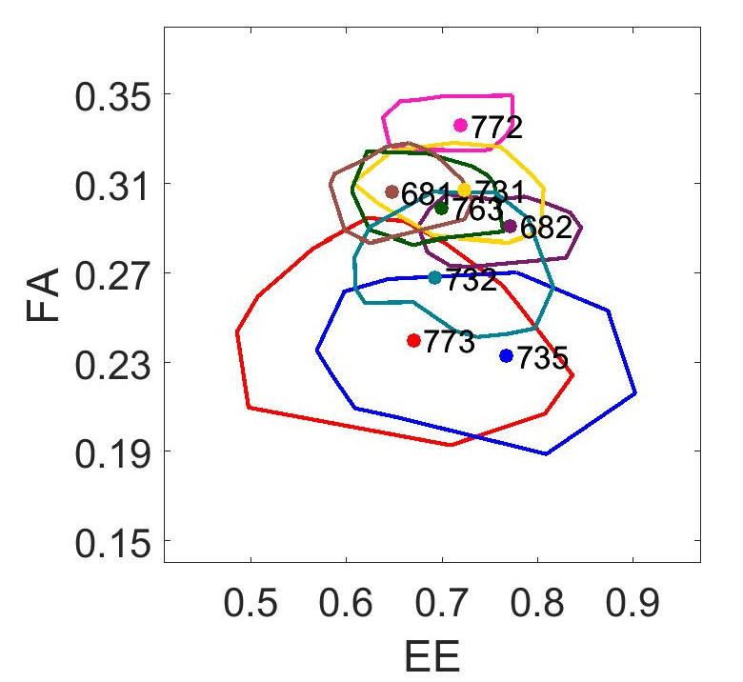
A | B

Slide 8
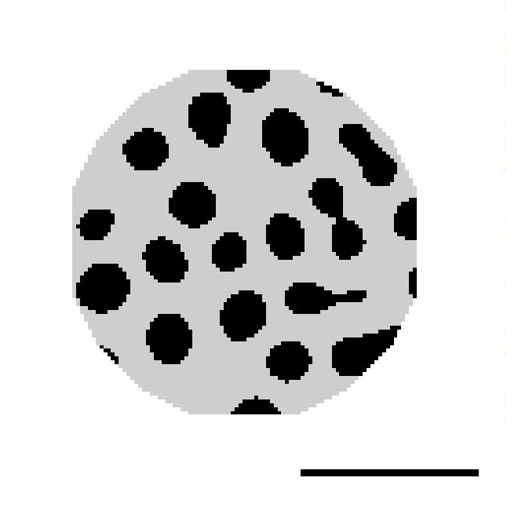
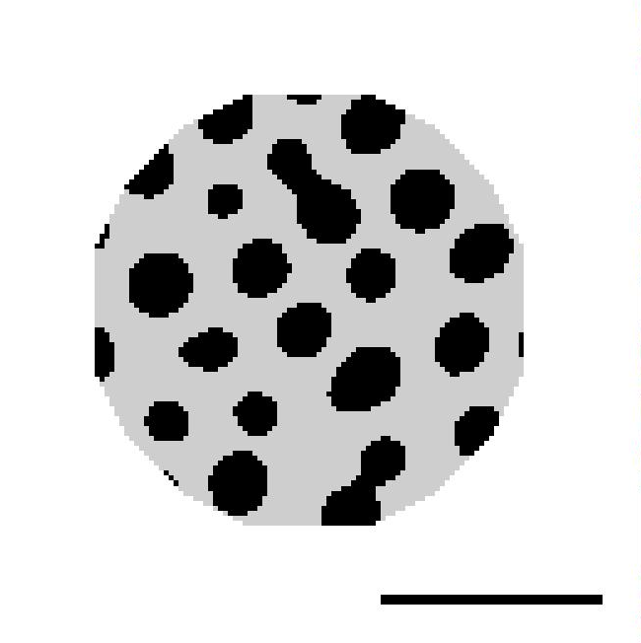
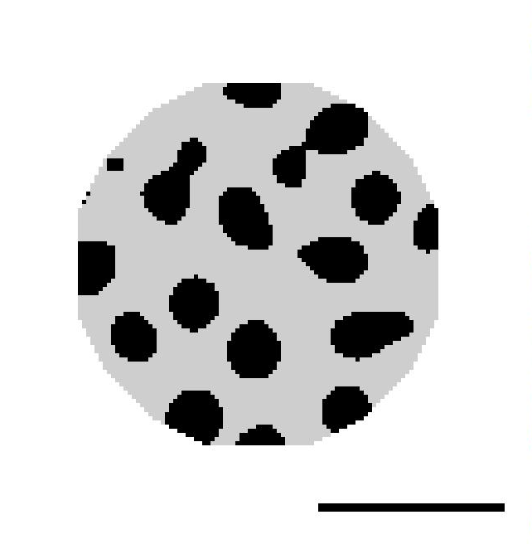
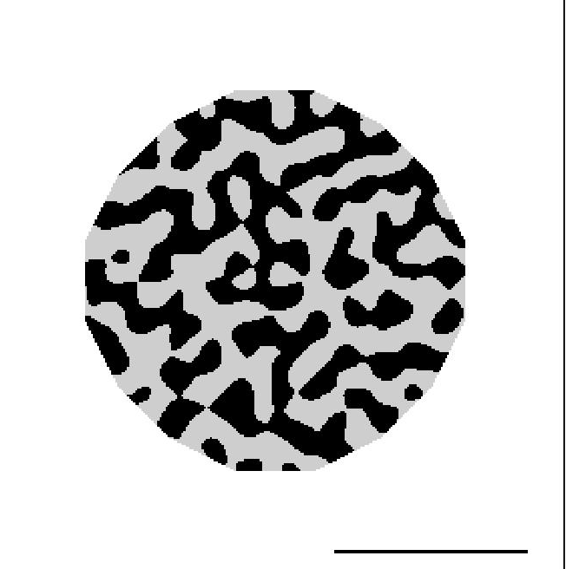
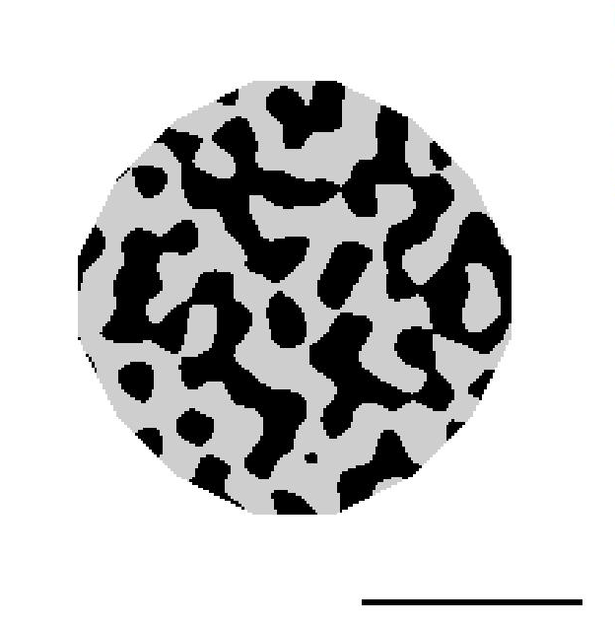
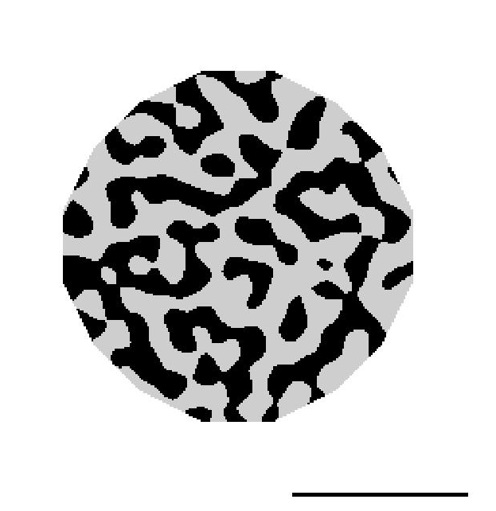
A
B

