Slide 1
Forest regrowth phase classification
BiomeEP output v3

Slide 2
Forest recovery phases
Phase | Variables involved/ dominant | Description of mortality dynamics in concert with auxiliary variables
Open canopy phase – presence/dominance? of grasses | %Cveg, nstems, CA, cmort_rate (%/year) | Caused by delayed onset in woody establishment due to strong competition with grasses; grasses dominate the %total vegetation carbon for a period. This co-occurs with initially low woody mortality rates in models where no stems in the lower size classes are present, or high mortality rates in models combined with a lack of transition of small stem size classes into larger ones, where small size classes continue to lose out over grasses. There is a marked delay in Crown Area increase, which should not go above 1000m2/ha until very late in the recovery process.
Open canopy phase - growth | Nstems, %cveg, cmort_rate (%/year), CA | Seedlings establish quickly, and grass may be present at the same time for a few years (often shown as Grasses making up a significant, but not dominant %c in Cveg after disturbance). The saplings manage to outcompete the grasses quickly, increase in biomass and then hit the self-thinning phase. The initial number of seedlings after disturbance is such that growth occurs without a lot of mortality initially (i.e. transition from one size class into another can be observed in the first years, accompanied with only a small to no reduction in number of stems caused by mortality), and gaps are initially slowly closing until self-thinning commences and total stem number decreases. Crown Area should be lower or around 10000 ? m2/ha, and increase quickly. For models without between PFT-competition, note that grasses may be present and form a larger %cveg initially, but there is no mechanisms of suppression by woody PFTs. Instead grasses just shrink their total %cveg the woody PFTs increase in biomass.
Closed canopy- self-thinning | Cmort_rate (%/year), nstems CA, | A mortality spike and steep decline, where not all established individuals grow into a larger size class, but self-thinning pressure occurs, also hinted at by canopy closure. The self-thinning phase is marked by transition of small size classes into larger size classes, with a substantial decrease in total number of stems. Initial crown Area should be only a bit lower or around 10000m2/ha ?, or increase very quickly. The grass fraction as percentage of total cveg is negligible. For a multi-story PPA approach, Crown projection area can go >10000 m2/ha since a multi-story forest emerges, and new saplings are allowed to emerge and form lower canopy layers. This means that the number of seedlings can still increase, even during the thinning-period, and the total number of stems variable has to be interpreted with caution as evidence for self-thinning.
Closed canopy-late successional phase | %Cveg, cmort_rate(%/year) | A shift in composition is evident in %cveg of the PFTs present and the mortality rate by a slight directional change in the trajectories, where both the PFT, but also the forest structure now shift into a secondary succession stage, towards a dynamic equilibrium.

Slide 3
V5 – last version outputs

Slide 4
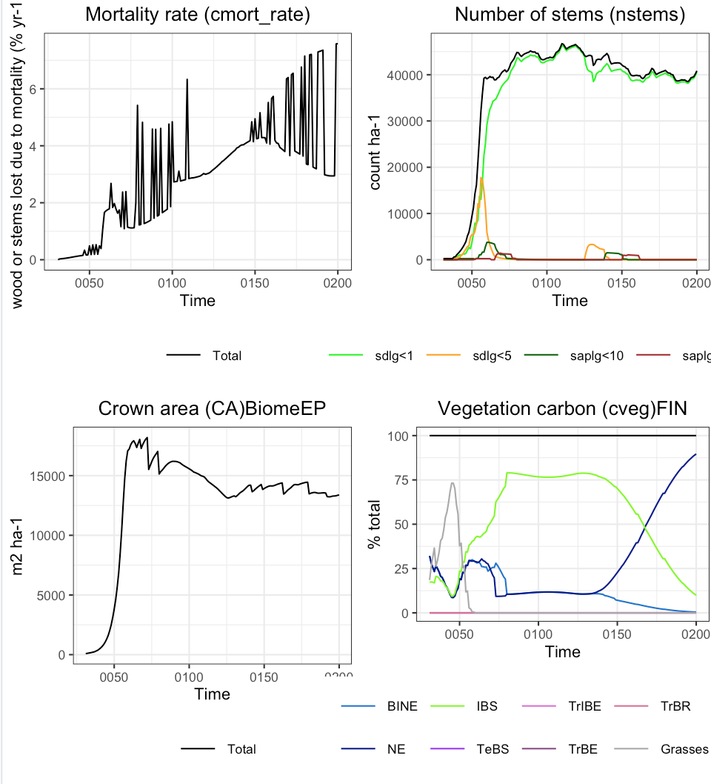
FIN - v5
2a
1. Open canopy- grass coexistence
(30-40yrs)
Evidence:
1a. delayed onset in woody establishment;
1b. grasses dominate the %total vegetation carbon for a period.
1c. Low wood mortality rates
3a
2a
2a
2a
1c
1a
3b
2. Open-canopy-growth
(40-60 yrs)
Evidence:
2a. The initial number of seedlings after disturbance is such that growth occurs without a lot of mortality initially (i.e. transition from one size class into another can be observed in the first years, accompanied with only a small to no reduction in number of stems caused by mortality).
2b. Crown area is around 10000 m2/ha, and increase quickly.
1b
2b
3. Closed-canopy,Self-thinning
(60-70 yrs)
Evidence:
3a. Mortality spike
Note: PPA-approach: nstems can still go up (understory is forming), while self. thinning occurs.
3b. Self-thinning phase is marked by transition of small size classes into larger size classes, with a substantial decrease in total number of stems.
Note: see that the big mayority of nstems are in the lower size-class.
3c. The grass fraction as percentage of total cveg is negligible.
3c

Slide 5
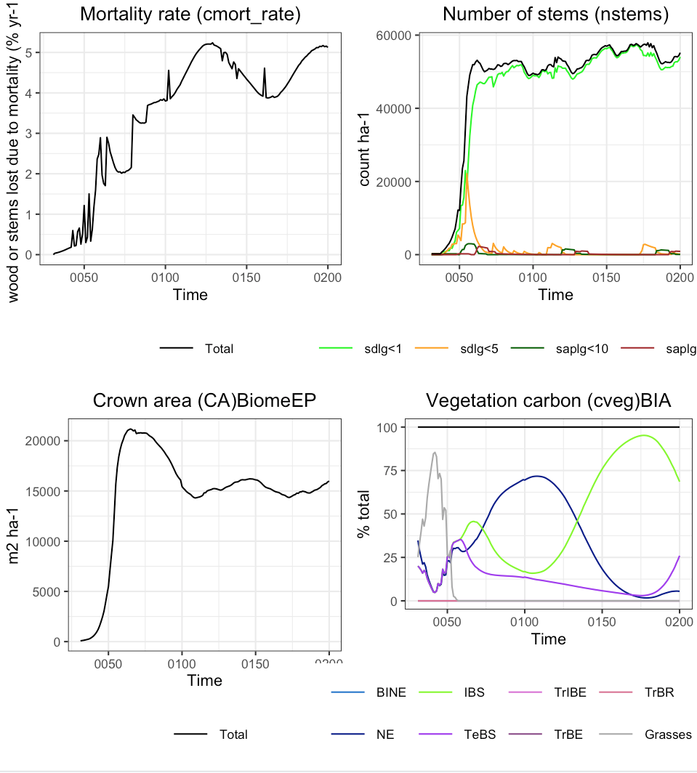
BIA - v5
2a
1. Open canopy- grass coexistence
(30-40yrs)
Evidence:
1a. delayed onset in woody establishment;
1b. grasses dominate the %total vegetation carbon for a period.
1c. Low wood mortality rates
3a
2a
2a
1c
1a
3b
2. Open-canopy-growth
(40-60 yrs)
Evidence:
2a. The initial number of seedlings after disturbance is such that growth occurs without a lot of mortality initially (i.e. transition from one size class into another can be observed in the first years, accompanied with only a small to no reduction in number of stems caused by mortality)
2b. Crown area is around 10000 m2/ha, and increase quickly.
1b
2b
3. Closed-canopy,Self-thinning
(60-70 yrs)
Evidence:
3a. Mortality spike
Note: PPA-approach: nstems can still go up (understory is forming), while self. thinning occurs.
3b. Self-thinning phase is marked by transition of small size classes into larger size classes, with a substantial decrease in total number of stems.
Note: see that the big mayority of nstems are in the lower size-class.
3c. The grass fraction as percentage of total cveg is negligible.
3c

Slide 6
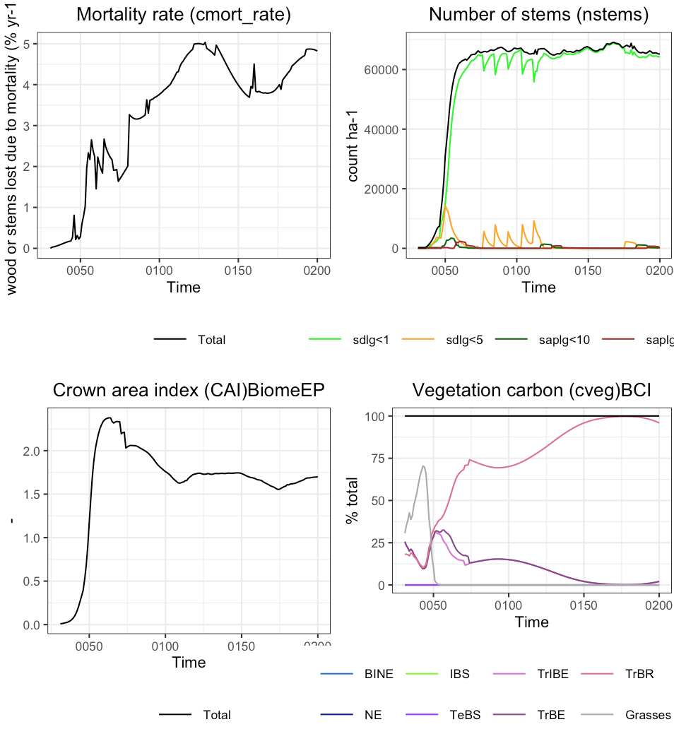
BCI - v5
2a
1. Open canopy- grass coexistence
(30-40yrs)
Evidence:
1a. delayed onset in woody establishment;
1b. grasses dominate the %total vegetation carbon for a period.
1c. Low wood mortality rates
3a
2a
2a
1c
1a
3b
2. Open-canopy-growth
(40-60 yrs)
Evidence:
2a. The initial number of seedlings after disturbance is such that growth occurs without a lot of mortality initially (i.e. transition from one size class into another can be observed in the first years, accompanied with only a small to no reduction in number of stems caused by mortality)
2b. Crown area is higher 10000 m2/ha because is a tropical forest, and increase quickly.
1b
2b
3. Closed-canopy,Self-thinning
(60-70 yrs)
Evidence:
3a. Mortality spike
Note: PPA-approach: nstems can still go up (understory is forming), while self. thinning occurs.
3b. Self-thinning phase is marked by transition of small size classes into larger size classes, with a substantial decrease in total number of stems.
Note: see that the big mayority of nstems are in the lower size-class.
3c. The grass fraction as percentage of total cveg is negligible.
3c

Slide 7
Old outputs versions:

Slide 8
V3

Slide 9
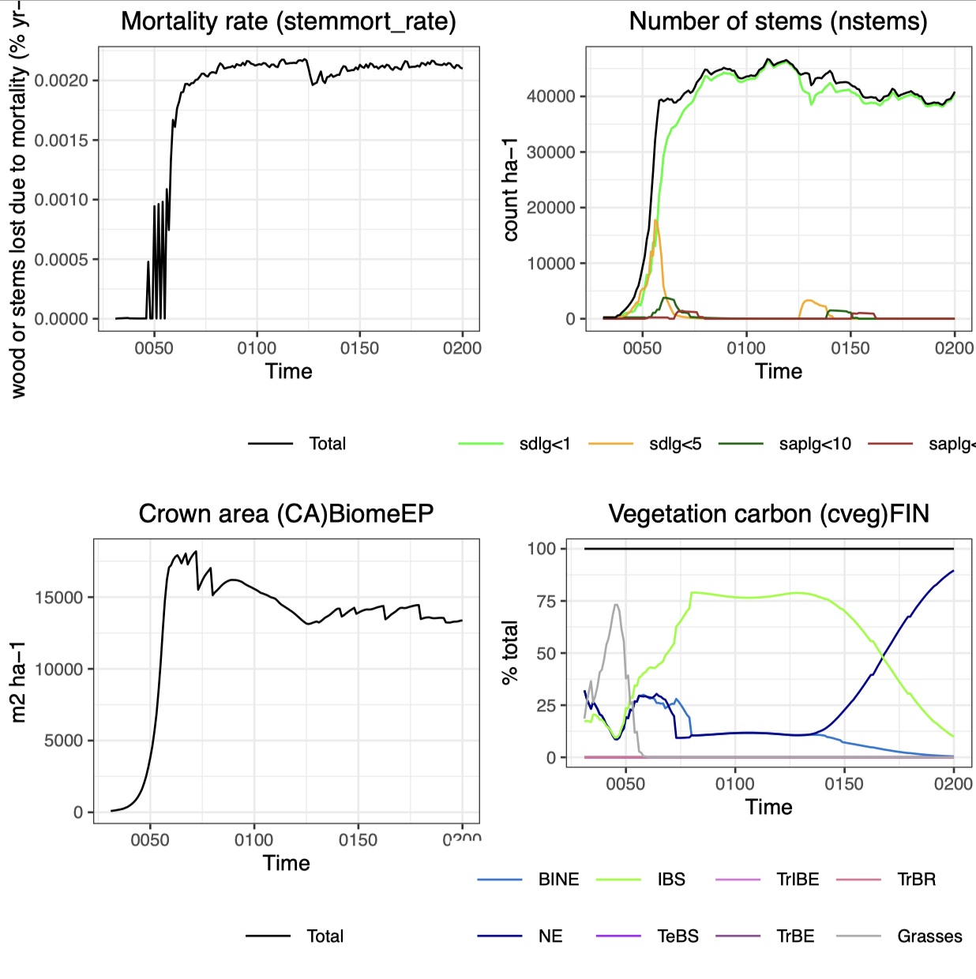
FIN
Tiny values!
Open canopy- grass coexistence
(30-40(ish))
Evidence:
delayed onset in woody establishment; grasses dominate the %total vegetation carbon for a period.
Open-canopy-growth( 40-60
Evidence:
The initial number of seedlings after disturbance is such that growth occurs without a lot of mortality initially (i.e. transition from one size class into another can be observed in the first years, accompanied with only a small to no reduction in number of stems caused by mortality),
Closed-canopy,Self-thinning (60-70)
Evidence:
not all established individuals grow into a larger size class, but self-thinning pressure occurs, also hinted at by canopy closure.
Note: PPA-approach: nstems can still go up (understory is forming), while self.thinning occurs

Slide 10
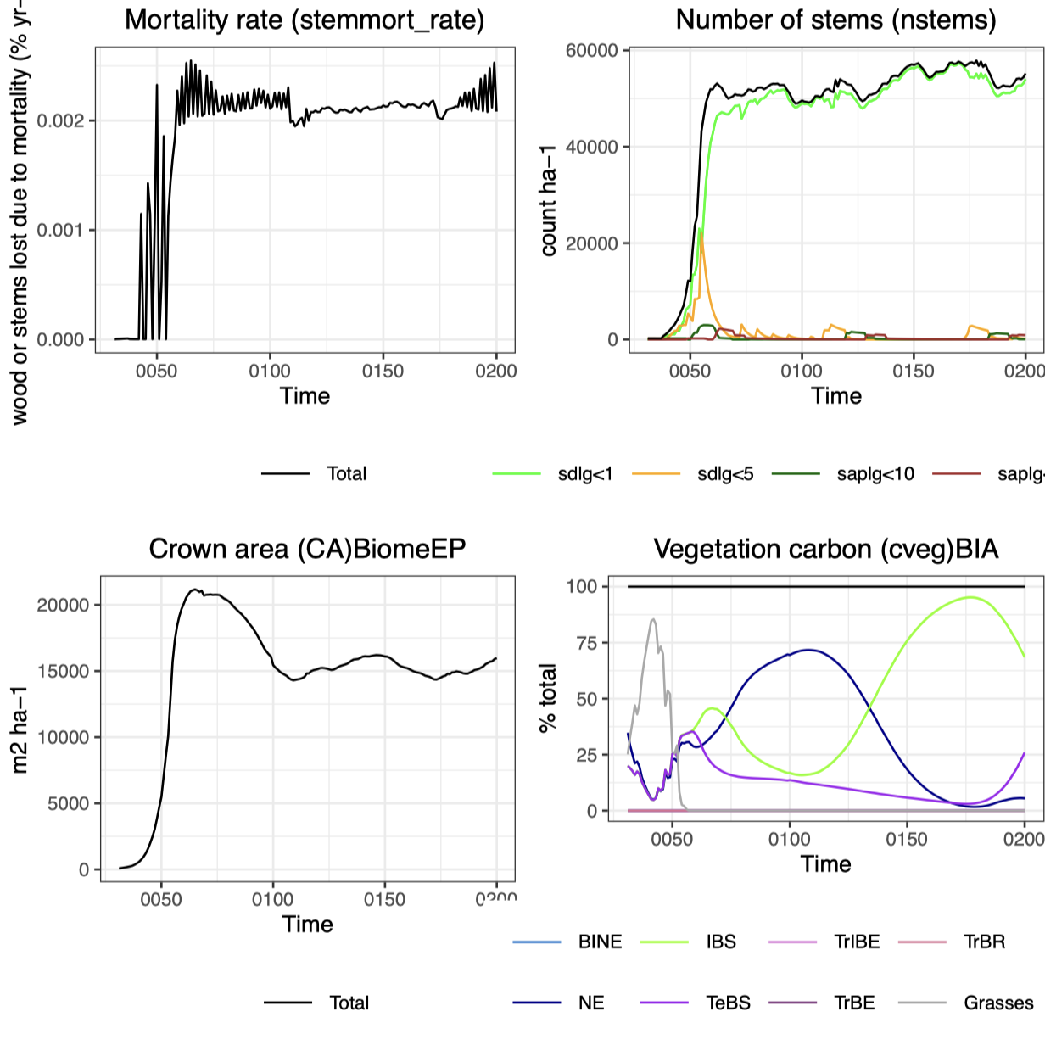
BIA

Slide 11
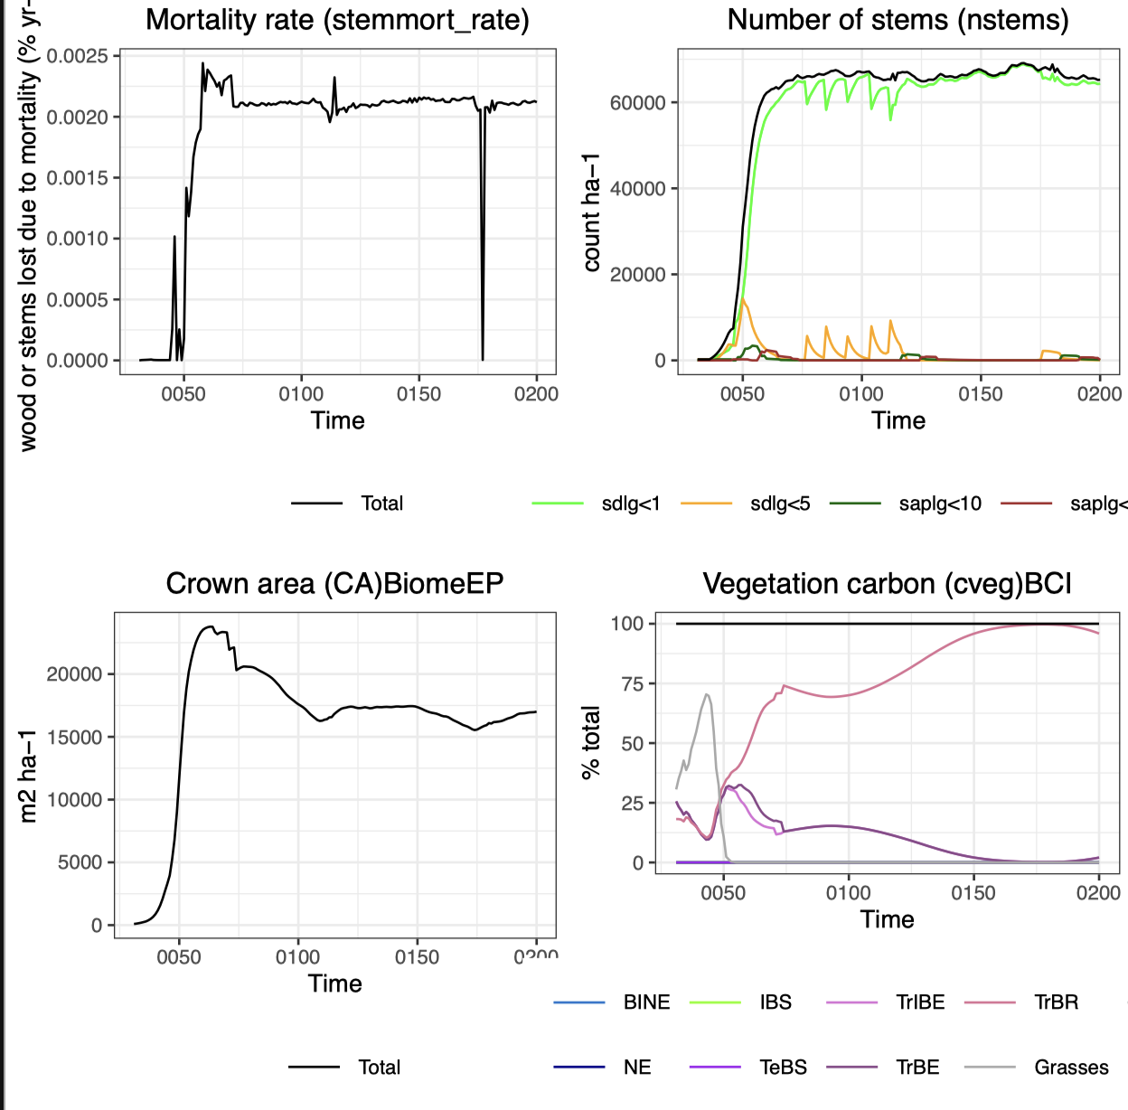
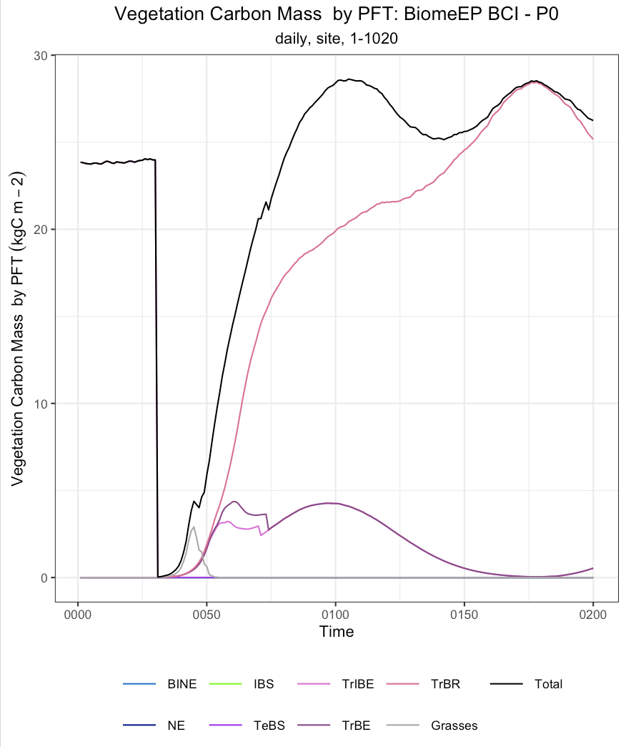
BCI

Slide 12
V4

Slide 13
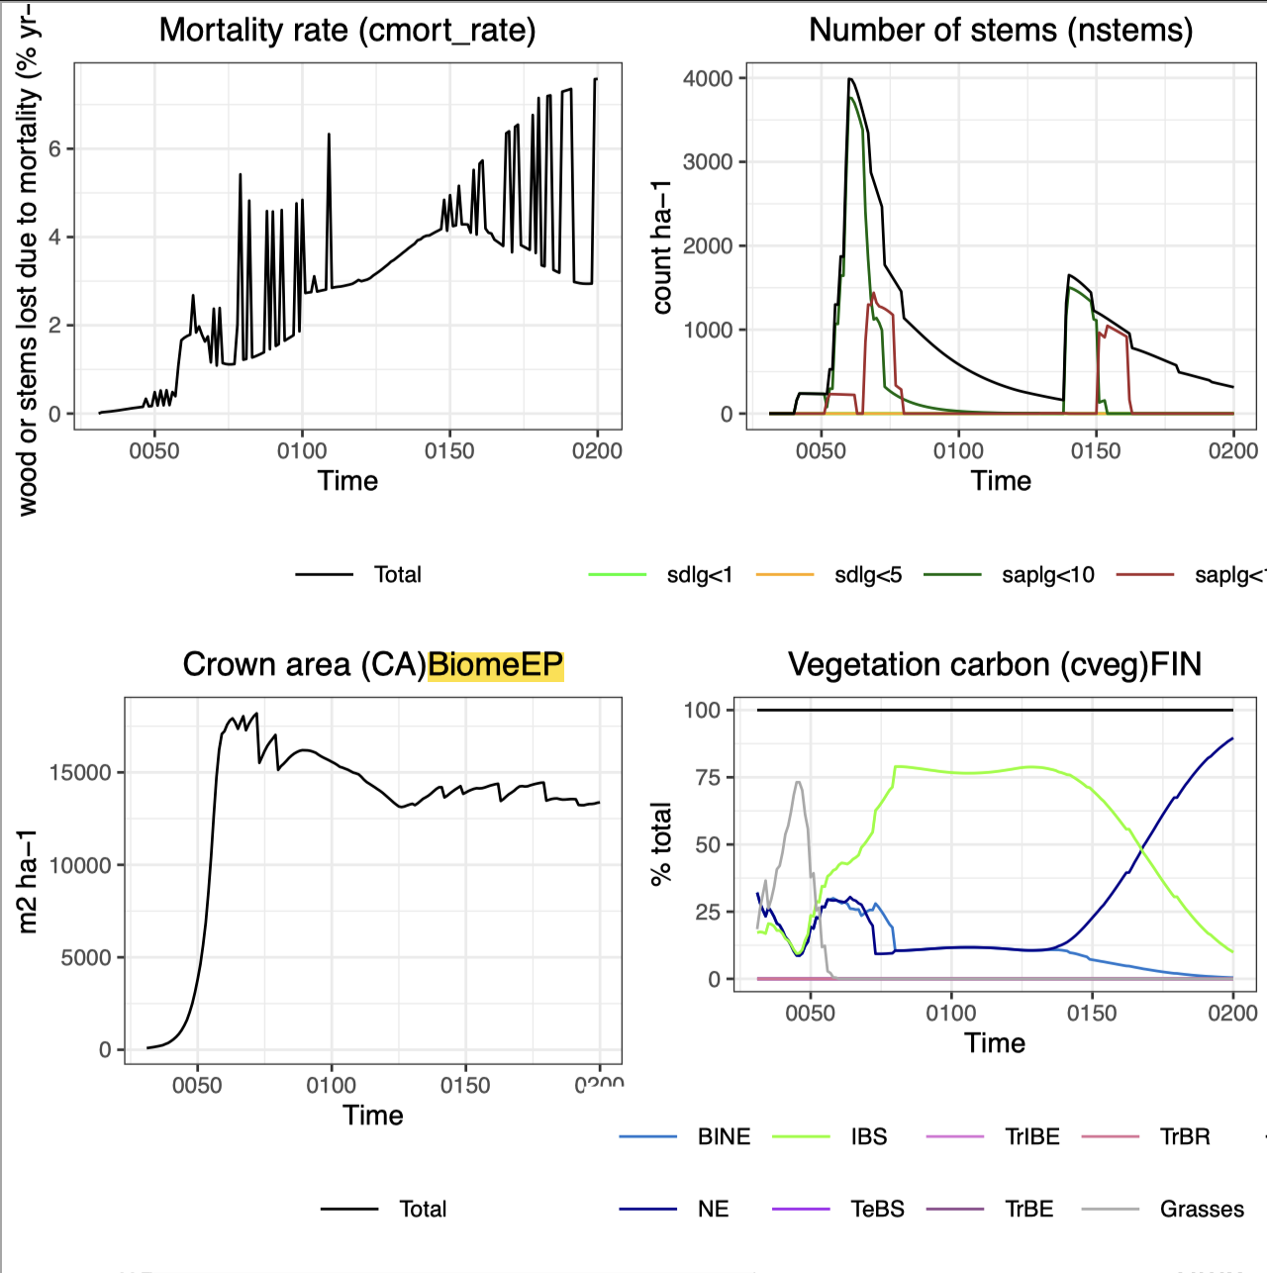
V4
FIN

Slide 14
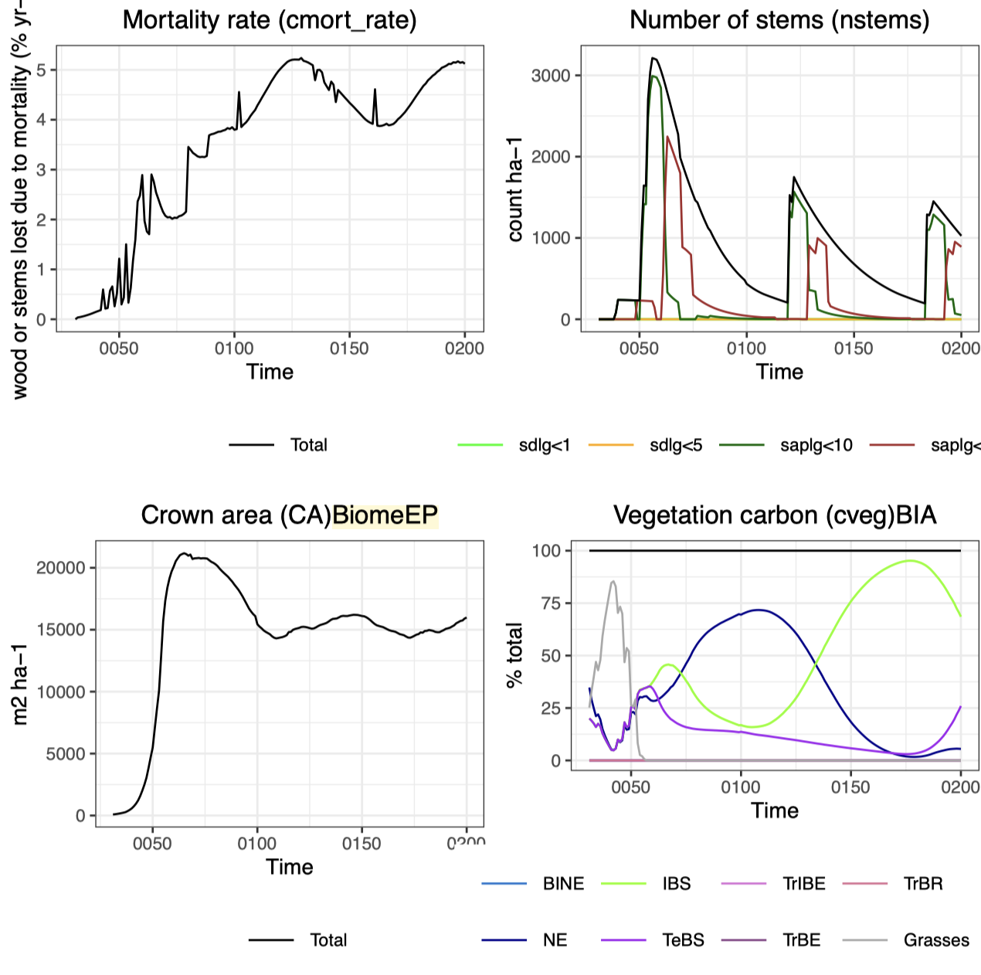
V4
BIA

Slide 15
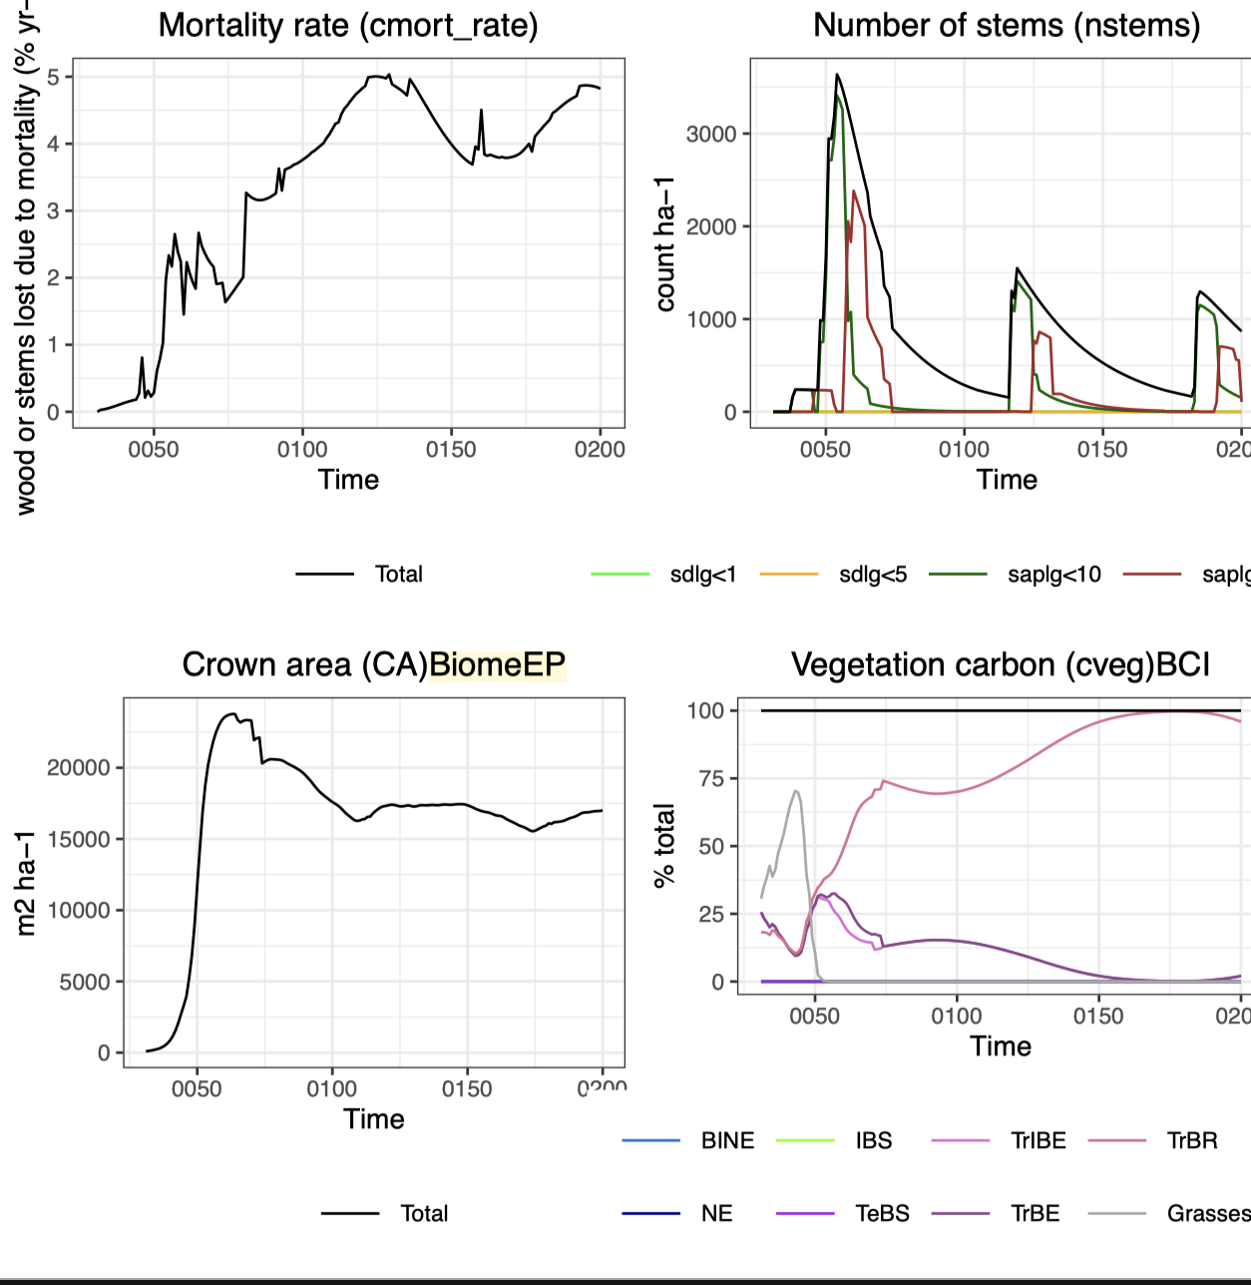
BCI

