Slide 1
AGDS set up

Slide 2
Infrastructure
Install:
R (programming language)
RStudio (code editor)
R libraries (expansions of R language)
git (version control)
Create account:
GitHub (online)
Link:
GitHub + RStudio (via SSH)

Slide 3
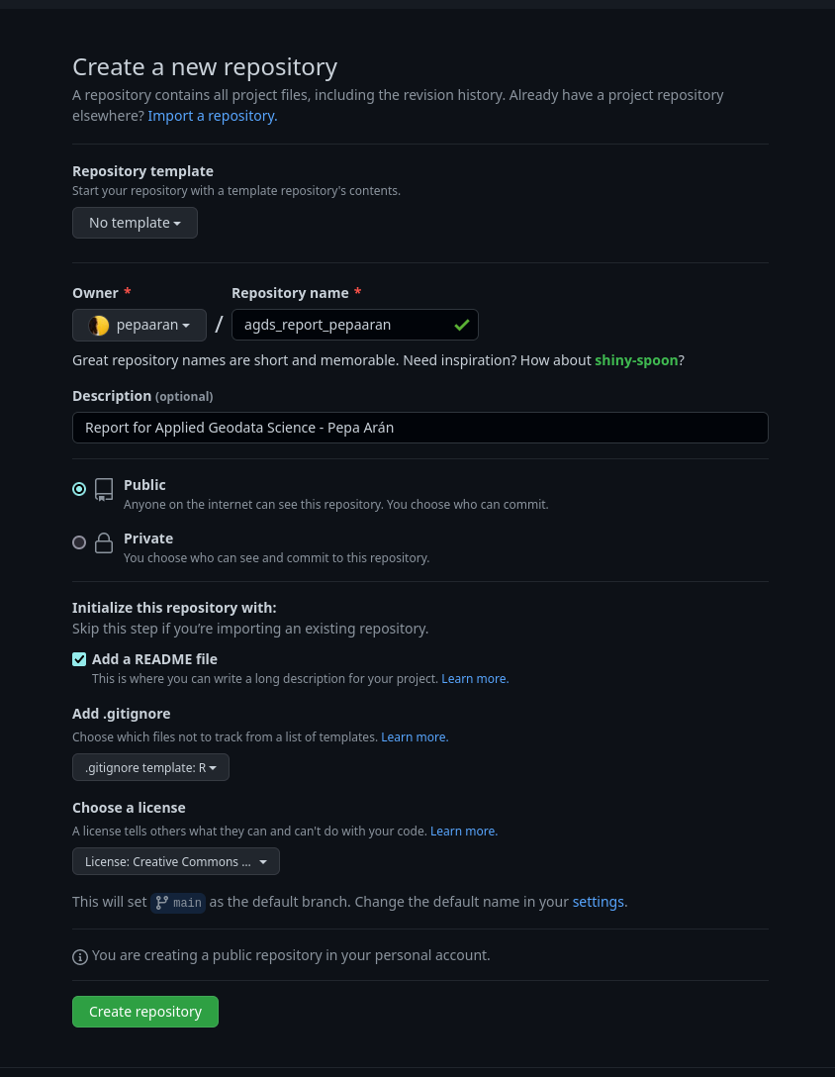
Report: Starting a data science project
Create a GitHub repository

Slide 4
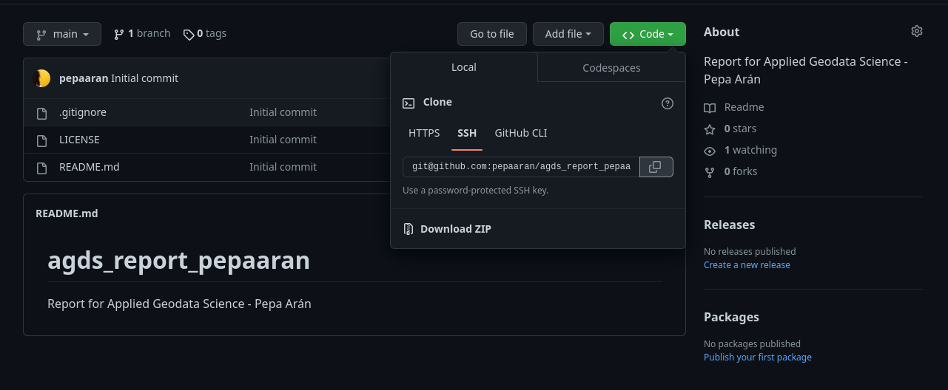
Report: Starting a data science project
Create a GitHub repository
Copy url to clone via SSH

Slide 5
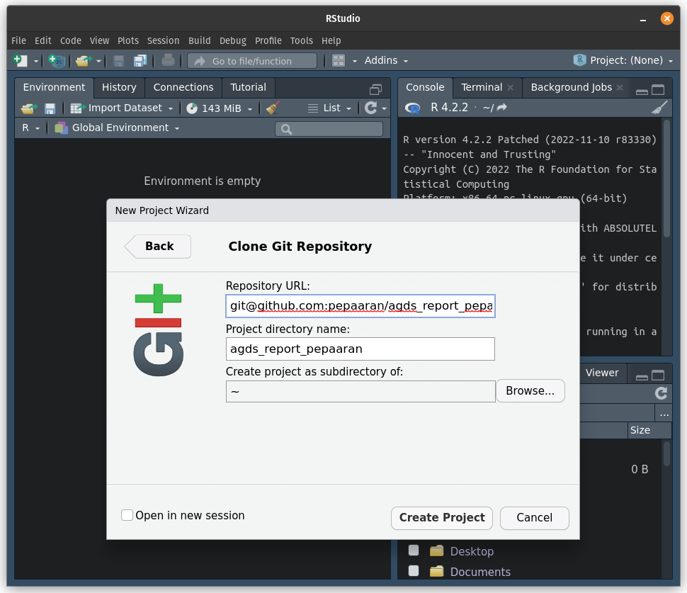
Report: Starting a data science project
Create a GitHub repository
Copy url to clone via SSH
Create new R project in RStudio from Git repo

Slide 6
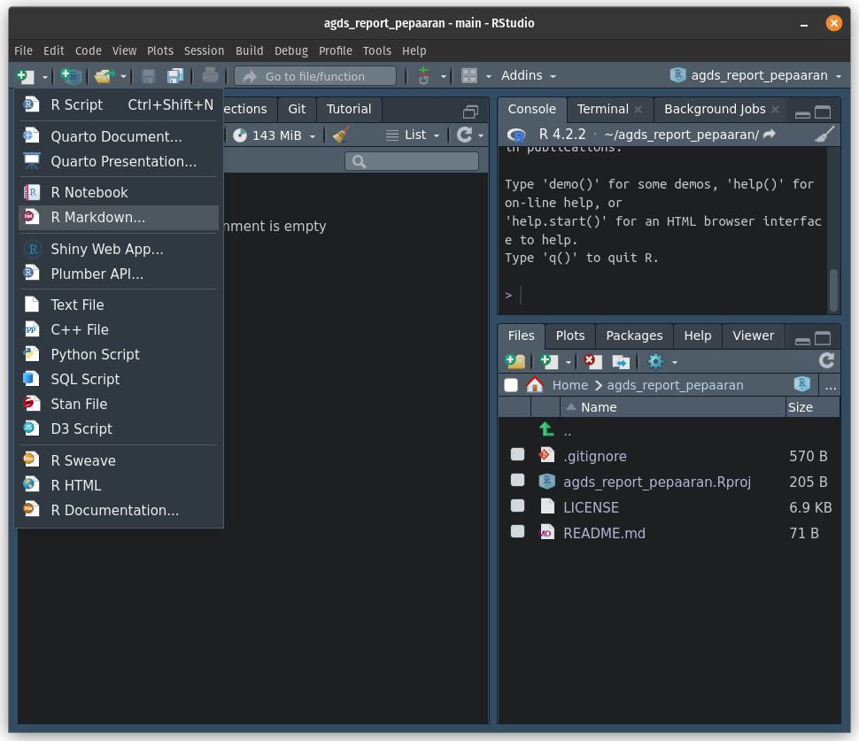
Report: Starting a data science project
Create a GitHub repository
Copy url to clone via SSH
Create new R project in RStudio from Git repo
Create R Markdown file

Slide 7
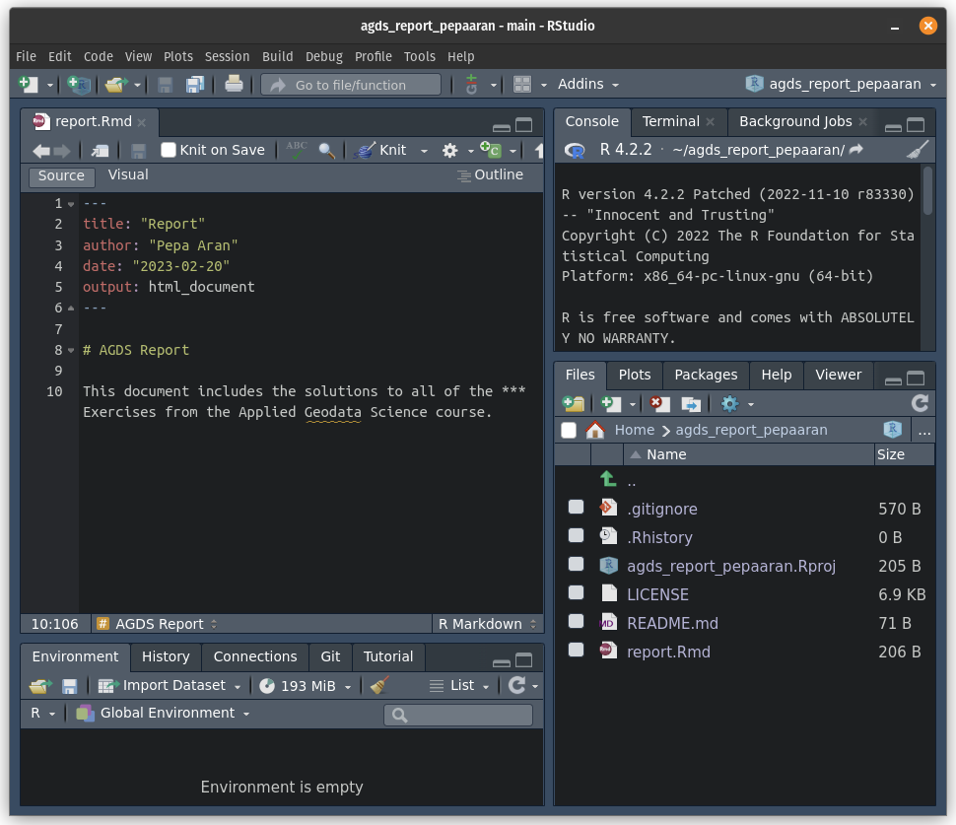
Report: Starting a data science project
Create a GitHub repository
Copy url to clone via SSH
Create new R project in RStudio from Git repo
Create R Markdown file
This is your report

